Slide 1

Deep Neural Architectures for Discourse Segmentation in E-Mail Based Behavioral Interventions
S04: Machine Learning in Clinical Predictive Modeling I
Mehedi Hasan, Alexander Kotov, Sylvie Naar, Gwen Alexander, April Carcone
Wayne State University, Detroit, MI

Slide 2
Disclosure
I and my co-authors as well as my and their spouses/partners have no relevant relationships with commercial interests to disclose

Slide 3
Learning Objectives
After participating in this session, the learner should be better able to:
Summarize the key challenges of qualitative analysis of patient-provider communication in the context of email-delivered behavioral interventions
Formulate the task of discourse segmentation of clinical interviews into textual fragments corresponding to patient and provider communication behaviors as a classification problem
Understand how traditional machine learning and deep learning methods utilizing word and punctuation embeddings as well as part-of-speech tags can be applied to the task of discourse segmentation

Slide 4
Motivation
The emergence of e-Health technologies has greatly expanded the reach of behavioral interventions
One such intervention is Motivational Interviewing (MI), a style of psychotherapy aimed at increasing intrinsic motivation and self-efficacy for behavior change
MI is linked to behavior change through the elicitation of patient “change talk”, or statements expressing patients own desires, abilities, need for and commitment to behavior change
Communication science approaches to understanding the efficacy of MI are inherently limited by manual qualitative analysis process of MI interventions
Our research: machine learning methods to facilitate qualitative analysis of MI interventions

Slide 5
Motivation
This work: machine learning methods for automated partitioning of email-based patient-counselor MI communication exchanges (e-Coaching) into textual fragments corresponding to distinct communication behaviors
ML methods can significantly reduce the time and resources to perform such segmentation → increased pace of behavioral sciences research to develop effective e-Coaching interventions
In the context of biomedical informatics, research on automated textual segmentation has primarily focused on sentence boundary detection and partitioning of clinical documents in patients’ electronic health records (EHR) into sections

Slide 6
Traditional MI qualitative analysis process
Traditional MI setting: in-person communication between patients and providers
Input: transcribed audio-recordings of MI sessions with counselor and patient utterances identified during transcription
Behavior coding of patient and provider utterances in MI session transcripts
Sequential analysis of behavior codes to identify counselor communication strategies to elicit patient “change talk”

Slide 7
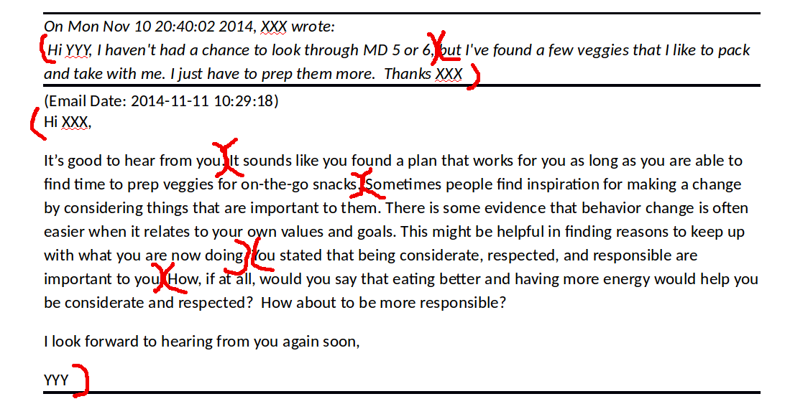
Major challenges
Unlike transcribed in-person exchanges, email correspondence is not naturally segmented into codable speech acts
Emails are unstructured text containing informal information exchanges in a non-traditional format
Discourse segments in e-Coaching do not have a clear breakpoint, such as the end of a sentence or a paragraph
Notes:
1) an e-Coach usually responds to several previous patient statements in one email. In contrast, in a traditional, in-person MI session, each utterance is assumed to be a response to an immediately preceding utterance.
2) One sentence may be divided into fragments corresponding to multiple MI behaviors. On the other hand, several sentences may represent a single MI behavior.

Slide 8
Dataset
49 e-Coaching sessions from Making Effective Nutritional Choices for Generation Y (MENU GenY), a public health intervention to encourage increased fruit and vegetable intake among young adults:
281 patient emails and 330 e-Coach emails
95,777 words and 7,140 punctuation marks
Each e-Coaching session corresponds to an MI intervention delivered via email
Emails were manually segmented into 3,138 text fragments corresponding to MI communication behaviors:
3,138 new segments and 99,779 same segments
Example: Hi[0] XXX[0] ,[0] its[0] good[0] to[0] hear[0] from[0] you[0] .[1] it[0] sounds[0] like[0]

Slide 9
Methods
Traditional Machine Learning Method:
Linear-chain Conditional Random Fields (CRF)
Deep Learning Methods:
Multi-layer Perceptron (MLP)
Bi-directional Recurrent Neural Networks (BRNN)
Convolutional Recurrent Neural Networks (CRNN)
Features:
Word and punctuation marks
Part-of-speech tags

Slide 10
Multilayer Perceptron (MLP)
Y_{new}
Y_{same}
The input to MLP consists of aggregated embeddings of n words or punctuation marks before and after each potential segment splitting point
Addition or multiplication was used for embedding aggregation
We used one hidden layer consisting of 128 neurons
Rectified Linear Unit (ReLU) was used as an activation function
output layer
hidden layer
embedding
concatenation
embedding
aggregation
embeddings
yeah
,
how
to
eat
better
Notes:
MLP is a neural network that consists of one or several fully connected layers that map an input into one or several outputs

Slide 11












Bi-directional Recurrent Neural Network
0
0
0
0
0
1
Typically utilized for tasks involving sequences
Consists of two Recurrent Neural Networks (RNNs) processing the input sequence in forward and backward directions
Gated Recurrent Unit (GRU) was used as RNN in this study
Hidden state of a BRNN is an aggregation of the hidden states of the forward and backward RNNs
$$\overset{⃖}{h_{6}}$$
$$\overset{⃖}{h_{5}}$$
$$\overset{⃖}{h_{4}}$$
$$\overset{⃖}{h_{3}}$$
$$\overset{⃖}{h_{2}}$$
$$\overset{⃖}{h_{1}}$$
$$\vec{h_{1}}$$
$$\vec{h_{2}}$$
$$\vec{h_{3}}$$
$$\vec{h_{4}}$$
$$\vec{h_{5}}$$
$$\vec{h_{6}}$$
yeah
,
how
to
eat
better

Slide 12
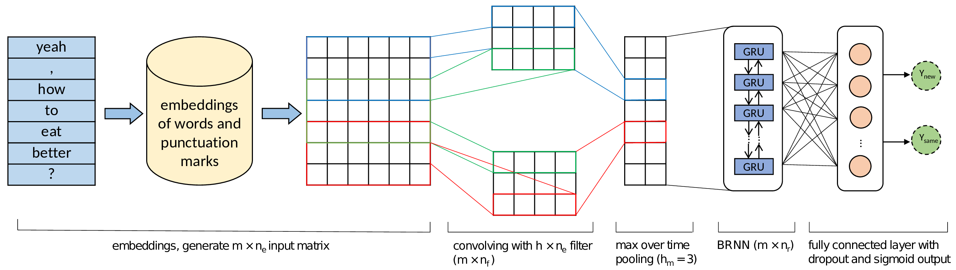
Convolutional Recurrent Neural Network
CRNN = Convolutional Neural Network (CNN) + Bi-directional Recurrent Neural Network (BRNN) + Multilayer Perceptron (MLP)
Notes:
CNN is used to extract the most significant features in a textual fragment based on the neighboring words or punctuation marks. 1D convolution is used, in which one filter is responsible for the extraction of one feature.

Slide 13
Parameter settings
Dimensionality of embeddings: 310
Word and punctuation marks: 300
POS tags: 10
Convolutional Neural Network:
Filter length in the convolution layer: 7
# of filters: 100
k-max pooling: 3
Bi-directional Recurrent Neural Networks:
Activation function: hyperbolic tangent
# of dimensions in the hidden state of RNNs: 200
Optimization
Adam with 50 epochs, batch size of 32 and learning rate of 0.001
Dropout and early stopping strategy were applied to prevent overfitting

Slide 14
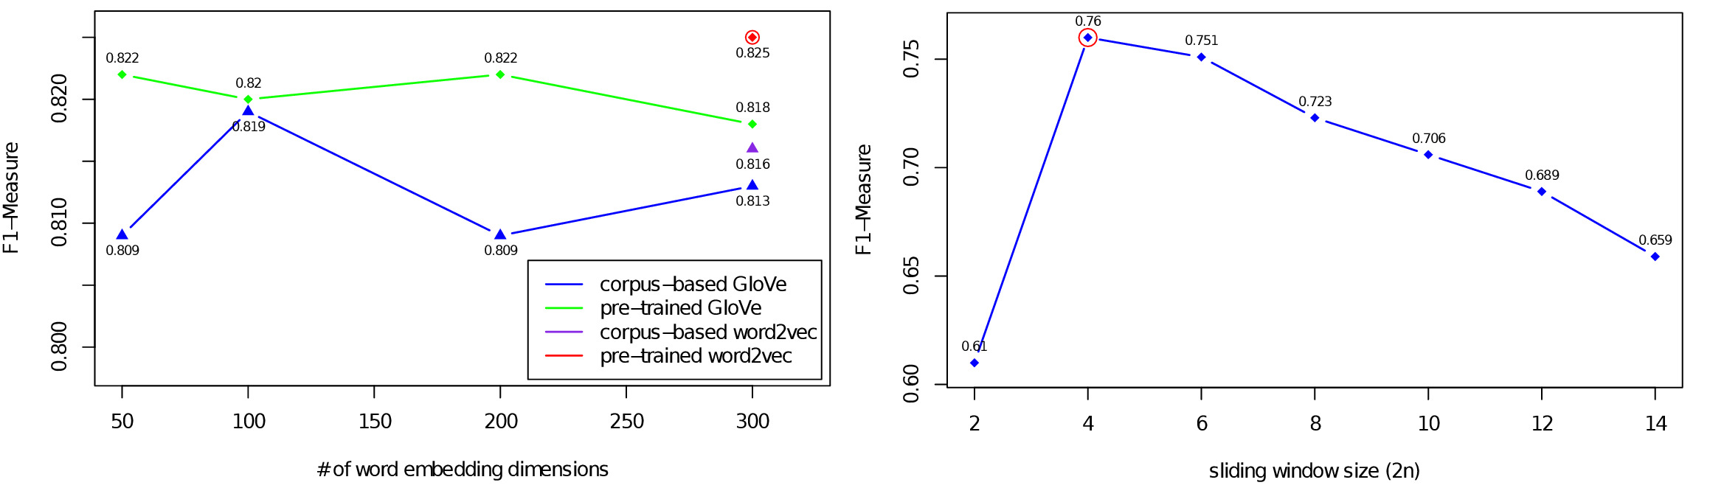
Parameter tuning
Performance of CRNN by varying the number of embedding dimensions
Performance of MLP by varying the sliding window size

Slide 15
Results
When only words were utilized:
Method | New segment |  |  | Overall |  |  | AUPR
 | Precision | Recall | F1-Score | Precision | Recall | F1-Score
CRF | 0.782 | 0.691 | 0.733 | 0.983 | 0.984 | 0.984 | 0.780
MLP | 0.836 | 0.593 | 0.694 | 0.982 | 0.983 | 0.982 | 0.736
BRNN | 0.606 | 0.680 | 0.641 | 0.977 | 0.976 | 0.976 | 0.655
CRNN | 0.775 | 0.797 | 0.785 | 0.986 | 0.986 | 0.986 | 0.818

Slide 16
Results
When a combination of words and punctuations along with POS tags were utilized:
Method | New segment |  |  | Overall |  |  | AUPR
 | Precision | Recall | F1-Score | Precision | Recall | F1-Score
CRF | 0.813 | 0.772 | 0.792 | 0.988 | 0.988 | 0.988 | 0.877
MLP | 0.817 | 0.710 | 0.760 | 0.986 | 0.987 | 0.986 | 0.842
BRNN | 0.683 | 0.820 | 0.745 | 0.985 | 0.983 | 0.984 | 0.770
CRNN | 0.789 | 0.864 | 0.825 | 0.990 | 0.989 | 0.989 | 0.867

Slide 17
Conclusions
The task of discourse segmentation in the context of email delivered MI interventions can be formulated as a binary classification problem
CRNN is the most accurate model among all machine learning methods considered in this study. CRNN achieved 0.989 F1-measure overall and 0.825 F1-measure for detecting “new segment”
Punctuation marks and POS features resulted in significant improvement in the performance of both traditional machine learning and deep learning methods
Deep learning methods can be successfully applied to the task of discourse segmentation of clinical conversation, which can significantly accelerate the pace of research in behavioral sciences on effective MI interventions

Slide 18
Future Research
Automated segmentation methods studied in this work can be integrated with automated MI behavior coding and sequence analysis methods from our earlier work to create a software pipeline for end-to-end automated analysis of MI interventions delivered via email:
Alexander Kotov, Mehedi Hasan, April Carcone, Ming Dong, Sylvie Naar-King, Kathryn Brogan Hartlieb, “Interpretable probabilistic latent variable models for automatic annotation of clinical text”, In Proceedings of the 2015 AMIA Annual Symposium, pages 785-795, 2015
Mehedi Hasan, Alexander Kotov, April Idalski Carcone, Ming Dong, Sylvie Naar, "A Study of the Effectiveness of Machine Learning Methods for Classification of Clinical Interview Fragments into a Large Number of Categories", Journal of Biomedical Informatics (JBI), vol. 62, pages 21-31, 2016
Mehedi Hasan, Alexander Kotov, April Idalski Carcone, Ming Dong, Sylvie Naar, Kathryn Brogan Hartlieb, "Predicting the Outcome of Patient-Provider Communication Sequences using Recurrent Neural Networks and Probabilistic Models", In Proceedings of the 2018 AMIA Informatics Summits, pages 64-73, 2018
Mehedi Hasan, April Idalski Carcone, Sylvie Naar, Susan Eggly, Gwen L. Alexander, Kathryn E. Brogan Hartlieb, Alexander Kotov, "Identifying Effective Motivational Interviewing Communication Sequences Using Automated Pattern Analysis", In the Journal of Healthcare Informatics Research (JHIR), vol .3 (1), pages 86-106, 2019
Notes:
TODO: update references for JHIR paper

Slide 19

Acknowledgments
Research Lab:
Textual Data Analytics Lab
Wayne State University
Other Collaborators:
Dr. April Carcone
Dr. Sylvie Naar, Florida State U
Dr. Gwen L. Alexander, HFHS
Funding:
National Institute of Health (NIDDK)
R21DK108071
Department of Family Medicine and Public Health members:
Student assistants
Research staff

Slide 20
Thank you! Questions?

