Slide 1


S14: Interpretable Probabilistic Latent Variable Models for Automatic Annotation of Clinical Text
Alexander Kotov¹, Mehedi Hasan¹, April Carcone¹, Ming Dong¹, Sylvie Naar-King¹, Kathryn Brogan Hartlieb²
¹ Wayne State University
² Florida International University

Slide 2
Disclosure
I have nothing to disclose

Slide 3
Motivation
Annotation = assignment of codes from a codebook to fragments of clinical text
Integral part of clinical practice or qualitative data analysis
Codes (or labels) can viewed as summaries abstractions
Analyzing sequences of codes allows to discover patterns and associations

Slide 4
Study context
We focus on clinical interview transcripts:
motivational interviews with obese adolescents conducted at a Pediatric Prevention Research Center at Wayne State University
Codes designate the types of patient’s utterances
Distinguish the subtle nuances of patient’s behavior
Analysis of coded successful interviews allows clinicians to identify communication strategies that trigger patient’s motivational statements (i.e. “change talk”)
Change talk has been shown to predict actual behavior change, as long as 34 months later

Slide 5
Problem
Annotation is traditionally done by trained coders
time-consuming, tedious and expensive process
We study the effectiveness of machine learning methods for automatic annotation of clinical text
Such methods can have tremendous impact:
decrease the time for designing interventions from months to weeks
increase the pace of discoveries in motivational interviewing and other qualitative research

Slide 6
Challenges
Annotation in case of MI = inferring psychological state of patients from text
Important indicators of emotions (e.g. gestures, facial expressions and intonations) are lost during transcription
Children and adolescents often use incomplete sentences and frequently change subjects
Annotation methods need to be interpretable

Slide 7
Coded interview fragments
Code | Example
CL- | I eat a lot of junk food. Like, cake and cookies, stuff like that.
CL+ | Well, I've been trying to lose weight, but it really never goes anywhere.
CT- | It can be anytime; I just don't feel like I want to eat (before) I'm just not hungry at all.
CT+ | Hmm. I guess I need to lose some weight, but you know, it's not easy.
AMB | Fried foods are good. But it's not good for your health.

Slide 8
Methods
Proposed methods:
Latent Class Allocation (LCA)
Discriminative Labeled Latent Dirichlet Allocation (DL-LDA)
Baselines:
Multinomial Naïve Bayes
Labeled Latent Dirichlet Allocation (Ramage et al., EMNLP’09)

Slide 9













Latent Class Allocation
LCA assumes the following generative process:
for each fragment $F$:
draw a binomial distribution $λ$ controlling the mixture of background and class-specific multinomials for $F$
for each word position $i$ in $F$:
draw Bernoulli switching variable $m_{f,i}$ determining the type of LM
draw a word either from class-specific $φ^{cls}$ or background $φ^{bg}$ LM
c
$$γ$$
$$λ$$
$$m$$
$$c$$
$$w$$
$$N_{F}$$
$$M$$
$$β^{cls}$$
$$φ^{cls}$$
$$φ^{bg}$$
$$β^{bg}$$
$$C$$

Slide 10





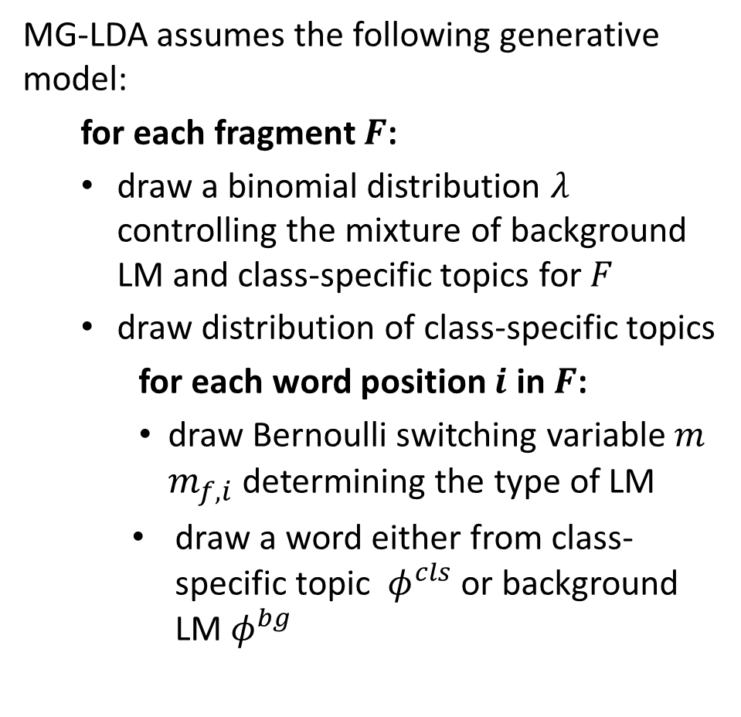










Discriminative Labeled LDA
MG-LDA assumes the following generative model:
for each fragment $F$:
draw a binomial distribution $λ$ controlling the mixture of background LM and class-specific topics for $F$
draw distribution of class-specific topics
for each word position $i$ in $F$:
draw Bernoulli switching variable $m$ $m_{f,i}$determining the type of LM
draw a word either from class-specific topic $φ^{cls}$ or background LM $φ^{bg}$
c
$$γ$$
$$λ$$
$$m$$
$$α^{cls}$$
$$Θ^{cls}$$
$$z$$
$$c$$
$$w$$
$$N_{F}$$
$$M$$
$$β^{cls}$$
$$φ^{cls}$$
$$φ^{bg}$$
$$β^{bg}$$
$$K^{cls}×C$$

Slide 11
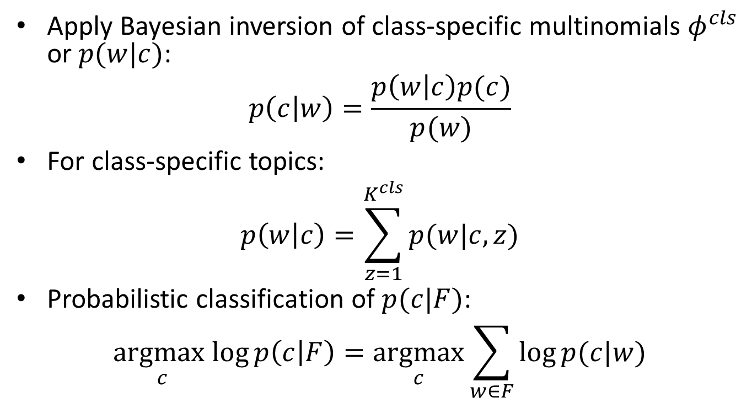
Classification
Apply Bayesian inversion of class-specific multinomials $φ^{cls}$ or $p(w|c)$:
$$p\left(c | w\right)=\frac{p\left(w | c\right)p(c)}{p(w)}$$
For class-specific topics:
$$p\left(w | c\right)=\sum_{z=1}^{K^{cls}}{p(w|c,z)}$$
Probabilistic classification of $p(c|F)$:
$$\underset{c}{argmax}log{p\left(c | F\right)}=\underset{c}{argmax}{\sum_{w∈F}{\log{p(c|w)}}}$$

Slide 12
Experiments
2966 manually annotated fragments of motivational interviews conducted at the Pediatric Prevention Research Center of Wayne State University’s School of Medicine
Only unigram lexical features were used
Preprocessing:
RAW: no stemming or stop-words removal
STEM: stemming but no stop-words removal
STOP: stop-words removal, but no stemming
STOP-STEM: stemming and stop-words removal
Randomized 5-fold cross-validation
results are based on weighted macro-averaging

Slide 13
Task 1: classifying 5 original classes
5 classes: CL-, CL+, CT-, CT+, AMB
Class distribution:
class | # samples | %
CL- | 73 | 2.46
CL+ | 875 | 29.50
CT- | 278 | 9.37
CT+ | 1657 | 55.87
AMB | 83 | 2.80

Slide 14
Task 1: performance
LCA:
DL-LDA:
 | Recall | Precision | F1-measure
RAW | 0.543 | 0.534 | 0.537
STEM | 0.557 | 0.542 | 0.549
STOP | 0.541 | 0.508 | 0.520
STOP-STEM | 0.543 | 0.515 | 0.525
 | Recall | Precision | F1-measure
RAW | 0.591 | 0.533 | 0.537
STEM | 0.586 | 0.515 | 0.527
STOP | 0.560 | 0.504 | 0.508
STOP-STEM | 0.557 | 0.492 | 0.498

Slide 15
Task 1: performance
Naïve Bayes:
L-LDA:
 | Recall | Precision | F1-measure
RAW | 0.522 | 0.523 | 0.506
STEM | 0.534 | 0.534 | 0.518
STOP | 0.511 | 0.526 | 0.510
STOP-STEM | 0.510 | 0.519 | 0.506
 | Recall | Precision | F1-measure
RAW | 0.537 | 0.530 | 0.480
STEM | 0.544 | 0.540 | 0.474
STOP | 0.530 | 0.520 | 0.478
STOP-STEM | 0.538 | 0.517 | 0.475
Notes:
Both SVM and NB achieve the best performance when no pre-processing is used.

Slide 16
Task 1: summary of performance
 | Recall | Precision | F1-measure
NB | 0.522 | 0.523 | 0.506
LCA | 0.543 | 0.534 | 0.537
L-LDA | 0.537 | 0.530 | 0.480
DL-LDA | 0.591 | 0.533 | 0.537
LCA shows the best performance in terms of precision and F1-measure
LCA and DL-LDA outperform NB in L-LDA in terms of all metrics
DL-LDA has higher recall than LCA and comparable precision and F1-measure
probabilistic separation of words by specificity + dividing class specific multinomials translates into better classification results

Slide 17
Most characteristic terms
Code | Terms
CL- | drink sugar gatorade lot hungry splenda beef tired watch tv steroids sleep home nervous confused starving appetite asleep craving pop fries computer
CL+ | stop run love tackle vegetables efforts juice swim play walk salad fruit
CT- | got laughs sleep wait answer never tired fault phone joke weird hard don’t
CT+ | time go mom brother want happy clock boy can move library need adopted reduce sorry solve overcoming lose
AMB | what taco mmm know say plus snow pain weather

Slide 18
Task 2: classifying CL, CT and AMB
3 classes: CL (CL+ and CL-), CT (CT+ and CT-) and AMB
Class distribution:
Performance:
class | samples | %
CL | 948 | 31.96
CT | 1935 | 65.24
AMB | 83 | 2.80
 | Recall | Precision | F1-measure
NB | 0.617 | 0.627 | 0.611
LCA | 0.674 | 0.651 | 0.656
L-LDA | 0.634 | 0.631 | 0.587
DL-LDA | 0.673 | 0.637 | 0.633

Slide 19
Task 3: classifying -, + and AMB
3 classes: + (CL+ and CT+), - (CL- and CT-) and AMB
Class distribution:
Performance:
class | # samples | %
- | 351 | 11.83
+ | 2532 | 85.37
AMB | 83 | 2.80
 | Recall | Precision | F1-measure
NB | 0.734 | 0.778 | 0.753
LCA | 0.818 | 0.771 | 0.790
L-LDA | 0.814 | 0.774 | 0.781
DL-LDA | 0.838 | 0.770 | 0.793

Slide 20
Summary
We proposed two novel interpretable latent variable models for probabilistic classification of textual fragments
Latent Class Allocation probabilistically separates discriminative from common terms
Discriminative Labeled LDA is an extension of Labeled LDA that differentiates between class specific topics and background LM
Experimental results indicated that LCA and DL-LDA outperform state-of-the-art interpretable probabilistic classifiers (Naïve Bayes and Labeled LDA) for the task of automatic annotation of interview transcripts

Slide 21
Thank you! Questions?

