Slide 1
Temporal Query Log Profiling to Improve Web Search Ranking
Alexander Kotov (UIUC)
Pranam Kolari, Yi Chang (Yahoo!)
Lei Duan (Microsoft)

Slide 2
Motivation
Improvements in ranking can be achieved in two ways:
Better features/methods for promoting high-quality result pages
Methods for filtering/demotion of adversarial and abusive content
Main idea: temporal information can be leveraged to characterize the quality of content.

Slide 3
Learning-to-Rank
Well known application of regression modeling
Learn useful features and their interactions for ranking documents in response to a user query
Features: document-specific, query-specific or document-query specific

Slide 4
Web Spam Detection
Ranking of search results is often artificially changed to promote certain type of content (web spam)
Anti-spam measures are highly reactive and ad hoc
No previous work explored the fundamental properties of spam hosts and queries
Notes:
Search engines are highly trafficked and revenue generating resource

Slide 5
Main idea
search logs
query and host profiles
P₁
P₂
P₃
time
P_{n}
measures₁
measures₂
measures₃
time
measures_{n}
aggregate into temporal features
Notes:
Extract a set of measures from search logs for queries and hosts at different time points and compute an aggregate score over all time points

Slide 6
Main idea
Temporal changes are quantified along two orthogonal dimensions: hosts and queries
Host churn: measure of inorganic host behavior in search results
Query volatility: measure of likelihood of a query being compromised by spammers

Slide 7
Host churn
Goal: quantify the temporal behavior of hosts in search results for different queries
Profile includes 4 attributes: query coverage, number of impressions, click-through rate, average position in search results)
Idea: spamming and low-quality hosts exhibit inorganic changes in their appearance in search results of different queries

Slide 8
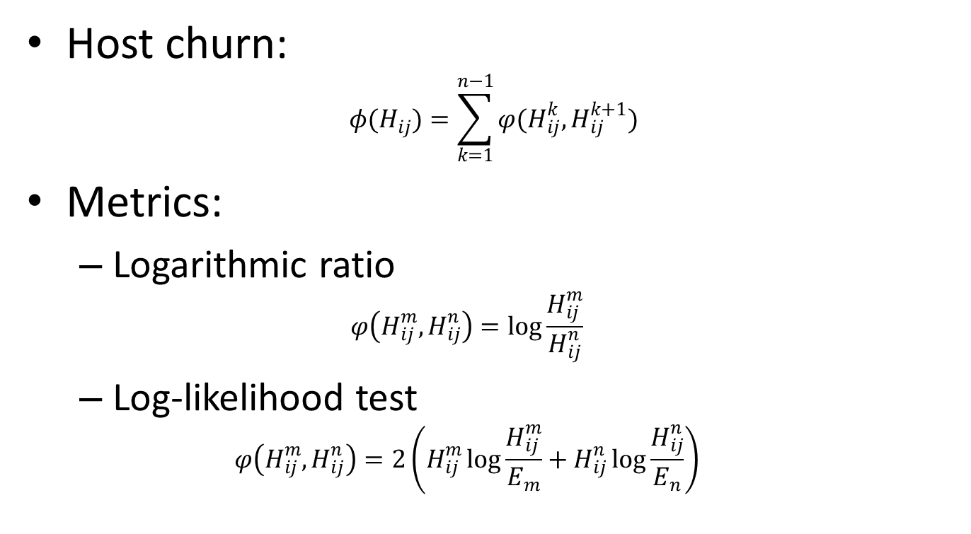
Host churn
Host churn:
$$φ(H_{ij})=\sum_{k=1}^{n−1}{φ(H_{ij}^{k},H_{ij}^{k+1})}$$
Metrics:
Logarithmic ratio
$$φ\left(H_{ij}^{m},H_{ij}^{n}\right)=\log{\frac{H_{ij}^{m}}{H_{ij}^{n}}}$$
Log-likelihood test
$$φ\left(H_{ij}^{m},H_{ij}^{n}\right)=2\left(H_{ij}^{m}\log{\frac{H_{ij}^{m}}{E_{m}}}+H_{ij}^{n}\log{\frac{H_{ij}^{n}}{E_{n}}}\right)$$
churn metric

Slide 9
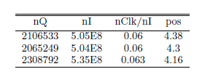
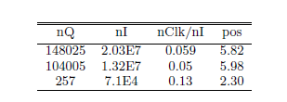
Host churn
normal host
spam host

Slide 10
Query volatility
Goal: identify queries with temporally changing behavior;
Profile: number of impressions, sets of results and click-throughs for a query at different time points;
Idea: spammed or potentially spammable queries exhibit highly inconsistent behavior over time.

Slide 11
Query volatility
Query results volatility: spam-prone queries are likely to produce semantically incoherent results over time
Query impressions volatility: buzzy queries are less likely to be spam-prone
Query clicks volatility: click-through densities on different search results positions are more consistent for less spam-prone queries
Query sessions volatility: users are less likely to be satisfied with search results and click on them for spam-prone queries

Slide 12
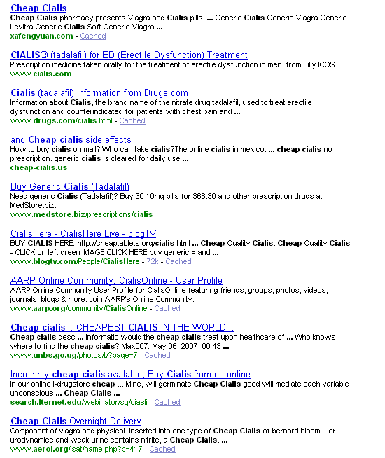
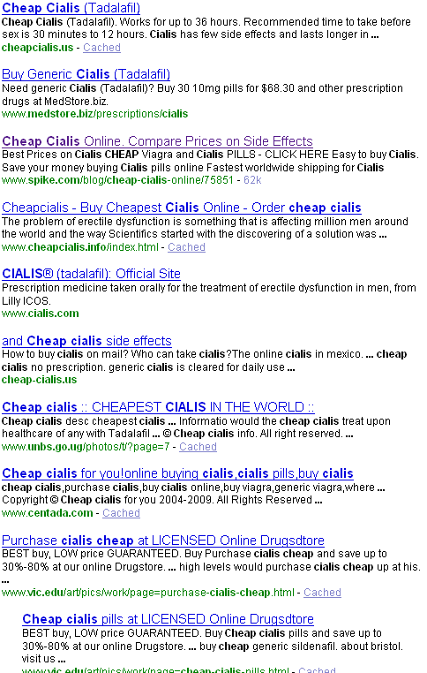
Query results volatility
Non-spam
Spam

Slide 13
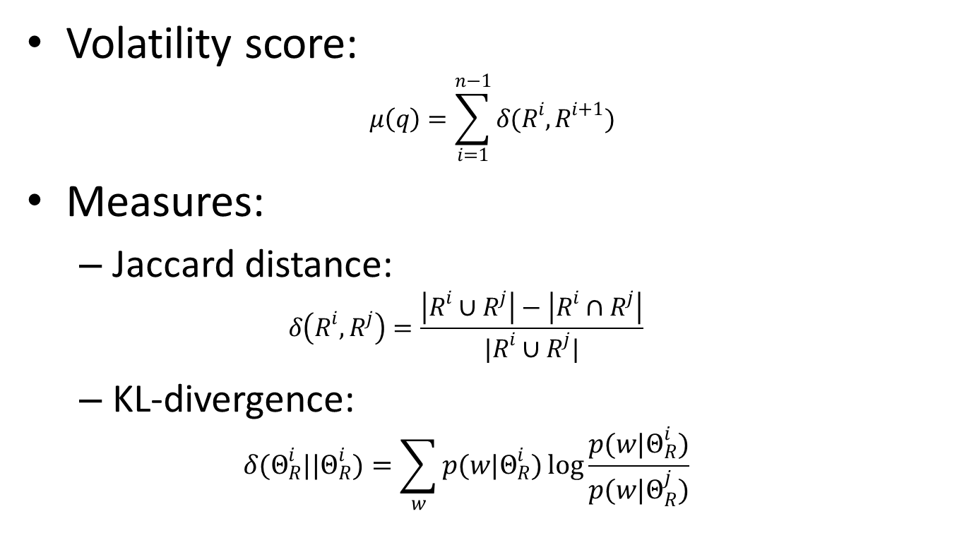
Query results volatility
Volatility score:
$$μ\left(q\right)=\sum_{i=1}^{n−1}{δ(R^{i},R^{i+1})}$$
Measures:
Jaccard distance:
$$δ\left(R^{i},R^{j}\right)=\frac{\left|R^{i}∪R^{j}\right|−\left|R^{i}∩R^{j}\right|}{|R^{i}∪R^{j}|}$$
KL-divergence:
$$δ(Θ_{R}^{i}||Θ_{R}^{i})=\sum_{w}{p(w|Θ_{R}^{i})\log{\frac{p(w|Θ_{R}^{i})}{p(w|Θ_{R}^{j})}}}$$
volatility metric

Slide 14
Query impressions volatility
Buzzy queries are less likely to be spam-prone, since buzz is a non-trivial prediction
Given time series of query counts, the ``buzziness’’ of a query is estimated with Kurtosis and Pearson coefficients

Slide 15
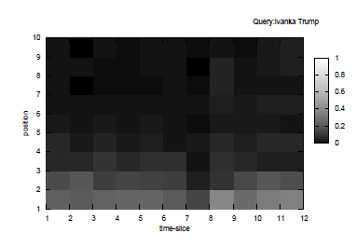
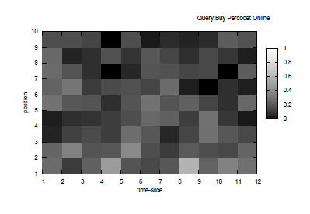
Query clicks volatility
Less-spam prone, navigational queries have consistently higher density of clicks on the first few search results
Click discrepancies are captured through mean, standard deviation and Pearson correlation coefficient for clicks and skips at each position

Slide 16
Query sessions volatility
Fraction of sessions with one click on organic search results [over all sessions for the query]
Fraction of sessions with no clicks on organic or sponsored search results
Fraction of sessions with no click on any of the presented organic results
Fraction of sessions with user clicks on a query reformulation
Notes:
Typical and atypical user behavior with respect to the quality of search results is captured with the following distinct characteristics

Slide 17
Spam-prone query classification
Spam-prone queries (284 queries)
Filter historical Query Triage Spam complaints
Non spam-prone queries (276 queries)
Gradient Boosted Decision Tree Model
10-fold cross-validation

Slide 18
Results
SPAMMEAN (baseline) – mean host-spam score for a query, developed over the years
VARIABILITY – features derived from temporal profiles, language-independent
Combined model most effective, variability by itself very effective

Slide 19
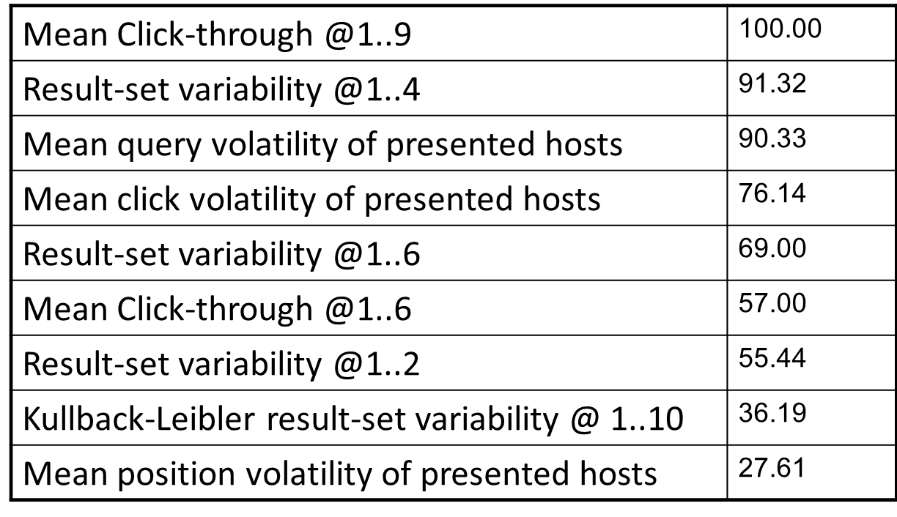
Results
Position, click and result-set volatility are the key features
SPAMMEAN continues to be ranked as the top feature in the combined model

Slide 20
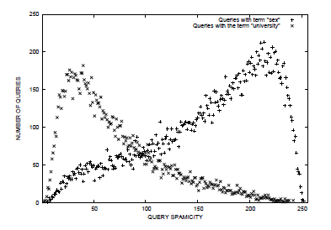
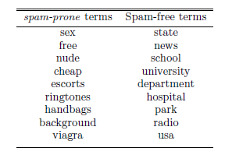
Results
“adult”- queries
“general”- queries
The distributions of query spamicity scores for queries containing spam and non-spam terms are clearly different
Key terms in queries on both sides of the spamicity score range indicate the accuracy of the classifier

Slide 21
Ranking
MLR ranking baseline (MLR 14)
1.8M query-url pairs used for training
Test on held-out data-set (7000 samples)
Query spamicity score is added to all production features
Evaluation using Discounted Cumulative Gain (DCG) metric
Spam Query Classification as a new feature
Covered queries are 50% of all queries

Slide 22
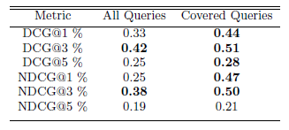
Results
The coverage of the spamicity score is 50%, hence the overall improvement across all queries is not statistically significant
Queries covered with spamicity score show signifcant improvement
Spamicity score feature ranks among the top 30 ranking features

Slide 23
Conclusions
Proposed a simple and effective method to characterize the temporal behavior of queries and hosts
Features based on temporal profiles outperform state-of-the-art baselines in two different tasks
Many verticals are similar to spam: trending queries.

Slide 24
Future work
More in-depth analysis of temporally correlated verticals: separate ranking function
Qualitative analysis of spam-prone queries along semantic dimensions
Shorter time intervals for aggregation

