Slide 1



Interactive Sense Feedback for Difficult Queries
Alexander Kotov and ChengXiang Zhai
University of Illinois at Urbana-Champaign

Slide 2
Roadmap
Query Ambiguity
Interactive Sense Feedback
Experiments
Upper-bound performance
User study
Summary
Future work

Slide 3
Query ambiguity
birds?
sports?
clergy?
Ambiguous queries contain one or several polysemous terms
Query ambiguity is one of the main reasons for poor retrieval results (difficult queries are often ambiguous)
Senses can be major and minor, depending on the collection
Automatic sense disambiguation proved to be a very challenging fundamental problem in NLP and IR [Lesk 86, Sanderson 94]
Notes:
Popularity of a sense is determined by the number of relevant documents in the collection

Slide 4
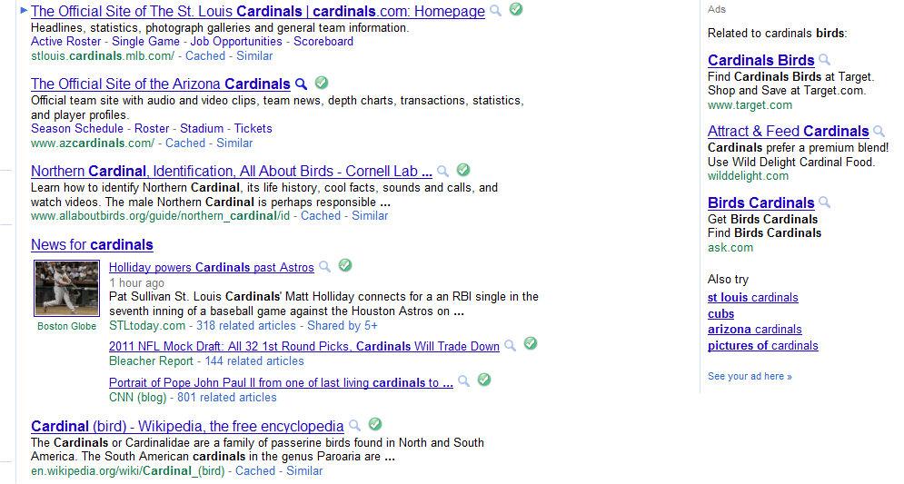
Query ambiguity
intent: roman catholic cardinals
baseball
college team
bird
sports
bird
Notes:
An ambiguous query is defined as a query which contains one or several polysemous terms

Slide 5
Query ambiguity
Did you mean cardinals as a bird, team or clerical?
target sense is minority sense; even diversity doesn’t help
top documents irrelevant; relevance feedback wont’ help
Can search systems improve the results for difficult queries by naturally leveraging user interaction to resolve lexical ambiguity?

Slide 6
Roadmap
Query Ambiguity
Interactive Sense Feedback
Experiments
Upper-bound performance
User study
Summary
Future work

Slide 7
Interactive Sense Feedback
Uses global analysis for sense identification:
does not rely on retrieval results (can be used for difficult queries)
identifies collection-specific senses and avoids the coverage problem
identifies both majority and minority senses
domain independent
Presents concise representations of senses to the users:
eliminates the cognitive burden of scanning the results
Allows the users to make the final disambiguation choice:
leverages user intelligence to make the best choice

Slide 8
Questions
How can we automatically discover all the “senses” of a word in a collection?
How can we present a sense concisely to a user?
Is interactive sense feedback really useful?

Slide 9
Algorithm for Sense Feedback
Preprocess the collection to construct a V x V global term similarity matrix (rows: all semantically related terms to each term in V)
For each query term construct a term graph
Cluster the term graph (cluster = sense)
Label and present the senses to the users
Update the query LM using user feedback

Slide 10
Sense detection
Methods for term similarity matrix construction:
Mutual Information (MI) [Church ’89]
Hyperspace Analog to Language (HAL) scores [Burgess ‘98]
Clustering algorithms:
Community clustering (CC) [Clauset ‘04]
Clustering by committee (CBC) [Pantel ‘02]

Slide 11











Sense detection
$${\hat{Θ}}_{q}^{s_{1}}$$
$$w_{1}$$
$$w_{2}$$
$$w_{3}$$
$$q$$
$$w_{4}$$
$$p\left(w | Θ_{q}^{′}\right)=αp\left(w | Θ_{q}\right)+\left(1−α\right)p(w|{\hat{Θ}}_{q}^{s_{1}})$$
$${\hat{Θ}}_{q}^{s_{2}}$$
$$w_{5}$$
$$w_{6}$$
$$w_{7}$$

Slide 12
Sense representation
4
Algorithm for sense labeling:
0.04
0.01
0.03
5
1. Sort terms in the cluster according to the sum of weights of edges to neighbors
0.02
0.1
2
0.01
While exist uncovered terms:
0.02
0.05
2. Select uncovered term with the highest weight and add it to the set of sense labels
0.06
0.03
3
0.11
0.01
1
3. Add the terms related to the selected term to the cover
0.01
0.02
0.02
6
5
Label:
1
4

Slide 13
Roadmap
Query Ambiguity
Interactive Sense Feedback
Experiments
Upper-bound performance
User study
Summary
Future work

Slide 14
Experimental design
Datasets: 3 TREC collections AP88-89, ROBUST04 and AQUAINT
Upper bound experiments: try all detected senses for all query terms and study the potential of using sense feedback for improving retrieval results
User study: present the labeled sense to the users and see whether users can recognize the best-performing sense; determine the retrieval performance of user selected senses

Slide 15
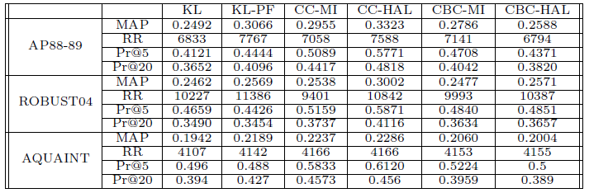
Upper-bound performance
Community Clustering (CC) outperforms Clustering by Committee (CBC)
HAL scores are more effective than Mutual Information (MI)
Sense Feedback performs better than PRF on difficult query sets

Slide 16
UB performance for difficult topics
 |  | KL | KL-PF | SF
AP88-89 | MAP | 0.0346 | 0.0744 | 0.0876
 | P@10 | 0.0824 | 0.1412 | 0.2031
ROBUST04 | MAP | 0.04 | 0.067 | 0.073
 | P@10 | 0.1527 | 0.1554 | 0.2608
AQUAINT | MAP | 0.0473 | 0.0371 | 0.0888
 | P@10 | 0.1188 | 0.0813 | 0.2375
Sense feedback outperforms PRF in terms of MAP and particularly in terms of Pr@10 (boldface = statistically significant (p<.05) w.r.t. KL; underline = w.r.t. to KL-PF)
Notes:
Boldface indicates statistical significance relative to KL baseline (95% confidence level, Wilcoxon signed rank test), underline indicates statistical significance relative to KL-PF

Slide 17
UB performance for difficult topics
 | Total | Diff | Norm | PF |  | SF
 |  |  |  | Diff+ | Norm+ | Diff+ | Norm+
AP | 99 | 34 | 64 | 19 | 44 | 31 | 37
ROBUST04 | 249 | 74 | 175 | 37 | 89 | 68 | 153
AQUAINT | 50 | 16 | 34 | 4 | 26 | 12 | 29
Sense feedback improved more difficult queries than PF in all datasets

Slide 18
User study
50 AQUAINT queries along with senses determined using CC and HAL
Senses presented as:
1, 2, 3 sense label terms using the labeling algorithm (LAB1, LAB2, LAB 3)
3 and 10 terms with the highest score from the sense language model (SLM3, SLM10)
From all senses of all query terms users were asked to pick one sense using each of the sense presentation method
Query LM was updated with the LM of the selected sense and retrieval results for the updated query used for evaluation

Slide 19
User study
Query #378:
euro
opposition
European Union?
Currency?
Sense 1 |  | Sense 2 |  | Sense 3
european | 0.044 | yen | 0.056 | exchange | 0.08
eu | 0.035 | frankfurt | 0.045 | stock | 0.075
union | 0.035 | germany | 0.044 | currency | 0.07
economy | 0.032 | franc | 0.043 | price | 0.06
country | 0.032 | pound | 0.04 | market | 0.055
LAB1: [european] [yen] [exchange]
LAB2: [european union] [yen pound] [exchange currency]
LAB3: [european union country] [yen pound bc] [exchange currency central]
SLM3: [european eu union] [yen frankfurt germany] [exchnage stock currency]

Slide 20
User study
 | LAB1 | LAB2 | LAB3 | SLM3 | SLM10
USER 1 | 18 (56) | 18 (60) | 20 (64) | 36 (62) | 30 (60)
USER 2 | 24 (54) | 18 (50) | 12 (46) | 20 (42) | 24 (54)
USER 3 | 28 (58) | 20 (50) | 22 (46) | 26 (48) | 22 (50)
USER 4 | 18 (48) | 18 (50) | 18 (52) | 20 (48) | 28 (54)
USER 5 | 26 (64) | 22 (60) | 24 (58) | 24 (56) | 16 (50)
USER 6 | 22 (62) | 26 (64) | 26 (60) | 28 (64) | 30 (62)
Users selected the optimal query term for disambiguation for more than half of the queries;
Quality of sense selections does not improve with more terms in the label
Notes:
in parenthesis-correct term for expansion, in boldface – correct term for disambiguation

Slide 21
User study
 | LAB1 | LAB2 | LAB3 | SLM3 | SLM10
USER 1 | 0.0543 | 0.0518 | 0.0520 | 0.0564 | 0.0548
USER 2 | 0.0516 | 0.0509 | 0.0515 | 0.0544 | 0.0536
USER 3 | 0.0533 | 0.0547 | 0.0545 | 0.0550 | 0.0562
USER 4 | 0.0506 | 0.0506 | 0.0507 | 0.0507 | 0.0516
USER 5 | 0.0519 | 0.0529 | 0.0517 | 0.0522 | 0.0518
USER 6 | 0.0526 | 0.0518 | 0.0524 | 0.056 | 0.0534
Users sense selections do not achieve the upper bound, but consistently improve over the baselines
(KL MAP=0.0474; PF MAP=0.0371)
Quality of sense selections does not improve with more terms in the label

Slide 22
Roadmap
Query Ambiguity
Interactive Sense Feedback
Experiments
Upper-bound performance
User study
Summary
Future work

Slide 23
Summary
Interactive sense feedback as a new alternative feedback method
Proposed methods for sense detection and representation that are effective for both normal and difficult queries
Promising upper bound performance all collections
User studies demonstrated that
users can recognize the best-performing sense in over 50% of the cases
user-selected senses can effectively improve retrieval performance for difficult queries
Notes:
Viable alternative to existing interactive feedback techniques, such as term, relevance and PRF

Slide 24
Future work
Further improve approaches to automatic sense detection and labeling (e.g, using Wikipedia)
Implementation and evaluation of sense feedback in a search engine application as a complimentary strategy to results diversification

