Slide 1
Geographical Latent Variable Models for Microblog Retrieval
Alexander Kotov^{1,2} Vineeth Rakesh² Eugene Agichtein³ Chandan K. Reddy²
¹Textual Data Analytics (TEANA) Lab
²Department of Computer Science, Wayne State University
³Information Retrieval Lab, Department of Mathematics & CS, Emory University
Presented at the 37th European Conference on Information Retrieval (ECIR’15)

Slide 2
Microblog retrieval: challenges
Severe vocabulary mismatch:
some tweets can be shorter than queries!
how to retrieve very short documents, which are conceptually relevant, but don’t contain most of the query terms
Relevance in microblog IR is multi-faceted:
scarce relevance signals in content of the tweets
other factors besides content matching: tweet recency, content quality and geographical focus

Slide 3
Example
Topic MB04 ``Mexico drug war’’
Terms ``mexico’’ and ``drug’’ individually occur in only about half of all relevant tweets for this topic
Other half contains conceptually related terms (``border’’, ``catapult’’, ``pot’’, ``fire’’, ``violence’’, ``smuggler’’)
Some relevant tweets do not include any relevant terms at all

Slide 4
Microblog retrieval: opportunities
Microblogs (like other social media documents) naturally include many different types of meta-data:
topical tags (hashtags)
timestamps
geographical location of Twitter users
Microblog IR systems should leverage both lexical and non-lexical information

Slide 5
Microblog retrieval: prior work
Utilizing timestamps:
use tweet as a query for document expansion via PRF [Efron et al., SIGIR’12]
re-rank initial results by estimating the temporal density of PRF documents [Efron et al., SIGIR’14]
select PRF documents by comparing temporal profiles for query and PRF documents [Miyanishi et al., CIKM’13]
Utilizing re-tweets
select PRF documents based on re-tweets [Choi et al., CIKM’12]
Geographical meta-data has been relatively overlooked

Slide 6
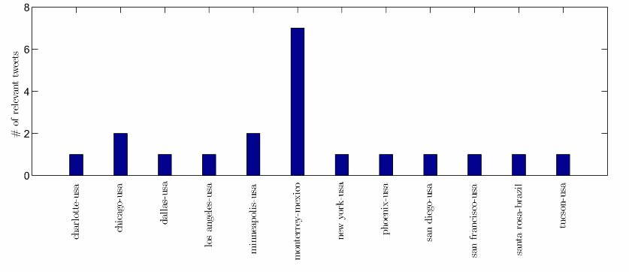
Utilizing geographical meta-data in microblog IR

Slide 7
Utilizing geographical meta-data in microblog IR
We propose two novel Latent Variable Models that utilize textual geographical locations to find topics or language models specific to those locations
Geo-specific topics include terms that are related within a particular geographical context
Use geo-specific topics and LMs to derive more precise, geographically-focused document expansion LMs

Slide 8
Utilizing geographical meta-data in microblog IR
“war” and “pot”, “war” and “catapult” are not normally strongly related word
however, in certain geographical contexts (e.g. Monterrey, Mexico) they are strongly related
proposed latent variable models can be used to find sets of related terms within particular geographical contexts and introduce them into document LMs

Slide 9
Post-hoc LDA geo-topic models
Idea: group documents belonging to each location into a sub-collection and fit LDA on each sub-collection
PH-GLDA: determines the number of topics for all locations by optimizing global collection perplexity
OPT-GLDA: determines the optimal number of topics for each location sub-collection by optimizing sub-collection perplexity

Slide 10





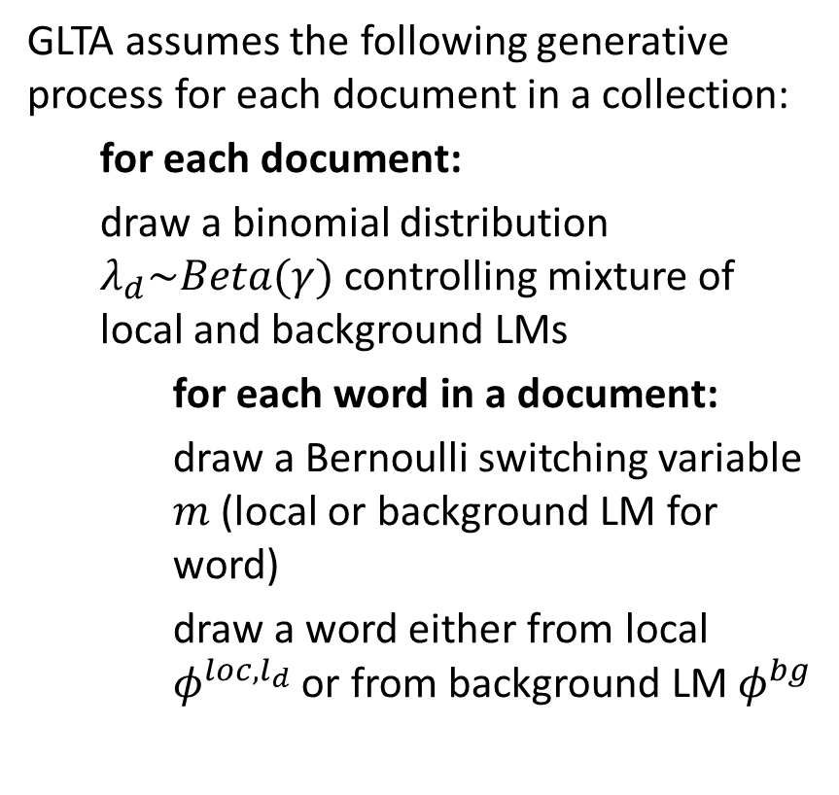







Geographical Latent Term Allocation
GLTA assumes the following generative process for each document in a collection:
for each document:
draw a binomial distribution $λ_{d}\sim Beta(γ)$ controlling mixture of local and background LMs
for each word in a document:
draw a Bernoulli switching variable $m$(local or background LM for word)
draw a word either from local $φ^{loc,l_{d}}$ or from background LM $φ^{bg}$
c
$$γ$$
$$λ$$
$$m$$
$$l$$
$$w$$
$$N_{d}$$
$$M$$
$$β^{loc}$$
$$φ^{loc}$$
$$φ^{bg}$$
$$β^{bg}$$
$$L$$

Slide 11






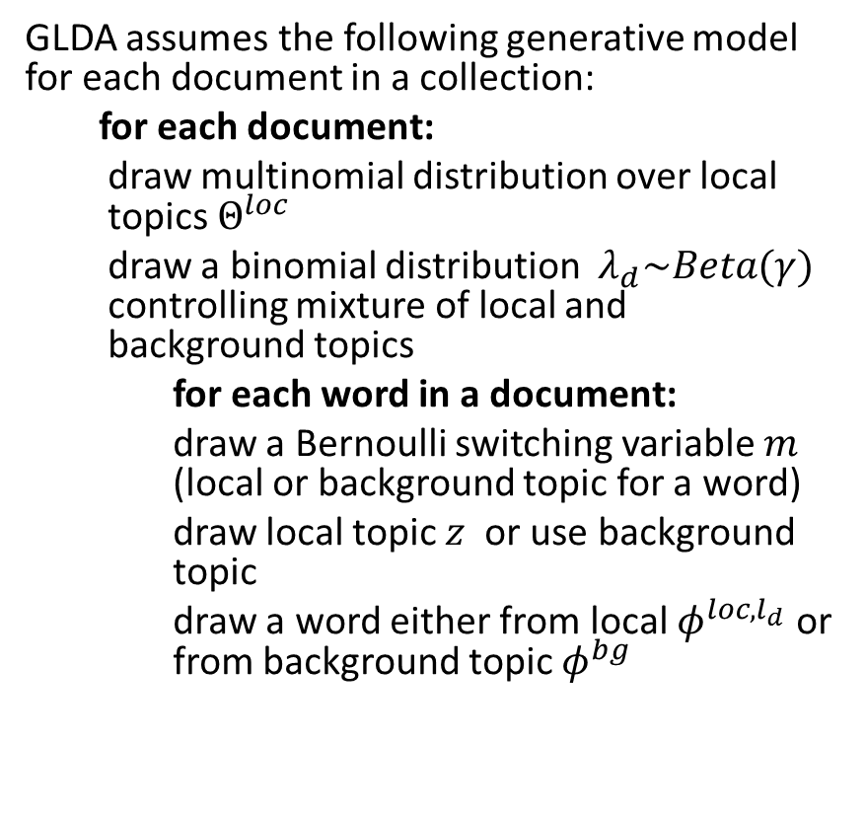









Geographical Latent Dirichlet Allocation
c
GLDA assumes the following generative model for each document in a collection:
for each document:
draw multinomial distribution over local topics $Θ^{loc}$
draw a binomial distribution $λ_{d}\sim Beta(γ)$ controlling mixture of local and background topics
for each word in a document:
draw a Bernoulli switching variable $m$ (local or background topic for a word)
draw local topic $z$ or use background topic
draw a word either from local $φ^{loc,l_{d}}$ or from background topic $φ^{bg}$
$$γ$$
$$λ$$
$$m$$
$$α^{loc}$$
$$Θ^{loc}$$
$$z$$
$$l$$
$$w$$
$$N_{d}$$
$$M$$
$$β^{loc}$$
$$φ^{loc}$$
$$φ^{bg}$$
$$β^{bg}$$
$$K^{loc}×L$$

Slide 12
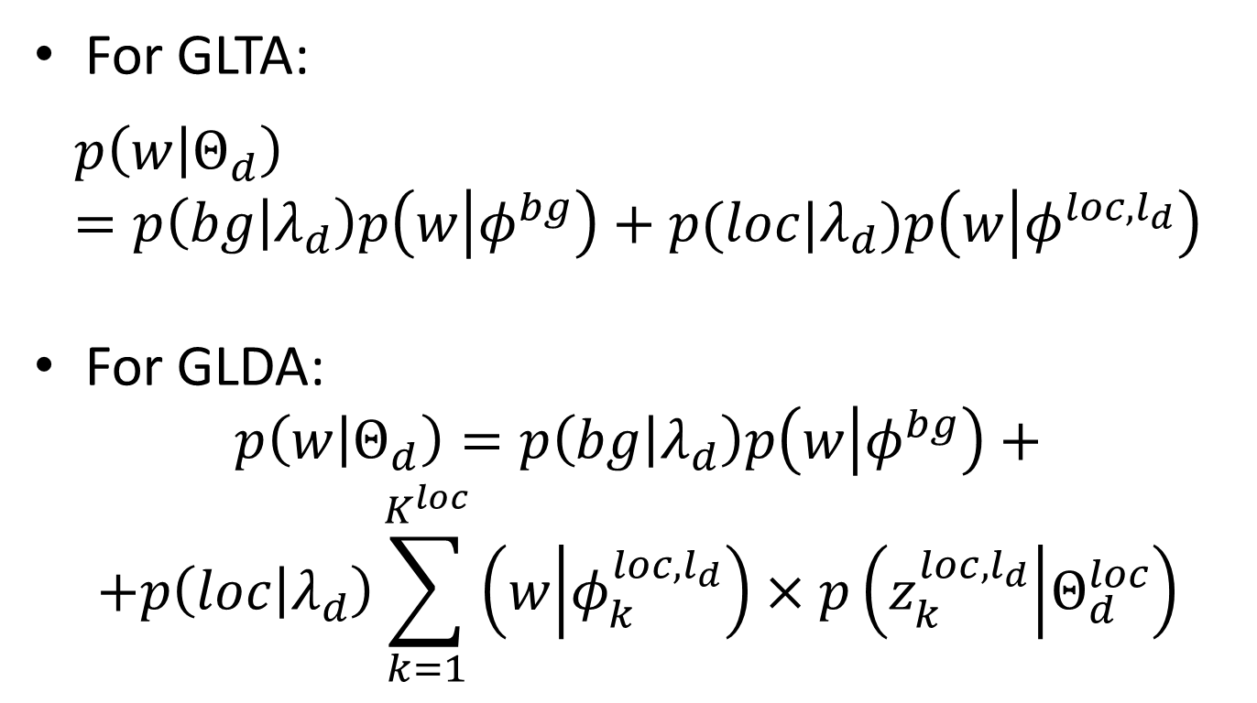
Document expansion LMs
For GLTA:
$$p\left(w | Θ_{d}\right)=p\left(bg | λ_{d}\right)p\left(w | φ^{bg}\right)+p(loc|λ_{d})p\left(w | φ^{loc,l_{d}}\right)$$
For GLDA:
$$p\left(w | Θ_{d}\right)=p\left(bg | λ_{d}\right)p\left(w | φ^{bg}\right)+$$
$$+p\left(loc | λ_{d}\right)\sum_{k=1}^{K^{loc}}{\left(w | φ_{k}^{loc,l_{d}}\right)×p\left(z_{k}^{loc,l_{d}} | Θ_{d}^{loc}\right)}$$

Slide 13
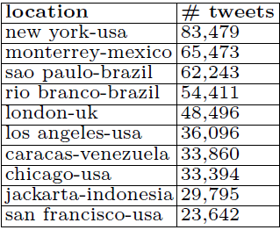
Experiments
Corpus: TREC 2011 Microblog track collection
Microblog posts were labeled by locations extracted from the profiles of their authors normalized to “city-country” format using Google Geocoding API
Training queries: 50 TREC 2011 Microblog track topics
Testing queries: 60 TREC 2012 Microblog track topics

Slide 14
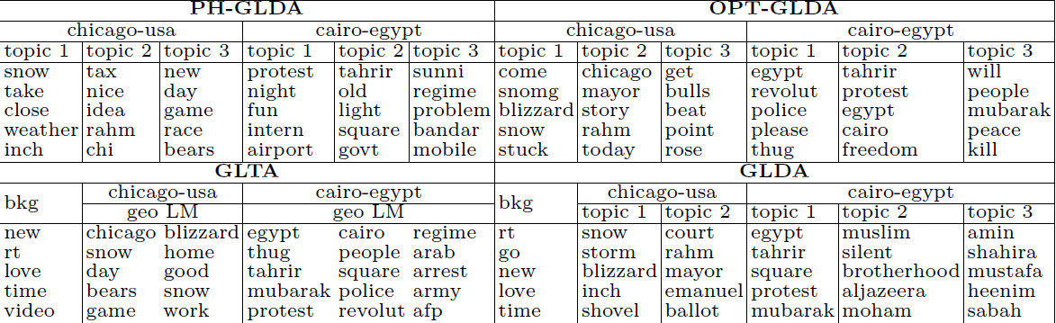
Topics

Slide 15
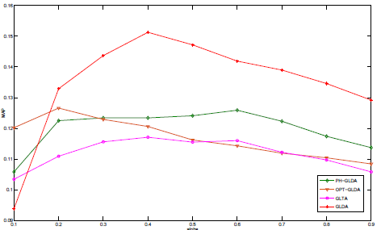
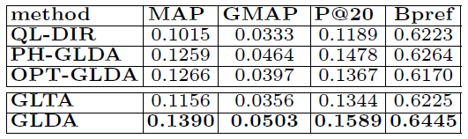
Training

Slide 16
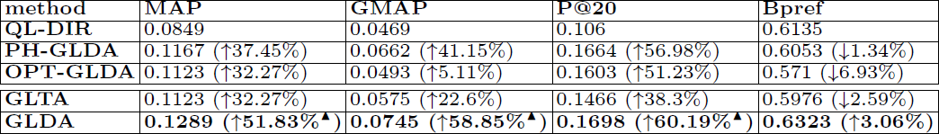

Testing
All geographical LVMs improve over baseline retrieval model (QL-DIR)
GLDA outperforms post-hoc LDA variants (PH-GLDA and OPT-GLDA) and GLTA
GLDA is the only model that improves over PH-GLDA (state-of-the-art baseline beating LDA) in terms of MAP, GMAP, P@20 and BPref

Slide 17
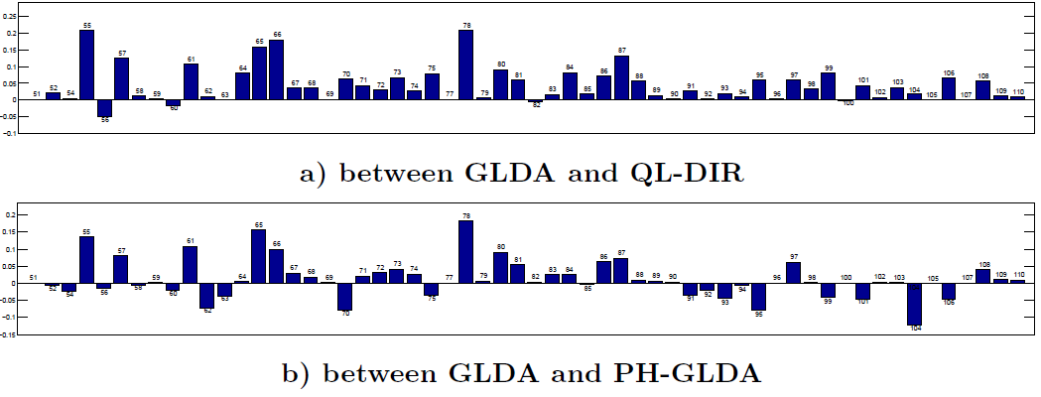
Topic by topic comparison
Most improved topics: “Chicago blizzard”, “Hu Jintao visit to the United States”, “Journalist treatment in Egypt”, “Joanna Yeates murder”
Hurt topics: “Starbucks Trenta cup”, “farmers markets opinions”, “texting and driving”

Slide 18
Summary
We proposed novel geographically-aware LVMs that work with textual geographical labels
Our approach does not require PRF
Demonstrated that geographically-focused document expansion LMs results in better retrieval performance

Slide 19
Thank you!
Questions?

