Slide 1
Modeling and Analysis of Cross-Session Search Tasks
Alexander Kotov, UIUC
Paul N. Bennett, Microsoft Research*
Ryen W. White*
Susan T. Dumais*
Jaime Teevan*

Slide 2
Simple vs. Cross-Session Tasks
Simple search tasks:
Composed of one/two continuous queries
Contain short time intervals between related queries
Completed within one search session
Cross-session search tasks:
Composed of multiple non-continuous queries
Cover several aspects
Contain long time intervals between related queries
Continue across several search sessions
Constitute 10% of all sessions, 25% of all queries [Donato et al. WWW’10]
Notes:
Information needs of search engine users vary in complexity. Simple search tasks (like finding a person’s home page or social networking site)
Complex of cross-session tasks

Slide 3
Typical Cross-Session Tasks
Event planning (e.g. wedding, vacation)
Shopping research (e.g. electronics, real estate)
Academic research
Political/personality research
How-to (How-do-I) research (fix a car, etc.)
Medical self-diagnosis and treatment

Slide 4
Example of Cross-Session Tasks
Time | Query
1/22/2011 1:10pm | peanut butter recipes
1/22/2011 1:13pm | peanut butter cookies
1/22/2011 1:25pm | calories peanut butter cookies
1/22/2011 3:10pm | weather nyc
1/22/2011 3:11pm | peanut butter sandwiches
1/22/2011 3:15pm | nyc 10-day weather forecast
1/22/2011 3:16pm | pb&j
1/22/2011 3:18pm | fluffanutter
1/22/2011 3:19pm | fluffernutter
1/22/2011 6:15pm | sigir 2011
1/22/2011 6:17pm | sigir 2010 schedule
1/23/2011 3:17pm | nytimes
1/24/2011 3:00pm | flight status united 123
1/25/2011 3:29pm | foodtv
1/25/2011 3:31pm | famous pb&j drop recipe
Long time gap between related queries
Interleaved with other tasks
No shared terms with previous related queries
Long periods focused on other tasks
Task continuation
Notes:
Define early dominant task

Slide 5
Supporting Cross-Session Tasks
Motivation
Relieve the cognitive burden of maintaining the context of search tasks
Improve search results by reflecting the long-term intent
Improve efficiency by pre-fetching the relevant content
Provide support for task resumption
Same Task: given a query, identify all previous queries on the same cross-session search task
Different models proposed for Same Task before [Jones&Klinkner CIKM’08; Donato et al. WWW’10];
Task Continuation: given a search task for a user and the last query of the user on the search task, predict whether the user will return to it in the future
Solution: classification framework
Classifiers: Logistic Regression and MART

Slide 6
Labeling
Use query refinement clusters and query graph with similarity threshold to produce automatic labels
Time | Query | Automatic Label | AutoDom | HumDom
1/22/2011 1:10pm | peanut butter recipes | peanut butter recipes | x | x
1/22/2011 1:13pm | peanut butter cookies | peanut butter recipes | x | x
1/22/2011 1:25pm | calories peanut butter cookies | peanut butter recipes | x | x
1/22/2011 3:10pm | weather nyc | weather nyc
1/22/2011 3:11pm | peanut butter sandwiches | peanut butter recipes | x | x
1/22/2011 3:15pm | nyc 10-day weather forecast | weather nyc
1/22/2011 3:16pm | pb&j |  |  | x
1/22/2011 3:18pm | fluffanutter |  |  | x
1/22/2011 3:19pm | fluffernutter |  |  | x
1/22/2011 6:15pm | sigir 2011 | sigir 2011
1/22/2011 6:17pm | sigir 2010 schedule | sigir 2011
1/23/2011 3:17pm | nytimes
1/24/2011 3:00pm | flight status united 123
1/25/2011 3:29pm | foodtv |  |  | x
1/25/2011 3:31pm | famous pb&j drop recipe |  |  | x
Notes:
Define early dominant task

Slide 7
Labeling
Focus on early dominant tasks: two distinct queries labeled with the same task in the first two days.
Time | Query | Automatic Label | AutoDom | HumDom
1/22/2011 1:10pm | peanut butter recipes | peanut butter recipes | x | x
1/22/2011 1:13pm | peanut butter cookies | peanut butter recipes | x | x
1/22/2011 1:25pm | calories peanut butter cookies | peanut butter recipes | x | x
1/22/2011 3:10pm | weather nyc | weather nyc
1/22/2011 3:11pm | peanut butter sandwiches | peanut butter recipes | x | x
1/22/2011 3:15pm | nyc 10-day weather forecast | weather nyc
1/22/2011 3:16pm | pb&j |  |  | x
1/22/2011 3:18pm | fluffanutter |  |  | x
1/22/2011 3:19pm | fluffernutter |  |  | x
1/22/2011 6:15pm | sigir 2011 | sigir 2011
1/22/2011 6:17pm | sigir 2010 schedule | sigir 2011
1/23/2011 3:17pm | nytimes
1/24/2011 3:00pm | flight status united 123
1/25/2011 3:29pm | foodtv |  |  | x
1/25/2011 3:31pm | famous pb&j drop recipe |  |  | x
Notes:
Define early dominant task

Slide 8
Labeling
Human annotators correct automatic labels for the dominant task (Cohen’s kappa ranges from 0.86 to 0.92)
Time | Query | Automatic Label | AutoDom | HumDom
1/22/2011 1:10pm | peanut butter recipes | peanut butter recipes | x | x
1/22/2011 1:13pm | peanut butter cookies | peanut butter recipes | x | x
1/22/2011 1:25pm | calories peanut butter cookies | peanut butter recipes | x | x
1/22/2011 3:10pm | weather nyc | weather nyc
1/22/2011 3:11pm | peanut butter sandwiches | peanut butter recipes | x | x
1/22/2011 3:15pm | nyc 10-day weather forecast | weather nyc
1/22/2011 3:16pm | pb&j |  |  | x
1/22/2011 3:18pm | fluffanutter |  |  | x
1/22/2011 3:19pm | fluffernutter |  |  | x
1/22/2011 6:15pm | sigir 2011 | sigir 2011
1/22/2011 6:17pm | sigir 2010 schedule | sigir 2011
1/23/2011 3:17pm | nytimes
1/24/2011 3:00pm | flight status united 123
1/25/2011 3:29pm | foodtv |  |  | x
1/25/2011 3:31pm | famous pb&j drop recipe |  |  | x
Notes:
Define early dominant task

Slide 9
Datasets
Editorial labels for
a random sample
Downsample negatives
Dataset | 10k | 3k | Human
Number of users | 10,852 | 3,376 | 1,218
Users returning to dominant | 1,694 | 1,688 | 701
Number of queries | 119,814 | 66,219 | 28,474
Query pairs | 1,486,492 | 866,860 | 660,120
Sample 10k users from one week of browser-based logs of browsing and searching episodes
10k: 15% return to dominant
3k: 50% return to dominant

Slide 10
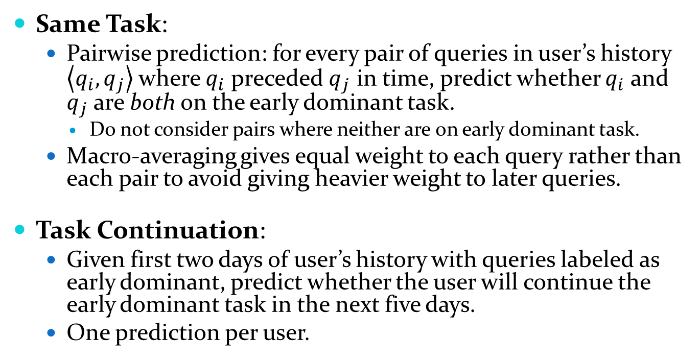
Prediction Tasks
Same Task:
Pairwise prediction: for every pair of queries in user’s history $\left\langle q_{i},q_{j}\right\rangle$ where $q_{i}$ preceded $q_{j}$ in time, predict whether $q_{i}$ and $q_{j}$ are both on the early dominant task.
Do not consider pairs where neither are on early dominant task.
Macro-averaging gives equal weight to each query rather than each pair to avoid giving heavier weight to later queries.
Task Continuation:
Given first two days of user’s history with queries labeled as early dominant, predict whether the user will continue the early dominant task in the next five days.
One prediction per user.

Slide 11
Same Task Features
Query-based:
Descriptiveness: query length (terms/chars),
Engagement: # clicks on top 10 results,
Examination: min/max position of clicked results
Session-based:
Activity/Engagement: # queries/clicks/time since the beginning of a session,
Similarity: presence of same/subset/superset query in session
History-based:
Activity/Engagement: # sessions/queries/clicks in history
Similarity: presence of same/subset/superset query in history
Pair-wise:
Similarity: # overlapping terms/Jaccard coefficient/Levenshtein edit distance, equal/subset/superset, co-clicked URLs
Time: time between two queries, same session

Slide 12
Same Task Results
 | 3k |  |  | 10k |  |  | Human
 | BASE | LR | MART | BASE | LR | MART | BASE | LR | MART
Macro statistics
Recall | 0.4157 | 0.6431 | 0.7258 | 0.4300 | 0.6693 | 0.7556 | 0.3267 | 0.6067 | 0.5617
Prec. | 0.8382 | 0.8135 | 0.8183 | 0.8240 | 0.8268 | 0.8233 | 0.6138 | 0.7857 | 0.7325
Acc. | 0.8970 | 0.9227 | 0.9331 | 0.9245 | 0.9646 | 0.9534 | 0.6104 | 0.7629 | 0.7118
F1 | 0.5495 | 0.7160 | 0.7681 | 0.5520 | 0.7383 | 0.7876 | 0.3957 | 0.6670 | 0.6156
Baseline: LR using only Levenshtein distance
Two classifiers show similar levels of accuracy on auto-labeled data
Performance decreases on human-labeled data
LR notably dominates MART for human-labeled data

Slide 13
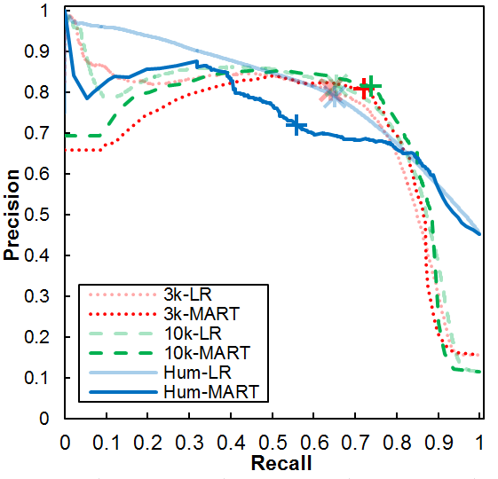
Same Task P-R Curves
LR dominates MART at the low recall/high precision end of the curves
LR has outperforms MART on the human-labeled data in the area of optimal F1
Notes:
LR model might be more applicable for high-precision tasks such as suggesting related queries

Slide 14
Same Task Feature Importance
Pair-wise features are more prevalent
Term overlap features are among the strongest signals
Same task queries are morphologically similar
Long, descriptive query terms are indicative of cross-session tasks
Feature | Weight
QueryTermsJac | 1.44
NumQueryChars₁ | 1.05
NumTermsOver | 0.93
NumQueryChars₂ | 0.79
SameSess | 0.52
HaveCoClickDom | 0.40
NumQueriesSess₁ | 0.31
SubQuerySess₂ | -0.30
NumQueryTerms₂ | -0.47
NumQueriesHist₁ | -0.52
NumQueryTerms₁ | -0.68
LevenDist | -0.84

Slide 15
Task Continuation Features
Same query, session and history features as Same Task
Session-based and History-based versions of:
Engagement: avg. time between pairs of queries
Satisfaction:
# queries with dwell time more than 30 secs.
# clicked queries / # queries,
Complexity: avg. number of unique terms per query,
Task relatedness: # co-clicked URLs with the same domain

Slide 16
Task Continuation Results
 | 3k |  |  | 10k |  |  | Human
 | BASE | LR | MART | BASE | LR | MART | BASE | LR | MART
Recall | 0.4038 | 0.6593 | 0.6546 | 0.0084 | 0.2777 | 0.3096 | 0.8154 | 0.7342 | 0.6971
Prec. | 0.5906 | 0.7555 | 0.7708 | 0.675 | 0.6784 | 0.7219 | 0.5961 | 0.7538 | 0.7766
Acc. | 0.5601 | 0.7228 | 0.7308 | 0.8441 | 0.8664 | 0.8726 | 0.5706 | 0.7074 | 0.7100
F1 | 0.4775 | 0.7029 | 0.7072 | 0.0166 | 0.3933 | 0.4305 | 0.6844 | 0.7428 | 0.7326
Baseline: LR using only NumQueriesHist
Two classifiers perform similarly on all datasets
Recall and precision substantially decrease when moving from smaller balanced auto-labeled dataset (3k) to larger unbalanced one (10k)
Recall significantly improves for both classifiers on manually corrected labels

Slide 17
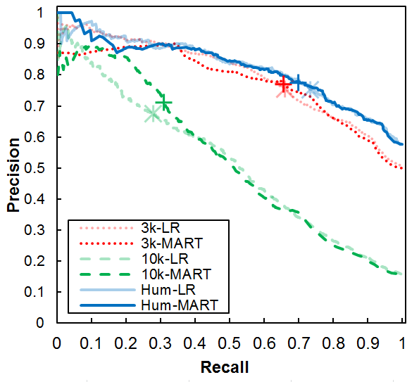
Task Continuation P-R Curves
Performance significantly decreases on 10k dataset
For human-labeled data MART has a slight advantage in the low recall/high precision region

Slide 18
Task Continuation Feature Importance
Feature | Weight
SameQueryHist | 1.11
NumSessHist | 0.60
NumDomQueriesHist | 0.39
AvgInterQTimeHist | 0.24
FreqDomQueriesHist | 0.24
NumDwell30Hist | 0.22
NumQueryHist | 0.21
NumTop10Clicks | -0.16
NumClicksHist | -0.18
NumQueryChars | -0.21
SubQueryHist | -0.23
SupQuerySess | -0.40
Re-finding is common
Dominant task related features are important
Complexity of the information need and close examination of results are indicative of task continuation
Users who search frequently and deeply likely use search for complex tasks
Notes:
Most predictive features reflect two aspects of a cross-session task: (i) user satisfaction with the presented search results (captured by the click-through rate: the more the user clicks the less likely she is to return to the task) and (ii) the difficulty of the task itself (number of queries issued, time between successive queries, dwell time)

Slide 19
Summary
Addressed an important problem of predicting cross-session task continuation
Designed large feature sets, reflecting:
Query descriptiveness, user engagement, examination depth, user activity, query similarity to previous history, time dependency, task complexity, and user satisfaction
Developed feature representation and learning techniques that could be used to accurately predict:
Whether two queries are on the same task
Whether a user will resume a task in a future session
Analyzed feature contributions. Of particular note:
Long, descriptive query terms are indicative of cross-session tasks
The complexity of the information need and close examination of results are indicative of task resumption

