Slide 1


Mining Named Entities with Temporally Correlated Bursts from Multilingual Web News Streams
Alexander Kotov, ChengXiang Zhai, Richard Sproat
University of Illinois at Urbana-Champaign

Slide 2
Roadmap
Problem definition
Previous work
Approach
Experiments
Summary

Slide 3
Motivation
Web data is generated by a large number of textual streams (news, blogs, tweets, etc.)
Bursts of entity mentions (people, locations) correspond to a particular event
Bursts of entity mentions are influenced by bursts of other entities
Intuition: bursts of semantically related entities should be temporally correlated
Notes:
Web data is naturally generated by a large number of streams. If we look at the behavior of individual entities within those streams….

Slide 4








Problem definition
magnitude
21
15
14
13
12
10
11
10
9
8
9
8
6
6
6
7
4
5
4
5
4
5
2
3
3
2
3
2
1
1
time lag
$$t_{0}$$
13
$$t_{T}$$
time
entity 1
11
7
6
=
sparsity
?
4
5
2
3
2
2
2
3
3
entity 2
1
1
$$t_{0}$$
$$t_{T}$$
time
Notes:
Any linguistic unit (term, phrase)
Input: streams of mention counts for a lexical unit
Output: correlation coefficient with respect to bursts
How do we know that they are correlated (labels of the problems)

Slide 5
Temporally correlated bursts
Problem: given a collection of textual streams discover named entities with correlated bursts
Provide multilingual summaries of real life events
Estimate social impact of a particular event in different countries
Differentiate between local and global events
Discover transliterations of named entities
Notes:
By knowing the entities that occur more frequently than usual, one can not only discover the major events happening at the moment, but also differentiate between local and global events

Slide 6
Roadmap
Problem definition
Previous work
Approach
Experiments
Summary

Slide 7
Previous work
Burst detection:
infinite-state automation (Kleinberg ’02)
factorial HMMs (Krause ‘06)
wavelet transformation (Zhu ’03)
Stream correlation:
distance-based measures: Pearson coefficient (Chien’05)
singular spectrum transformation (Ide’05)
topic based (PLSA, LDA) (Wang’09)
Notes:
Smoothing is good for large volumes of data, but is not suitable for precise alignment of bursts across multiple streams, due to distortion of shape, duration and magnitude of bursts after smoothing
Contribution
Citations
Deficiency

Slide 8
Previous work
Smoothing is efficient for large amount of data, but not precise
Do not abstract away from the raw data
Distance based measures suffer from magnitude and sparsity problems
Temporal lags are not considered

Slide 9
Roadmap
Problem definition
Previous work
Approach
Experiments
Summary

Slide 10
Approach
Difference in magnitude: normalization with Markov Modulated Poisson Process
Temporal lag: flexible alignment of bursts using dynamic programming
Notes:
Contribution of this work

Slide 11
Markov-Modulated Poisson Process
Ergodic Markov chain over finite number of states
Each state is associated with Poisson distribution
“Burstiness’’ of a state is represented by the intensity parameter of Poisson distribution
States are labeled by the rank of the intensity parameter

Slide 12
Normalization
21
mention counts
15
14
13
12
10
11
10
9
8
9
8
6
6
6
7
4
5
4
5
4
5
2
3
3
2
3
2
1
1
1
1
1
1
1
1
2
2
2
2
2
1
1
1
3
3
3
3
3
3
2
1
3
3
3
3
1
1
1
1
time
MMPP states
13
11
7
6
4
5
2
3
2
2
2
3
3
1
1
1
1
1
1
1
1
1
2
1
1
1
1
1
1
1
3
3
3
1
2
2
1
1
1
2
2
2
1
1
1
time
Notes:
How is bursty determined

Slide 13
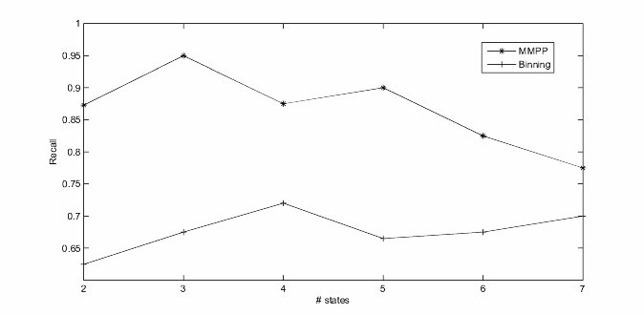
Normalization
MMPP consistently outperforms the baseline
The optimal performance is achieved when the number of states is 3

Slide 14
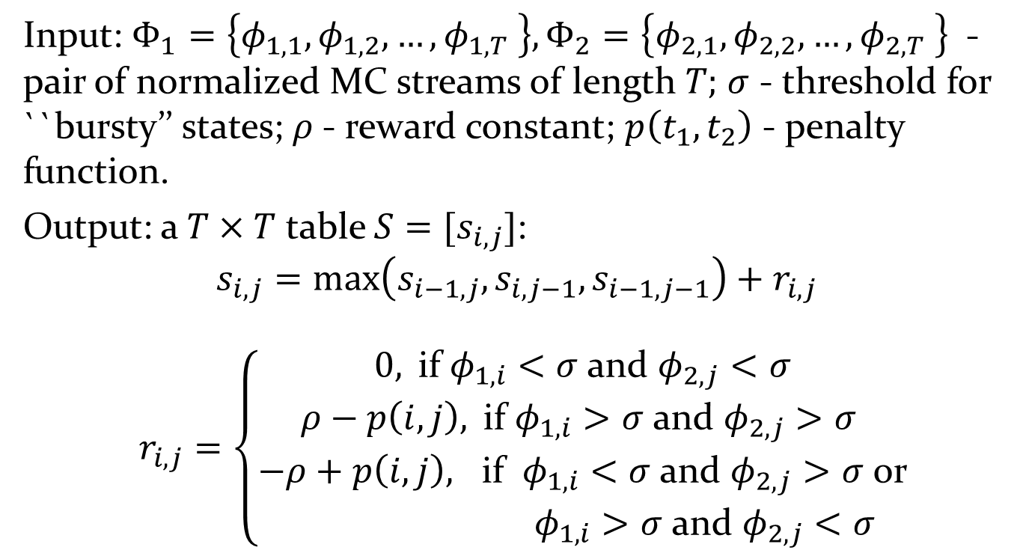
Burst Alignment
Input: $Φ_{1}=\left\{φ_{1,1},φ_{1,2},…,φ_{1,T} \right\},Φ_{2}=\left\{φ_{2,1},φ_{2,2},…,φ_{2,T} \right\}$ -pair of normalized MC streams of length $T;$ $σ$ - threshold for ``bursty’’ states; $ρ$- reward constant; $p\left(t_{1},t_{2}\right)$ - penalty function.
Output: a $T×T$ table $S=[s_{i,j}]$:
$$s_{i,j}=\max\left(s_{i−1,j},s_{i,j−1},s_{i−1,j−1}\right)+r_{i,j}$$
$r_{i,j}=\left\{\begin{aligned}0, \text{if} φ_{1,i}<σ \text{and} φ_{2,j}<σ \\ ρ−p\left(i,j\right), \text{if} φ_{1,i}>σ \text{and} φ_{2,j}>σ \\ −ρ+p\left(i,j\right), \text{if} φ_{1,i}<σ \text{and} φ_{2,j}>σ \text{or} \\ φ_{1,i}>σ \text{and} φ_{2,j}<σ\end{aligned}\right.$

Slide 15
Burst alignment
exponential penalty
perfect alignement
logarithmic penalty
Notes:
Imagine that this is a dynamic programming table, which represents the search space. A path from the upper left to a lower right corner in the table corresponds to a particular alignment of streams a has an overall score. The algorithm searches for the path that maximizes the score. The functional form of the penalty function determines the size of the region of a search space where correlated bursts still positively contribute to the overall correlation score. Exponential function favors short gaps and hence the path cannot significantly deviate from the diagonal. Logarithmic penalty increases the size of the search space by allowing longer gaps.

Slide 16
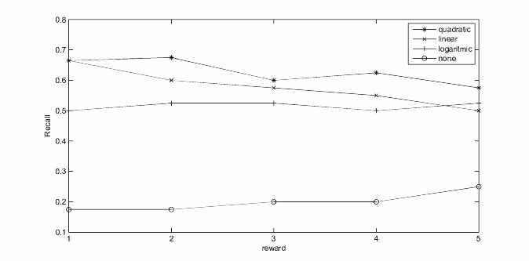
Burst alignment
quadratic penalty function in combination with reward constant of 2 is optimal
maximum permitted temporal gap is 1 day

Slide 17
Roadmap
Problem definition
Previous work
Approach
Experiments
Summary

Slide 18

Dataset
News data crawled from RSS feeds over 4 month
Basic named entity recognition
Basic stemming

Slide 19
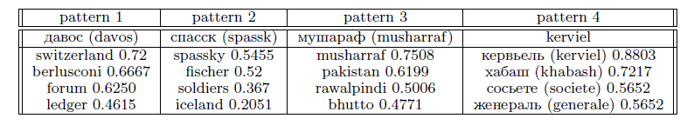
Correlated Bursts
Real life events:
Pattern 1: World Economic Forum in Davos, Switzerland and death of actor Heath Ledger;
Pattern 2: death of Bobby Fischer
Pattern 3: assassination of Benazir Bhutto
Pattern 4: French bank major trading loss incident and death of George Habash

Slide 20
Mining transliterations
Static aligned corpora:
+ identical or semantically related contents
+ temporal topical alignment
- limited coverage
Web:
+ covers almost any domain
- difference in burst magnitude
- temporal lag between bursts
Notes:
Move to experiment part

Slide 21
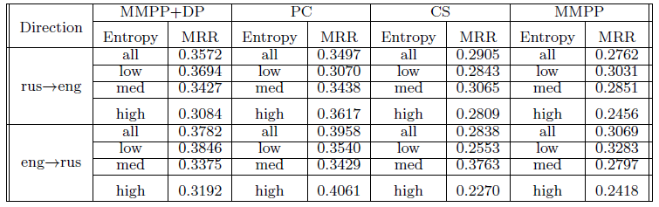
Transliteration
MMPP+DP outperforms one baseline (CS) in all entropy categories and the other baseline (PC) for low- and medium-entropy (more “bursty’’) entities;
Combination of MMPP+DP performs better than MMPP alone.

Slide 22
Roadmap
Problem definition
Previous work
Approach
Experiments
Summary

Slide 23
Summary
Novel multi-stream text mining problem
Our approach can effectively discover correlated bursts corresponding to major and minor real life events
Effective for unsupervised discovery of transliterations
Method is data independent and not limited to textual domain
Notes:
Experimentally demonstrated that the method is effective for unsupervised discovery of transliterations

Slide 24
Contributions
First method to use MMPP for burst detection in textual streams
Algorithm for temporally flexible stream correlation based on bursts
Unsupervised method for language-independent transliteration without any linguistic knowledge

Slide 25
Future work
Applying proposed method to non-textual data (e.g., sensor streams)
Burst correlations between entities different types of Web 2.0 data (news and tweets, news and blogs, news and tags, etc.)
Notes:
From streams of sensor readings from components of a system, discover components which simultaneously exhibit anomalous behavior

