Slide 1


Towards Natural Question-Guided Search
Alexander Kotov (akotov2@illinois.edu)
ChengXiang Zhai (czhai@cs.uiuc.edu)
WWW 2010, Raleigh
April 30, 2010
University of Illinois at Urbana-Champaign
Notes:
Good afternoon, my name is Alexander Kotov, I’m a PhD student working in the Text Information Management group at UIUC. In this talk, I’ll introduce Question-Guided search a novel framework for Interactive Information Retrieval, which I developed with my advisor Professor Cheng Zhai

Slide 2
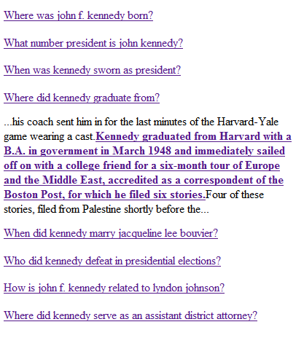
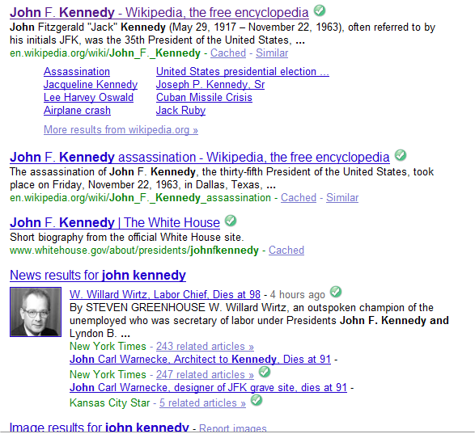
Motivation
keyword search: “john kennedy”
Information need is not completely specified
Asking a questions is the most natural way to express information need
Information need usually corresponds to an underlying question
Accurate determination of the underlying question may save user effort substantially
How can we do that?
Idea: guess the information need by automatically generating and presenting clarification questions and short answers to them.
1
Notes:
The key motivation behind interactive search in general and question-guided search in particular is that the search tasks and information needs, corresponding to them, are different. Sometimes, users have a clear idea of what they are looking for and their queries are well defined, other times the idea is vague or users just want to explore a particular topic. For example, suppose a user is searching for information about President John Kennedy…
The easiest and the most straightforward way to do so for a person, who is used to keyword-based search paradigm is to pose a keyword query, like “john f. kennedy”. However, such a query does not fully specify the user’s information need….
The query-based search paradigm assumes that users have sufficient knowledge about the query domain and are able to find good differentiator terms. In reality however, people are naturally not used to formulating short string requests.
According to surveys, asking a natural language questions is the most natural way for search engine users to express their information needs. However, QA systems cannot yet answer arbitrary questions posed by users. What can we do? The key idea behind question-guided search is to guess the information need by presenting to the user a set of automatically generated natural language questions and short answers to them. Well, if we cannot answer any possible question, can we at least attempt to guess it.
As humans, you might well think that asking question for a question is not very polite, but as IR researchers most of you will agree that accurate determination of the underlying question can substantially save user efforts
There are several possible scenarios of using questions-answer pairs. First, a user can point on the question and get the answer directly along with some contextual information. In this sense, questions can be considered as shortcuts to information. By clicking on the answer the users can be redirected to the document where the answer is contained.

Slide 3
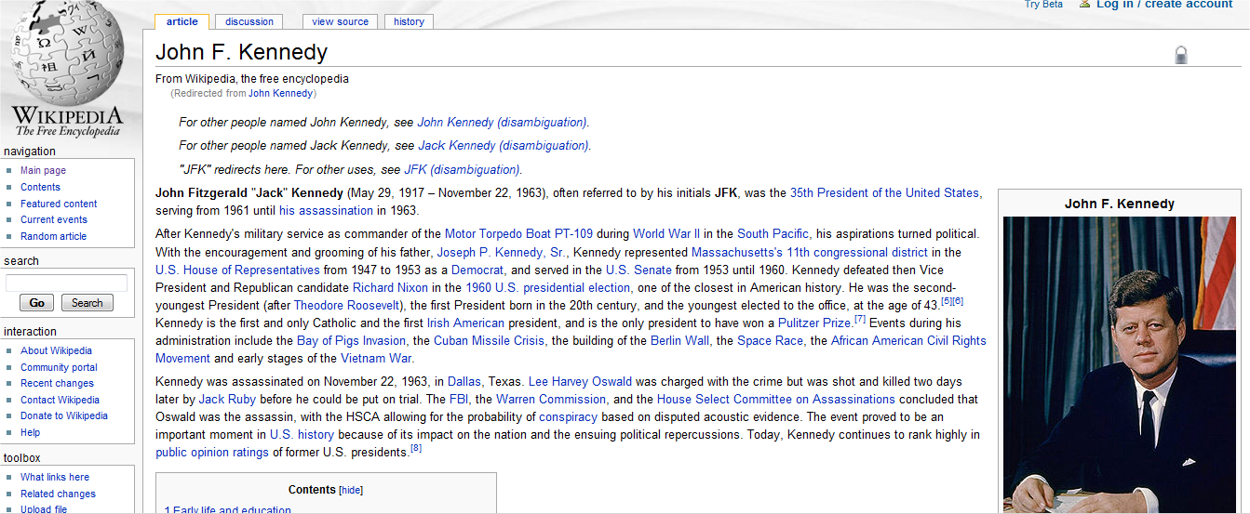
Motivation
Clicking on the answer to a question redirects a user to the page where the answer is contained for more information
2

Slide 4
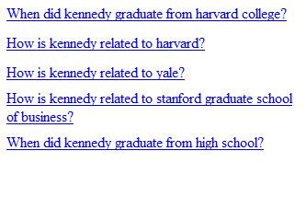
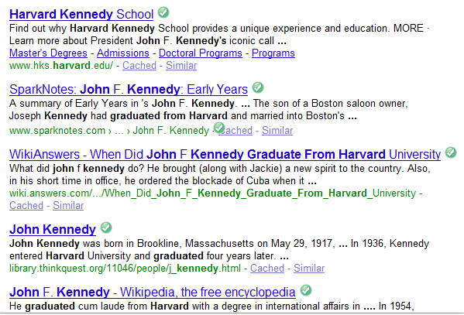
Motivation
Clicking on a question brings up both a new result list and a list of questions reflecting the user feedback
3
Notes:
clicking on a question generates a new set of questions and result pages, reflecting the user feedback. In this sense, questions can be considered as a feedback mechanism. Ambiguous, imprecise and exploratory queries are the best candidates for refinement

Slide 5
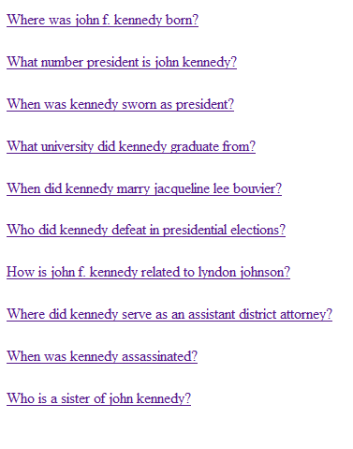
Benefits
Questions correspond to particular facts or aspects of a keyword query topic
Questions allow ad hoc exploration of query topics without any prior knowledge about them
More natural way of engaging users into interactive feedback
Questions are shortcut to the answers or can progressively guide users to the answers they are looking for
Questions can always be answered
4
Notes:
users can click on a document and be redirected to the document, containing the answer for further information. In this sense, questions can be considered as shortcuts for information. Short, ambiguous, under-specified queries are the best candidates for refinement.

Slide 6
Question-guided search
Problem: How to automatically generate such clarification questions?
How to index the right content?
How to use the index to generate questions?
How to rank generated questions?
How to interpret and utilize the question-based user feedback?
5
Notes:
Obviously, enabling interactive question-based retrieval requires to go beyond the bag-of-words view of document collections and develop special methods for all major stages of the retrieval process. In particular …

Slide 7
Roadmap
Indexing
Question generation
Ranking
Feedback
Evaluation

Slide 8
Syntactic Parsing (Minipar)
Mary found a solution to the problem.
found
head
subj:person
obj
Mary
solution
det
mod
modifier
a
to
pcomp-n
problem
det
the
Dependency parsing helps to avoid language variability (“After thinking for a while, Mary found a solution to the difficult problem”)
6
Notes:
Given an input sentence, Minipar returns its dependency tree, in which the nodes correspond to the terms in the sentence along with the syntactic and semantic labels assigned to them and the edges represent the dependency relationships between the terms.
Converts nominative sentences into parse trees;
Parse tree is a set of dependency relations;
Dependency relation is a binary relation two terms;
Dependency parsing helps to avoid syntactic variability:
“After thinking for several days, John finally found a solution to the difficult problem” vs. “John found a solution to the problem”

Slide 9
Syntactic pattern
1
Smaller number of semantic patterns, compared to surface patterns
Patterns are manually specified in the configuration file (we used 32 patterns)
Indexing: searching document collection for occurrences of syntactic patterns (tree automata).
<pattern id="1">
<slots>
<slot id=“1" role=“verb” parent=“” attrs=“” />
<slot id=“2" role="s" parent=“1” attrs=“pers“ />
<slot id=“3" role=“pred" parent=“1” attrs=“” />
<slot id=“4” role=“mod” parent=“3” attrs=“”/>
<slot id=“5” role=“pc:loc” parent=“4” attrs=“loc”/>
</slots>
<questions>
<question focus=“2" text="Where {1:term}
{2:stem} {3:term}?" />
<question focus=“5" text="Who {1:term} {3:term} {4:term} {5:stem}?" />
</questions>
</pattern>
verb
2
3
subj:pers
pred
semantic label
4
mod
5
pc:loc
syntactic label
Main idea: locate instances of syntactic patterns during indexing and convert those instances into questions for a given query
7
Notes:
Overall solution as a picture, reduce text
If we consider only syntactic and semantic labels of the nodes in a dependency tree, disregarding the specific terms corresponding to the nodes, we will get a generalized dependency tree or syntactic pattern;

Slide 10
Examples of patterns
Wilson lived in Columbia, South Carolina, the state capital, from 1870-1874, where his father was professor at the Columbia Theological Seminary.
1
0
2
3
4
5
0:verb
1:s (person)
2:mod
3:pc (loc)
4:mod
5:pc (date)
Voight is the father of actress Angelina Jolie (Angelina Jolie Voight is her birth name) and actor James Haven
1
0
2
3
4
0:verb
1:s (person)
2:pred
3:mod
4:pc (person)
8
Notes:
patterns have a clear semantics behind them

Slide 11
Indexing
Kennedy was born at 83 Beals Street in Brookline, Massachusetts on Tuesday, May 29, 1917 at 3:00pm, the second son of Joseph Kennedy and Rose Fitzgerald.
2
1
3
4
5
1
dictionary
id | term
1 | kennedy
2 | was
3 | be
4 | born
5 | in
6 | brookline
7 | massachusetts
instances
iid | sid | did | pid | stid | tid | slid | slpos
5 | 10 | 2 | 4 | 3 | 2 | 1 | 1
5 | 10 | 2 | 4 | 1 | 1 | 2 | 1
5 | 10 | 2 | 4 | 4 | 4 | 3 | 1
5 | 10 | 2 | 4 | 5 | 5 | 4 | 1
5 | 10 | 2 | 4 | 6 | 6 | 5 | 1
5 | 10 | 2 | 4 | 7 | 7 | 5 | 2
verb
2
3
subj:pers
pred
4
mod
5
pcomp:loc
Terms filling the slots of pattern instances
Pattern instances
9
Notes:
Add word

Slide 12


Big picture
Index
instances
collection
query
questions
patterns
10

Slide 13
Roadmap
Motivation
Indexing
Question generation
Ranking
Feedback
Evaluation

Slide 14
Question generation
Kennedy was born at 83 Beals Street in Brookline, Massachusetts on Tuesday, May 29, 1917 at 3:00pm, the second son of Joseph Kennedy and Rose Fitzgerald.
2
1
3
4
5
Question templates:
Who [1:term] [3:term] [4:term] [5:stem]?
Where [1:term][2:stem][3:term]?
1
verb
2
3
subj:pers
pred
4
Questions:
Who was born in Brookline, Massachusetts ?
Where was Kennedy born ?
mod
1
3
4
5
5
pcomp:loc
1
2
3
11

Slide 15
Roadmap
Motivation
Indexing
Question generation
Ranking
Feedback
Evaluation

Slide 16
Ranking
Each ranking heuristic is function, that maps a question into a real number.
QT : number of query terms that occur both in the query and the question (questions containing more query terms are more relevant)
PM : number of query terms that occur both in the query and the slots of the pattern instance , from which the question was generated (specific vs. general patterns)
DS : the retrieval score of the query with respect to the document that contains the instance (allows to incorporate standard retrieval methods)
12
Notes:
Sample text illustrate the number of query terms

Slide 17
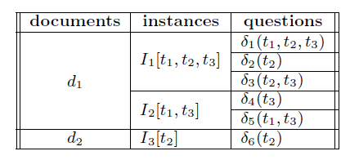
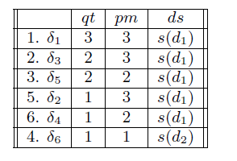
Ranking
Ranking function is a binary function on question pairs such that if ,
Given a query , which matches 3 pattern instances , , and generates 6 questions
13
Notes:
Merge two tables

Slide 18
Question generation algorithm
search index for instances of syntactic patterns matching query terms
for each instance
locate question templates containing query terms
instantiate the slots of question templates containing query terms
compute ranking heuristics
determine the position of a generated question in the ranked list
14

Slide 19
Roadmap
Motivation
Indexing
Question generation
Ranking
Feedback
Evaluation

Slide 20
Feedback
Kennedy was born at 83 Beals Street in Brookline, Massachusetts on Tuesday, May 29, 1917 at 3:00pm, the second son of Joseph Kennedy and Rose Fitzgerald.
2
1
3
4
5
Original query: “john kennedy”
Clicked question: Where was Kennedy born?
Expanded query: “john kennedy born brookline massachusetts”
New query brings up questions about brookline massachusetts
Feedback cycle: clicking on a question generates an expanded query, which is resubmitted to the system and retrieves a new set of questions
15
Notes:
Original query can be expanded with terms from the other slots of an instance from which question has been generated

Slide 21
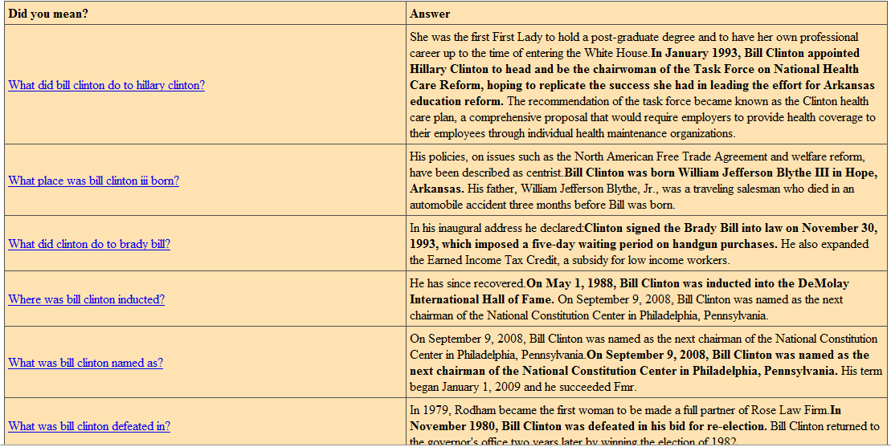
Sample session 1
16

Slide 22
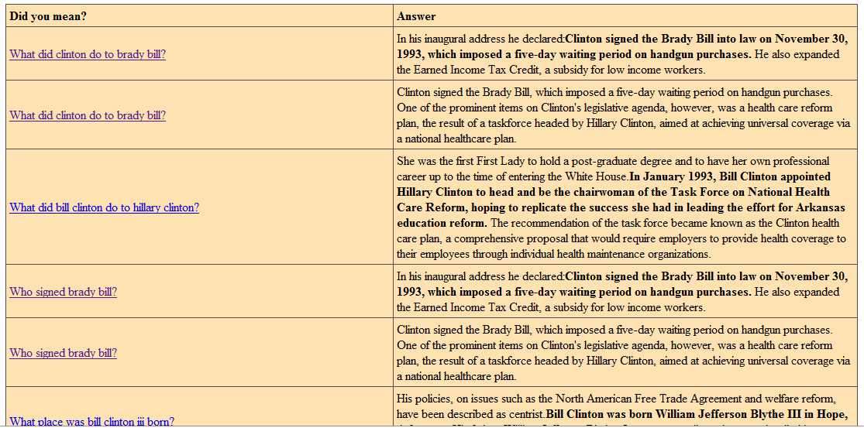
Sample session 1
17

Slide 23
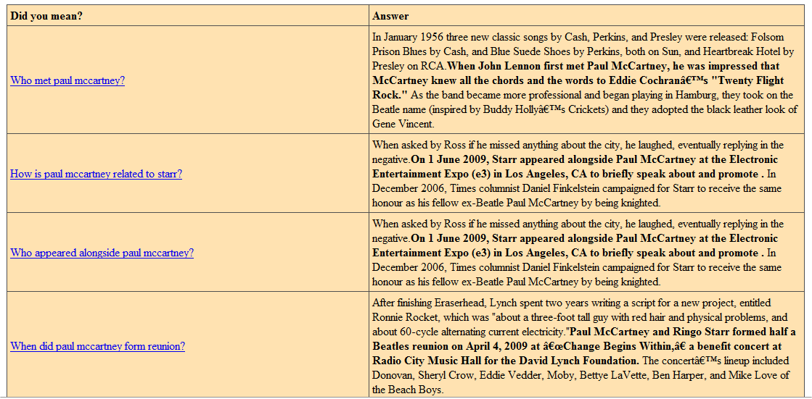
Sample session 2
18

Slide 24
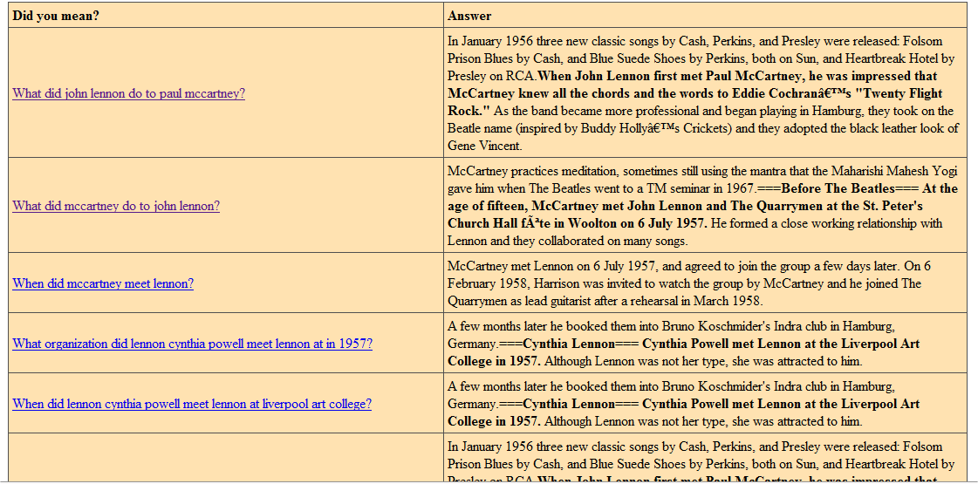
Sample session 2
19

Slide 25
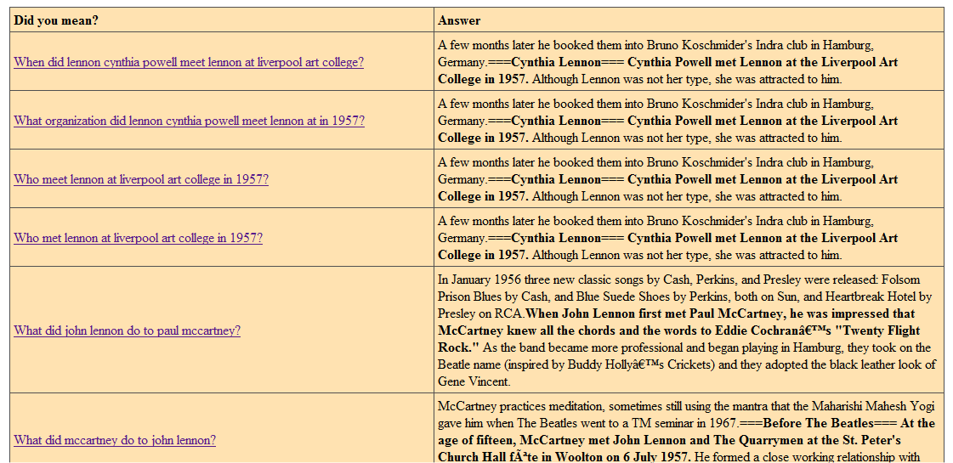
Sample session 2
20

Slide 26
Roadmap
Motivation
Indexing
Question generation
Ranking
Feedback
Evaluation

Slide 27
Evaluation
Dataset: 3000 most viewed articles in 2009 combined with the biographic articles about the famous Americans
Total of 19547 articles ~300 Mb
30 top-ranked questions presented for evaluation for each query
Users could submit their own queries or click on the list of pre-defined ones
Users were asked to judge well-formedness, interestingness and relevance of questions
21

Slide 28
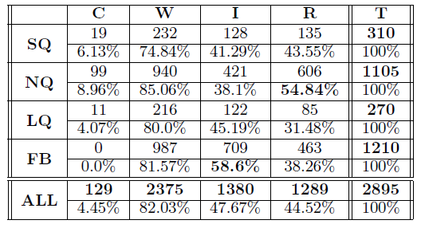
Evaluation
Feedback questions are the most interesting ones;
Overall click-through rate >3% (users clicked on at least one question);
Relevance is the highest for normal queries.
22
Notes:
Abbreviations, more explanations,

Slide 29
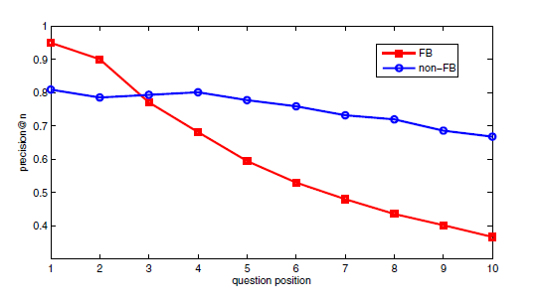
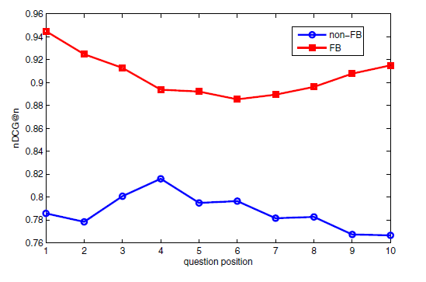
Evaluation
Question based feedback aggressively refines the information need by bringing up a small number of highly relevant questions to the top of the question list;
Question feedback improves the ranking by bringing the highly relevant and interesting questions to the first 3-4 positions in the ranked list.
23
Notes:
Big font for NDCG

Slide 30
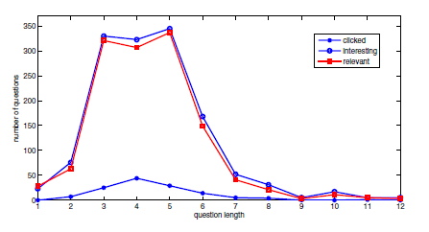
Evaluation
Relevance of questions is strongly correlated with interestingness
Users mostly click on medium length (3,4,5-word) questions and find such medium length questions to be more interesting
24

Slide 31
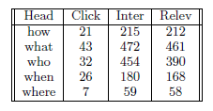
Evaluation
Compared distribution of clicked, interesting and relevant questions across question groups, determined by the head word
Users found factual questions (what, who) to be more interesting than questions about time and location
25

Slide 32
Concluding remarks
New framework for interactive search
Proposed methods for all components of the retrieval process: indexing of syntactic patterns, questions generation based on templates, ranking and feedback
Implemented the idea in a prototype working with a subset of Wikipedia
Experimental results show the promise of the proposed framework
26
Notes:
Future work

Slide 33
Future work
Aggregation of semantically related questions and alternative question presentation interface
Methods for automatic induction of syntactic patterns and interesting question templates from text collections
Alternative question ranking functions (learning-to-rank)
Using external resources (knowledge bases) to generate refinement questions independent of document collections
27

Slide 34

Thank you!
akotov2@illinois.edu
http://timan.cs.uiuc.edu/

