Slide 1
Parametric and Non-parametric User-aware Sentiment Topic Models
Zaihan Yang Alexander Kotov Aravind Mohan Shiyong Lu
Textual Data Analytics (TEANA) Lab
Department of Computer Science, Wayne State University
Presented at ACM SIGIR 2015, Santiago, Chile

Slide 2
Outline
Motivation
USTM framework
Evaluation
Conclusion

Slide 3
Motivation
Popularity of Web 2.0 resulted in large amount of publicly available subjective content created by demographically diverse user base:
social networks and microblogs
forums
consumer review platforms
Such content is an important source of information for:
consumers, who often make their purchasing decisions based on opinions of other people
businesses, who need to understand customer preferences in different market segments

Slide 4
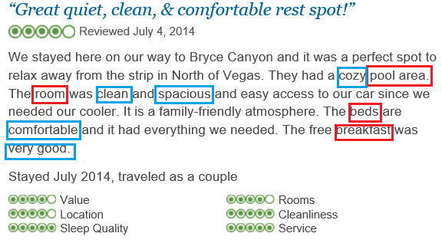
Review structure
Reviews are typically a mixture of:
Aspects (topics): terms corresponding to topical aspects (room, pool, bed, breakfast)
Sentiments about aspects: words reflecting opinions about those aspects
Notes:
Opinion analysis has been a subject of intensive research for a decade. What do we know so far?
We know that reviews such as the one on the slide
Aspects (topics): terms corresponding to the aspects of a product or service that the user is discussing (there are multiple of them)
Sentiments about aspects: opinionated or subjective words about those aspects

Slide 5
Demographics of review authors
Previous research in sentiment analysis and opinion mining has focused on three tasks:
identification and extraction of aspects (topics) in reviews
detection of sentiment polarity of reviews (aspects, sentences)
summarization of aspects (topics) in reviews by sentiment polarity
However, demographic information of review authors has not been factored in those analyses
Notes:
One important piece of information has not been taken into account

Slide 6
Importance of accounting for demographic information
Different consumer demographic groups focus on different aspects of products and services, and have different preferences regarding each aspect:
better understanding of these preferences → better policies for government agencies and higher sales for businesses
Similar people tend to have similar preferences:
providing opinions of similar users to customers → easier decision making and greater customer satisfaction

Slide 7
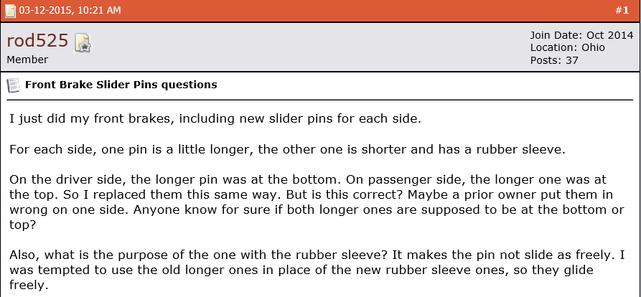
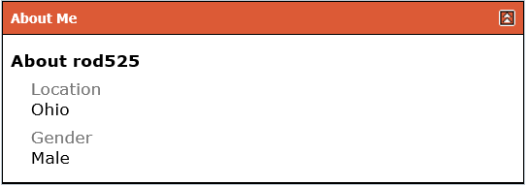
Demographics of review authors
Demographic information about review authors is provided in user profiles
Demographic group (or market segment) is a set of users sharing one or several user meta-data tags (e.g. “26-35 year-old males”, “females living in New York”)
User meta-data can be viewed as a set of textual labels (tags) associated with reviews
Notes:
Demographic information or meta-data about review authors is often provided by on-line consumer review platforms in user profiles
In the simples case, market segments correspond to a set of all distinct user meta-data labels in a given collection of reviews. Arbitrary market segments can be dynamically created by combining two or more tags depending on the required resolution of topic summaries.

Slide 8
Problem and our solution
Novel problem: summarization of contrasting opinions about aspects of products and services by different demographic groups (market segments)
We leverage supervised generative models of text and propose parametric and non-parametric User-Sentiment Topic Models (USTM)
Notes:
This gives rise to a fundamental research problem

Slide 9
Outline
Motivation
USTM framework
Evaluation
Conclusion

Slide 10
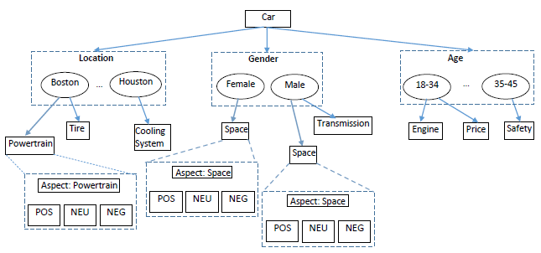
USTM topical structure
Root: user attributes (meta-data tags)
Level 1: aspects
Level 2: sentiment sub-topics
Notes:
In other words, USTM adds additional layer of user meta-data tags to topic-sentiment aspects to produce more fine-grained summaries.

Slide 11
Sentiment summarization using topic models
Mei, Ling et al. Topic Sentiment Mixture: Modeling Facets and Opinions in Weblogs, WWW’07
Lin and He. Joint Sentiment/Topic Model for Sentiment Analysis, CIKM’09 (JST)
Jo and Oh. Aspect Sentiment Unification Model for On-line Review Analysis. WSDM’11 (ASUM)
Kim, Zhang et al. A Hierarchical Aspect-Sentiment Unification Model for Online Reviews, AAAI’13
Supervised topic models
Blei and McAuliffe. Supervised Topic Models, NIPS’07
Ramage, Manning and Dumais. Partially Labeled Topic Models for Interpretable Text Mining, KDD’11
User-Sentiment Topic Models
Notes:
How does our research fit into the big picture of text mining and opinion analysis research?

Slide 12
USTM framework
USTM-FT(W):
fixed number of topics per each user meta-data label
each word is associated with a latent sentiment
USTM-FT(S):
fixed number of topics per each user meta-data label
words in one sentence share the same latent sentiment
USTM-DP(W):
different number of topics per each user meta-data label
USTM-DP(S):
each tag with different number of topics

Slide 13
USTM-FT(W)
β
γ
ξ
s
S
Ndt x K
α
Θ
z
w
Φ
Ndt
T x K x S
η
Λ
ψ
t
Ndw
M

Slide 14
USTM-FT(S)
γ
ξ
s
β
δ
ϑ
p
S
Ndt x K
α
Θ
z
w
φ
Ndt
T x K x S
η
Λ
ψ
t
Ndw
Nds
M

Slide 15
Outline
Motivation
USTM framework
Evaluation
Conclusion

Slide 16
Experimental setup
Datasets:
Auto: crawl of automotive reviews from FordForum.com
Hotel: crawl of hotel reviews from TripAdvisor.com
Sentiment lexicons:
PARADIGMhasm: Kim, Zhang et al. A Hierarchical Aspect-Sentiment Model for Online Reviews, AAAI’13
MPQA: Turney and Litman. Measuring Praise and Criticism: Inference of Semantic Orientation from Association, TOIS’03
Dataset | #reviews | #tags | voc. size | # tokens | avg. len
Auto | 11,254 | 401 | 4,952 | 326,225 | 32.19
Hotel | 7,266 | 324 | 6,430 | 441,489 | 60.75

Slide 17
Examples of topics
65
NEU POS NEG | breakfast times subway square place street tip close tips quiet new tips comfortable york floor desk excellent amazing square suite service hotels lobby walk time little terrible bathroom breakfast place
18-24
NEU POS NEG | new night nice lobby central city floor free price time york times square check night time friendly lovely fantastic minutes bed floor service bathroom breakfast trip disappointing problem night
tip
quiet
nightlife
location
Dover, Ohio
female
NEU POS NEG | ford bronco, make sure, lincoln ls, back seat, air control, fuse box, power loss car club, seat belt, heard good, good deal, wheel base, local ford, heard good Isn’t bad, bad wire, bad wheel, gone bad, go wrong, find bad, negative battery
male
NEU POS NEG | throttle body, position sensor, ignition parts, power steering, fuel system dash light, nice car, back seat, right side, high end, drive truck, engine lights bad wheel, ford thunderbird, started acting, bad wheel, bad wire, engine runs
interior design
Dover, Ohio
functional components

Slide 18
Examples of topics
Fort worth, Texas
female
NEU POS NEG | conditioner heat heater explorer turn car truck air help engine amp hot good conditioner vents heater dash air correct small blow amp left turn signal bed explorer suggestion bulbs negative
male
NEU POS NEG | defrost heater hot vents time trying works fix fine waste battery water engine flow check truck mods thermostat deg correct original heated happening part food bad truck works circuit care
Climate
control
female
NEU POS NEG | cold new know looking work fine headers control start thanks starter remote cold lights computer battery positive snow good focus problem engages battery truck gear half hour negative bad
male
NEU POS NEG | fuel thanks caliper gas valve drier tank start gt wiring battery wires freeze positive power engine relay large tank fuel bad car check mustang air cowl valve defrost
Minnesota
Battery, starter

Slide 19
Perplexity
Model | Auto | Hotel
Parametric models
USTM-FT(W)+Uni+P | 849.37 | 2146.48
USTM-FT(W)+Uni+M | 959.80 | 2512.26
USTM-FT(S)+Uni+P | 744.10 | 2099.34
USTM-FT(S)+Uni+M | 782.93 | 2257.53
USTM-FT(W)+Bi+P | 1324.27 | 3188.09
USTM-FT(W)+Bi+M | 1435.38 | 3221.79
USTM-FT(S)+Bi+P | 1236.58 | 2749.09
USTM-FT(S)+Bi+M | 1314.75 | 3066.19
Non-parametric models
USTM-DP(S)+Uni+P | 704.85 | 1792.55
USTM-DP(W)+Uni+P | 835.45 | 2007.32
Model | Auto | Hotel
Baselines
ASUM+Uni+P | 1190.92 | 2317.13
ASUM+Uni+M | 1247.09 | 2563.96
ASUM+Bi+P | 1358.87 | 2883.01
ASUM+Bi+M | 1581.50 | 3160.39
JST+Uni+P | 1091.01 | 2093.46
JST+Uni+M | 1127.07 | 2563.96
JST+Bi+P | 1236.58 | 2749.09
JST+Bi+M | 1314.75 | 3066.19
USTM models outperform JST and ASUM
Sentence-based models perform better than word-based
Unigram-based models are more accurate than bigram-based
DP-based models are better than FT
Smaller lexicon works better

Slide 20
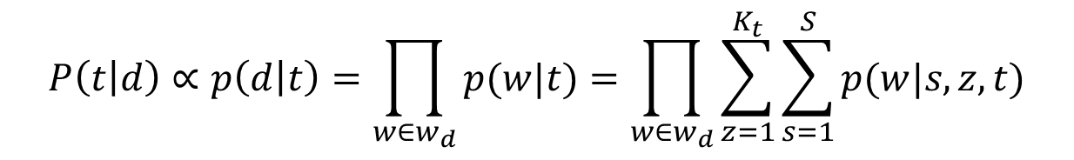
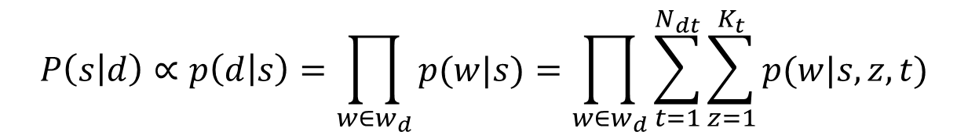
Evaluation tasks
Review sentiment classification:
User attribute prediction:
$$P\left(s | d\right)∝p\left(d | s\right)=\prod_{w∈w_{d}}{p(w|s)}=\prod_{w∈w_{d}}{\sum_{t=1}^{N_{dt}}{\sum_{z=1}^{K_{t}}{p(w|s,z,t)}}}$$
$$P\left(t | d\right)∝p\left(d | t\right)=\prod_{w∈w_{d}}{p(w|t)}=\prod_{w∈w_{d}}{\sum_{z=1}^{K_{t}}{\sum_{s=1}^{S}{p(w|s,z,t)}}}$$

Slide 21
Sentiment classification
Model | Recall | F1 | Accuracy
USTM-FT(W)+P USTM-DP(W)+P USTM-FT(S)+P USTM-DP(S)+P ASUM+P JST+P | 0.8282 0.7789 0.8279 0.8193 0.5725 0.4812 | 0.8914 0.8605 0.8871 0.8854 0.7180 0.6402 | 0.8194 0.7878 0.8396 0.8264 0.5668 0.4778
USTM-FT(W)+M USTM-DP(W)+M USTM-FT(S)+M USTM-DP(S)+M ASUM + M JST + M | 0.8915 0.8294 0.7658 0.7217 0.5579 0.4588 | 0.9284 0.8918 0.8494 0.8257 0.7071 0.6189 | 0.8836 0.8447 0.7880 0.7190 0.5421 0.4643
USTM models outperform both ASUM and JST in terms of all metrics

Slide 22
Attribute prediction
Datatset | Model | MAP
Auto Auto Auto Auto | USTM-FT(W)+P USTM-DP(W)+P USTM-FT(S)+P USTM-DP(S)+P | 0.7678 0.6563 0.7630 0.6226
Hotel Hotel Hotel Hotel | USTM-FT(W)+P USTM-DP(W)+P USTM-FT(S)+P USTM-DP(S)+P | 0.4516 0.4278 0.4466 0.4052
USTM models perform better on the Auto dataset than on the Hotel dataset
Word-based topic model perform better than sentence-based
Topic models with fixed number of topics outperform DP

Slide 23
Conclusion
We proposed parametric and non-parametric topic models the incorporate demographic information about review authors for market segment-based opinion summarization
We experimentally demonstrated the effectiveness of the proposed models for market segment-based opinion summarization, sentiment classification and user attribute prediction
Our method is not limited to consumer reviews and can be applied to demographic group-based summarization of subjective content of any type (e.g. discussion of events, societal and political issues in blogs)

Slide 24
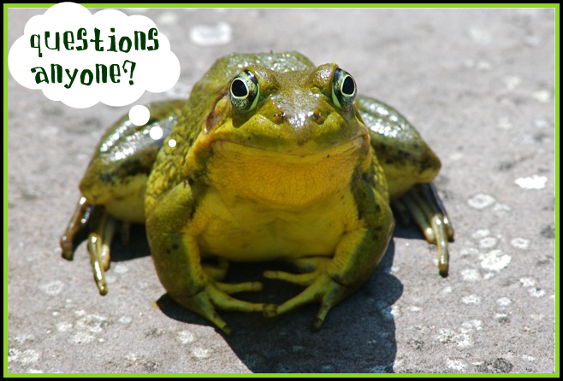
Thank you!
Datasets are available at github.com/teanalab/USTM
Questions?

