Slide 1
Applications of Support Vector Machines in Chemo and Bioinformatics
V.K. Jayaraman
Savitribai Phule Pune University
Pune 411 007

Slide 2


Supervised or Unsupervised
Unsupervised
Supervised

Slide 3
Supervised or Unsupervised
Unsupervised : Provided a set of features algorithm groups data into clusters ( does not require class information)
Supervised : Employs class label information of some instances to build a model. Model is validated employing unseen data

Slide 4
Unsupervised Classification
Algorithm will cluster the data points into groups
Input
Salary Experience
5000 0.5
6000 0.75
7500 0. 8
8000 1.5
10000 1
20000 2
…….. So on
Credit Worthy
Not Credit Worthy
Class information need not be provided

Slide 5
Supervised Classification
Input
Salary Experience Class Label
5000 0.5 0
6000 0.75 0
7500 0. 8 0
8000 1.5 0
10000 1 1
20000 2 1
…….. So on
Credit Worthy
Not Credit Worthy
Algorithm will be trained on a set of given data points.
This algorithm will classify unseen data points into classes
Class information is need for training

Slide 6
SUPPORT VECTOR
CLASSIFICATION

Slide 7
Support Vector Classification
Introduced by Vapnik and co-workers in 1992
Rigorously based on statistical learning theory
SVM Classifier can Recognize Patterns efficiently
Solve Real Life Problems in :
  Chemo/Bio Informatics
  Many many other fields

Slide 8
Training / Testing Classifiers
Training
Set
Total
Data
Test
Set

Slide 9
General Approach
Train classifier to give minimum error
Test on the unknown data
Training Set
Classifier
Test Set
Classifier

Slide 10
Selecting Hyperplane
Salary Experience Class Label
5000 0.5 0
6000 0.75 0
7500 0. 8 0
8000 1.5 0
10000 1 1
20000 2 1
…….. So on
Not Credit Worthy
Credit Worthy
y = mx + c → [ w^{T} x ] + b
W - weight vector
b - bias
W - vector : having dimensions equivalent to number of features
X : x1, x2, x3, ……. Input Vector
y : +1 class 1
y : -1 class 2

Slide 11
Selecting Hyperplane
The job is to find a hyperplane (w₁ x₁ + w₂ x₂ )+b=0 .
Different combinations of values of w₁ and w₂ are possible:
Say, for w₁ = 1.261 and w₂ = 1.34 , we might
get a hyperplane as shown in the figure.
Not Credit Worthy
Credit Worthy
for w₁ = 0.567 and w₂ = 3.165 , the hyperplane changes.

Slide 12
Selecting Hyperplane
In the same way, if we had 3 features x₁ , x₂ and x_{3,}
Solving (w₁ x₁ + w₂ x₂ + w₃ x₃)+b=0 would give us a 3D-hyperplane
Generalizing for n features, x₁ , x₂ , x₃ … x_{n}
Solving (w₁ x₁ + w₂ x₂ + w₃ x₃ + …+ w_{n} x_{n} )+b=0 would give us a n-dimensional hyperplane.

Slide 13
Which Hyperplane is Better ?
(a)
(b)
(c)
(d)

Slide 14
Concept of Margin: Auxiliary Hyperplane
[w^{T}x] + b = 0
Hyperplane
[w^{T}x] + b = + 1
[w^{T}x] + b = - 1
Support Vectors
Auxiliary Hyperplane
Margin
Notes:
Why margin given? Properties of margin.
Removing redundancy by maximizing margin

Slide 15
Concept of Margin
The best separating hyperplane (the one with maximal margin) is obtained only for an optimal set of w_{i} values and b.
This can be posed as a QP optimization problem expressed in terms of a lagrangian equation.
Training
Sequences
Features
SVM
(w₁ x₁ + w₂ x₂ )+b=0
W and b values from α
Hyperplane Equation
Lagrangian
QP solver

Slide 16
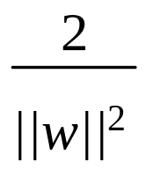
Maximum Margin Classifier
Constrain the data belonging to two different classes to be at least distance ‘1’ from the separating hyperplane
Minimize the risk of overfitting by choosing the maximal margin hyperplane in feature space
[w^{T}x] + b = 0
[w^{T}x] + b = + 1
[w^{T}x] + b = - 1
margin =
margin

Slide 17
Computing the margin(1)
We know,
wx⁺ + b = +1 …(1)
wx⁻ + b = -1 …(2)
Also, x⁺ = x⁻ + λw …(3)
for some value of λ.
Substituting x⁺ from eq. 3 in eq. 1,
w(x⁻ + λw) + b = 1
w.x⁻ + λ.(w.w) + b =1
(w.x⁻ + b) + λ.(w.w) =1
Substituting (w.x⁻ + b) from eq. 2;
[wx] + b = 0
[wx⁺] + b = + 1
[wx⁻] + b = - 1
x⁺
-1 + λ.(w.w) =1
λ=2/(w.w)
x⁻
M=margin width

Slide 18
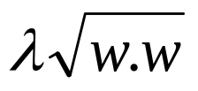
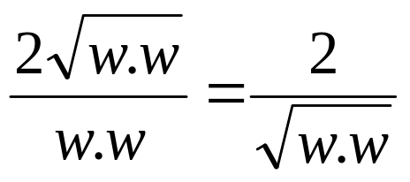
Computing the margin(1)
We know,
wx⁺ + b = +1 …(1)
wx⁻ + b = -1 …(2)
Also, x⁺ = x⁻ + λw …(3)
for some value of λ.
And λ=2/(w.w) …(4)
| x⁺ - x⁻ |=M …(5)
M = | x⁺ - x⁻ | = |λw|
Substituting λ from eq. 4;
M= λ | w|=
[wx] + b = 0
[wx⁺] + b = + 1
[wx⁻] + b = - 1
x⁺
x⁻
M=margin width
=>M=

Slide 19
SVM Linear Classifier
( Constrained Optimization)
W = (1,3)
W = (1,4)
b = 0.5
b = 0.2
Hyperplane equation : [w^{T}x] + b = 0
have weight vector (w) and bias (b)
Only a particular combination of w and b will give the best
Separation so, SVM Classification is an optimization problem

Slide 20
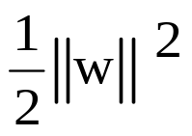
SVM Linear Classifier
( Constrained Optimization)
Constrain the data belonging to two different classes to be at least distance ‘1’ from the separating hyperplane
[w^{T}x] + b = 0
Minimize
[w^{T}x] + b = 1
[w^{T}x] + b = -1
For negative class
y_{i} = -1 and ([w^{T}x] + b)≤ -1
y_{i}([w^{T}x] + b ) ≥ 1
For positive class
y_{i} = 1 and ([w^{T}x] + b) ≥ 1
y_{i}([w^{T}x] + b ) ≥ 1
1
1

Slide 21
Primal Problem
Minimize
Subject to :
y_{i} ( [ w^{T} x_{i} ] + b ) ≥ 1 , i = 1, 2, …. N
Can be further solved
  Using Lagrange multipliers
  Primal-Dual theory of optimization.
Ultimately leads to a convex Quadratic Optimization problem containing unique solution.
  Contrast to: Neural Net Several Local Minima

Slide 22
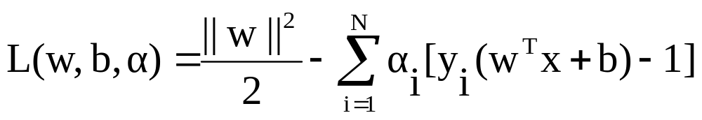
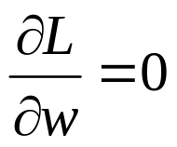
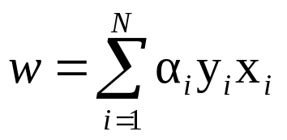
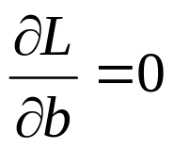
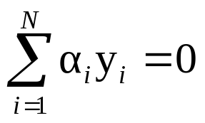
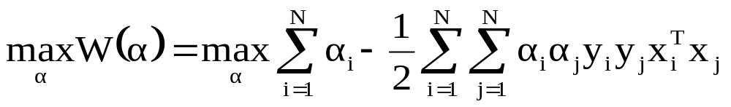

Using Lagrange multipliers
Differentiating w.r.t. w and b
→
→
We get the dual problem as
Notes:
CHANGE

Slide 23

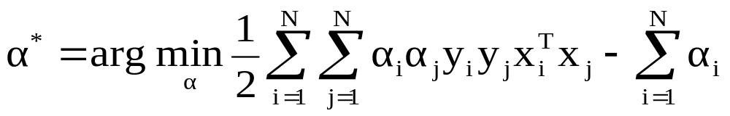
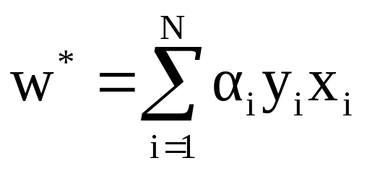
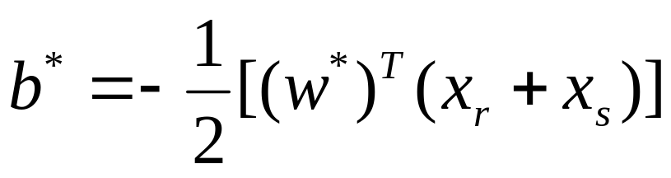
Algorithmic steps (so far):
We have a Convex QP problem, which has a unique solution
Firstly, we solve for
Then, we obtain the hyperplane, ie. values of w and b

Slide 24
Calculating the value of α
Programming libraries available for solving Quadratic Optimization problems (QP solvers) are used to compute the values of α from the lagrangian form.
Lagrangian
Equations
QP Solver
Values of
α

Slide 25
Calculating value of b - bias
Mean Hydrophobicity Net Charge … Class
-1.68 -7 1
-2.003 3 -1
w
[ w^{T} x ] + b = + 1
[ w^{T} x ] + b = - 1
[ w^{T} xr ] + b = +1
[ w^{T} xs ] + b = -1
[ w^{T} (xr + xs ) ] + 2b = 0
[ w^{T} (xr + xs ) ] = - 2b
➔ b* = - ½ [ (w*)^{T} (xr + xs ) ]
+
Xs
Xr
b

Slide 26
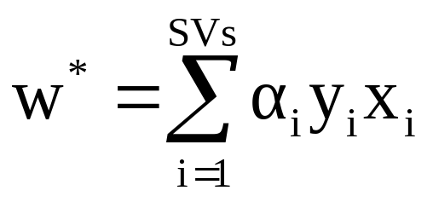
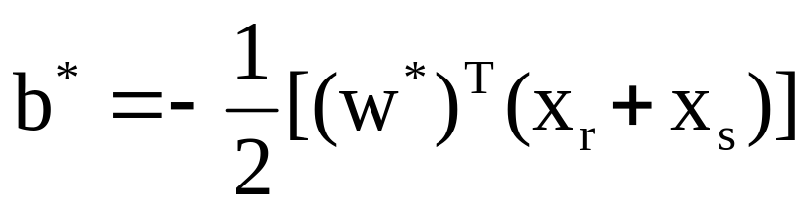
Idea of Support Vectors
From optimization, we can prove that only the points on margin
have non- zero values
These points are called as Support Vectors.
Only support vector information is sufficient to classify new
unseen data
Optimal Hyperplane
Support Vectors
Margin

Slide 27
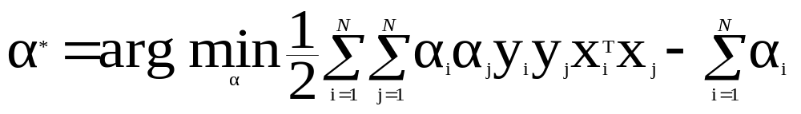
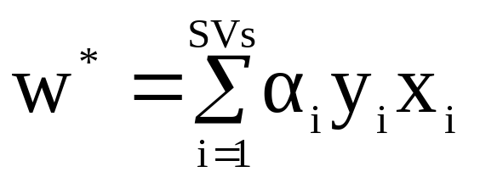
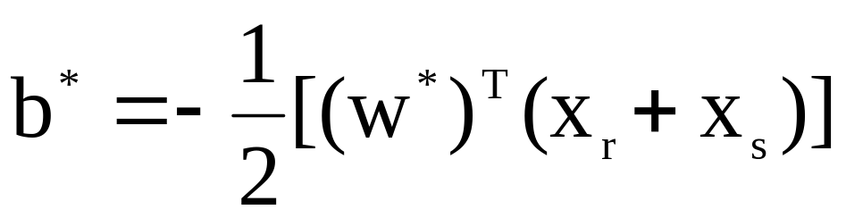
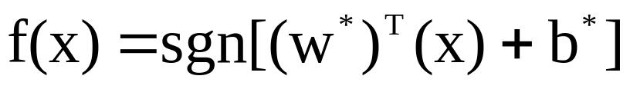
Training Algorithm (so far)
Employ the trained classifier for the unseen testing data

Slide 28
Over Fitting
Over fitting : Perfect training accuracy but poor performance on unseen data.
Employ Functions with Optimal Complexity for Good Generalization

Slide 29
Structural Risk Minimization
under fitting
over fitting
Complexity
+
Training Error
Training
Errors
complexity
Best Trade-off
Functions in increasing complexity

Slide 30
Structural Risk Minimization (SRM) Principle
Empirical Risk Minimization Minimizes average error : Overfits training error, remains functionally complex
Structural Risk : Provides a specific way to incorporate complexity measure along with empirical risk
SVM is based on SRM
Vapnik-Chervonenkis (VC) dimension controls complexity of algorithm
VC Dimension : Measures how many training points can be shattered for all possible labeling using functions of the class
Maximization of margin leads to minimization of VC dimension

Slide 31

Limitations of Linear Classifier
Linear classifier is not always the winner.

Slide 32
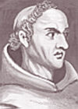
Ockham’s Razor
William of Ockham, 14th-century English logician.
As per him,
  "All things being equal, the simplest solution tends to be the best one."

Slide 33
Example: Learning in the Feature Space
Not linearly separable One-Dimensional dataset
(x , x/2) → (x , x⁴)
y
y
x
Hyperplane
x
X : -5 –4 –3 –2 –1 0 1 2 3 4 5 6
X/2 : -2.5 -2 -1.5 -1 -0.5 0 0.5 1 1.5 2 2.5 3
X^4 : 625 256 81 16 1 0 1 16 81 256 625 1296
Notes:
X : -5 –4 –3 –2 –1 0 1 2 3 4 5 6
X/2: -2.5 -2 -1.5 -1 -.5 0 .5 1 1.5 2 2.5 3
X^4 : 625 256 81 16 1 0 1 16 81 256 625 1296

Slide 34
Learning in the Feature Space
Mean Hydrophobicity Net Charge Class
-1.68 -7 1
-1.464 0 1
-1.961 2 -1
-2.003 3 -1
Can we have a function that transforms lower dimensional
non-Separable data into higher dimensional separable data
φ
x
φ (x)
-1.68 -7 1
-1.464 0 1
-1.961 2 -1
-2.003 3 -1
6.01 3.9 2.5 1
0.17 2.0 8.0 1
3.10 5.6 3.6 -1
5.0 4.3 4.7 -1

Slide 35
Learning in the Feature Space
Map the data into a feature space where they are linearly separable
φ
Input Space
x
φ (x)
Feature Space

Slide 36
Learning in the Feature Space
φ
x
φ (x)

Slide 37
SVM Linear Classifier in High Dimensional Space
[ w^{T} φ(x) ] + b = -1
[w^{T} φ(x)] + b = 0
[w^{T}φ(x)] + b = 1
Support Vectors
1
1

Slide 38
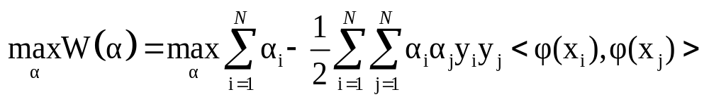

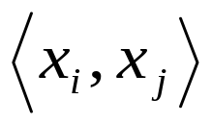
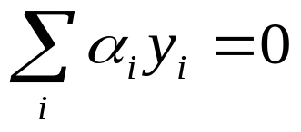
Higher Dimensional Feature Space
The Dual problem now becomes:
Real life problems have several input features
  Gene Expression Profiles → Thousands of Genes
  Drug Discovery → More than 100 thousand Descriptors
Eg. 256 dimensional data, polynomial of degree 5 gives the feature space dimension ≈ 10¹⁰
Notes:
CHANGE

Slide 39
INTRODUCTION TO KERNELS

Slide 40
EXAMPLE
Input Vector, X |  | Desired Response, Y
x₁ | x₂
-1 | -1 | -1
-1 | +1 | +1
+1 | -1 | +1
+1 | +1 | -1
Thus we have the matrix
0 0 -2
0 2 -2 0 Not classified by
0 -2 2 0 SVM
-2 0 0 2

Slide 41


EXAMPLE CONTD…
Modifying the operation to solve the problem using SVM
Now the input features are as follows:
1 1 - -1
1 -1 - 1
1 -1 -1
1 1 1
φ(x_{i}) = [ 1 x_{i1}² x_{i1} x_{i2} x_{i2}² x_{i1} x_{i2} ]

Slide 42
Thus in the same way all the input features can be obtained by using the following matrix.
Where Thus the
matrix
now is
K₁₁ = φ(x₁₁) φ(x₁₁) ^{T} K₁₂= φ(x₁₁) φ(x₁₂) ^{T} K₁₃= φ(x₁₁) φ(x₁₁) ^{T} K₁₄= φ(x₁₁) φ(x₁₂) ^{T i=1, j=1}
K₂₁ = φ(x₂₁) φ(x₂₁) ^{T} K₂₂= φ(x₂₁) φ(x₂₂) ^{T} K₂₃= φ(x₂₁) φ(x₂₁) ^{T} K₂₄= φ(x₂₁) φ(x₂₂) ^{T i=2, j=2}
K₃₁ = φ(x₃₁) φ(x₃₁) ^{T} K₃₂= φ(x₃₁) φ(x₃₂) ^{T} K₃₃= φ(x₃₁) φ(x₃₁) ^{T} K₃₄= φ(x₃₁) φ(x₃₂) ^{T i=3, j=3}
K₄₁ = φ(x₄₁) φ(x₄₁) ^{T} K₄₂= φ(x₄₁) φ(x₄₂) ^{T} K₄₃= φ(x₄₁) φ(x₄₁) ^{T} K₄₄= φ(x₄₁) φ(x₄₂) ^{T i=4, j=4}
K =
K₁₁ = φ(x_{i}) * φ(x_{j}) ^{T}
= 1 + 1 + 1 + 2 + 2 + 2
= 9
1 1 1
9 1 1
1 1 9 1
1 1 1 9
K =

Slide 43
Input Vector, XI |  | Desired Response, Y
x₁ | x₂
-1 | -1 | -1
-1 | +1 | +1
+1 | -1 | +1
+1 | +1 | -1

Slide 44



Thus by converting the feature space from 2 to 6 we can solve the given problem.
= ²
Thus by using the kernel where p = 2, we can solve the problem in the input space only.
As = 2 where i=j
Thus when we substitute it in the formula we get (2+1)² = 9

Slide 45
Thus as can be seen, now the example can be solved.
However as can be seen,
For 2 features 6 features were needed to classify
For 100 features, 1000,000 may not be simple for the SVM to classify. Hence we use kernel functions.

Slide 46
Introduction of Kernel Function
Working in high dimensional feature spaces solves the problem of expressing complex functions
BUT….
  Computationally intractable
  Data Dimensionality increases exponentially in the feature space
SOLUTION….
Introduce kernel functions for simplification

Slide 47

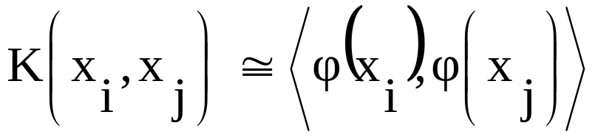
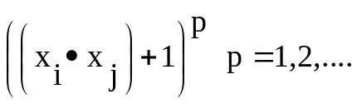
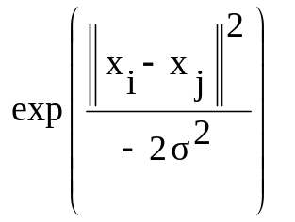
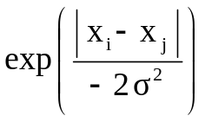
Kernel Functions
Kernel function in
input space
Dot product in the higher dimensional feature space
Polynomial
Gaussian Radial Basis Function
Exponential Radial Basis Function

Slide 48

Polynomial Kernel
For polynomial kernel of degree 2
In terms of monomials
In feature space
Similarly,

Slide 49
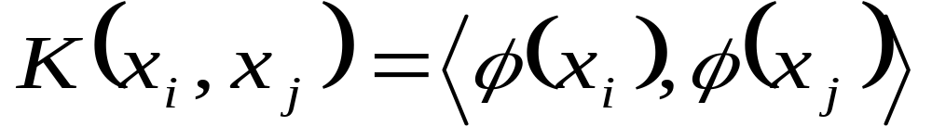
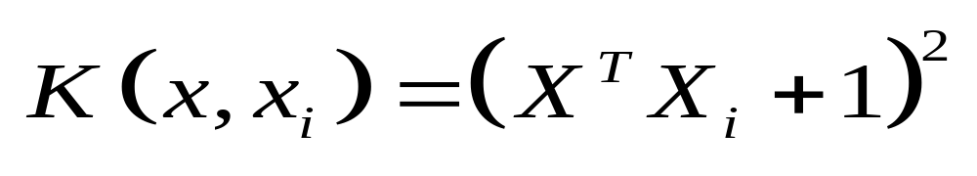
So, SVM = Linear Classifier in high dimensional space with computation in the input space itself

Slide 50
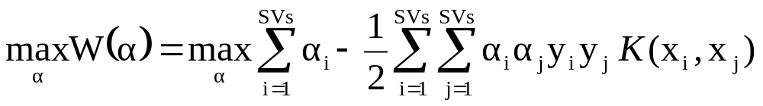
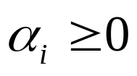
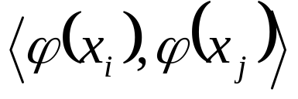
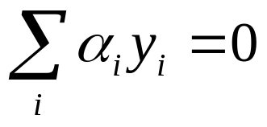
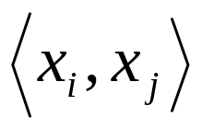
Kernel Functions
The QP problem with introduction of Kernel functions:
SVM = Linear Classifier in the High Dimensional Feature space
Introduction of Kernel Function enables computations in Input
space itself
Notes:
CHANGE

Slide 51
Synopsis-SVM Classifier
GOAL: To find the hyperplane equation from the training examples.
Input features(eg. Mean hydrophobicity, net charge)
A. Linearly non-separable input space (few features).
B. Linearly separable input space (huge number of features)
Application of some function (kernel function) transforms the input space from non-separable (A) to a linearly separable one (B).

Slide 52
Allowance for misclassifications
w^{T}x + b = 0
w^{T}x + b = 0
ξ_{i}
Perfect Classification leads in Reduction In Margin and Over fitting
Slack variable ξ_{i} reflects the extent to which the point fails to satisfy the margin

Slide 53



Soft Margin Formulation
The QP problem with soft margin:
ξ_{i}
C: Regularization parameter (user-defined)
Trade off Between Margin Maximization and Misclassification
Notes:
CHANGE

Slide 54
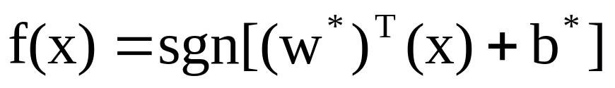
SVM Algorithm
Training a model
  Select a kernel function
  Tune the other kernel parameters (how part yet to come !!)
  Decide the best hyperplane using the previously mentioned equations
Testing the data
  For each new unseen data, decide the class as

Slide 55
MODEL SELECTION IN SVM

Slide 56
Selecting Kernel Function
Choose best possible Kernel Function and its parameters.
Domain knowledge is useful for selecting kernel, some domain specific kernels are :
  String kernel
  Fisher kernel
  Mismatch kernel
  Graph kernel
  Wavelet kernel
One of these three kernels : Polynomial, RBF, Exponential will work in majority of domains.
SVM in combination of Genetic Algorithm can be employed for automatic selection of Kernel Function and its Parameters

Slide 57
Choosing Multiple Parameters for SVM
Choosing multiple optimal hyper parameters : An important step in SVM design
Usually done by,
  Minimizing an estimate of generalization error
  Some other related performance measure

Slide 58
Parameters that Need to be Tuned
Regularization parameter, C: determines the trade off between margin maximization and error minimization
Kernel parameter, (σ or d ): implicitly defines the nonlinear mapping from input space to some high-dimensional feature space

Slide 59
Commonly used Methods for
Parameter Tuning
k-fold cross validation
Leave-one-out error estimation

Slide 60
k-fold Cross Validation
The training data is randomly split into k mutually exclusive subsets (or the folds) of approximately equal size
For k times
  SVM decision rule is obtained using k -1 of the subsets
  Then tested on the subset left out

Slide 61
3-fold Cross Validation
Fold 1
E
r
r
o
r
Total
Data
Fold 2
Fold 2
SVM
Fold 3
Testing Data
Training Data

Slide 62
3-fold Cross Validation
Fold 1
E
r
r
o
r
Total
Data
Fold 2
Fold 2
SVM
Fold 3
Testing Data
Training Data

Slide 63
3-fold Cross Validation
Testing Data
Fold 1
Training Data
E
r
r
o
r
Total
Data
Fold 2
Fold 2
SVM
Fold 3

Slide 64
3-fold Cross Validation
Fold 1
E
r
r
o
r
s
Total
Data
Fold 2
Fold 2
SVM
Fold 3
Validation error = Average of three errors

Slide 65
Leave-one-out error (LOO) estimate
Extreme form of k -fold cross-validation
  k is equal to the number of examples, l
For l times
  SVM decision rule is obtained using l -1 of the examples
  Then tested on the subset left out example
Good thing about LOO
  Almost unbiased estimate of the expected generalization
  error
Limitation
  Computationally expensive since computations require
  running the training algorithm l times.

Slide 66


SVM with RBF Kernel
SVM with RBF kernel function has two parameters
  c → Regularization
  → Width of RBI Kernel function
Sparse grid with this parameters is :
1
10
100
1000
10000
Run SVM with grid values of parameters
Find cross validation error
Choose kernel with least cross validation error
Repeat with other kernels
1
c
10
100
1000
10000
Notes:
ALPHA

Slide 67
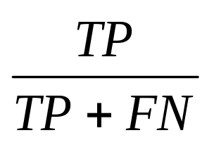
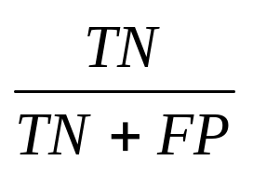
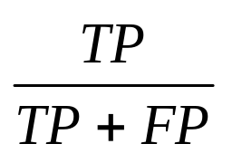
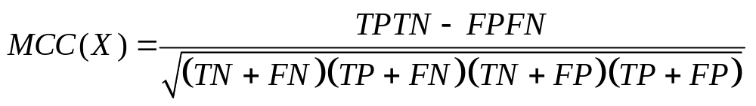
Model Evaluation Measures
Sensitivity =
TP = True Positive
TN = True Negative
FP = False Positive
FN = False Negative
Specificity =
Precision =
Matthew’s Correlation Coefficient

Slide 68
Multi-Class SVM
The multi-class classification problem
  Decomposition to several binary problems
  For which the standard (binary) SVM can be used.
Three most commonly used approaches:
  One-against-all
  One-against-one
  Directed Acyclic Graph (DAG)

Slide 69
One-Against-All
i^{th} model separates i^{th} class from the rest ‘k-1’ classes.
  ‘k’ binary SVM models
For a test case
  The class with the highest vote is the winning class
*
*
*
*
*
*
*
*
*
*
*

Slide 70
One-Against-One
Each class is trained with all the other classes
  ‘k(k-1)/2’ binary SVM models
For a test case
  The class with the maximum votes is the winning class
*
*
*
*
*
*
*
*
*
*
*

