Slide 1
K Nearest Neighbors
www.ismartsoft.com

Slide 2
The k-Nearest Neighbor Classifier
One of the simplest machine learning algorithms for classification.
Based on the idea that training examples belonging to the same class if they are similar; say for eg. lie close together in the euclidean space.
New examples are classified according to closest training examples in the feature space.

Slide 3
The k-Nearest Neighbor Classifier
New examples are classified based on their proximity to the k-nearest training examples. The class labels are assigned by counting votes from the labels of the k nearest neighbors. This is done as follows (say k=3):
  Compute euclidean distance from the new example to each of the examples in the train set.
  Identify the 3 (for k=3) nearest points in the train set from this point.
  Count the class labels from each class which these nearest neighbors belong to.
  Assign the class that labels 2 or more of these nearest examples to the new point.

Slide 4
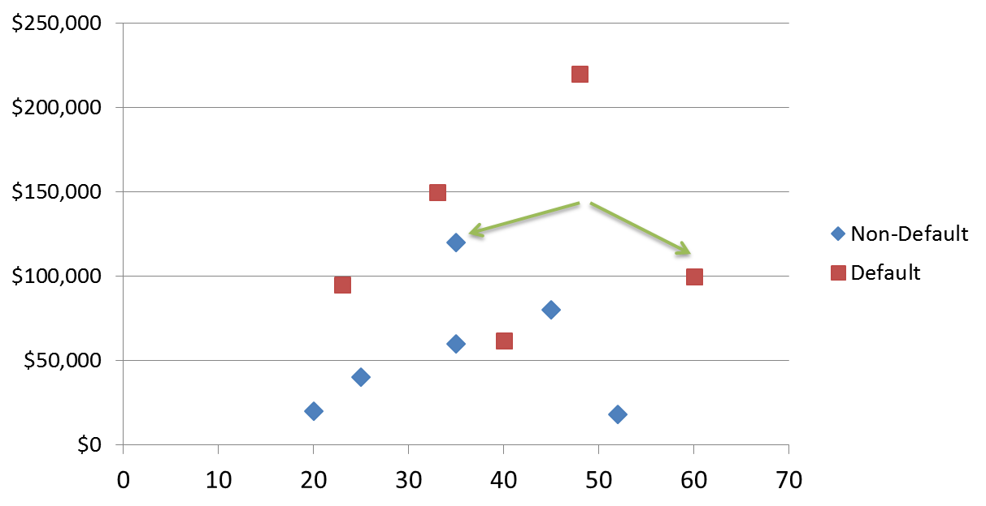

KNN Classification
Loan$
Age
www.ismartsoft.com

Slide 5

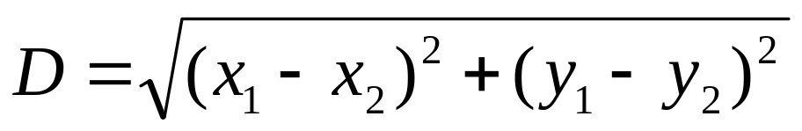
KNN Classification – Distance
Age | Loan | Default | Distance
25 | $40,000 | N | 102000
35 | $60,000 | N | 82000
45 | $80,000 | N | 62000
20 | $20,000 | N | 122000
35 | $120,000 | N | 22000
52 | $18,000 | N | 124000
23 | $95,000 | Y | 47000
40 | $62,000 | Y | 80000
60 | $100,000 | Y | 42000
48 | $220,000 | Y | 78000
33 | $150,000 | Y | 8000
48 | $142,000 | ?
Euclidean Distance
www.ismartsoft.com

Slide 6
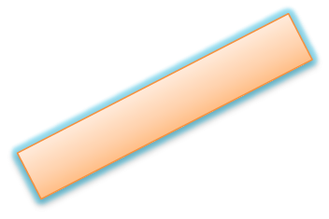
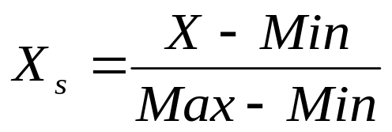
KNN Classification – Standardized Distance
Age | Loan | Default | Distance
0.125 | 0.11 | N | 0.7652
0.375 | 0.21 | N | 0.5200
0.625 | 0.31 | N | 0.3160
0 | 0.01 | N | 0.9245
0.375 | 0.50 | N | 0.3428
0.8 | 0.00 | N | 0.6220
0.075 | 0.38 | Y | 0.6669
0.5 | 0.22 | Y | 0.4437
1 | 0.41 | Y | 0.3650
0.7 | 1.00 | Y | 0.3861
0.325 | 0.65 | Y | 0.3771
0.7 | 0.61 | ?
Standardized Variable
www.ismartsoft.com

Slide 7
KNN – Number of Neighbors
If K=1, select the nearest neighbor
If K>1,
  For classification select the most frequent neighbor.
  For regression calculate the average of K neighbors.
www.ismartsoft.com

Slide 8
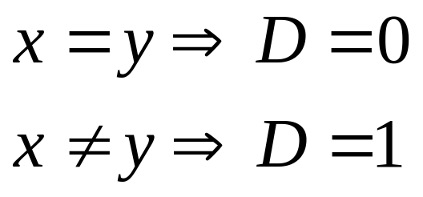
Distance – Categorical Variables
X | Y | Distance
Male | Male | 0
Male | Female | 1
www.ismartsoft.com

Slide 9
Curse of Dimensionality
Distance usually relates to all the attributes and assumes all of them have the same effects on distance
The similarity metrics do not consider the relation of attributes which result in inaccurate distance and then impact on classification precision. Wrong classification due to presence of many irrelevant attributes is often termed as the curse of dimensionality
For example: Each instance is described by 20 attributes out of which only 2 are relevant in determining the classification of the target function. In this case, instances that have identical values for the 2 relevant attributes may nevertheless be distant from one another in the 20 dimensional instance space.

Slide 10
Weighted K Nearest Neighbor
Approach 1
  Associate weights with the attributes
  Assign weights according to the relevance of attributes
    Assign random weights
    Calculate the classification error
    Adjust the weights according to the error
    Repeat till acceptable level of accuracy is reached
Approach 2
  Backward Elimination
  Starts with the full set of features and greedily removes the one that most improves performance, or degrades performance slightly

Slide 11
Weighted K Nearest Neighbor
Approach 3 (Instance Weighted)
  Gradient Descent
  Assign random weights to all the training instances
  Train the weights using Cross Validation
Approach 4 (Attribute Weighted)
  Gradient Descent
  Assign random weights to all the attributes
  Train the weights using Cross Validation

Slide 12
Definitions
Accuracy
  Accuracy = (# of correctly classified examples / # of examples) X 100
Standard Euclidean Distance
  d(x_{i} ,x_{J} ) = √(For all attributes a ∑ (x_{i,a} – x_{J,a})² )

Slide 13
Backward Elimination
For all attributes do
  Delete the attribute
  For each training example x_{i} in the training data set
    Find the K nearest neighbors in the training data set based on the Euclidean distance
    Predict the class value by finding the maximum class represented in the K nearest neighbors
    Calculate the accuracy as
Accuracy = (# of correctly classified examples / # of training examples) X 100
  If the accuracy has decreased, restore the deleted attribute

Slide 14
Weighted K-NN using Backward Elimination
Read the training data from a file <x, f(x)>
Read the testing data from a file <x, f(x)>
Set K to some value
Normalize the attribute values in the range 0 to 1.
  Value = Value / (1+Value);
Apply Backward Elimination
For each testing example in the testing data set
  Find the K nearest neighbors in the training data set based on the Euclidean distance
  Predict the class value by finding the maximum class represented in the K nearest neighbors
  Calculate the accuracy as
    Accuracy = (# of correctly classified examples / # of testing examples) X 100

Slide 15
Example of Backward Elimination
# training examples | 100
# testing examples | 100
# attributes | 50
K | 3
Simple KNN
Accuracy/Correctly Classified Examples (training set) = 56 with all the 50 attributes
Accuracy/Correctly Classified Examples (test set) = 51 with all the 50 attributes
Applying the backward elimination, we eliminate 16 irrelevant attributes
  Accuracy/Correctly Classified Examples (training set) = 70 with 34 attributes
  Accuracy/Correctly Classified Examples (test set) =64 with 34 attributes

Slide 16
Instance Weighted K-NN using Gradient Descent
Assumptions
  All the attribute values are numerical or real
  Class attribute values are discrete integer values
    For example: 0,1,2…..
Algorithm
  Read the training data from a file <x, f(x)>
  Read the testing data from a file <x, f(x)>
  Set K to some value
  Set the learning rate α
  Set the value of N for number of folds in the cross validation
  Normalize the attribute values in the range 0 to 1
    Value = Value / (1+Value)

Slide 17
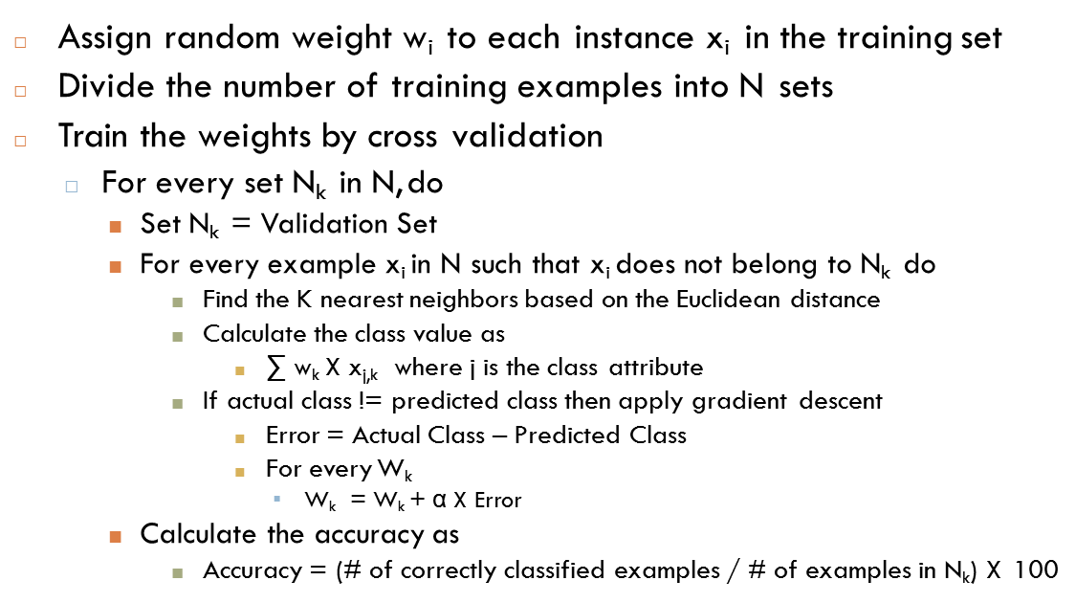
Instance Weighted K-NN using Gradient Descent Continued…

Slide 18
Instance Weighted K-NN using Gradient Descent Continued…
Train the weights on the whole training data set
  For every training example x_{i}
    Find the K nearest neighbors based on the Euclidean distance
    Calculate the class value as
      ∑ w_{k} X x_{j,k} where j is the class attribute
    If actual class != predicted class then apply gradient descent
      Error = Actual Class – Predicted Class
      For every W_{k}
        W_{k} = W_{k} + α X Error
    Calculate the accuracy as
      Accuracy = (# of correctly classified examples / # of training examples) X 100
  Repeat the process till desired accuracy is reached

Slide 19
Instance Weighted K-NN using Gradient Descent Continued…
For each testing example in the testing set
  Find the K nearest neighbors based on the Euclidean distance
  Calculate the class value as
∑ w_{k} X x_{j,k}
where j is the class attribute
Calculate the accuracy as
  Accuracy = (# of correctly classified examples / # of testing examples) X 100

Slide 20
Example with Gradient Descent
Consider K = 3, α = 0.2, and the 3 nearest neighbors to x_{q}
are x₁,x₂,x₃
K nearest neighbors | Euclidean Distance | Class | Random Weights
X₁ | 12 | 1 | W₁ = 0.2
X₂ | 14 | 2 | W₂ = 0.1
X₃ | 16 | 2 | W₃ = 0.005
□ Class of x_{q} = 0.2 X 1 + 0.1 X 2 + 0.005 X 2 = 0.41 => 0
Correct Class of x_{q} = 1
Applying Gradient Descent
□ W₁ = 0.2 + 0.2 X (1 - 0) = 0.4
□ W₂ = 0.1 + 0.2 X (1 - 0) = 0.3
□ W₃ = 0.005 + 0.2 X (1 - 0) = 0.205
□ Class of x_{q} = 0.4 X 1 + 0.3 X 2 + 0.205 X 2 = 1.41
Class of x_{q} => 1
Simple K-NN would have predicted the class as 2

Slide 21
Attribute Weighted KNN
Read the training data from a file <x, f(x)>
Read the testing data from a file <x, f(x)>
Set K to some value
Set the learning rate α
Set the value of N for number of folds in the cross validation
Normalize the attribute values by standard deviation
Assign random weight wi to each attribute Ai
Divide the number of training examples into N sets

Slide 22
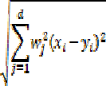
Attribute Weighted KNN continued
Train the weights by cross validation
  For every set Nk in N, do
    Set Nk = Validation Set
    For every example xi in N such that xi does not belong to Nk do
      Find the K nearest neighbors based on the Euclidean distance
Return the class that represents the maximum of the k instances
If actual class != predicted class then apply gradient descent
  Error = Actual Class – Predicted Class
  For every Wk
    Wk = Wk + α * Error * Vk (where Vk is the query attribute value)
Calculate the accuracy as
  Accuracy = (# of correctly classified examples / # of examples in Nk) X 100

Slide 23
Attribute Weighted KNN continued
Train the weights on the whole training data set
  For every training example xi
    Find the K nearest neighbors based on the Euclidean distance
    Return the class that represents the maximum of the k instances
    If actual class != predicted class then apply gradient descent
      Error = Actual Class – Predicted Class
      For every Wk
        Wk = Wk + α * Error * Vk (where Vk is the query attribute value)
  Calculate the accuracy as Accuracy = (# of correctly classified examples / # of training examples) X 100
  Repeat the process till desired accuracy is reached
For each testing example in the testing set
  Find the K nearest neighbors based on the Euclidean distance
  Return the class that represents the maximum of the k instances
  Calculate the accuracy as
    Accuracy = (# of correctly classified examples / # of testing examples) X 100

Slide 24
Results (KNN Vs Back Elimination)
Heart Data Set | K | Learning Rate | # of examples | # of training examples | # of testing examples | # of attributes | # of classes | Accuracy
KNN | 2 | NA | 270 | 224 | 46 | 13 | 2 | 78.26
Back Elimination | 2 | NA | 270 | 224 | 46 | 9 | 2 | 80.44
Wine Data Set | K | Learning Rate | # of examples | # of training examples | # of testing examples | # of attributes | # of classes | Accuracy
KNN | 2 | NA | 178 | 146 | 32 | 13 | 3 | 78.26
Back Elimination | 2 | NA | 178 | 146 | 32 | 4 | 3 | 80.44
Hill Valley Data Set | K | Learning Rate | # of examples | # of training examples | # of testing examples | # of attributes | # of classes | Accuracy
KNN | 2 | NA | 1212 | 606 | 606 | 100 | 2 | 54.95
Back Elimination | 2 | NA | 1212 | 606 | 606 | 94 | 2 | 54.62

Slide 25
Results (KNN Vs Back Elimination)
100
90
80
70
60
50
KNN
40
30
20
10
0
Back Elimination
Accuracy (%)
Wine Data Set
Heart Data Set
Hill Valley Data Set
UCI Datasets

Slide 26
Results (KNN Vs Instance WKNN)
Heart Data Set - 1 | K | Learning Rate | # of examples | # of training examples | # of testing examples | # of attributes | # of classes | Accuracy
KNN | 2 | NA | 303 | 203 | 100 | 13 | 4 | 56
Instance WKNN | 2 | 0.001 | 303 | 203 | 100 | 13 | 4 | 60
Wine Data Set | K | Learning Rate | # of examples | # of training examples | # of testing examples | # of attributes | # of classes | Accuracy
KNN | 2 | NA | 178 | 146 | 32 | 13 | 3 | 81.25
Instance WKNN | 2 | 0.005 | 178 | 146 | 32 | 13 | 3 | 81.25

Slide 27
Results (KNN Vs Instance WKNN)
90
80
70
60
50
40
30
20
10
0
KNN
Instance WKNN
Accuracy (%)
Wine Data Set
Heart Data Set
UCI Datasets

Slide 28
Results (Heart Data Set)
Heart Data Set | K | Learning Rate | # of examples | # of training examples | # of testing examples | # of attributes | # of classes | Accuracy
KNN | 3 | NA | 270 | 224 | 46 | 13 | 2 | 78.26
Back Elimination | 3 | NA | 270 | 224 | 46 | 11 | 2 | 84.78
Attribute WKNN | 3 | 0.005 | 270 | 224 | 46 | 13 | 2 | 84.78
Instance WKNN | 3 | 0.001 | 270 | 224 | 46 | 13 | 2 | 73.91

Slide 29
Results (Heart Data Set)
86
84
82
80
78
76
74
72
70
68
Accuracy in %
Accuracy in %
KNN
Back Elimination
Attribute WKNN
Instance WKNN

Slide 30
Results (Wine Data Set)
Wine Data Set | K | Learning Rate | # of examples | # of training examples | # of testing examples | # of attributes | # of classes | Accuracy
KNN | 3 | NA | 178 | 146 | 32 | 13 | 3 | 87.5
Back Elimination | 3 | NA | 178 | 146 | 32 | 10 | 3 | 84.38
Attribute WKNN | 3 | 0.005 | 178 | 146 | 32 | 13 | 3 | 87.5
Instance WKNN | 3 | 0.005 | 178 | 146 | 32 | 13 | 3 | 62.5

Slide 31
Results (Wine Data Set)
100
90
80
70
60
50
40
30
20
10
0
Accuracy in %
Accuracy in %
KNN
Back Elimination
Attribute WKNN
Instance WKNN

Slide 32
Results (Heart-1 Data Set)
Heart-1 Data Set | K | Learning Rate | # of examples | # of training examples | # of testing examples | # of attributes | # of classes | Accuracy
KNN | 3 | NA | 303 | 203 | 100 | 13 | 4 | 57
Back Elimination | 3 | NA | 303 | 203 | 100 | 8 | 4 | 53
Attribute WKNN | 3 | 0.005 | 303 | 203 | 100 | 13 | 4 | 58
Instance WKNN | 3 | 0.005 | 303 | 203 | 100 | 13 | 4 | 53

Slide 33
Results (Heart-1 Data Set)
59
58
57
56
55
54
53
52
51
50
Accuracy in %
Accuracy in %
KNN
Back Elimination
Attribute WKNN
Instance WKNN

Slide 34
Results (Hill Valley Data Set)
Hill Valley Data Set | K | Learning Rate | # of examples | # of training examples | # of testing examples | # of attributes | # of classes | Accuracy
KNN | 3 | NA | 1212 | 606 | 606 | 100 | 2 | 50.99
Back Elimination | 3 | NA | 1212 | 606 | 606 | 94 | 2 | 50.66
Attribute WKNN | 3 | 0.005 | 1212 | 606 | 606 | 100 | 2 | 51.32
Instance WKNN | 3 | 0.005 | 1212 | 606 | 606 | 100 | 2

Slide 35
Results (Hill Valley Data Set)
51.4
Accuracy in %
51.2
51
50.8
50.6
Accuracy in %
50.4
50.2
KNN
Back Elimination
Attribute WKNN
Instance WKNN

Slide 36
Implementation
Implemented in C++
Implemented following algorithms
  Simple K-NN
  Weighted K-NN with backward elimination
  Weighted K-NN with cross validation and gradient descent
    Instance Weighted KNN
    Attribute Weighted KNN
Assumptions made while implementation
  All the attribute values are numerical
  Class attribute values are distinct integer values
    For example: 0,1,2…..
  Euclidean Distance used for similarity measure
  For N fold cross validation, N = 3
  A training example which is not near any instance is removed from the training set
  For K = 1, do not consider the nearest with distance = 0 (nearest is the same as queried)
Details will be available on my website in a couple of days
  http://www.d.umn.edu/~deoka001/index.html

Slide 37
DIET
Outline
  What is DIET ?
  DIET Algorithm
  Wrapper Model
  Results

Slide 38
DIET
DIET is an algorithm which uses a simple wrapper approach to heuristically search through a set of weights used for nearest neighbor classification.
DIET sometimes causes features to lose
weight, sometimes to gain weight and sometimes to remain the same.

Slide 39
DIET Algorithm
In the DIET algorithm we have a discrete, finite set of weights instead of continuous weights.
If we choose k number of weights then the set of weights will be:
{0,1/k,2/k,…,(k-1)/k,1}
If k = 2, then the set of weights would be {0, 1} which means that we either give weight = 0 or 1 to an attribute.
When k = 1, we have only one weight which is taken as 0. This translates into simply ignoring all the weights and predicting the most frequent class.
Generally when we have k weights, we start with the assignment closest to the middle weight.

Slide 40
DIET Algorithm Continued…
For each attribute we move through the weight space in search of the weight which minimizes the error until minimum or maximum of the weight is reached.
The number of neighbors used in the classification is 1 since the goal is to investigate feature weighting rather than the number of neighbors
Error is calculated every time using tenfold cross validation over the training data with KNN algorithm.
A halting criterion is used where in we stop the search when five consecutive nodes have children with no better results than their parents. (0.1%)

Slide 41
Wrapper Model
We search through the weight space heuristically using the wrapper model.
We search the space for feature subsets till we reach some threshold accuracy.
The paper mentions about using the wrapper model, but the authors have not mentioned how they have adapted the model for DIET.
The approaches used for feature subset selection are backward elimination where you start with all the features and greedily remove the one that most improves performance and another is forward selection which starts with a empty set of features and greedily adds features.

Slide 42
DIET Results
For data sets that contain few or no irrelevant features, DIET performs comparably to simple KNN or slightly worse due to the increased size of the hypothesis space.
For domains in which relevant features have equal importance, DIET with few weights outperforms DIET with many weights.
DIET with one non zero weight, which means that either a feature is relevant or irrelevant, outperforms DIET with many weights on most of real world data sets tested.

Slide 43
References
Machine Learning – Tom Mitchell
The Utility of Feature Weighting in Nearest- Neighbor Algorithms - Ron Kohavi, Pat Langley, Yeogirl Yun
Irrelevant Features and the Subset Selection Problem – George John, Ron Kohavi, Karl Pfleger

Slide 44
Summary
KNN is conceptually simple, yet able to solve complex problems
Can work with relatively little information
Learning is simple (no learning at all!)
Memory and CPU cost
Feature selection problem
Sensitive to representation
www.ismartsoft.com

Slide 45
Questions?
www.ismartsoft.com

