Slide 1
Supervised vs. Unsupervised Learning
Supervised learning (classification)
Supervision: The training data (observations, measurements, etc.) are accompanied by labels indicating the class of the observations
New data is classified based on the training set
Unsupervised learning (clustering)
The class labels of training data is unknown
Given a set of measurements, observations, etc. with the aim of establishing the existence of classes or clusters in the data

Slide 2
We will now see a few examples on Supervised Learning.

Slide 3
Example 1
An emergency room in a hospital with newly admitted patients.
A decision is needed: whether to put a new patient in an intensive-care unit.
Due to the high cost of ICU, those patients who may survive less than a month are given higher priority.
Problem: to predict high-risk patients and discriminate them from low-risk patients.

Slide 4
Example 1
The attributes or features that will be used in the previous example can be-
Age
Blood pressure
Sugar level
Past history
Medical Reports etc

Slide 5
Example 2
A credit card company receives thousands of applications for new cards. Each application contains information about an applicant.
Problem: to decide whether an application should approved, or to classify applications into two categories, approved and not approved.

Slide 6
2
The features here can be-
age
Marital status
annual salary
outstanding debts
credit rating
etc.

Slide 7
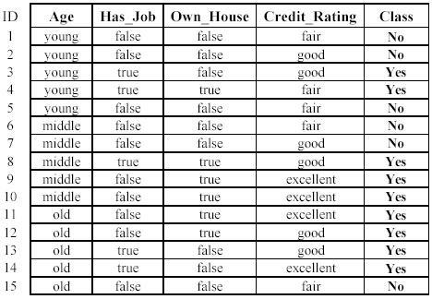
2

Slide 8

3- Identify handwritten characters: classify each image of character into one of 10 categories ‘0’, ‘1’, ‘2’ …
6132
2056
2014
4283
2064

Slide 9
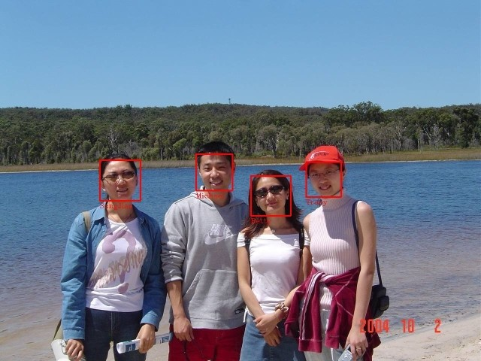
4- Face detection
discriminating human faces from non faces.

Slide 10
5-Text Categorization (multi category)
Categorize text documents into predefined categories . For example, categorize news into ‘sports’, ‘politics’, ‘science’, etc.
Soft tissue found in T-rex fossil
Find may reveal details about cells and blood vessels of dinosaurs
Thursday, March 24, 2005 Posted: 3:14 PM EST
WASHINGTON (AP) -- For more than a century, the study of dinosaurs has been limited to fossilized bones. Now, researchers have recovered 70-million-year-old soft tissue, including what may be blood vessels and cells, from a Tyrannosaurus rex.
Health may be concern when giving kids cell phones
Wednesday, March 23, 2005 Posted: 11:14 AM EST
SEATTLE, Washington (AP) -- Parents should think twice before giving in to a middle-schooler's demands for a cell phone, some scientists say, because potential long-term health risks remain unclear.
Wall Street gears up for jobs Saturday, March 26, 2005: 11:41 AM EST
NEW YORK (CNN/Money) - Investors on Inflation Watch 2005 have a big week to look forward to -- or be wary of -- depending on how you look at it.
Probe finds atmosphere on Saturn moon
Thursday, March 17, 2005 Posted: 11:17 AM EST
LOS ANGELES, California (Reuters) -- The space probe Cassini discovered a significant atmosphere around Saturn's moon Enceladus during two recent passes close by, the Jet Propulsion Laboratory said on Wednesday

Slide 11
6- IRIS dataset
– consists of 3 classes, 50 instances each – 4 numerical attributes (sepal and petal length and width in cm)
each class refers to a type of Iris plant (Setosa, Versicolor, Verginica)
The first class is linearly separable from the other two while the 2nd and the 3rd are not linearly separable .

Slide 12
7- restaurant domain
Two classes: wait, leave
Ten attributes: Alternative available? Bar in restaurant? Is it Friday? Are we hungry? How full is the restaurant? How expensive? Is it raining? Do we have a reservation? What type of restaurant is it? What’s the purported waiting time?

Slide 13
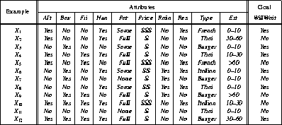
7

Slide 14
8-Spam detection
A certain email can be classified as spam or non spam
This is done using supervised techniques.
The attributes taken into consideration are sender, subject, specific keywords, frequency etc.

Slide 15
9- Bioinformatics

Slide 16
10
Can you suggest any examples ?

