Slide 1


SQL Sync Service
Russ
Prathikson

Slide 2



Applications
SQL Sync Service Background Process
Runs in the background to make synchronizations to your SQL database
SQL Sync Service Control Panel
GUI that allows you to manage the SQL Sync Service Background Process

Slide 3
Offline Data Collection Process
Wait for X amount of time until sync status is checked again
While Background service is running, checking for a connection to online database
Connection is found
Data from Sqlite database is converted and uploaded to MSSQL database
Offline database is cleared and notification message is shown

Slide 4
Online Data Collection Process
The background service periodically checks for a connection to the online database
The data stored in the local database is converted and added to the MSSQL database.
Data is converted and saved using the built in tools of Entity Framework

Slide 5
Database Schema
Software
Microsoft SQL Server
Docker Desktop (SQL Server 2022 image)
SQLite (for offline storage)
C# Entity Framework
Synchronizations (Metadata)
Device Data (Primary Table)
Tables

Slide 6
Tables
DeviceData
Columns
ID (PK, int)
DeviceName (string)
DeviceType (string)
Timestamp (DateTime)
UOM1 (string)
UOM1Value (double)
UOM2 (string)
UOM2Value (double)
Columns
Synchronizations
ID (PK, int)
Records added (int)
TimeSynced (Datetime)

Slide 7
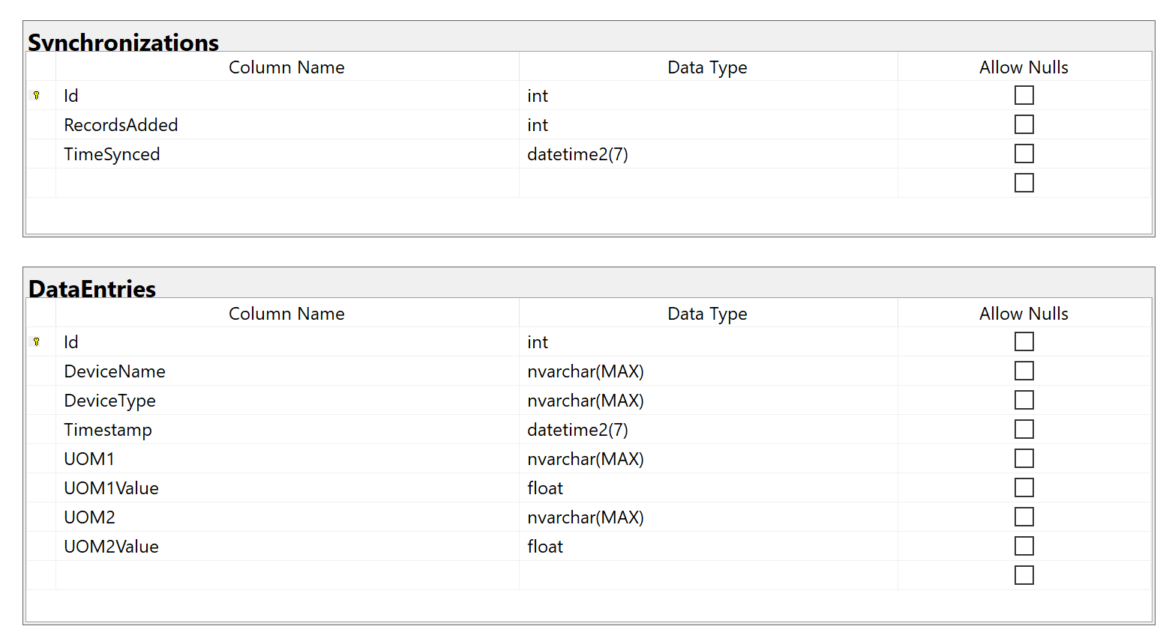
MSSQL Database structure

Slide 8
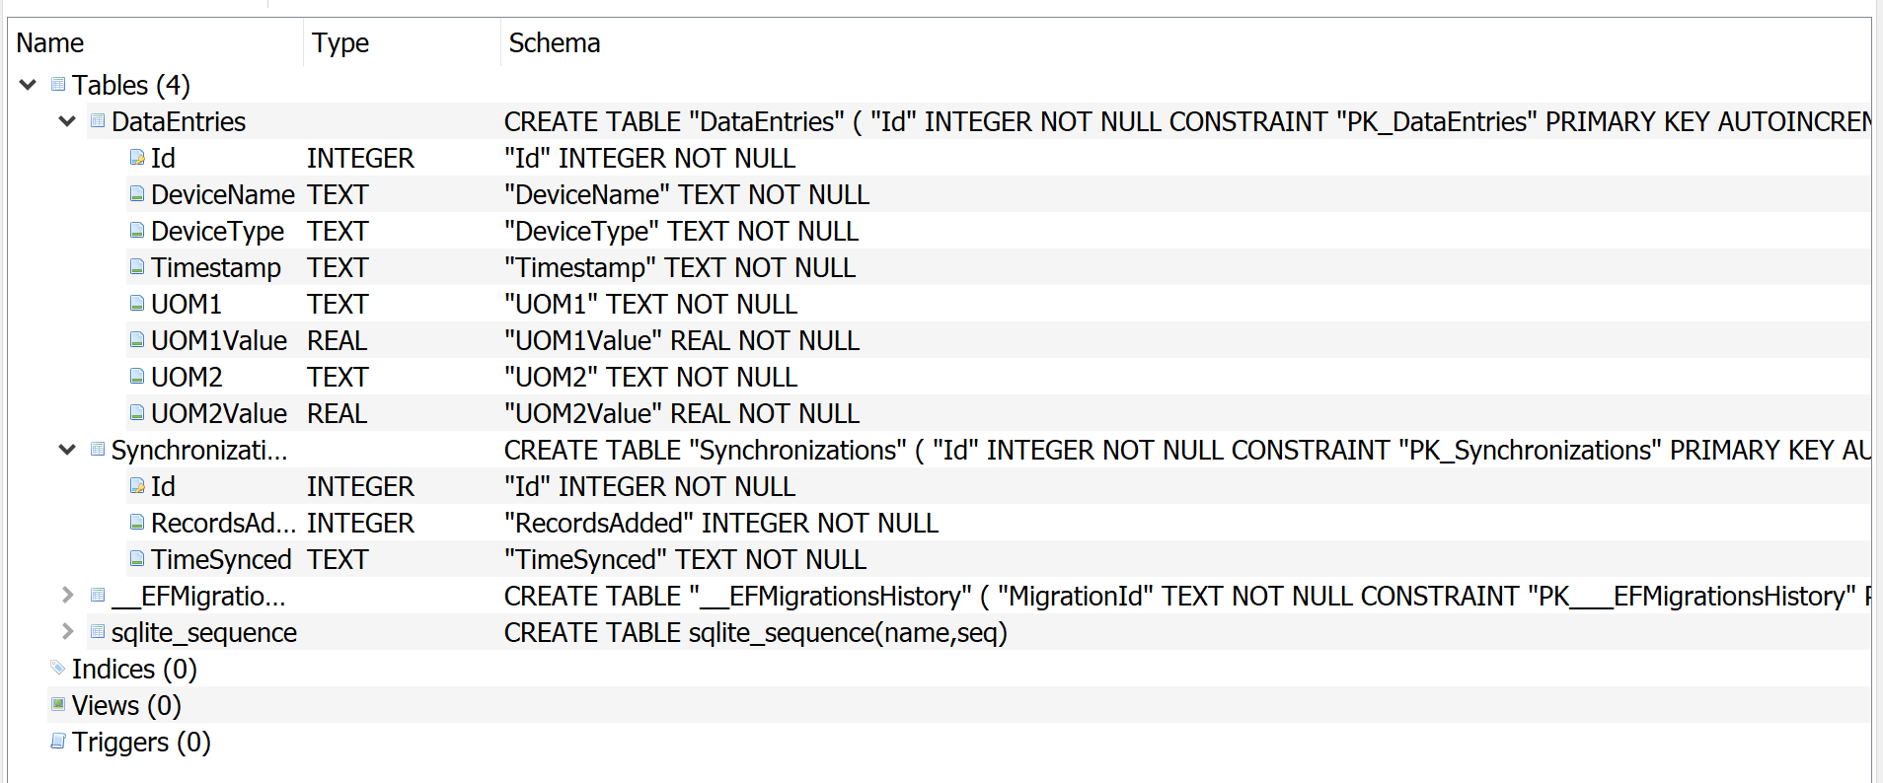
SqlITE Database structure

Slide 9
Group Dynamics
Planning
All group members planned the database schema
All group members discussed how to implement synchronization app structure
Task Completion
Russ created the database schema using C# Entity Framework both for SQL Server and SQLite
Russ created the common library (C# class library), background service app and control panel applications
Prathikson worked on the Random Data generation and saving it to the offline database. And Russ synced it to the SQL Server by the background service Russ Created.
Prathikson Build the Power BI dashboard for the database.
Russ Worked On the PowerPoint.

Slide 10
Business Intelligence Dashboard
What types of analysis
Total Reads
Spatial Mapping
Classifications
Read Summations
Single Device Data
etc.

