Slide 1
Final project presentation

Slide 2

About author
Hi, my name is Ruslan and here are a few facts about me:
Techical support person who wants more
For a healthy and active lifestyle
I believe in myself and not in the horoscope

Slide 3
Deploy of the fruit store
Why I decided to do this and what i need to achieve this goal
  First of all, it is vital for me to improve my skills and learn new technologies.
  Being working on a position of technical support I do a lot of routine work that could be automated and free up time to learn something new.
  No matter how experienced you are, the human factor plays a role, so automation is a very important aspect, especially in the IT field, that partially eliminates the errors occurrence under the influence of human factors.
  The aim of this task is to speed up the deployment process and reduce the amount of manual work.
  To achieve this we need to create two environments, the test and production ones and the separate one to run the automation server
  The next step is by using the automation server to get our website from a version control system to run it on the test and then the production server.

Slide 4
The following tools and environments are used:
Terraform (Is used to automatically launch EC2 instances without need of manual launching)
Jenkins ( provides build and deploy)
Docker (run my Jenkins server)
EC2 instances with Nginx web servers
Github

Slide 5
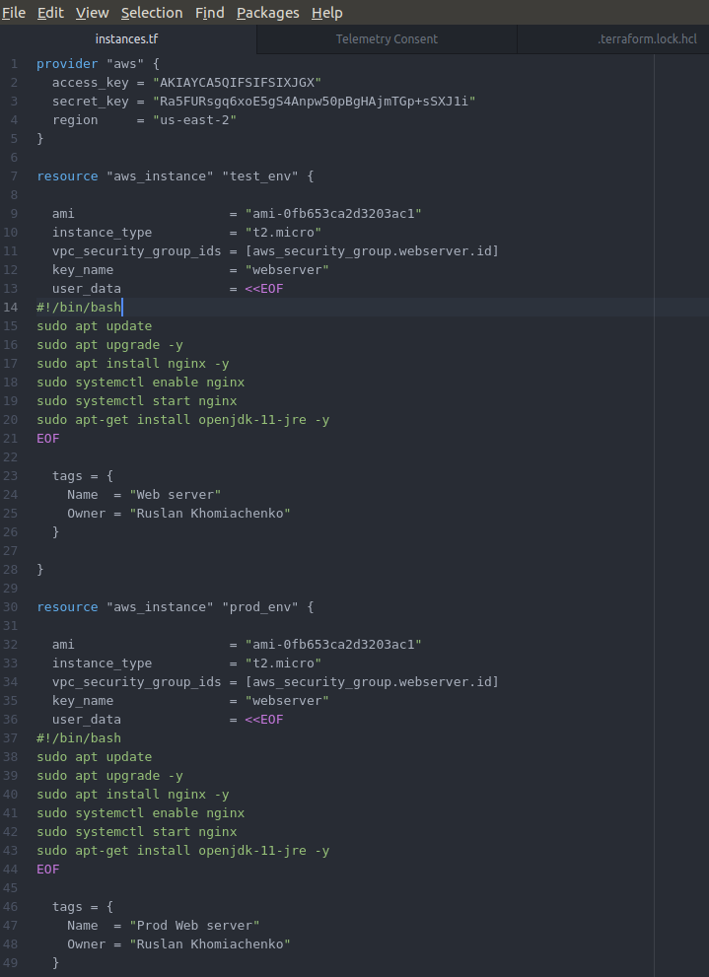
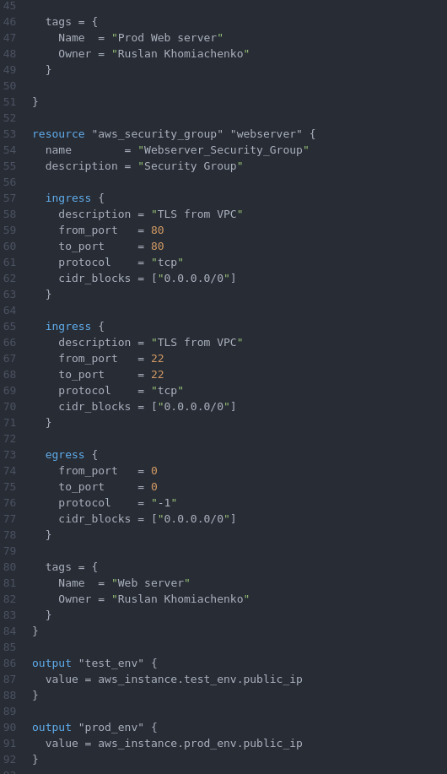
Describe the EC2 instances with Terraform

Slide 6
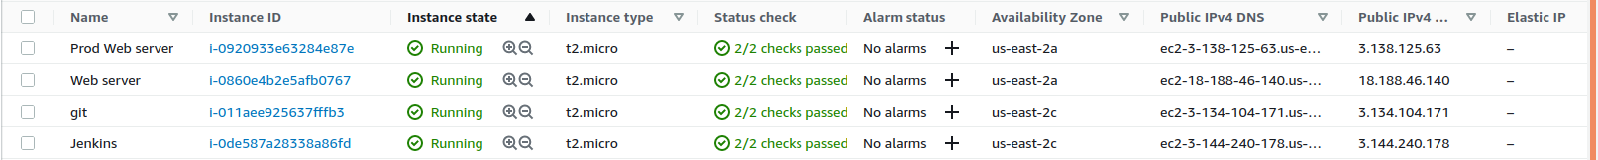
Run our Jenkins in Docker conteiner
docker container run -d -p 8080:8080 \
-v hope_save:/var/jenkins_home \
--name jenkinslocal \
jenkins/jenkins:lts

Slide 7
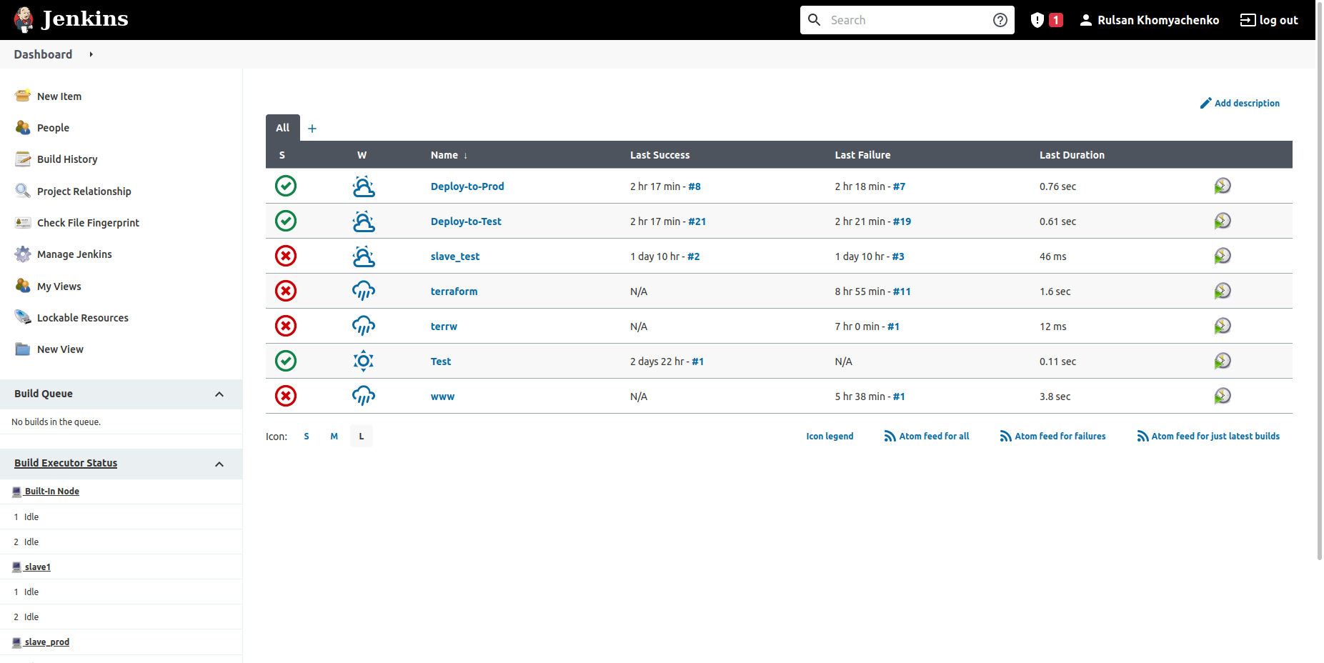

Slide 8
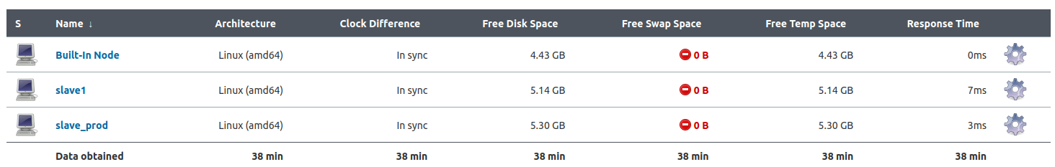
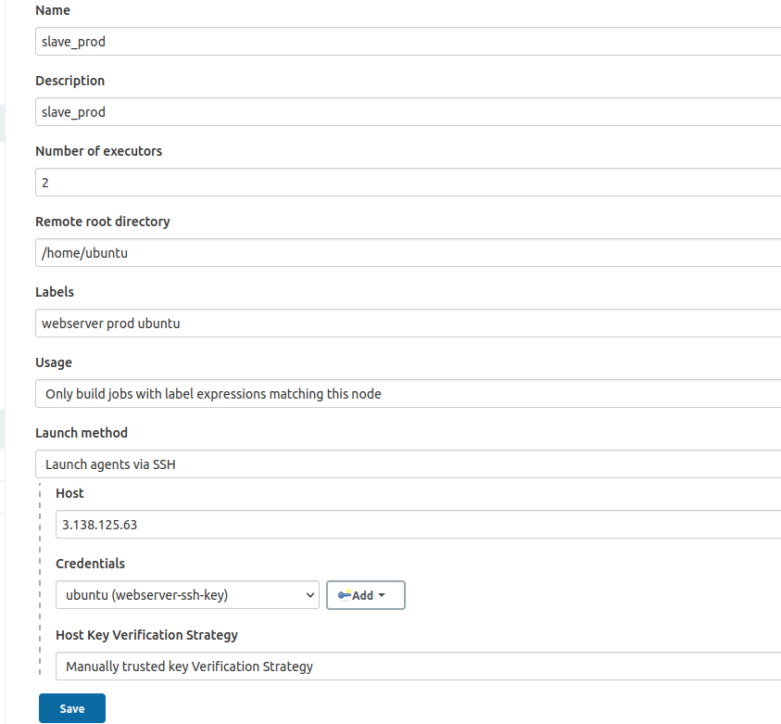
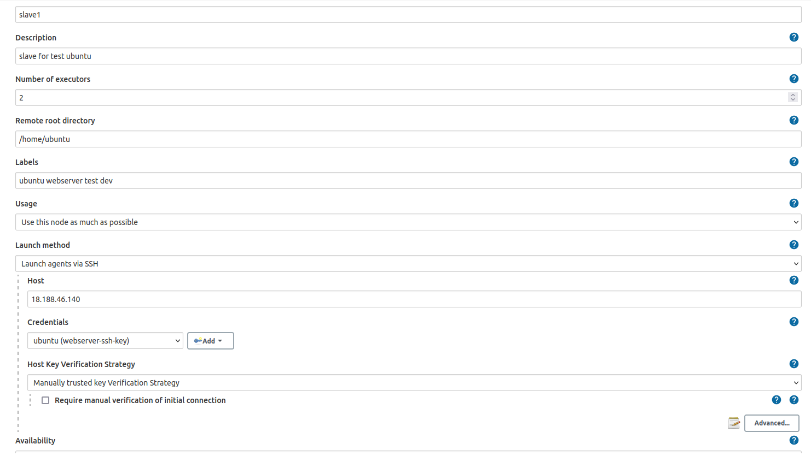
Setup Jenkins nodes to connect to our EC2 instances (slave1 for test server and slave_prod for production server)

Slide 9
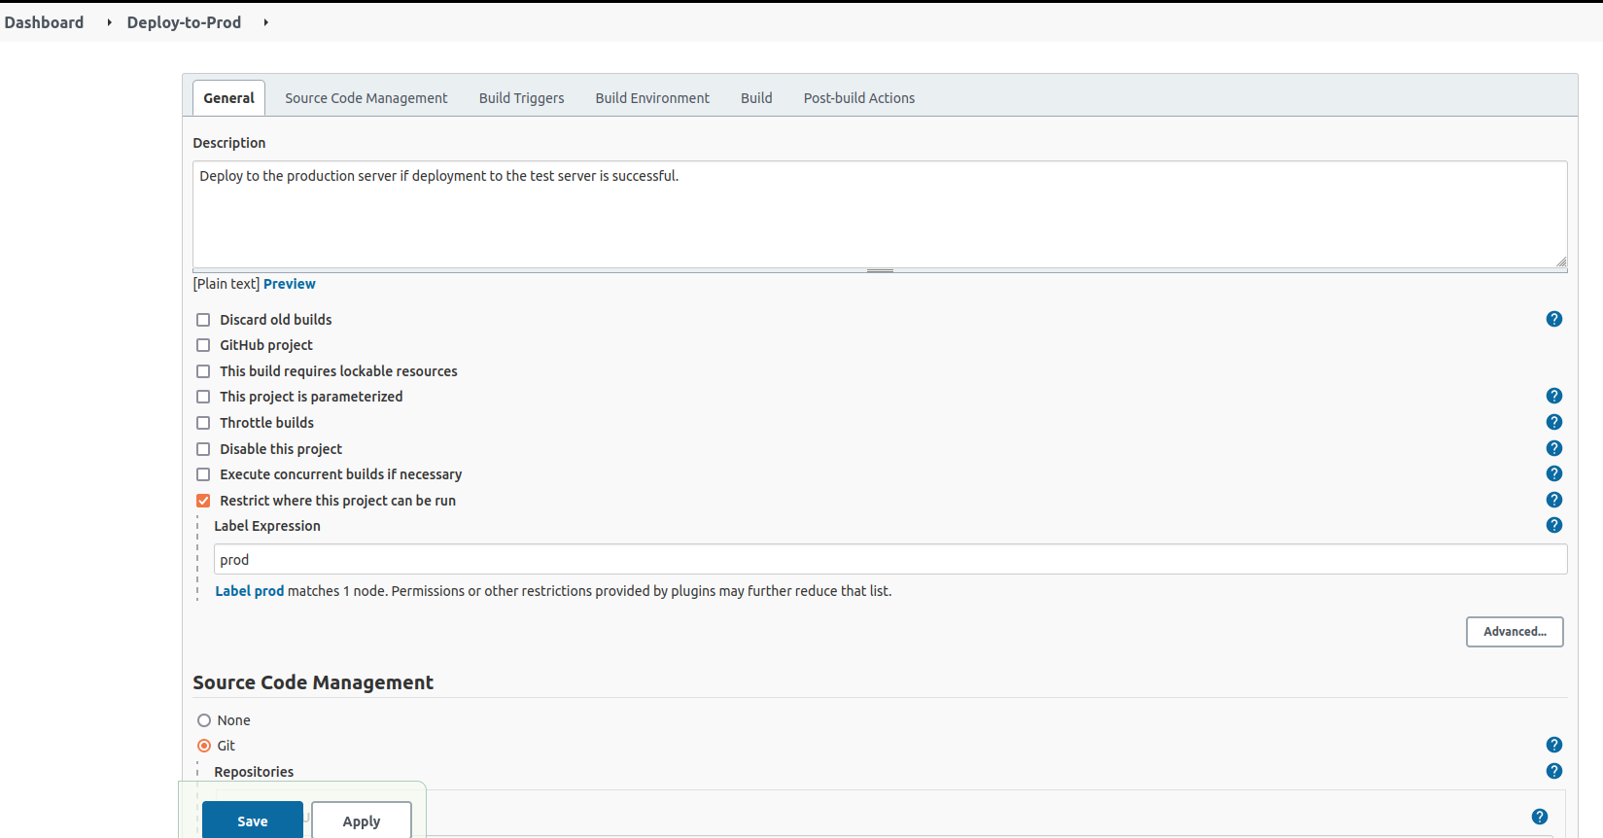
Configure our jobs, the job for test enviroment is almost the same

Slide 10
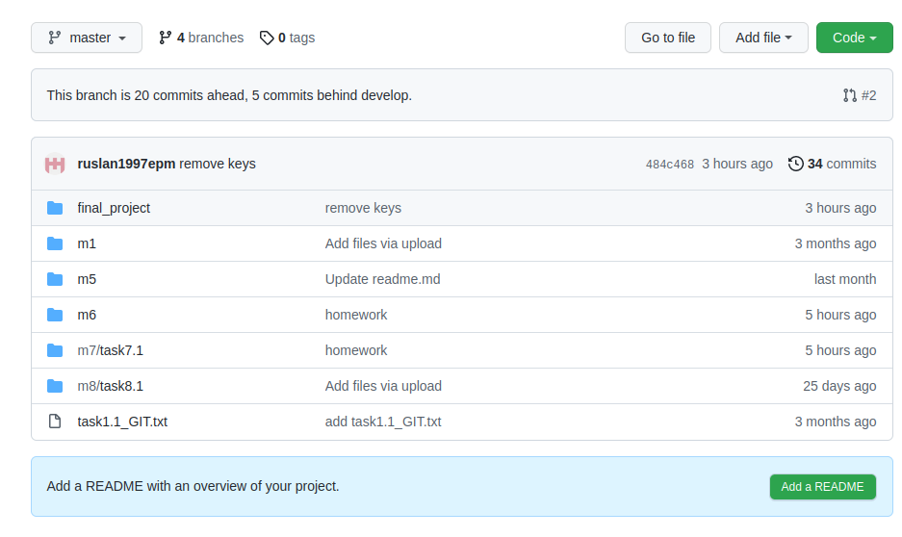
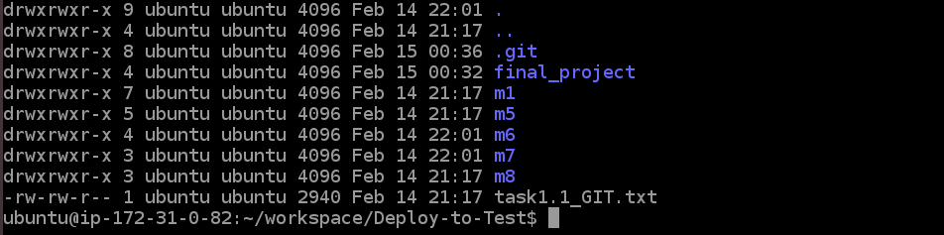
Once we run the job "Deploy-to-Test", Jenkins will push all repo to the Test server
Then with the shell commands, the files of the website from the /final_project folder will be synced to /var/www/html to up the website.

Slide 11


Slide 12
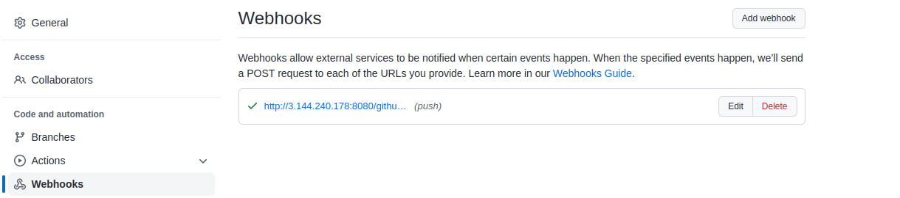
Once the "Deploy-to-Test" job has been successfully built, the separate agent "slave_prod" runs the job "Deploy-to-Prod" in order to deploy the website to the production server.
In case the build of "Deploy-to-Test" has failed, the "Deploy-to-Prod" would not be run.
In order to automate deploying from github, there was configured the "Webhook" on Github that tells Jenkins to deploy the website on the test server once "git push" is done.

Slide 13
What would like to add and improve, but has not yet been implemented
1. Run Terraform script from Jenkins in a separate job and not run manually from local PC.
2. Every time I stop/terminate instances and then up them with terraform again, the IP addresses are changed, and due to this Jenkins nodes cannot establish a connection with the servers and I have to reconfigure them manually.
Maybe it is possible with Ansible, but I have not learned it yet.
3. Create a pipeline.
4. Another way is to run all fresh EC2 instances (test server, prod server, server for Jenkins) by a single "terraform apply"
In this case, I want my docker image with configured Jenkins to be downloaded from docker hub and deployed on any fresh instance.

Slide 14
Thank you for your attention!

