Slide 1


Slide 2
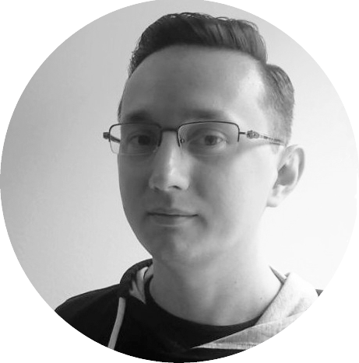
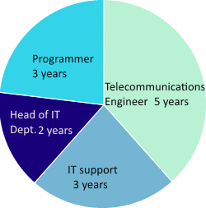



Ten years of work experience in IT
Difficulty level - Russia
Passionate about new technologies
Dozens of successfully finished projects
Ruslan Abdulin
Engineer
Programmer
LNU Student
Arduino Enthusiast

Slide 3
PLAN
getting Telegram
looking at Bot API
creation a Bot
getting TOOLS
using Python
skipping Questions

