Slide 1
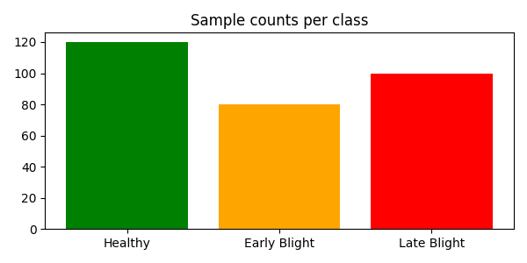
Ruslan Asgarov | ID 13
Task: Plant Disease Classification
Dataset: PlantVillage - Tomato
Classes: 3 (Healthy, Early Blight, Late Bliht)
Target Accuracy: >=88%

Slide 2
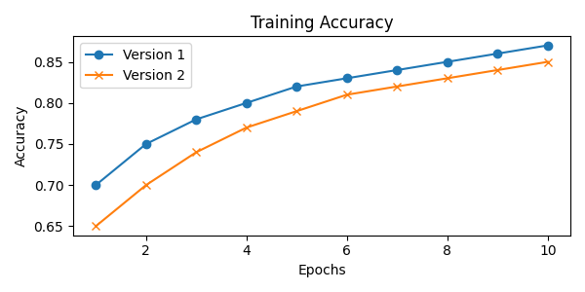
Training Comparison
Version 1: Adam, lr=0.0001, batch=32
Version 2: Adam, lr=0.00001, batch=32

Slide 3
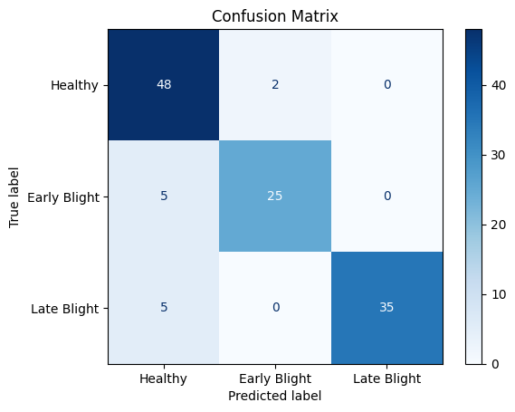
Best Results
- Final Test Accuracy: 87%
- Best Class: Healthy
- Worst Class: Early Blight

