Slide 1
Runtime View
Software Architecture (group F)

Slide 2
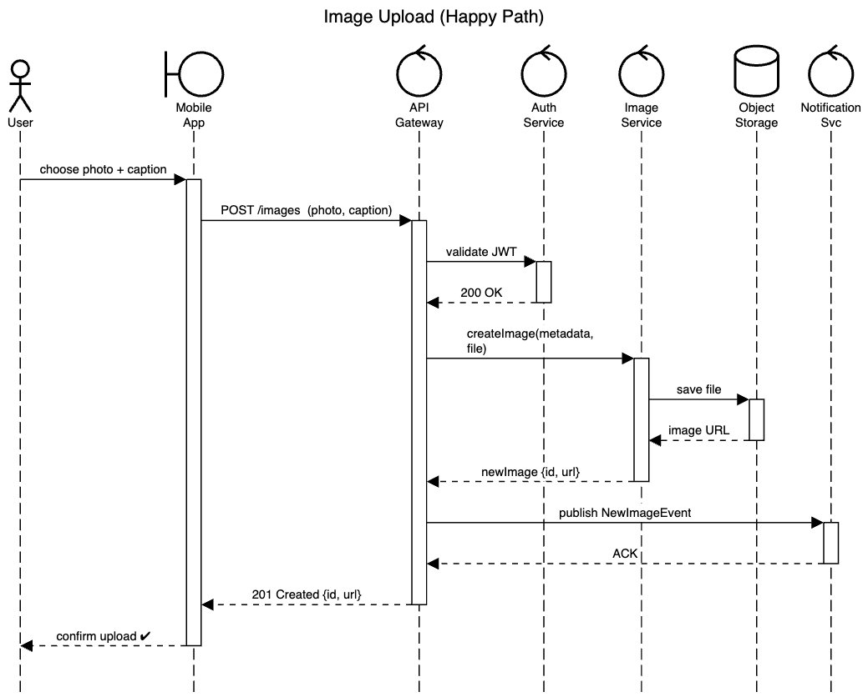
Using sequencediagram.org

Slide 3
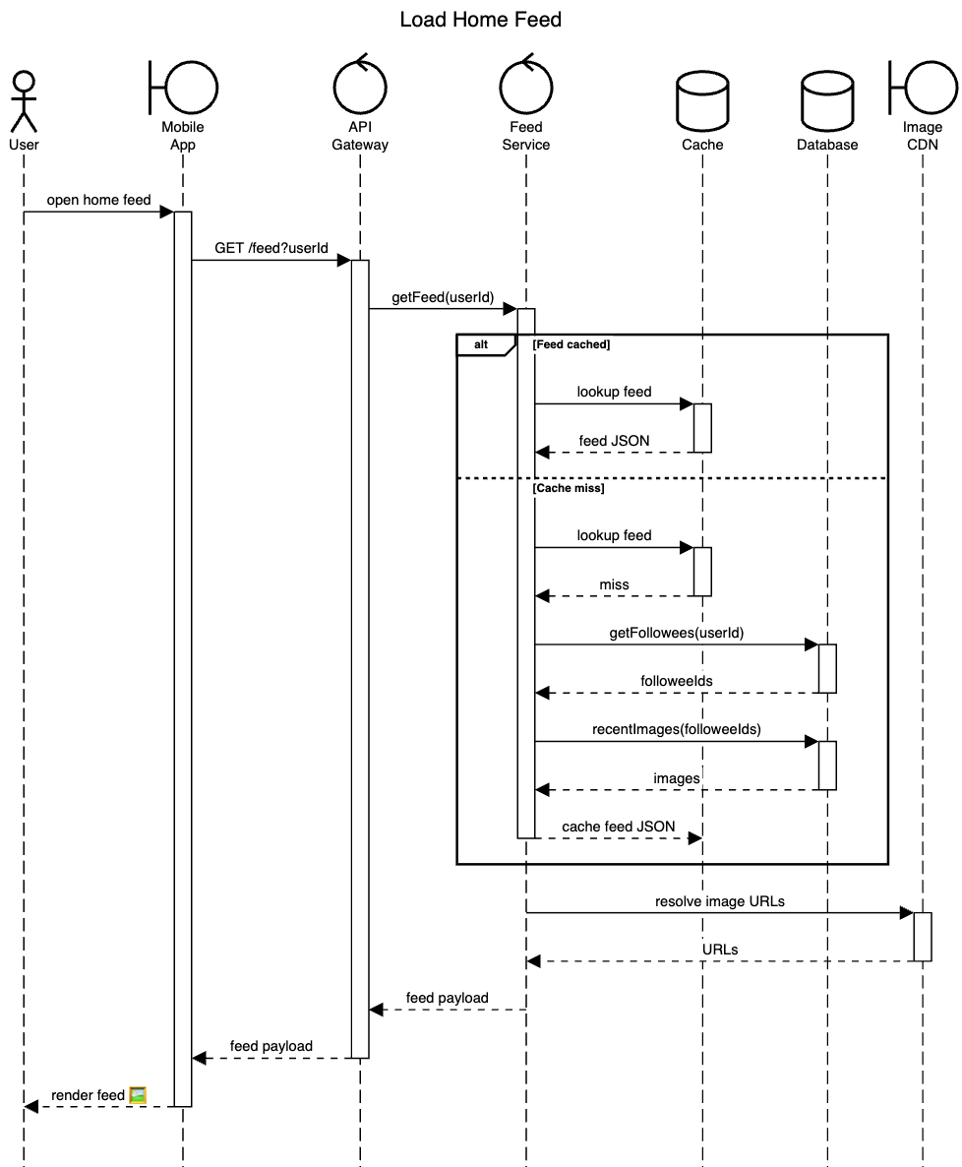
Using sequencediagram.org

