Slide 1
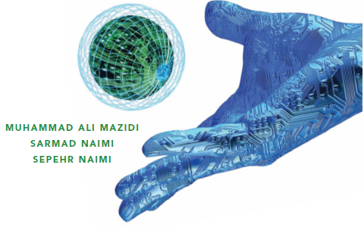
AVR Hardware Connections and Flash Loading
The AVR microcontroller
and embedded
systems
using assembly and c

Slide 2
Topics
AVR Pins
AVR simplest connections
Fuse bits and clock source
Fuse bits and startup time
What is inside a hex file?
Loading a hex file into flash
Start with MDE AVR 32 Trainer board

Slide 3
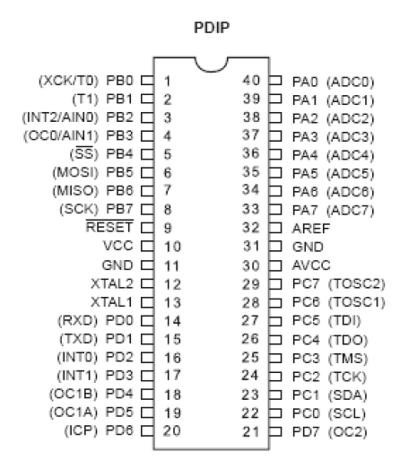
ATmega 32 pins
Clears all the registers and restart the execution of program
Provides supply voltage to the chip. It should be connected to +5
Reference voltage for ADC
These pins are used to connect external crystal or RC oscillator
Supply voltage for ADC and portA. Connect it to VCC

Slide 4
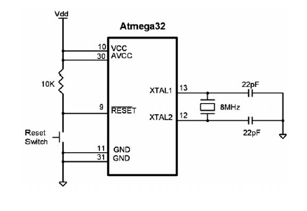
AVR simplest connection

Slide 5
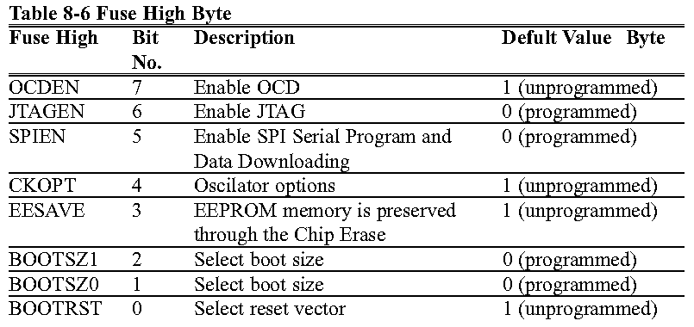
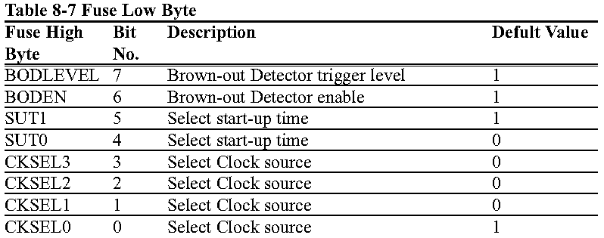
Fuse bytes of ATmega 32
Values of fuses is needed before system starts
They control some features of hardware
There are Fuse bytes in Atmega32

Slide 6
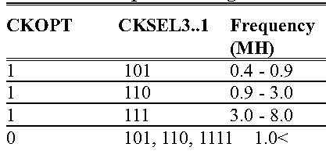
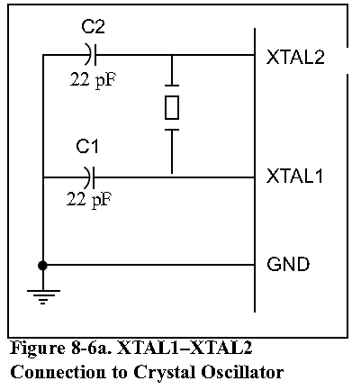
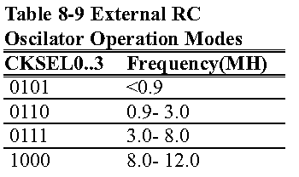
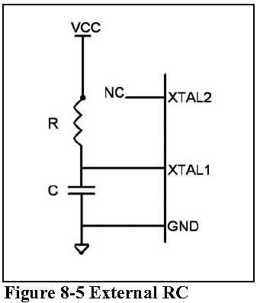
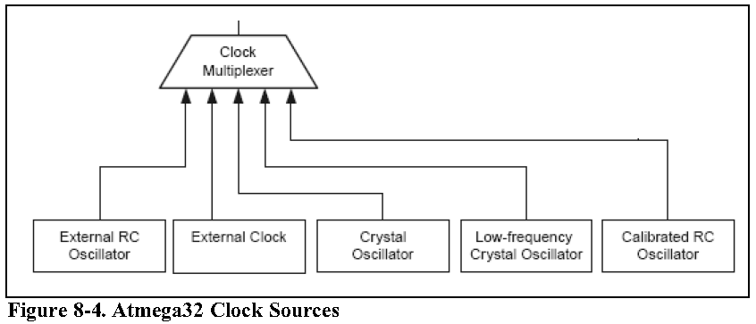
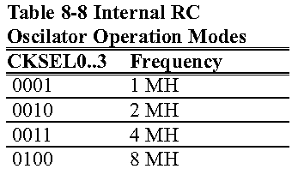
Clock source in ATmega 32

Slide 7
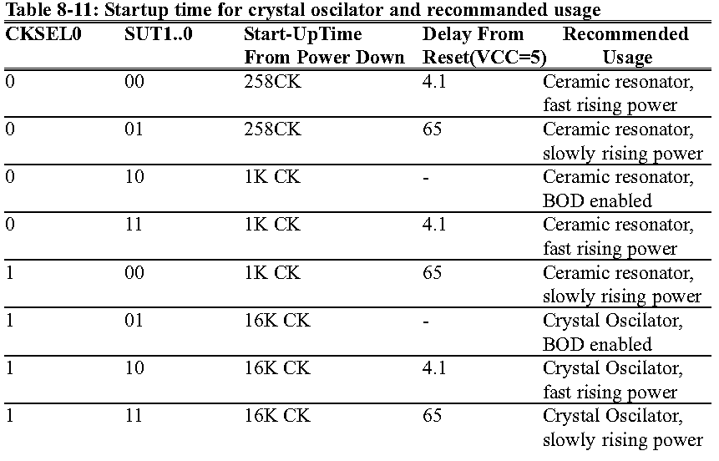
Power on Reset and Burn on Detection
Burn on Detection (BOD): Monitors the level of VCC and reset the system if (VCC<BOD level)
The most difficult time for a system is during power up. To pass this time, In AVR when RESET pin becomes high, program does not starts running. It starts running after a specified time has elapsed. SUT0 and SUT1 define this time.

Slide 8
Golden Rule of Fuse bits
If you are using an external crystal with a frequency more 1MH you can set all of the CKSEL3, CKSEL2, CKSEL1, SUT1 and SUT0 to 1 and clear CKOPT to 0.

Slide 9
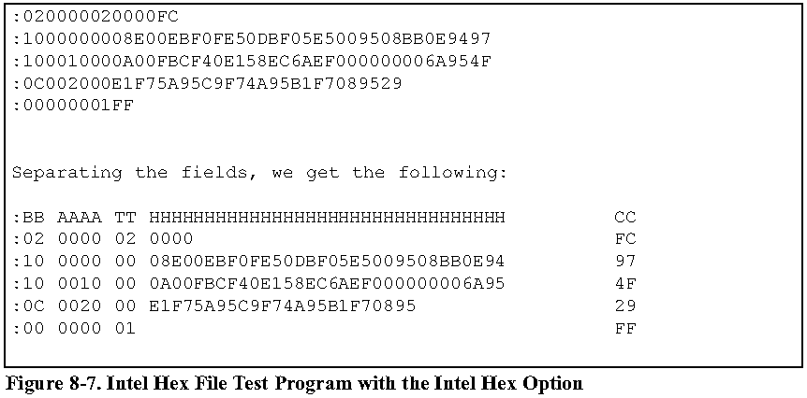
Inside an HEX file
Type of line:
00: there are more lines to come after This line.
01: this is the last line
02: Segment address
This is a 16-bit address; The loader places the first byte of data into this memory address.
It can address 64k locations
Each line starts with a colon.
how many bytes are in the line.
Real Data
Checksum

Slide 10
AVR Programming
Parallel programming
ISP
  SPI
  JTAG
Boot loader

