Slide 1
I²C (Inter-Integrated Circuit)

Slide 2
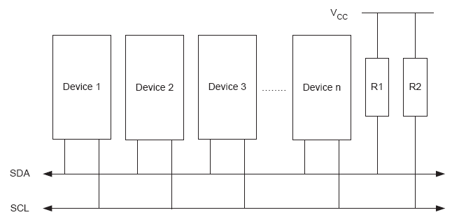
I²C
started by Philips
synchronize the data transfer between two chips
SDA (Serial Data), SCL (Serial Clock)
Wire AND
About 128 devices (nodes) can share a bus

Slide 3
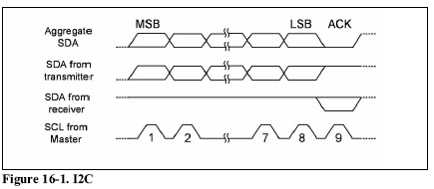
I2C …
Master Transmit CLK ( transmitter or receiver)
Receiver does not change the level of SDA unless it wants to generate ACK
Note: Receiver can be Master or Slave

Slide 4
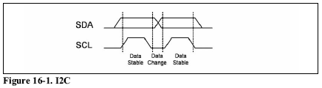
Bit Format
each data bit transferred on the SDA line is synchronized by a high-to-low pulse of clock on the SCL line.
Data line can change only when the clock line is low. Stop and Start conditions are exceptions.

Slide 5
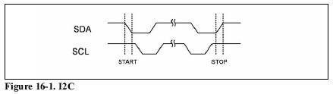
Start and Stop conditions
STOP and START conditions must be distinguished from bits of address or data. That is why they do not obey the bit format rule
START and STOP conditions are generated by the master.

Slide 6
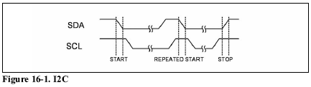
Repeated Start
f a master,which has the control of the bus, wishes to initiate a new transfer and does not want to release the bus before starting the new transfer, it issues a new STARTcondition between a pair of START and STOP conditions.

Slide 7
Packet Format
  Each packet is 9 bits long.
  First 8 bits are put on SDA by the transmitter
  9th bit is an acknowledge by the receiver
    NACK (leave high) or ACK (pull down)

Slide 8
Packet Format
Packet Types:
  Address Packet
  Data Packet

Slide 9
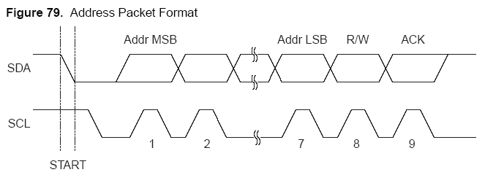
Address packet
Started by a Start Condition
7 bits address, MSB first
Define R/W
ACK or NACK

Slide 10
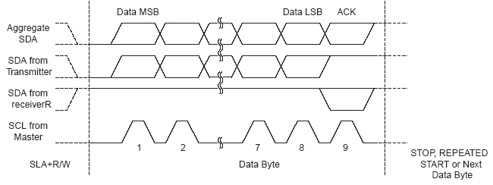
Data packet format
Can be transmitted by either Master or Slave
Is 8 bit long ( MSB first)
Followed by ACK/ NACK from receiver
NACK does not necessarily indicate error

Slide 11
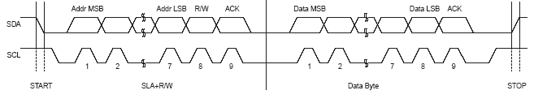
Typical data transmission

Slide 12
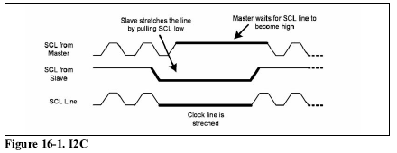
Clock Stretching
If an addressed slave device is not ready to process more data it will stretch the clock by holding the clock line (SCL) low after receiving (or sending) a bit of data.

Slide 13
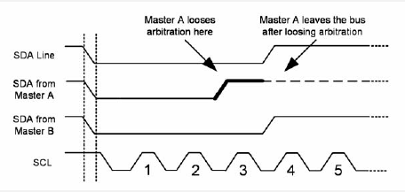
Arbitration
it is possible that two or more masters initiate a transmission at about the same time
Each transmitter has to check the level of the bus and compare it with the level it expects
  if it doesn't match, that transmitter has lost the arbitration, and will switch to slave mode

Slide 14
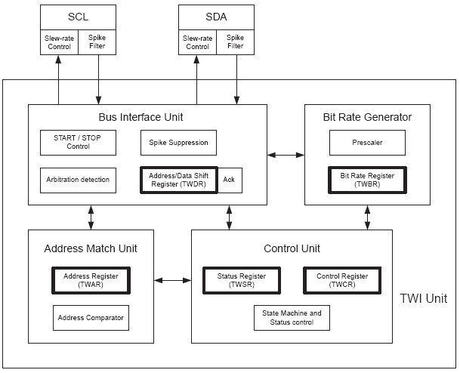
I²C unit in AVR

Slide 15
I²C unit in AVR
Bus Interface Unit
  detects and generates START, REPEATED START and STOP conditions.
  detects arbitration
  controls sending or receiving ACK
  transfers packets of data or address.
Bit Rate Generation Unit
  controls the frequency of the system clock (SCL) when operating in a master mode

Slide 16
I²C unit in AVR
Address Match Unit
  ompares the received address byte with the 7-bit address in TWI address register and informs the control unit upon an address match.
Control Unit
  controls the TWI module and generates responses according to settings in the TWI control register
  sets the contents of the status register
  according to current state.

Slide 17
I²C unit in AVR

Slide 18
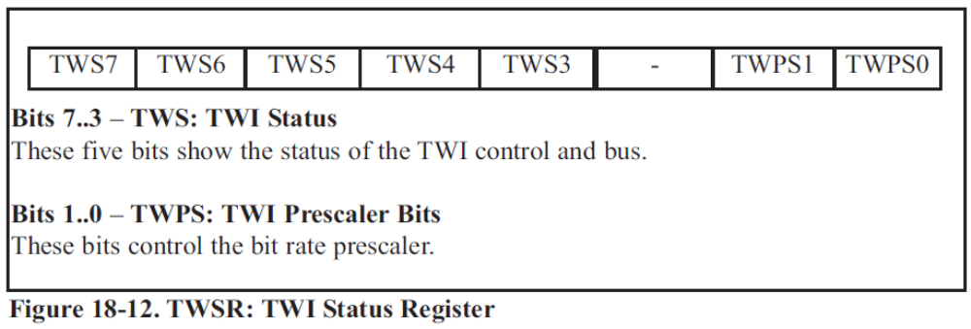

I²C Registers in AVR
TWI Status Register (TWSR)
TWI Bit Rate Register (TWBR)

Slide 19

TWAR (TWI Address Register)
TWA6-0 (TWI slave Address)
TWGCE (TWI General Call Recognition Enable bit)
  1: Answer to general call

Slide 20

TWI Control Register
TWINT (TWI Interrupt Flag)
TWEA (TWI Enable Acknowledge Bit)
  1:ACK, 0:NACK
TWSTA (TWI Start condition bit)
TWSTO (TWI Stop condition bit)
TWWC (TWI Write Collision flag)
TWEN (TWI Enable bit)
TWIEN (TWI Interrupt Enable)

Slide 21
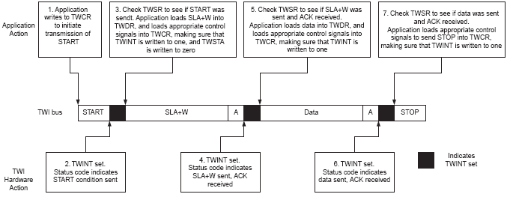
TWI Control Register

Slide 22
TWI Control Register
TWINT (TWI Interrupt Flag)
TWEA (TWI Enable Acknowledge Bit)
  1:ACK, 0:NACK
TWSTA (TWI Start condition bit)
TWSTO (TWI Stop condition bit)
TWWC (TWI Write Collision flag)
TWEN (TWI Enable bit)
TWIEN (TWI Interrupt Enable)

Slide 23
TWI, Master Mode programming
Initializing
  Set the TWI module clock frequency by setting the values of the TWBR register and the TWPS bits in the TWSR register.
  Set the TWEN bit in TWCR to one to enable the TWI module
Transmit START condition
  Set TWEN, TWSTA, and TWINT bits of TWCR to one.

Slide 24
TWI, Master Mode programming
Send Data
  Copy the data byte to the TWDR
  Set the TWEN and TWINT bits of the TWCR to one to start sending the byte.
  Poll TWINT flag in TWCR register to see whether the byte transmitted completely
Receive Data
  Set TWEN and TWINT bits of TWCR to one to start receiving a byte.
  Poll TWINT flag in TWCR to see whether a byte has been received completely
  read the received byte from the TWDR

Slide 25
TWI, Master Mode programming
Transmit STOP condition
  Set TWEN, TWSTO, and TWINT bits of TWCR to one
    Note: we cannot poll the TWINT flag after transmitting the STOP condition

Slide 26
TWI, Slave Mode programming
Initializing
  Set the slave address by setting the values for the TWAR register.
    7 bits for address
    8th bit is TWGCE ( 1 = answer general calls)
  Set the TWEN bit in TWCR to one to enable the TWI module
  Set the TWEN, TWINT, and TWEA bits of TWCR to one to enable the TWI and acknowledge generation
Listening
  poll the TWINT flag to see when the slave is addressed by a master device or use its interrupt

Slide 27
TWI, Slave Mode programming
Send Data
  Copy the data byte to the TWDR
  Set the TWEN, TWEA, and TWINT bits of the TWCR register to one to start sending the byte.
  Poll TWINT flag in TWCR register to see whether the byte transmitted completely
Receive Data
  Set TWEN and TWINT bits of TWCR to one to start receiving a byte.
  Poll TWINT flag in TWCR to see whether a byte has been received completely
  read the received byte from the TWDR

Slide 28
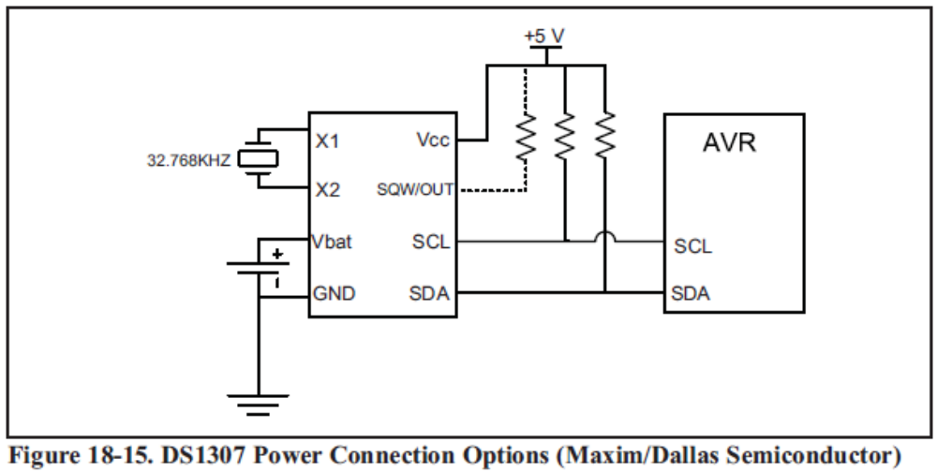
DS1307 (Real Time Counter)
  The clock/calendar
  seconds, minutes, hours (24 or 12 hours)
  day, date, month, and year information

Slide 29
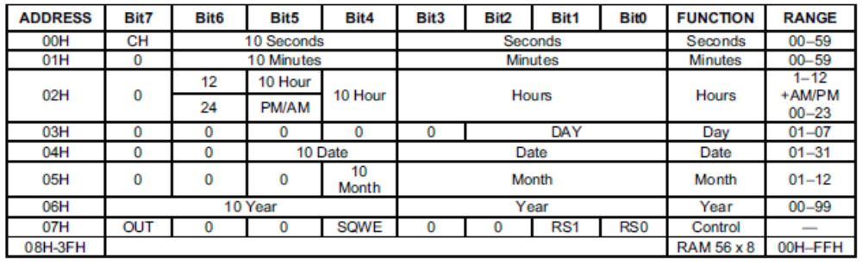
DS1307 (Real Time Counter)
  64 bytes of Ram
  BCD format is used
  Bit7 of address location 0 (CH) should be zero to enable the oscillator
  Address location 07 is the control register

Slide 30
DS1307 (Real Time Counter)
Register Pointer
  In DS1307 there is a register pointer that specifies the byte that will be accessed in the next read or write command.
  After each read or write operation, the content of the register pointer is automatically incremented. It is useful inmultibyte read or write.

Slide 31
Write to DS1307
Transmit START condition
Transmit the address of DS1307 (1001101) followed by 0 to indicate a write operation
Transmit the address of location you want to access (it set the value of Register Pointer)
Transmit one or more bytes of date
Transmit STOP condition

Slide 32
Read from DS1307
Transmit START condition
Transmit the address of DS1307 (1001101) followed by 1 to indicate a read operation
Receive one or more bytes of date
Transmit STOP condition
  Note: the register pointer indicates which address will be read ( you should set it using a write operation)

