Slide 1

ADC and DAC Programming in AVR
The AVR microcontroller
and embedded
systems
using assembly and c

Slide 2
Topics
What is ADC and why do we need it?
ADC major characteristics
ADC in AVR
Hardware Consideration
AVR ADC Programming
  ADCH and ADCL
  ADMUX
  ADCSRA
DAC
Signal conditioning and sensors

Slide 3
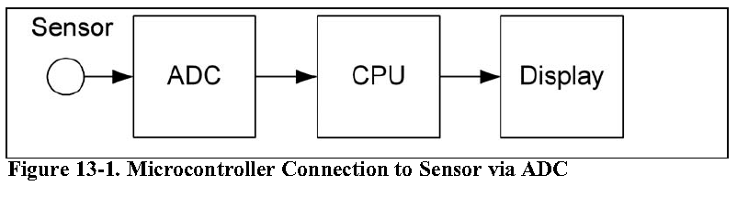
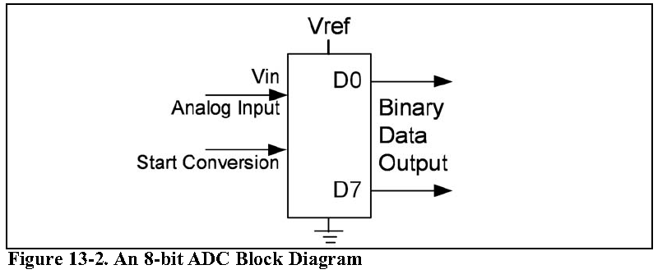
What is ADC? Do we need it?
Analogue vs. digital signal

Slide 4
ADC major characteristics
Conversion Time
Resolution
Vref
Parallel vs. serial
Input channels
Step Size

Slide 5
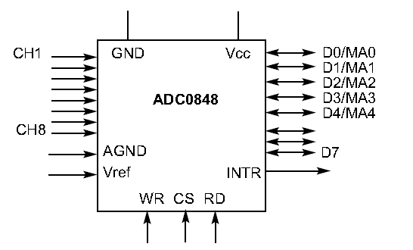
Some of ADC Signals
Dout = Vin / Step size
  ( in 8 bit ADC and Vref = 2.56 what is D out for 20mV input voltage?)
Start of Conversion
Channel Selector

Slide 6
ADC in AVR
Atmega 16/32 have internal ADC
  8 analogue input channel
  7 differential input channel
  2 differential input channel with 10x or 200x gain
  3 source of Vref
  Internal 2.56V Vref generator

Slide 7
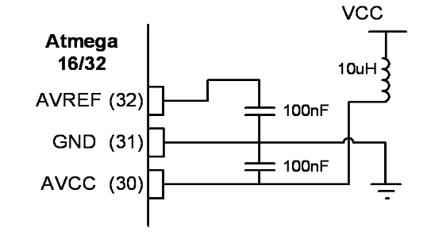
Hardware Consideration

Slide 8
ADCH and ADCL Data registers
ADCH:ADCL store the results of conversion.
The 10 bit result can be right or left justified:
ADLAR = 0
ADLAR =1

Slide 9
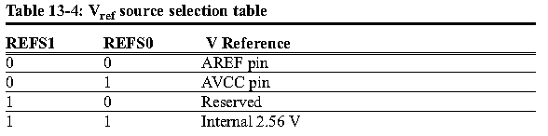
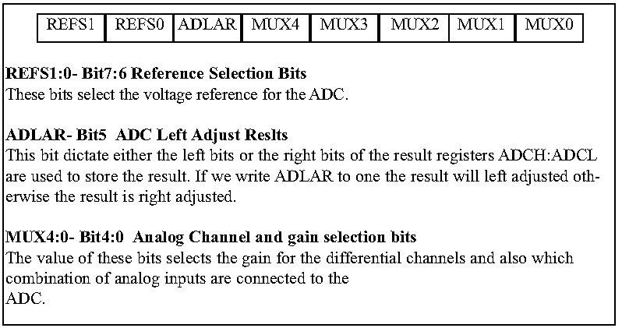
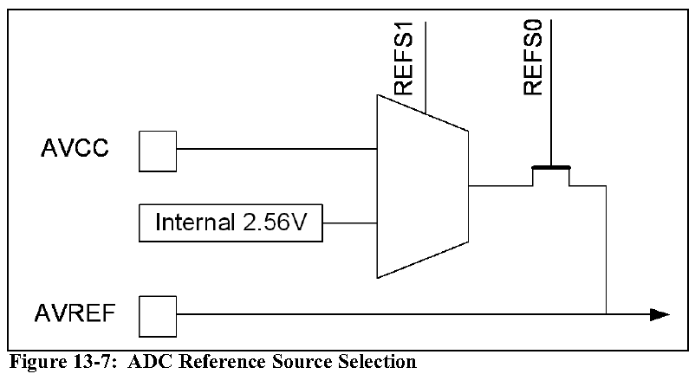
ADMUX

Slide 10
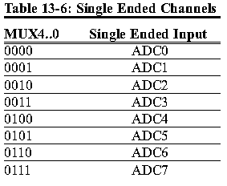
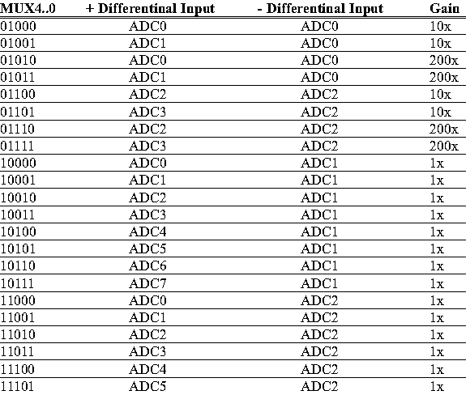
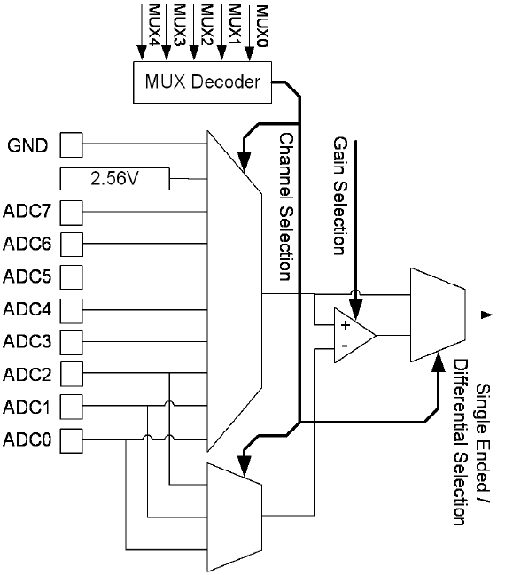
ADC input selection

Slide 11
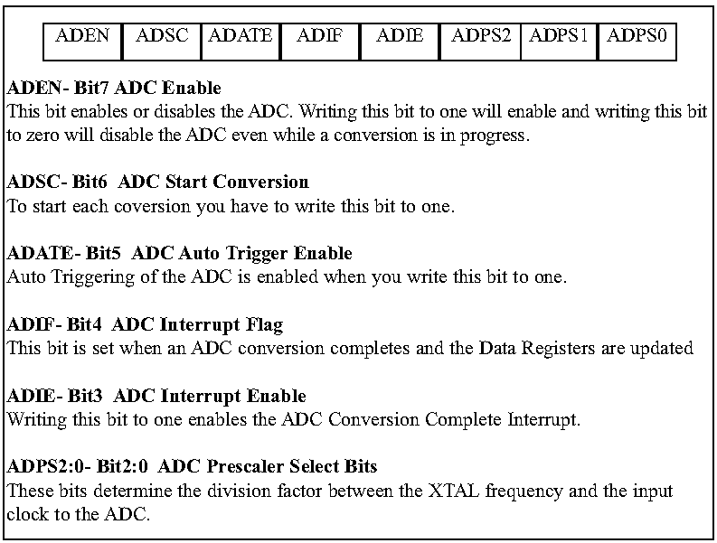
ADCSA

Slide 12
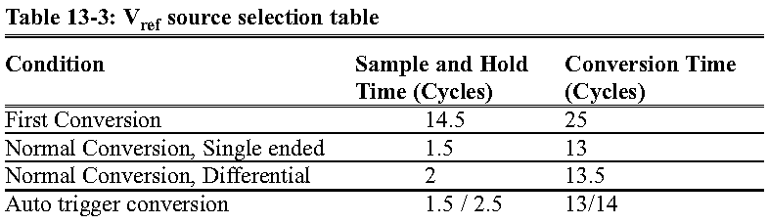
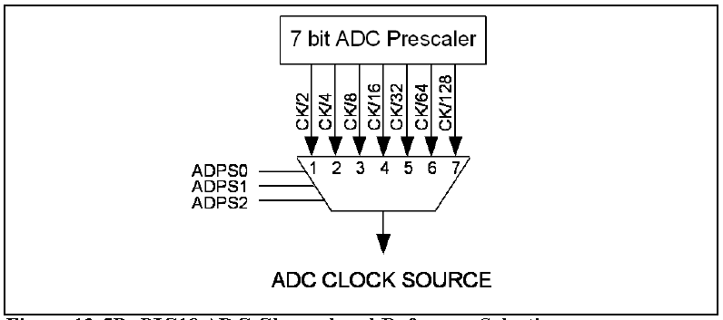
ADC Prescaler
PreScaler Bits let us change the clock frequency of ADC
The frequency of ADC should not be more than 200 KHz
Conversion time is longer in the first conversion

Slide 13
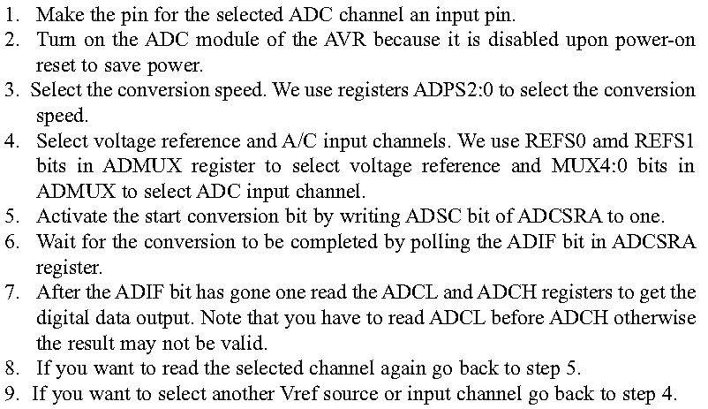
Programming ADC

Slide 14
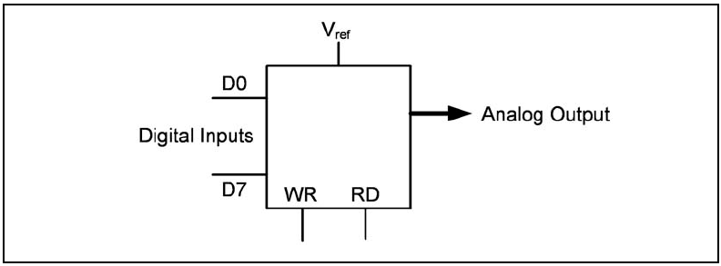

DAC
What is DAC ?
How to connect an DAC to AVR?

Slide 15
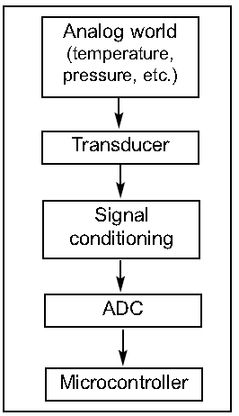
Signal conditioning
Thermo couple provides temp in form of uV
PT100 provides temp in form of resistance
Some humidity sensor provide the result in form of Capacitance
-> We have to change these signals to Voltage to convert it by ADC
    This job is called signal conditioning

Slide 16
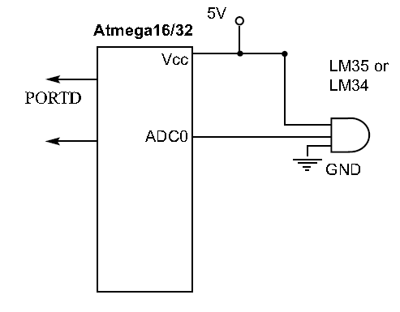
Sensor Interfacing

