Slide 1
DC motor and PWM

Slide 2
Topics
DC motor
  Unidirectional control
  Bidirectional control
PWM modes
  Wave generating using Fast PWM
  Wave generating using Phase correct PWM

Slide 3
DC motor

Slide 4

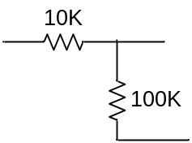
Unidirectional control
+12V
AVR
Analog Ground
M
VCC
Analog
Power
GND
TIP120
+5^{V}
Digital Ground

Slide 5
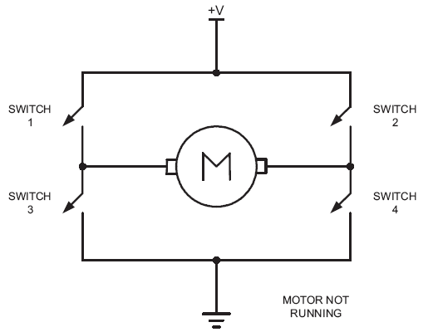
Bidirectional control

Slide 6
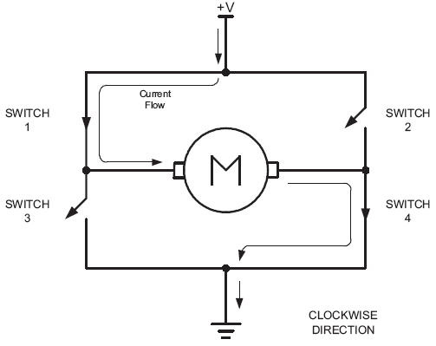
Bidirectional (clock wise)

Slide 7
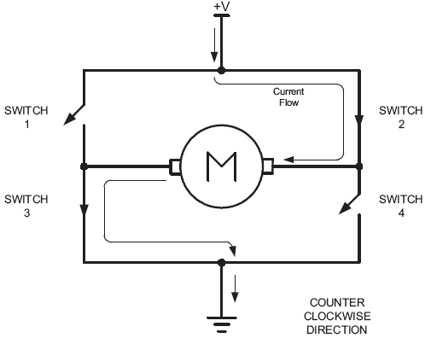
Bidirectional (counter clockwise)

Slide 8
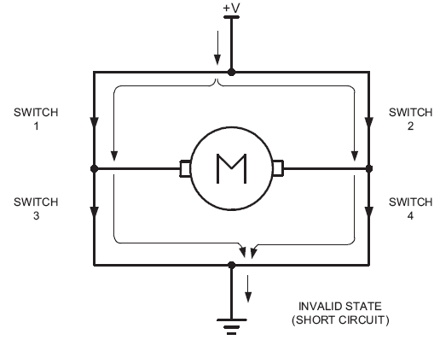
Bidirectional

Slide 9
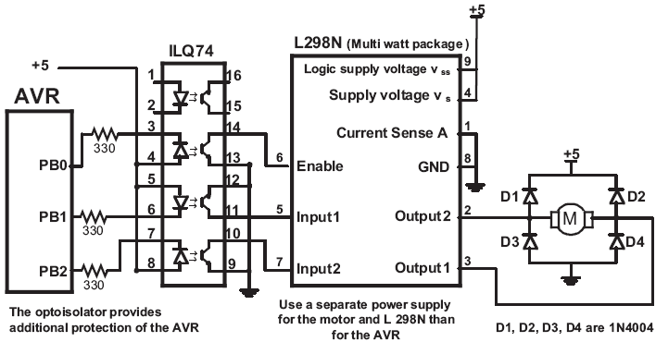
Using L298N

Slide 10
Timer0 Review
TCCR0
TCNT0
TOV0
=
OCF0
OCR0

Slide 11
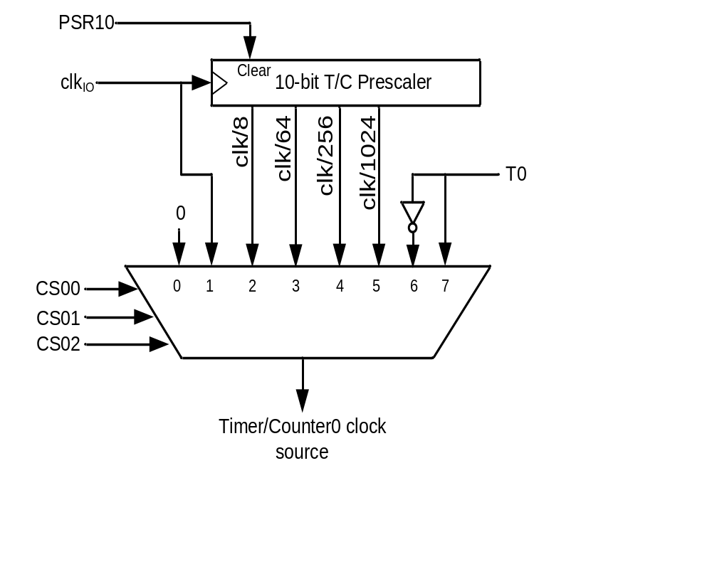
Clock Selector (CS)
Timer Mode (WGM)
CS02 CS01 CS00 Comment
0 0 0 No clock source (Timer/Counter stopped)
0 0 1 clk (No Prescaling)
0 1 0 clk / 8
0 1 1 clk / 64
1 0 0 clk / 256
1 0 1 clk / 1024
1 1 0 External clock source on T0 pin. Clock on falling edge
1 1 1 External clock source on T0 pin. Clock on rising edge
WGM00 WGM01 Comment
0 0 Normal
0 1 CTC (Clear Timer on Compare Match)
1 0 PWM, phase correct
1 1 Fast PWM

Slide 12
Fast PWM mode
Similar to Normal mode but OCR0 is buffered.
0
TCNT0
TOV0:
1
0xFF
TOV
TOV
TOV
0
time
TCNT0
FF
TOV0
=
OCF0
FE
OCR0
2
1
TOV0
0
TOV0 = 1
OCR0-BUF

Slide 13
Phase Correct PWM mode
Goes up and down like a yo-yo
When TCNT becomes zero, the TOV0 flag sets.
0
TCNT0
TOV0:
1
0xFF
0
TOV
time
FF
TCNT0
FE
TOV0
=
OCF0
2
OCR0
TCNT0=0xFF
1
0
TOV0 = 1
OCR0-BUF

Slide 14
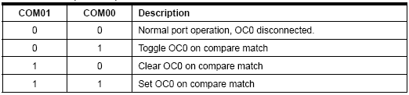
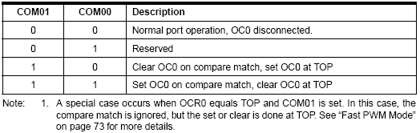
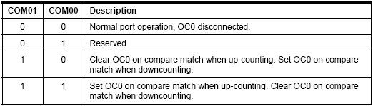
Compare Output Mode (COM)
CTC or Normal (Non PWM)
Fast PWM
Phase Correct PWM

Slide 15
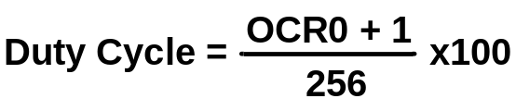
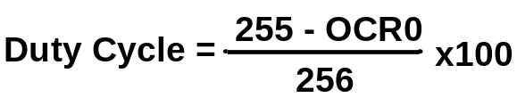
Fast PWM
Duty cycle = changeable (0% to 100%)
Frequency = selectable between limited choices
Phase Correct PWM
Compare Output Mode (COM)
CTC or Normal (Non PWM)
TCNT0
TCNT0
0xFF
0xFF
OCR0
OCR0
0
0
Fast PWM
OC0
OC0
COM=2
OC0
OC0
COM=3
f_{clk}
F_{OC0}=
N(256)

Slide 16
Assuming XTAL = 8 MHz, make the following pulse duty cycle = 75% and frequency = 31.250KHz
f_{clk}
8MHz
8MHz
F_{OC0}=
31.250KHz=
N =
=1
N(256)
N(256)
31.250K*256
75/100 = (OCR0+1)/255 ➔ OCR0+1 = 191 = 0xBF ➔ OCR0 = 0xBE
LDI R20,0xBE
OUT OCR0,R20
LDI R20,0x79
OUT TCCR0,R20
OCR0 = 0xBE;
TCCR0 = 0x79;

Slide 17
Compare Output Mode (COM)
CTC or Normal (Non PWM)
Fast PWM
Phase Correct PWM

Slide 18

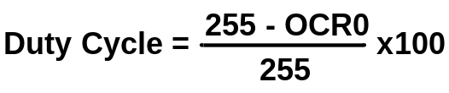
Phase Correct PWM
Duty cycle = changeable (0% to 100%)
Frequency = selectable between limited choices
Compare Output Mode (COM)
TCNT0
CTC or Normal (Non PWM)
TCNT0
0xFF
0xFF
OCR0
OCR0
0
0
OC0
Fast PWM
OC0
COM=2
OC0
OC0
COM=3
Phase Correct PWM
f_{clk}
F_{OC0}=
N(510)

