Slide 1

Arithmetic and Logic
Chapter 5
The AVR microcontroller
and embedded
systems
using assembly and c

Slide 2
Objectives
The concept of signed numbers and 2’complement
Addition and subtraction instructions
Carry and overflow
Logical instruction and masking
Compare instruction and branching
Shift, Rotate and Data serialization
BCD, Packed BCD and ASCII conversion.

Slide 3
Some ideas
100 – 34 = ?
99 – 34 = ?
100 – 34 = (99-34) + 1
34 – 19 = ?
34 +100 -19 – 100 = 34 + (99-19)+1 -100

Slide 4
100000000 – 00101101 = ?
=011111111 – 00101101 + 1 =A
010110110 – 00101101 =
010110110 + A – 100000000 =

Slide 5
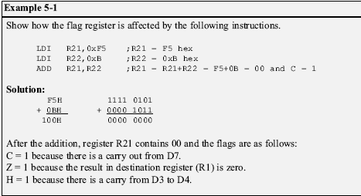
ADD instructions
ADD Rd,Rr ;Rd = Rd + Rr ( Direct or immediate are not supported)

Slide 6
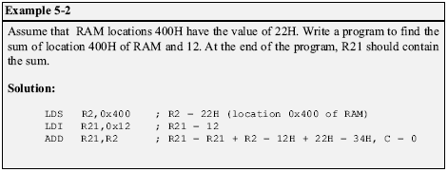
ADD instructions
ADD Rd,Rr ;Rd = Rd + Rr ( Direct or immediate are not supported)

Slide 7

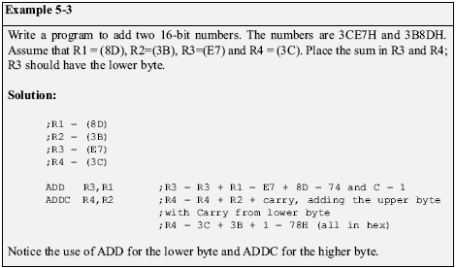
ADC instructions

Slide 8
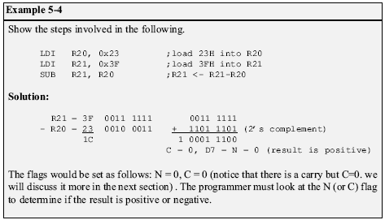
SUB instruction
SUB Rd,Rr ;Rd = Rd - Rr ( immediate are not supported)
SUB Rd,Rr ; Rd = Rd – K

Slide 9
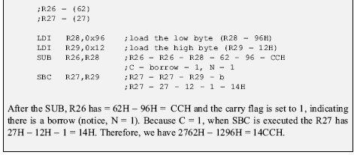
SBC instruction
SBC Rd,Rr ;Rd = Rd – Rr-C ( immediate are not supported)
SBIc Rd,Rr ;Rd = Rd – K-C
27 62 (H)
- 11 96 (H)
-----------
11 CC (H)

Slide 10

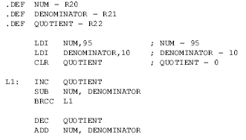
Multiplication and Division

Slide 11
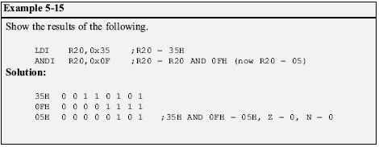
Logic Instructions
AND Rd,Rr ;Rd = Rd AND Rr
OR Rd,Rr ;Rd = Rd OR Rr
EOR Rd,Rr ;Rd = Rd XOR Rr ( immediate are not supported)
COM Rd,Rr ;Rd = 1’ Complement of Rd (11111111 – Rd)
NEG Rd,Rr ;Rd = 2’ Complement of Rd (100000000 – Rd)
AND is used to clear an specific bit/s of a byte
OR is used to set an specific bit/s of a byte

Slide 12


Setting and Clearing bits
AND Rd,Rr ;Rd = Rd AND Rr
OR Rd,Rr ;Rd = Rd OR Rr
EOR Rd,Rr ;Rd = Rd XOR Rr ( immediate are not supported)
COM Rd,Rr ;Rd = 1’ Complement of Rd (11111111 – Rd)
NEG Rd,Rr ;Rd = 2’ Complement of Rd (100000000 – Rd)
AND is used to clear an specific bit/s of a byte
OR is used to set an specific bit/s of a byte
AND
OR

Slide 13
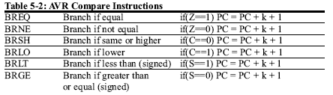
Branch and CP Instructions
CP Rd,Rr ;Rd – Rr (only flags are set)
BRVC is used to branch when oVerflow is clear to zero
BRVS is used to branch when oVerflow is set to one

Slide 14
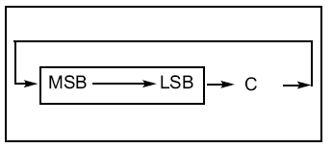
ROR instruction
ROR Rd ;Rd (only flags are set)
In ROR, as bits are rotated from left to right, the carry flag enters the MSB
and the LSB exits to the carry flag. In other words, in ROR the C is moved to the MSB, and the LSB is moved to the C.
See what happens to 0010 0110 after running 3 ROR instructions:
CLC ;make C = 0 (carry is 0 )
LDI R20 , 0x26 ;R20 = 0010 0110
ROR R20 ;R20 = 0001 0011 C = 0
ROR R20 ;R20 = 0000 1001 C = 1
ROR R20 ;R20 = 1000 0100 C = 1

Slide 15
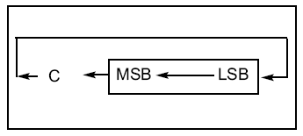
ROL instruction
ROR Rd ;Rd (only flags are set)
ROL. In ROL, as bits are shifted from right to left, the carry flag enters the LSB and the MSB exits to the carry flag. In other words, in ROL the C is moved to the LSB, and the MSB is moved to the C.
SEC ;make C = 1 (carry is 0)
LDI R20,0x15 ;R20 = 0001 0101
ROL R20 ;R20 = 0010 1011 C = 0
ROL R20 ;R20 = 0101 0110 C = 0
ROL R20 ;R20 = 1010 1100 C = 0
ROL R20 ;R20 = 0101 1000 C = 1

Slide 16
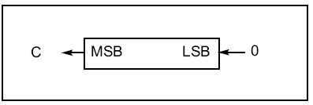
LSL instruction
LSL Rd ;logical shift left
In LSL, as bits are shifted from right to left,
0 enters the LSB and the MSB exits to the
carry flag. In other words, in LSL 0 is
moved to the LSB, and the
MSB is moved to the C.
this instruction multiplies content of the register by 2 assuming that after
LSL the carry flag is not set.
In the next code you can see what happens to 00100110 after running 3 LSL instructions.
CLC ;make C = 0 (carry is 0 )
LDI R20 , 0x26 ;R20 = 0010 0110(38) c = 0
LSL R20 ;R20 = 0100 1100(74) C = 0
LSL R20 ;R20 = 1001 1000(148) C = 0
LSL R20 ;R20 = 0011 0000(98) C = 1 as C=1 and content of R20
;is not multiplied by 2

Slide 17
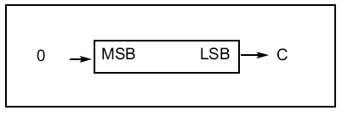
ROR Rd ;Rd (only flags are set)
In LSR, as bits are shifted from left to
right, 0 enters the MSB and the LSB exits to the carry flag. In other words, in LSR
0 is moved to the MSB, and
the LSB is moved to the C.
this instruction divides content of the register by 2 and carry flag contains the remainder of division.
In the next code you can see what happens to 0010 0110 after running 3 LSL instructions.
LDI R20,0x26 ;R20 = 0010 0110 (38)
LSR R20 ;R20 = 0001 0011 (19) C = 0
LSR R20 ;R20 = 0000 1001 (9) C = 1
LSR R20 ;R20 = 0000 0100 (4) C = 1

Slide 18
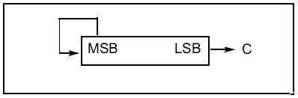
ASR Instruction
ROR Rd ;Rd (only flags are set)
ASR means arithmetic shift right. ASR
instruction can divide signed number by 2. In LSR, as bits are shifted from left to
right, MSB is held constant and the LSB exits to the carry flag. In other words
MSB is not changed but is copied to D6, D6 is moved to D5, D5 is moved to D4
and so on.
In the next code you can see what happens to 0010 0110 after running 5 ASL instructions.
LDI R20 , 0D60 ;R20 = 1101 0000(-48) c = 0
LSL R20 ;R20 = 1110 1000(-24) C = 0
LSL R20 ;R20 = 1111 0100(-12) C = 0
LSL R20 ;R20 = 1111 1010(-6) C = 0
LSL R20 ;R20 = 1111 1101(-3) C = 0
LSL R20 ;R20 = 1111 1110(-1) C = 1

Slide 19
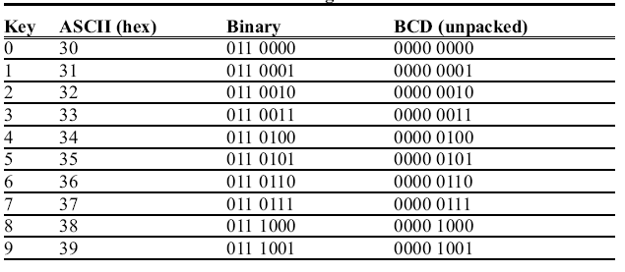
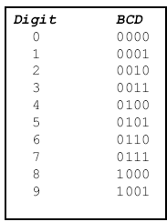
BCD, Packed BCD and ASCII conversion.
ASCII Codes
BCD
BCD Codes
Packed BCD
BCD₁
BCD₀
ASCII and BCD Codes for Digits 0–9

Slide 20
Packed BCD to ASCII conversion
To convert packed BCD to ASCII:
you must first convert it to unpacked BCD.
Then the unpacked BCD is tagged with 011 0000 (30H).
Packed BCD = 1001 0010
Un packed BCD = 0000 1001 , 0000 0010
ACSII = 0011 1001 , 0011 0010

