Slide 1

Advanced Assembly
Chapter 6
The AVR microcontroller
and embedded
systems
using assembly and c

Slide 2
Topics
Assembler directives
Addressing modes
Macro
EEPROM memory
Checksum

Slide 3
Some Assembler directives
 | Example
+ | LDI R20,5+3 ;LDI R20,8
- | LDI R30,9-3 ;LDI R30,6
* | LDI R25,5*7 ;LDI R25,35
/ | LDI R19,8/2 ;LDI R19,4
 | Example
& | LDI R20,0x50&0x10 ;LDI R20,0x10
| | LDI R25,0x50|0x1 ;LDI R25,0x51
^ | LDI R23,0x50^0x10 ;LDI R23,0x40
 | Example
<< | LDI R16, 0x10<<1 ;LDI R16,0x20
>> | LDI R16, 0x8 >>2 ;LDI R16,0x2

Slide 4
HIGH and LOW
LDI R20, LOW(0x1234)
LDI R21, HIGH(0x1234)
LDI R20, $34
LDI R21, $12
$1234
HIGH
LOW
LDI R20, LOW(-200)
LDI R21, HIGH(-200)
LDI R20, $FF
LDI R21, $38
-200 =
$FF38
HIGH
LOW

Slide 5
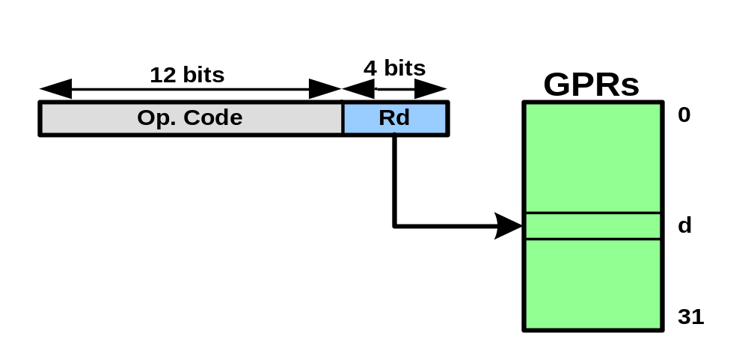
Single Register Addressing Mode
Single Register Addressing Mode
  INC Rd
    INC R19
  DEC Rd
    DEC R23 ;R23 = R23 – 1

Slide 6
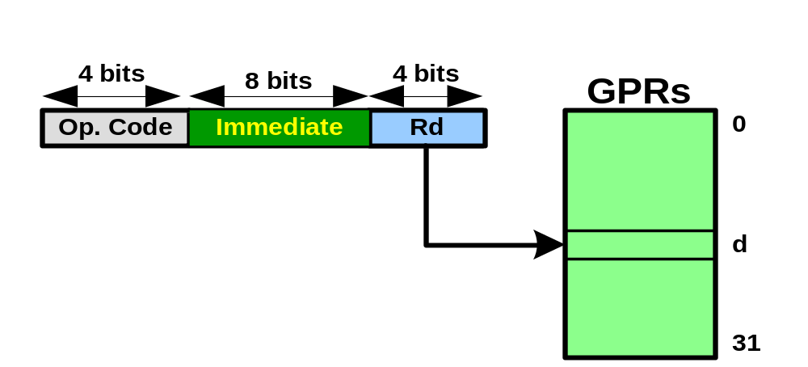
Immediate Addressing Mode
(Single register with immediate)
LDI Rd,K
  LDI R19,25
SUBI Rd,K
  SUBI R23,5 ;R23 = R23 – 5
ANDI Rd,K
  ANDI R21,0x15

Slide 7
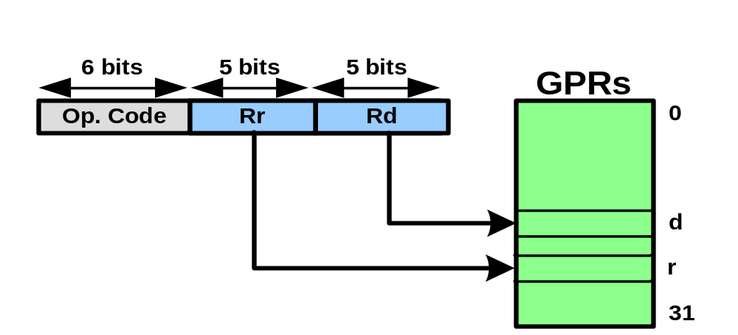
Two-register addressing mode
ADD Rd,Rr
  ADD R26,R23
SUB Rd,Rr
  LDI R20,R10

Slide 8


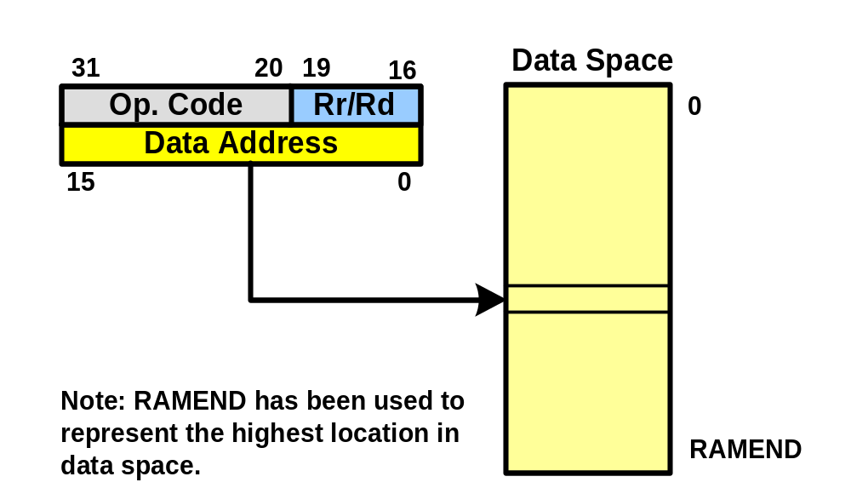
Direct addressing mode
LDS Rd,address
  LDS R19,0x313
STS address,Rs
  STS 0x95,R19

Slide 9
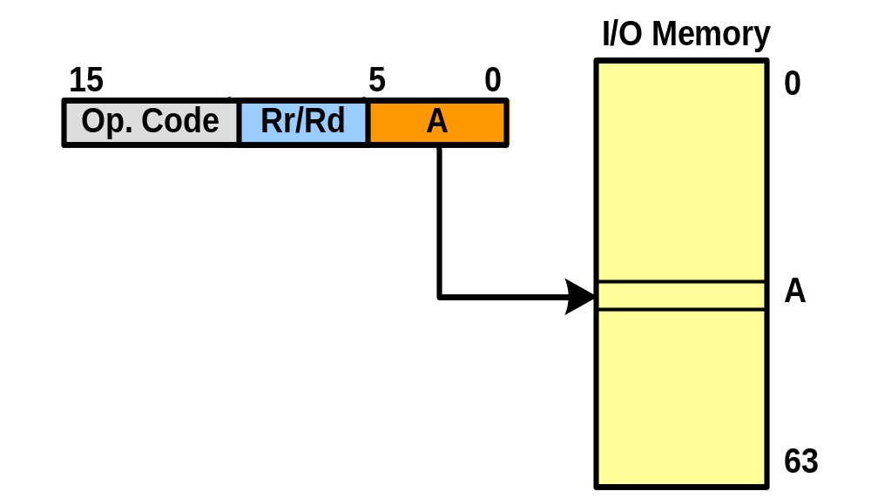
I/O direct addressing mode
OUT address, Rs
  OUT 0x70,R16
IN Rs,address
  IN R19,0x90

Slide 10
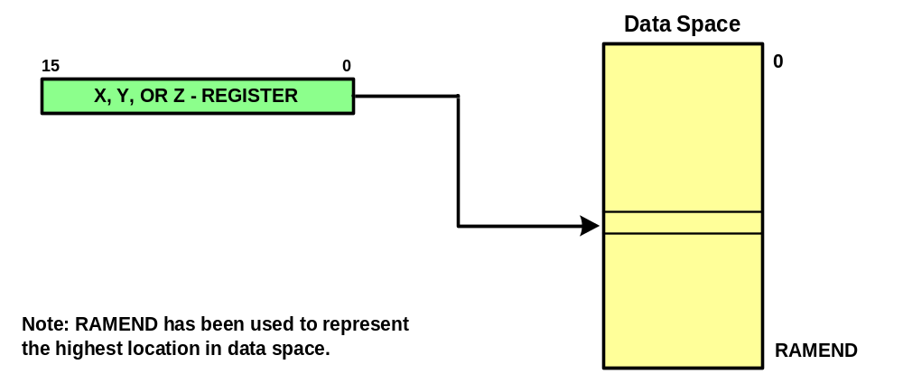
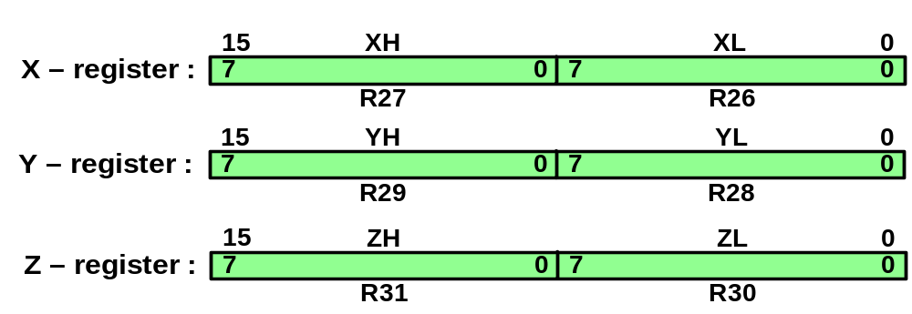
Register indirect addressing mode
LD Rd,X
  LD R24,X
  LD R19,Y
  LD R20,Z
ST X,Rd
  ST X,R18
  ST Y,R20

Slide 11
Example
Write a program to copy the value $55 into memory locations $140 to $144
LDI R19,0x5 ;R19 = 5 (R19 for counter)
LDI R16,0x55 ;load R16 with value 0x55 (value to be copied)
LDI YL,0x40 ;load the low byte of Y with value 0x40
LDI YH,0x1 ;load the high byte of Y with value 0x1
L1: ST Y,R16 ;copy R16 to memory location 0x140
INC YL ;increment the low byte of Y
DEC R19 ;decrement the counter
BRNE L1 ;loop until counter = zero
LDI YL,0x40
LDI YH,0x1
LDI YL,LOW(0x140)
LDI YH,HIGH(0x140)

Slide 12
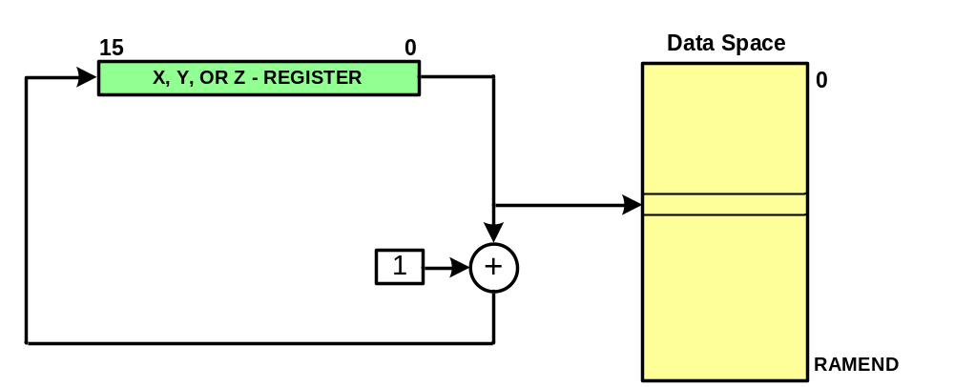
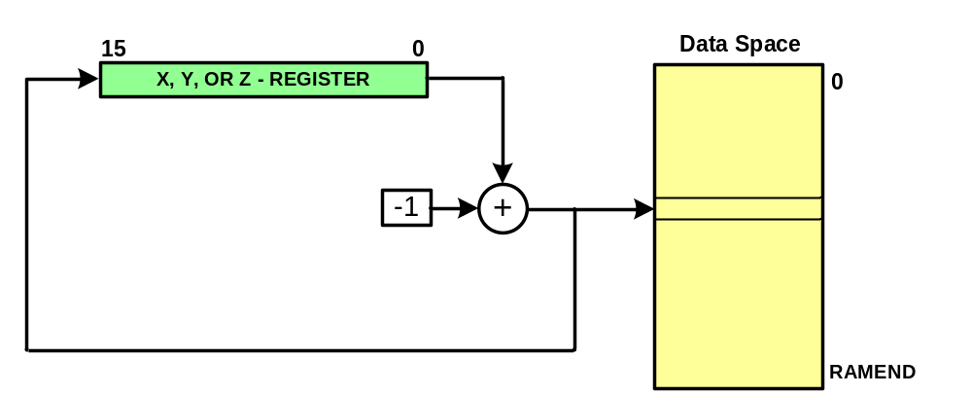
Auto-increment and Auto decrement
Register indirect addressing with Post-increment
  LD Rd, X+
    LD R20,X+
  ST X+, Rs
    ST X+, R8
Register indirect addressing with Pre-decrement
  LD Rd, -X
    LD R19,-X
  ST –X,R31

Slide 13
Example
Write a program to copy the value $55 into memory locations $140 to $444
LDI R19,0x5 ;R19 = 5 (R19 for counter)
LDI R16,0x55 ;load R16 with value 0x55 (value to be copied)
LDI YL,LOW($140) ;load the low byte of Y with value 0x40
LDI YH,HIGH($140) ;load the high byte of Y with value 0x1
L1: ST Y+,R16 ;copy R16 to memory location Y
DEC R19 ;decrement the counter
BRNE L1 ;loop until counter = zero

Slide 14
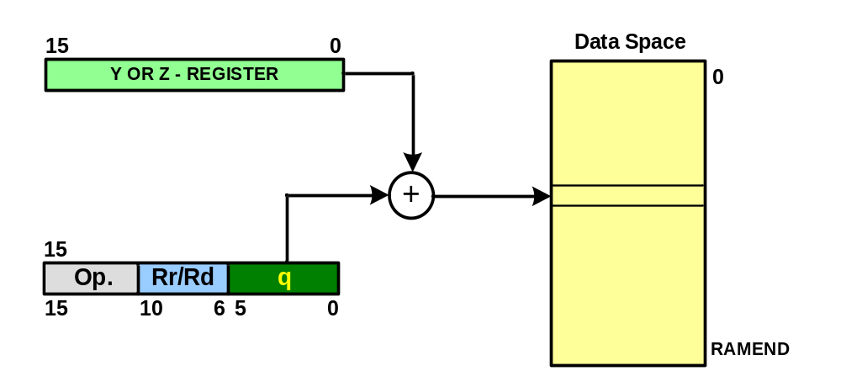
Register indirect with displacement
STD Z+q,Rr ;store Rr into location Z+q
  STD Z+5,R20 ;store R20 in location Z+5
LDD Rd, Z+q ;load from Z+q into Rd
  LDD R20, Z+8 ;load from Z+8 into R20

Slide 15
Storing fixed data in flash memory
DATA1: .DB 28 ;DECIMAL(1C in hex)
DATA2: .DB 0b00110101 ;BINARY (35 in hex)
DATA3: .DB 0x39 ;HEX
DATA4: .DB 'Y' ;single ASCII char
DATA6: .DB "Hello ALI" ;ASCII string

Slide 16
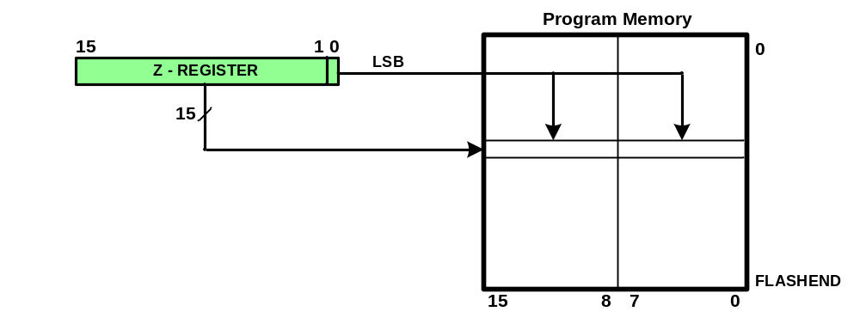
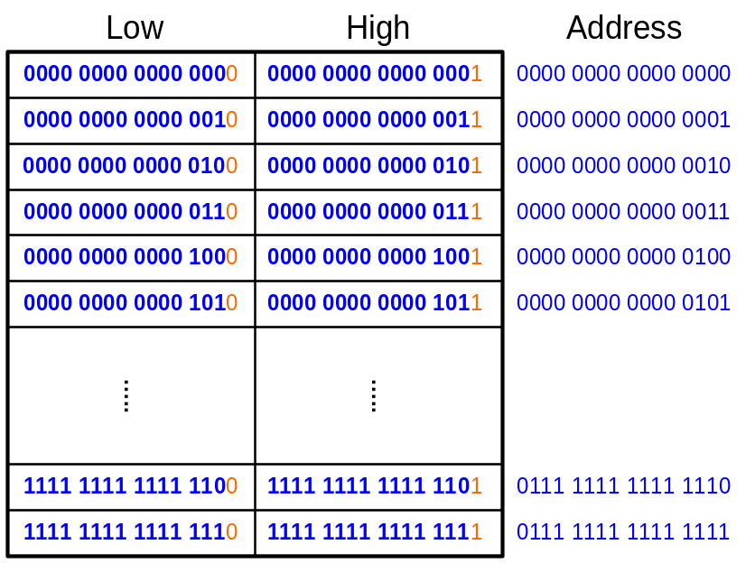
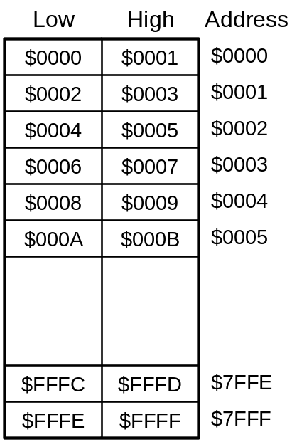
Storing fixed data in flash memory
LPM Rd, Z
  LPM R15, Z
  Example:
    LDI R30,0x80
    LDI R31,0
    LPM R18,Z ;read from the low byte of loc 0x40
LPM Rd, Z+
  LPM R20,Z

Slide 17
Example
Analyze the following program; then rewrite it using LPM R20,Z+
.ORG $0000 ;burn into ROM starting at 0
LDI R20,0xFF
OUT DDRB,R20 ;make PB an output
LDI ZL, LOW(MYDATA<<1) ;ZL = 0 look-up table low-byte addr
LDI ZH,HIGH(MYDATA<<1) ;ZH = 0A look-up table high-byte addr
LPM R20,Z
OUT PORTB,R20 ;send it to Port B
INC ZL ;R30 = 01 pointing to next byte (A01)
LPM R20,Z ;load R20 with 'S' char pointed to by Z
OUT PORTB,R20 ;send it to Port B
INC ZL ;R30 = 02 pointing to next (A02)
LPM R20,Z ;load R20 with 'A' char pointed to by Z
OUT PORTB,R20 ;send it to Port B
HERE: RJMP HERE ;stay here forever
;data is burned into code(program) space starting at $500
.ORG $500
MYDATA: .DB "USA"
LPM R20,Z
OUT PORTB,R20
INC ZL
LPM R20,Z
OUT PORTB,R20
INC ZL
LPM R20,Z+
OUT PORTB,R20
LPM R20,Z+
OUT PORTB,R20

Slide 18
Example
Assume that ROM space starting at $500 contains the message “The Promise of World Peace”. Write a program to bring it into CPU one byte at a time and place the bytes in RAM locations starting at $140.
.ORG 0 ;burn into ROM starting at 0
LDI ZL, LOW(MYDATA<<1) ;R30 = 00 low-byte addr
LDI ZH, HIGH(MYDATA<<1) ;R31 = 0A, high-byte addr
LDI XL, LOW(0x140) ;R26 = 40, low-byte RAM address
LDI XH, HIGH(0x140) ;R27 = 1, high-byte RAM address
AGAIN: LPM R16, Z+ ;read the table, then increment Z
CPI R16,0 ;compare R16 with 0
BREQ END ;exit if end of string
ST X+, R16 ;store R16 in RAM and inc X
RJMP AGAIN
END: RJMP END
.ORG 0x500 ;data burned starting at 0x500
MYDATA: .DB "The Promise of World Peace",0

Slide 19
Macro
.MACRO INITSTACK
LDI R16,HIGH(RAMEND)
OUT SPH,R16
LDI R16,LOW(RAMEND)
OUT SPL,R16
.ENDMACRO
INITSTACK

Slide 20
Macro
.MACRO LOADIO
LDI R20,@1
OUT @0,R20
.ENDMACRO
LOADIO DDRB,0xFF
LOADIO PORTB,0x55

Slide 21
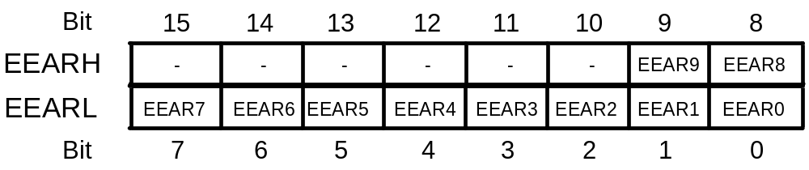



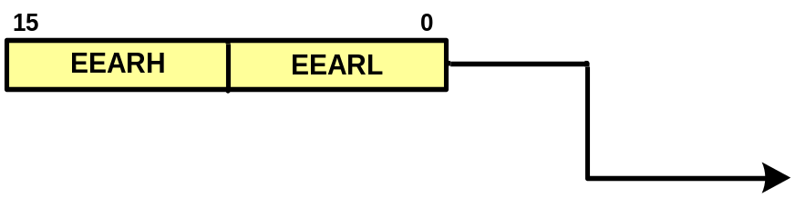
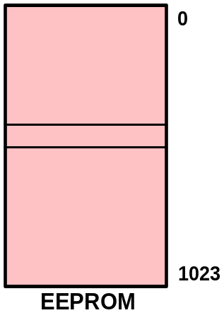

EEPROM
EEPROM Address Register
EEPROM is a place to store data. It is not deleted when power is off
ATmega32 has 1024 bytes of EEPROM
In AVR 3 registers are dedicated to EEPROM
  EEARH:EEARL
  EEDR
  EECR
EEPROM Data Register
EEPROM Control Register

Slide 22
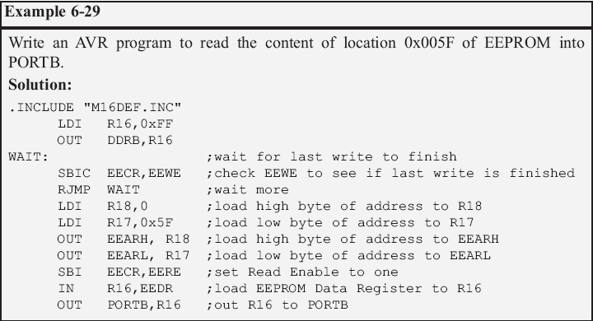
Reading from EEPROM
1. Wait until EEWE becomes zero.
2. Write new EEPROM address to EEAR (optional)
3. Set EERE to one.
4. Read EEPROM data from EEDR.

Slide 23
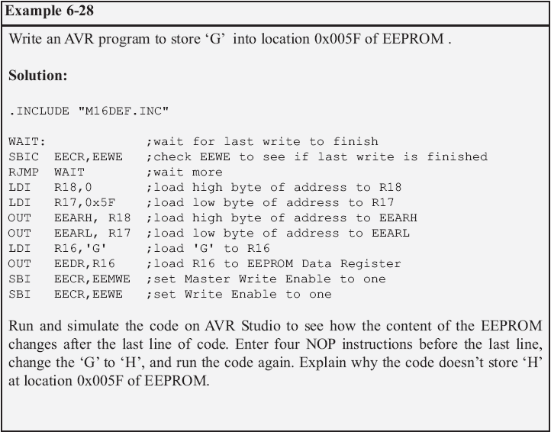
Writing into EEPROM
1. Wait until EEWE becomes zero.
2. Write new EEPROM address to EEAR (optional).
3. Write new EEPROM data to EEDR (optional).
4. Set EEMWE bit to one.
5. Within four clock cycles after setting EEMWE, set EEWE to one.

Slide 24
Checksum
To detect data corruption
Calculating checksum byte:
  Add the bytes together and drop the carries
  Take the 2’s complement of the total sum
Testing checksum
  Add the bytes together and drop the carries
  Add the checksum byte to the sum
  If the result is not zero, data is corrupted

Slide 25
Example
Find the checksum byte for the followings:
$25, $62, $3F, $52
Solution:
$25
+ $62
+ $3F
+ $52
$1 18
Checksum byte = 2’s complement of $18 = $E8

Slide 26
Example
The checksum byte is $E8. Test checksum for the following data:
$25, $62, $3F, $52
Solution:
$25
+ $62
+ $3F
+ $52
+ $E8
$00 ➔ not corrupted

