Slide 1

Fixing Non-blocking Data Structures for Better Compatibility with Memory Reclamation Schemes
Md Amit Hasan Arovi, arovi@psu.edu, The Pennsylvania State University, USA
Ruslan Nikolaev, rnikola@psu.edu, The Pennsylvania State University, USA

Slide 2
Non-blocking Data Structures
Allow multiple threads to operate without mutual exclusion
Lock-free data structures: at least one thread always makes progress
Wait-free data structures: all threads always make progress in a finite number of steps
Require safe memory reclamation (SMR) techniques
Epoch-Based Reclamation (EBR) is easy-to-use but has potentially unbounded memory usage
Hazard Pointers (HP) is more difficult to use but is robust

Slide 3
Problems with Non-blocking Data Structures
Many robust memory reclamation schemes (e.g., HP) fail to support optimistic traversals used in many lock-free algorithms:
Harris’ linked list
The Natarajan-Mittal tree
Many others (skip lists, hash tables, etc)
Workarounds are sometimes available with performance costs
Harris-Michael linked list
No such modification for the Natarajan-Mittal tree

Slide 4
Problem: Harris’ Linked List with HP
A
B
C
F
Thread 0: Delete(B) => Node B is marked for logical deletion
... Thread 0 is stalled

Slide 5
Problem: Harris’ Linked List with HP
Thread 1 (Search)
A
B
C
F
traversing the list
Thread 1: Locate node F

Slide 6
Problem: Harris’ Linked List with HP
Thread 1 (Search)
A
B
C
F
Thread 2 (Delete)
Thread 2: Delete(C)

Slide 7
Problem: Harris’ Linked List with HP
Thread 1 (Search)
A
B
C
F
Thread 2 (Delete)
Thread 2: Node C is marked for logical deletion

Slide 8
Problem: Harris’ Linked List with HP
Thread 1 (Search)
A
B
C
F
Unlinking
Thread 2 (Delete)
Thread 2 unlinks the entire chain of nodes between Node A and Node F
(assuming all consecutive nodes in the chain are logically deleted)

Slide 9
Problem: Harris’ Linked List with HP
Thread 1 (Search)
A
B
C
F
Unlinking
Thread 2 (Delete)
Reclaim Node C
Node C is Reclaimed by Thread 2 and returned to the OS

Slide 10
Problem: Harris’ Linked List with HP
Thread 1 (Search)
traversing the list
SEGFAULT: Node C
A
B
C
F
Unlinking
Thread 2 (Delete)
Reclaim Node C
Thread 1 fails when accessing Node C

Slide 11
Safe Concurrent Optimistic Traversals (SCOT)
Instead of fixing the SMR → fix the data structure
Resolves the robustness vs. applicability dilemma, ERA Theorem [PODC ’23]
Redesign traversals to add local validation

Slide 12
SCOT: Harris’ Linked List
N1
N2
N3
N4
N5
N6
Initial State: List Contains Nodes N1-N6

Slide 13
SCOT: Harris’ Linked List
N1
N2
N3
N4
N5
N6
Reserved
by [Hp1]
Reserved
by [Hp0]
Hp0: protects next Hp1: protects curr Hp2: protects prev (not available at the very beginning)

Slide 14
SCOT: Harris’ Linked List
N1
N2
N3
N4
N5
N6
Reserved
by [Hp2]
Reserved
by [Hp1]
Reserved
by [Hp0]
Moving hazard pointers when moving to the next iteration: curr (N1) [Hp1] -> prev [Hp2] next (N2) [Hp0] -> curr [Hp1] (new) next (N3) [Hp0]

Slide 15
SCOT: Harris’ Linked List
N1
N2
N3
N4
N5
N6
Node N2-N4 are logically deleted

Slide 16

SCOT: Harris’ Linked List
Dangerous zone
N1
N2
N3
N4
N5
N6
Need to be careful while traversing the dangerous zone

Slide 17
SCOT: Harris’ Linked List
Dangerous zone
N1
N2
N3
N4
N5
N6
Reserved by [Hp1]
Reserved by [Hp0]
N1 and N2 protected by hazard pointers’ reservations

Slide 18
SCOT: Harris’ Linked List
Dangerous zone
N1
N2
N3
N4
N5
N6
Reserved by [Hp2]
Reserved by [Hp1]
Reserved by [Hp0]
Next destination N3 N1 is the last safe node and protected by Hp2
Key Observation: Removing only a prefix of a chain

Slide 19
SCOT: Harris’ Linked List
Dangerous zone
N1
N2
N3
N4
N5
N6
Reserved by [Hp2]
Reserved by [Hp1] [Hp3]
Reserved by [Hp0]
Next destination N3 N1 is the last safe node and protected by Hp2 N2 is the first unsafe node protected by Hp3
Hp3 is an extra hazard pointer which protects the 1st unsafe node Hp2 protects the last safe node

Slide 20
SCOT: Harris’ Linked List
Dangerous zone
Validate
prev_next
N1
prev
N2
N3
N4
N5
N6
Reserved by [Hp2]
Reserved by [Hp3]
Reserved by [Hp0]
Validate (*prev = prev_next) after reserving N3 (Hp0)

Slide 21
SCOT: Harris’ Linked List
Dangerous zone
Validate
prev_next
N1
prev
N2
N3
N4
N5
N6
Reserved by [Hp2]
Reserved by [Hp3]
Reserved by [Hp1]
Reserved
by [Hp0]
Validate (*prev = prev_next) after reserving N4 (Hp0)

Slide 22

SCOT: Recovery
Dangerous zone
Validate
prev_next
N1
prev
N2
N3
N4
N5
N6
Reserved by [Hp2]
Reserved by [Hp3]
Reserved by [Hp1]
Reserved
by [Hp0]
What if (*prev = prev_next) validation fails due to a new node being inserted or the chain of logically deleted nodes being already eliminated by a concurrent thread?
We start from the last safe node (N1)

Slide 23

SCOT: Recovery
Dangerous zone
Validate
prev_next
N1
prev
N2
N3
N4
N5
N6
Reserved by [Hp2]
Reserved by [Hp3]
Reserved by [Hp1]
Reserved
by [Hp0]
What if the last safe node (N1) is also logically deleted? We start from the beginning

Slide 24
SCOT: The Natarajan-Mittal Tree
R
root
A
ancestor
F
B
successor
G
C
Leaf nodes contain actual keys Keys in Internal nodes are used for traversal
H
D
parent
leaf
K
E

Slide 25
SCOT: The Natarajan-Mittal Tree
R
root
A
ancestor
F
B
successor
F=1
G
C
F=1
D
parent
H
Leaf nodes G, H, E are deleted (flagged, F=1)
F=1
leaf
K
E

Slide 26
SCOT: The Natarajan-Mittal Tree
R
root
A
ancestor
F
B
successor
F=1
T=1
G
C
F=1
T=1
When leaf nodes G, H, E are deleted (flagged, F=1) Siblings (B-C, C-D, D-K) are tagged (T=1)
D
parent
H
T=1
F=1
leaf
K
E

Slide 27
SCOT: The Natarajan-Mittal Tree
R
root
R
root
Ancestor’s right link is changed from successor (B) to the remaining leaf node (K)
A
ancestor
A
ancestor
F
B
successor
leaf
F=1
T=1
F
K
G
C
F=1
T=1
An important observation: a chain of consecutively tagged edges can be eliminated with one CAS operation by updating ancestor’s link from successor to the remaining leaf node
successor node is the last untagged node
H
D
parent
T=1
F=1
leaf
K
E

Slide 28
SCOT: The Natarajan-Mittal Tree
We allocate 5 hazard pointers to protect nodes in the underlying search procedure: current, leaf, parent, successor, and ancestor. The current node points to the lowest node that is currently considered
After each HP reservation of the current node, if the corresponding node is flagged or tagged, we need to verify that ancestor still points to successor
If ancestor points to some other node or successor becomes tagged, we need to restart from the very beginning

Slide 29
SCOT: Wait-free traversal: Harris’ Linked List
N1
N2
N3
N4
N5
N6
The original data structure with EBR allows wait-free read-only traversals, no need to restart from the beginning

Slide 30
SCOT: Wait-free traversal: Harris’ Linked List
Dangerous zone
Validate
prev_next
N1
prev
N2
N3
N4
N5
N6
If validation fails due to the data structure state change and the last safe node is logically deleted, we need to restart from the beginning;
guarantees lock-free but not wait-free progress.

Slide 31
SCOT: Wait-free traversal: Harris’ Linked List
Our approach is specifically tailored for traversals and uses a per-thread record entry.
Avoids nonstandard instructions (only a regular CAS) and complexity related to dynamically-allocated descriptors (OPODIS ’12, PPoPP ’14).
Search Request_Help Slow_Search

Slide 32
SCOT: Wait-free traversal: Harris’ Linked List
Our approach is specifically tailored for traversals and uses a per-thread record entry.
Avoids nonstandard instructions (only a regular CAS) and complexity related to dynamically-allocated descriptors (OPODIS ’12, PPoPP ’14).
Search Request_Help Slow_Search
Insert / Delete Help_Threads Slow_Search
True

Slide 33
SCOT: Wait-free traversal: Harris’ Linked List
Input request (T_{helpee})
Output result (T_{helpee})
Value
IsInput
Value
IsInput
slow-path cycle #
1
result True/False
0
bit 63:1
bit 0
bit 63:1
bit 0
Output is produced by both helpee and helpers

Slide 34
Evaluation Setup
AMD EPYC 9754, 128 cores, 256 hardware threads, 384 GiB of RAM
SMR Schemes
No-Reclamation (NR) baseline which leaks memory
Epoch-Based Reclamation (EBR)
Hazard Pointers (HP): TPDS ’04
Hazard Eras (HE): SPAA ’17
Interval-Based Reclamation (IBR): PPoPP ’18
Hyaline-1S (HLN): PODC ’19, PLDI ’21

Slide 35
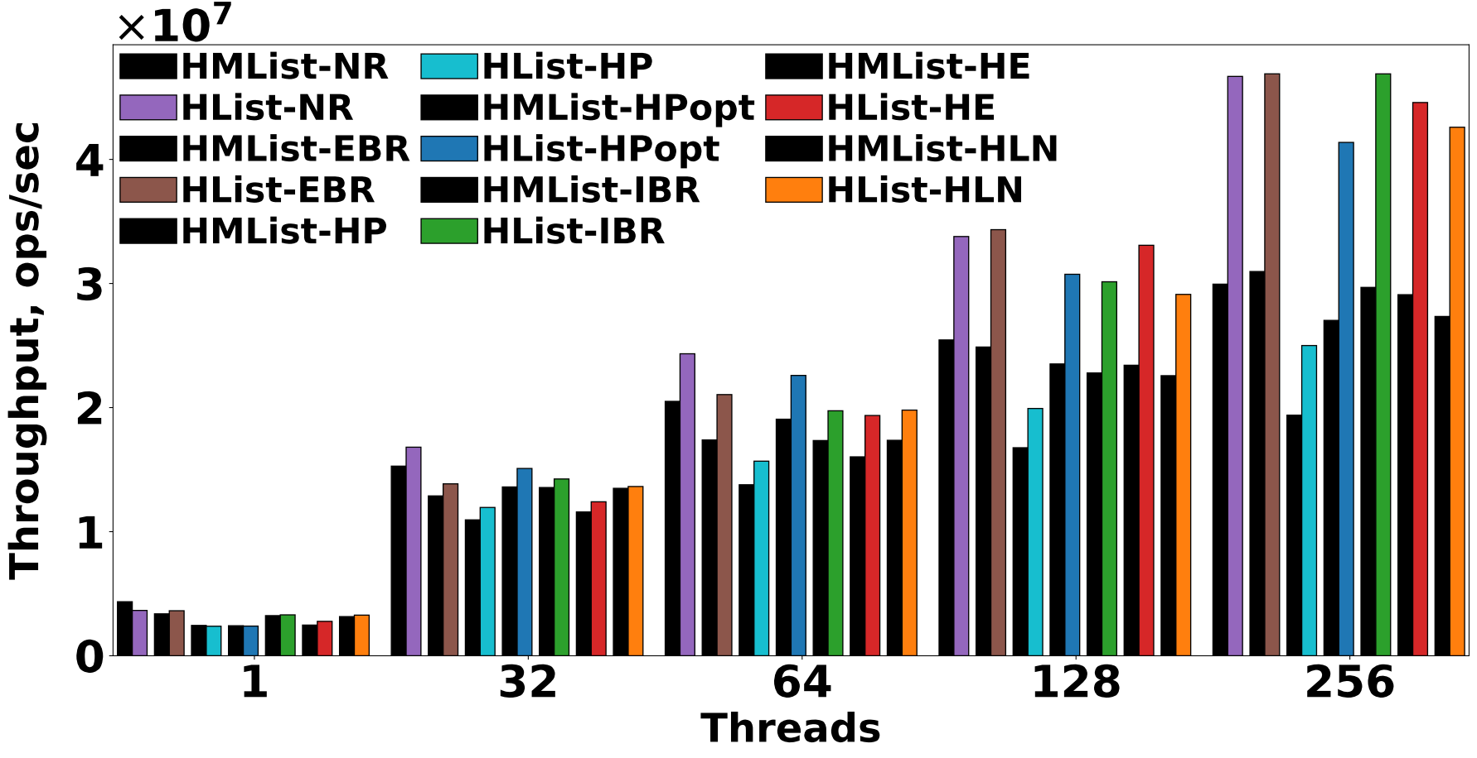
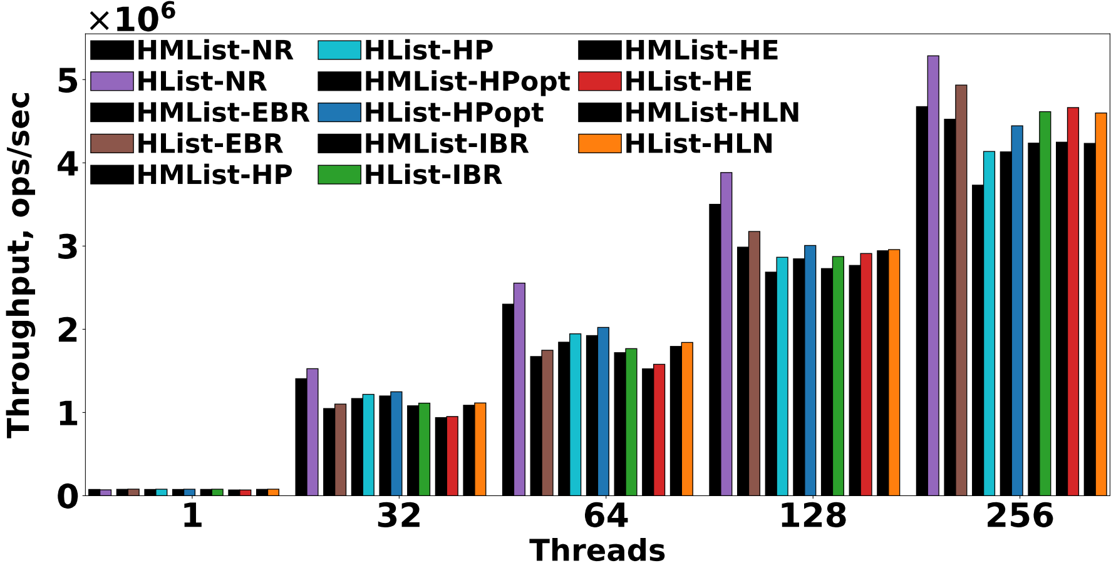
Evaluation: Harris vs. Harris-Michael list (Throughput)
(a) Key Range = 512
(b) Key Range = 10,000

Slide 36
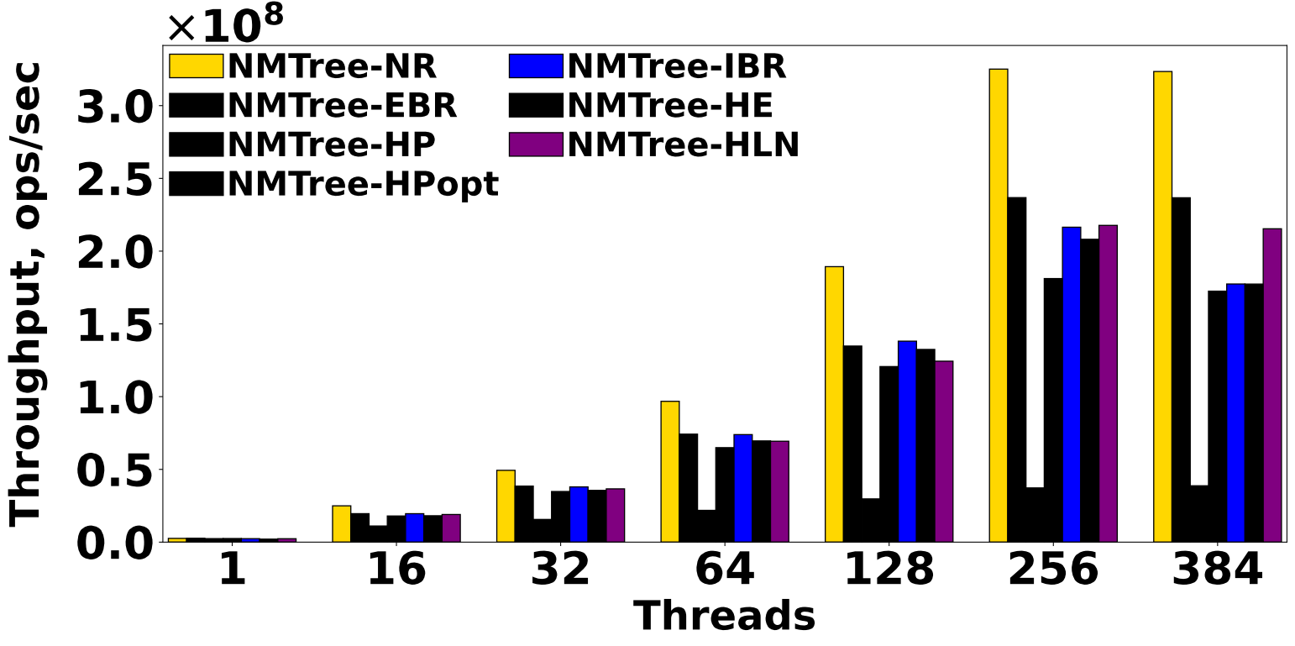
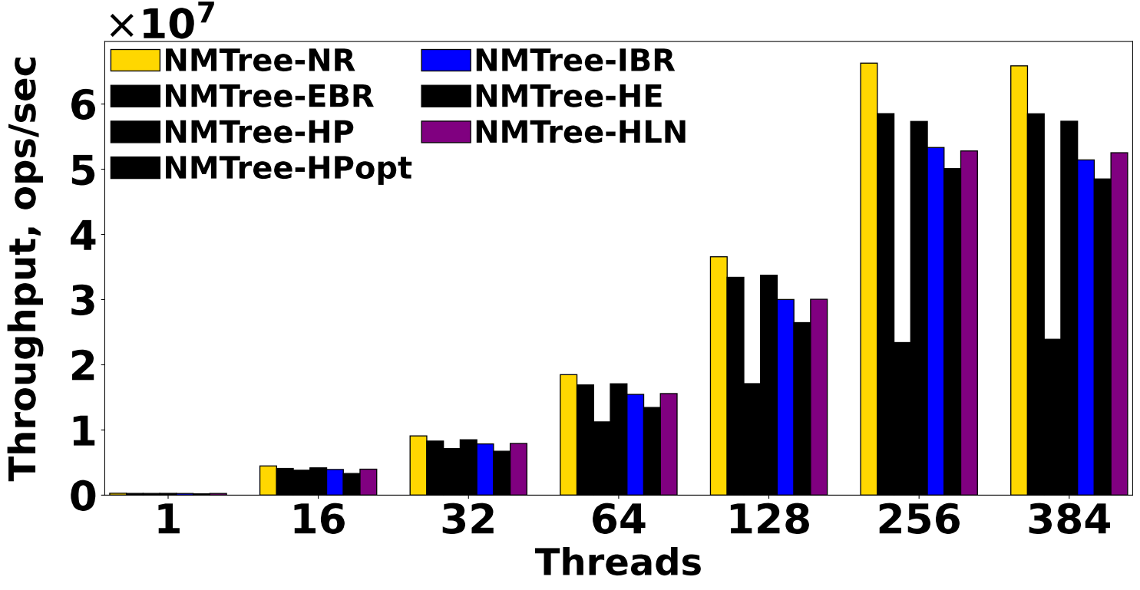
Evaluation: The Natarajan-Mittal tree (Throughput)
(a) Key Range =100,000
(b) Key Range = 50,000,000

Slide 37

Code Availability
Code is open-source and available: GitHub Repository: https://github.com/rusnikola/scot Zenodo DOI: https://doi.org/10.5281/zenodo.17707898

Slide 38
Code Availability
Code is open-source and available: GitHub Repository: https://github.com/rusnikola/scot Zenodo DOI: https://doi.org/10.5281/zenodo.17707898
Thank You!
Questions?

Slide 39
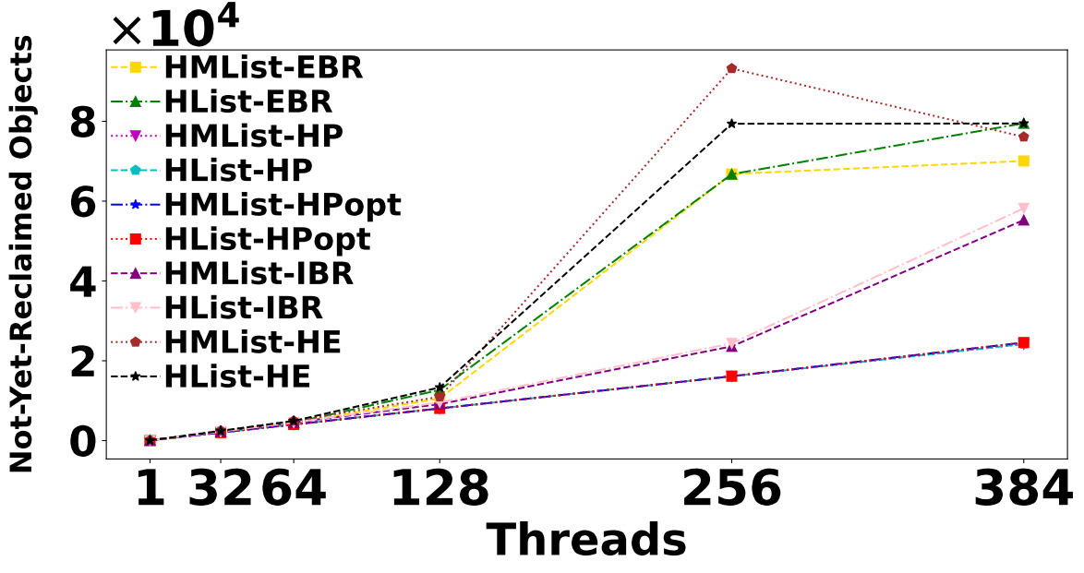
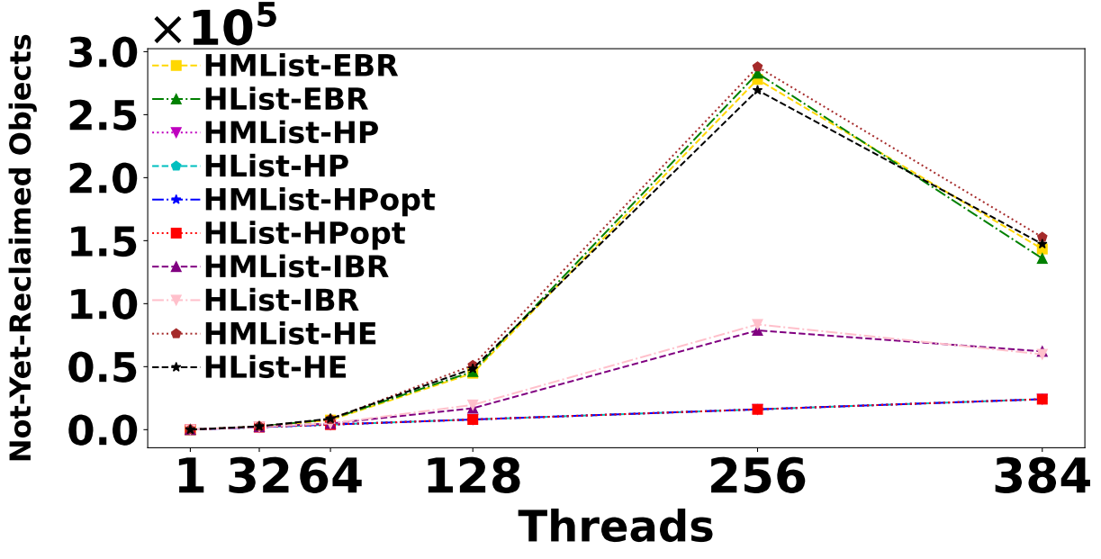
Evaluation: Harris vs. Harris-Michael list (Avg. Number of Not-Yet-Reclaimed Objects)
(a) Key Range = 512
(b) Key Range = 10,000

Slide 40
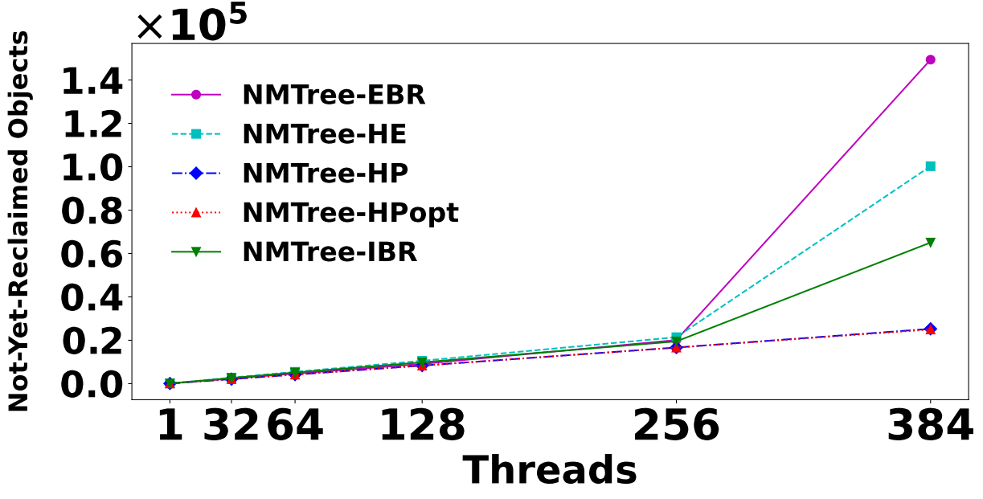
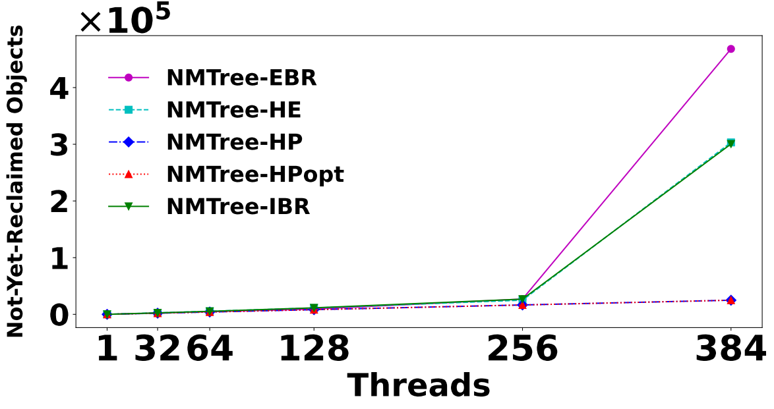
Evaluation: The Natarajan-Mittal tree (Avg. Number of Not-Yet-Reclaimed Objects)
(a) Key Range = 128
(b) Key Range = 100,000

Slide 41
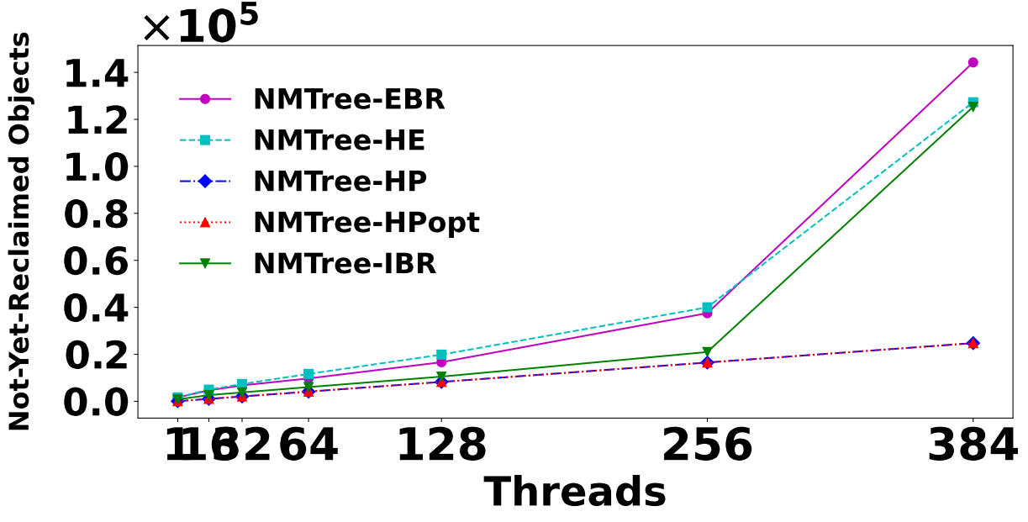
Evaluation: The Natarajan-Mittal tree (Avg. Number of Not-Yet-Reclaimed Objects)
(c) Key Range = 50,000,000

