Slide 1
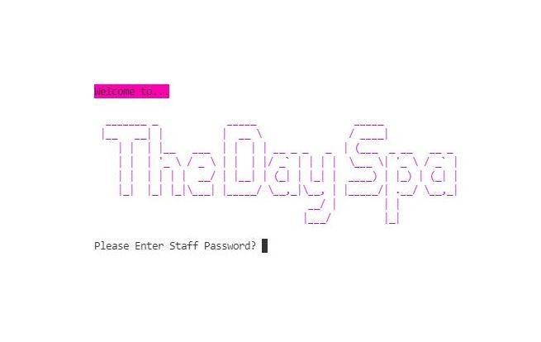
T1A3
Terminal Assessment
Customer Database
Loyalty Card Tracking App

Slide 2
Features
-Add new customers details, phone number, name DOB and points accrued
-View current points, and add to them manually depending on booking
-Reset the points number when they are ‘cashed in’
-Delete old customer records
-View customer card/information
-See which customers have a birthday today
Terminal Assessment
Customer Database
Loyalty Card Tracking App
Used by a staff member at front counter

Slide 3
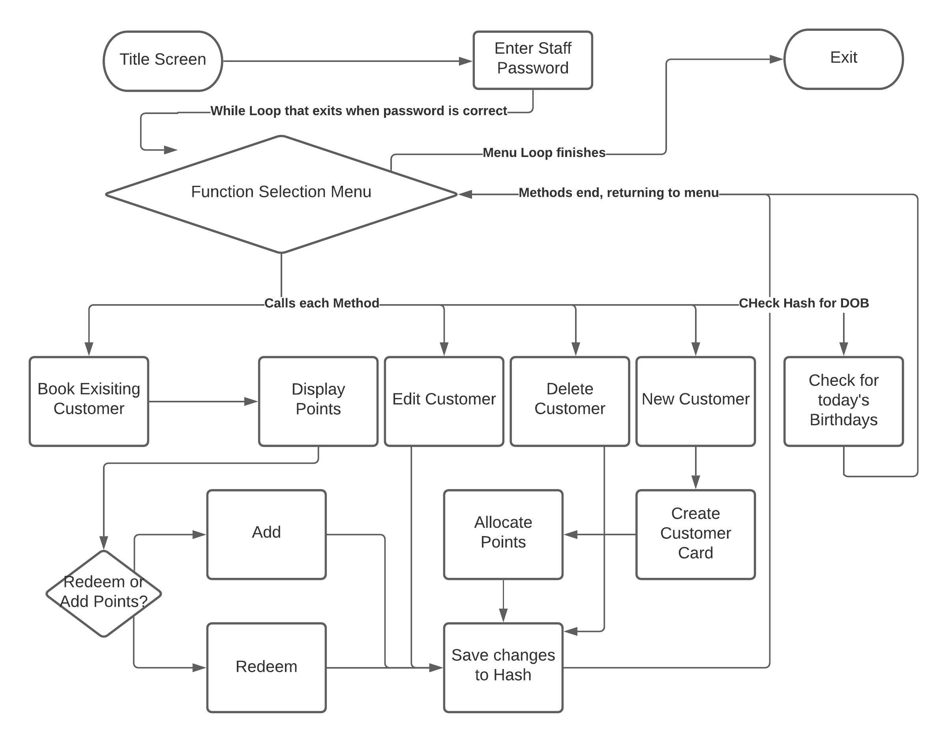
Control Flow
The user will be presented with a title screen, then enter a While Loop which will expect a pre-shared password to exit, and allow the user to get to the main menu.
Each menu item (excluding exit) will run a method either creating, deleting, displaying or editing a hash (customer) inside an array.
Birthday lookup will be handled by a method displaying each hash that matches the entered data (birthdate).
The exit will be handled but the menu being housed in a loop and a variable exit = true being required to exit the loop and closing the program.

Slide 4
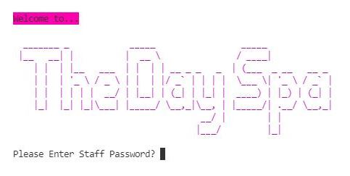
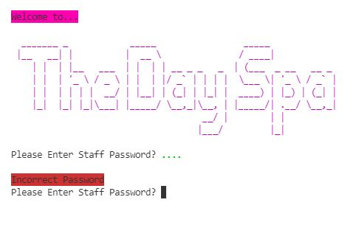
Home Screen
Ascii Art Title, utilizing Colorise, Artii, and Rainbow Ruby Gems
Password Prompt with masked password entry, via TTY-Prompt Ruby Gem
Incorrect passwords yields a repeated question
Correct password proceeds to main-menu

Slide 5
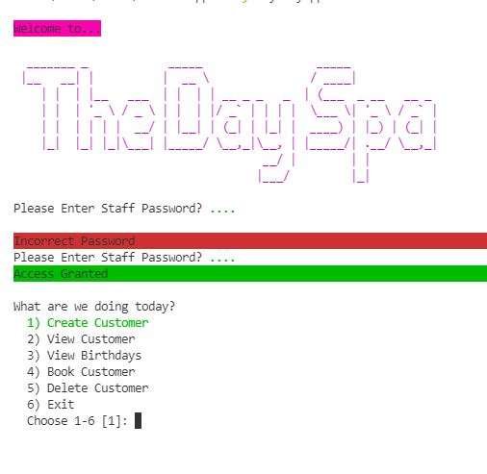
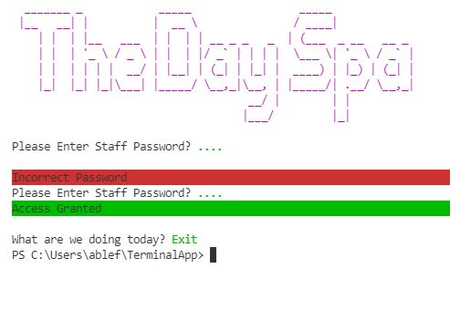
Main Menu
Menu is a TTY-Prompt Gem
Select by entering number and pressing enter
Each selection runs its own method and returns to menu loop
Upon exit, the loop ends and program closes

Slide 6
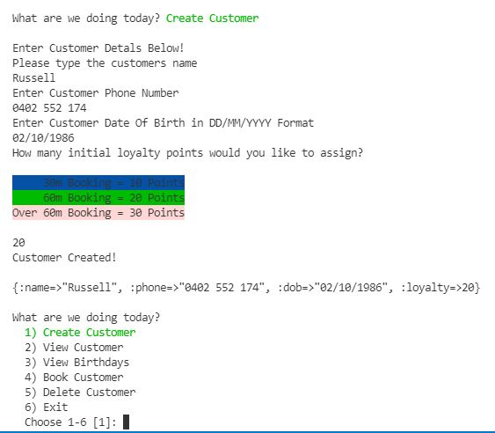
Creating New Customer
User will be prompted to enter customer details and set an initial amout of loyalty points
Customer is saved in the database, a message will be displayed and return to main menu

Slide 7
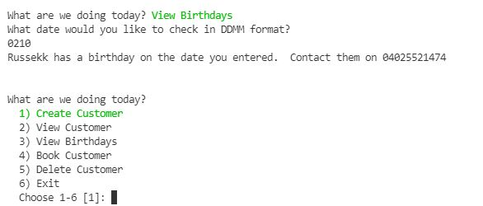
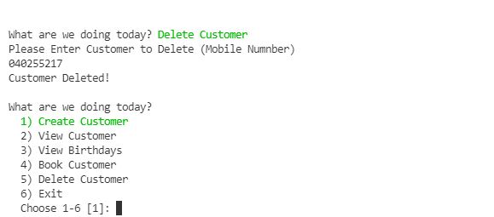
Birthday Lookup and phone number presented
Customer Deletion

Slide 8
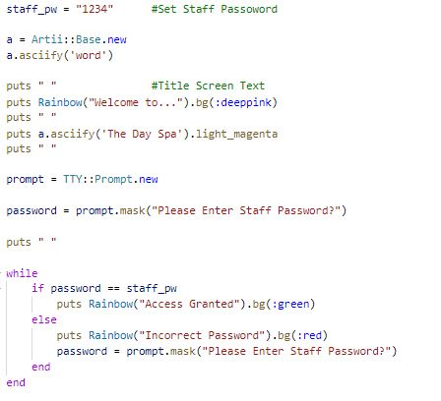
Password Prompt
Title Screen
Ruby Gems, artii and colorise for title screen
Password is set
Password entry is masked with TTY Prompt
While loop to iterate until the password is correct

Slide 9
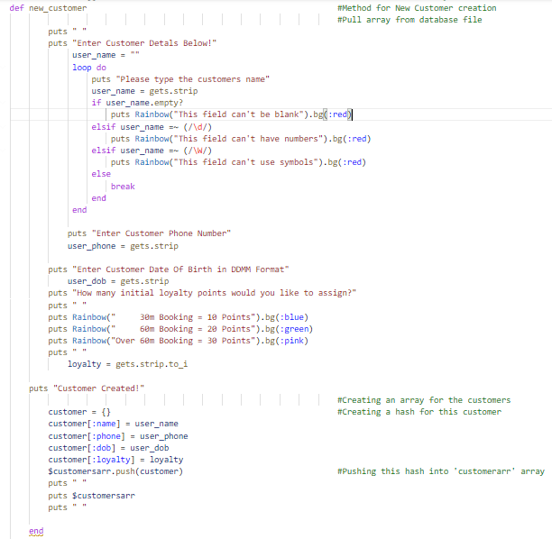
Creating New Customer
Customer details are entered and checked for incorrect characters or blank fields with regular expressions and empty?
Customer is saved as a hash, and inserted into a global array

Slide 10
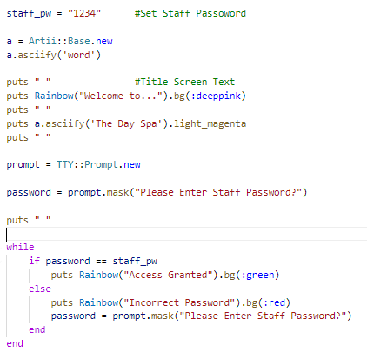
Home Screen
Staff password is set
Rainbow, Colorise and Artii Gem
Title Text
TTY Prompt mask to hide password
While loop to repeat password prompt until password is correct
Rainbow Gem correct/incorrect text

Slide 11
Challenges
-Control flow in a real world application, implementing Ruby knowledge in general
- rSpec, TTD, week 8 shell scripting ect.
-Time management and scaling features down to fit the timeframe
-Spending way too much time figuring out how to store an array or hashes in a text file
Favourite Parts
Developing an app to solve a real world problem
Learning more about Ruby and programming in general
Future Plans
Database file customer storage
Email functionality
Front end web interface
QR/Barcode scanning for customer tracking and voucher generation

Slide 12
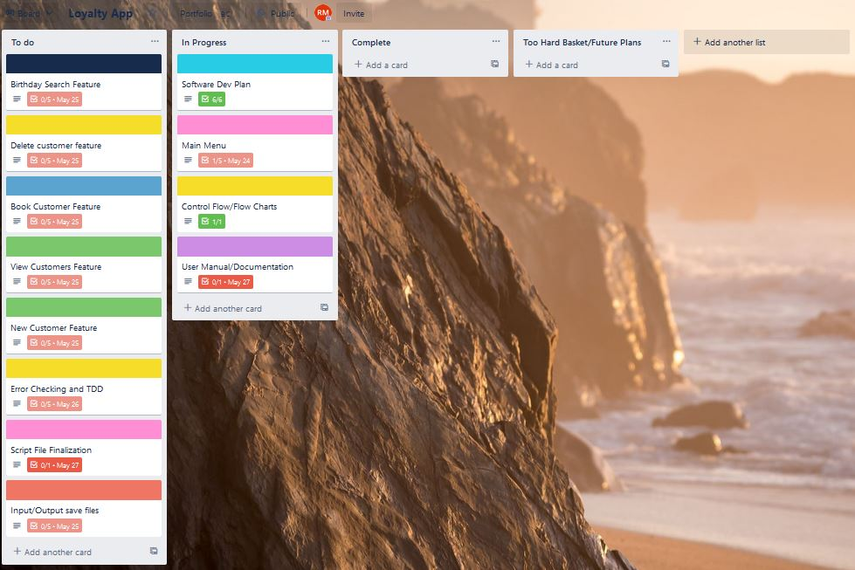
Trello Screenshots

Slide 13
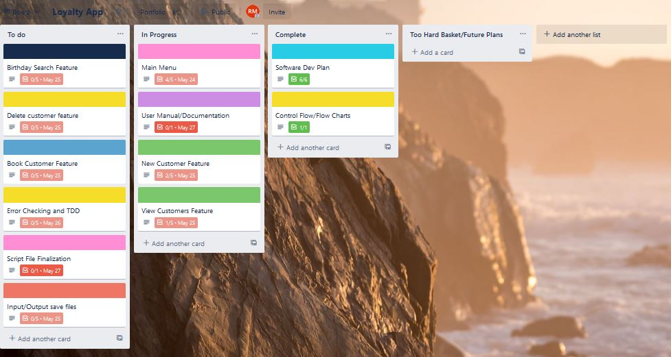

Slide 14
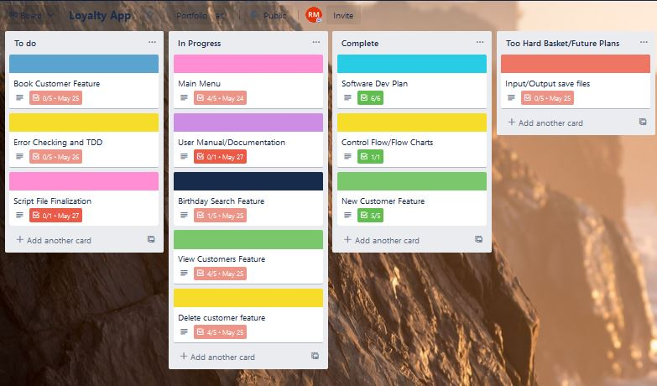

Slide 15
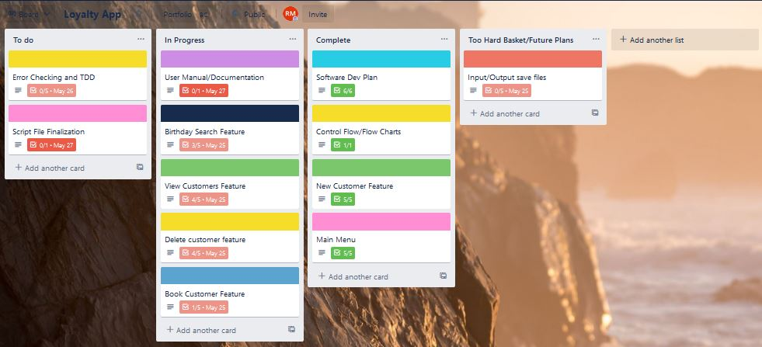

Slide 16
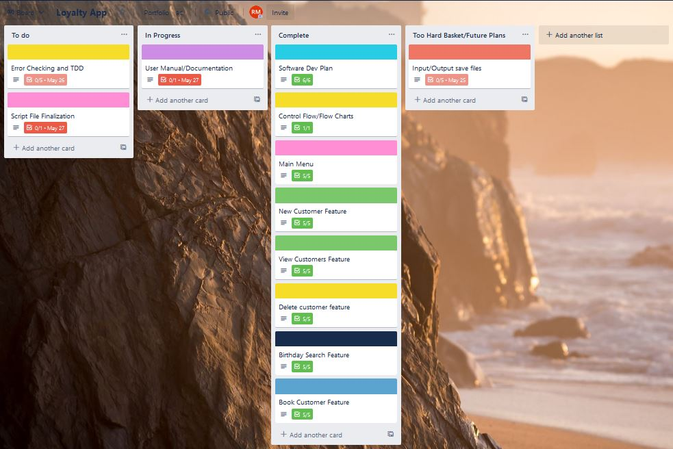

Slide 17
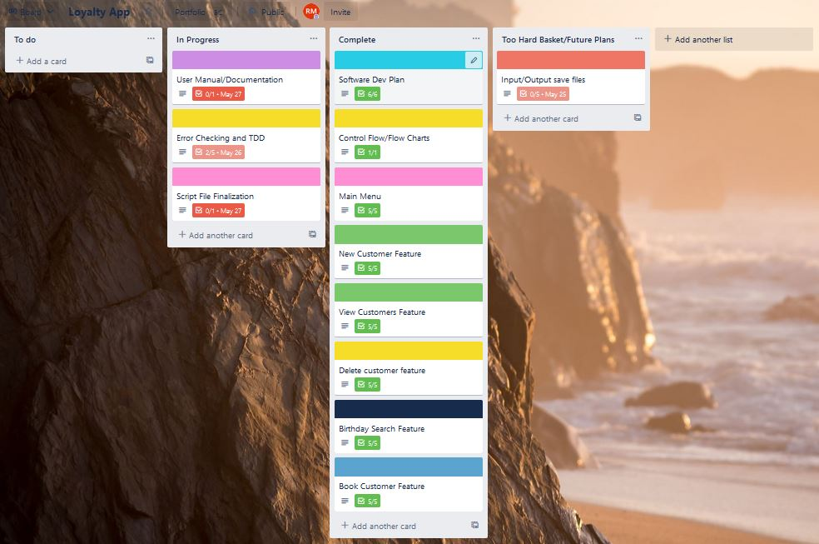

Slide 18
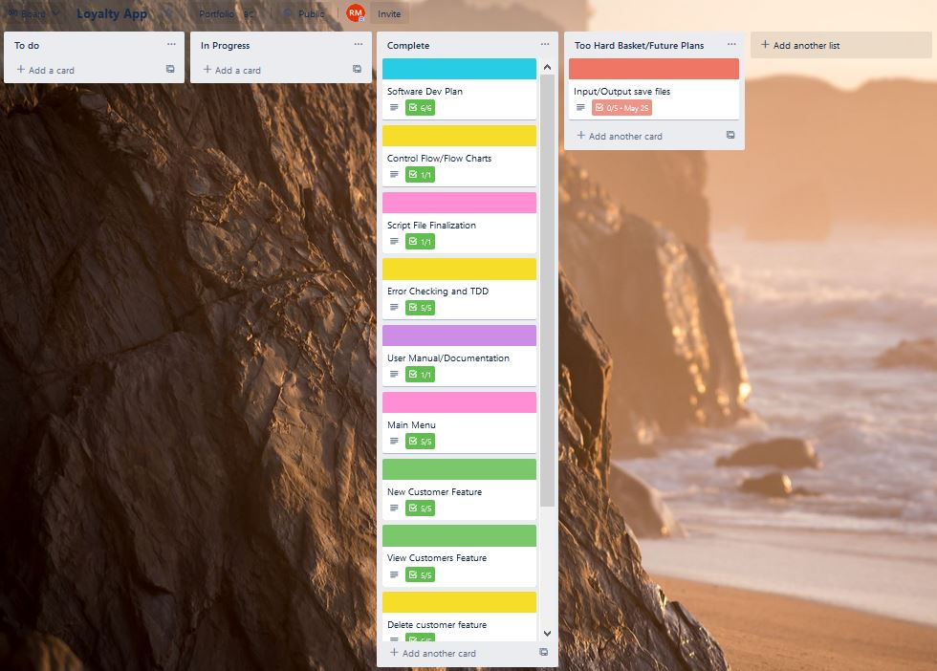

Slide 19
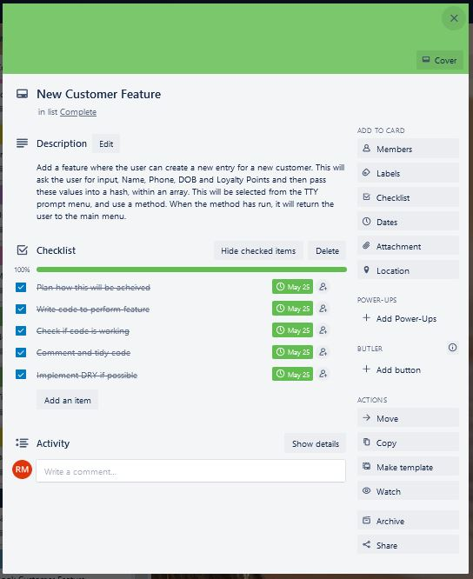

Slide 20
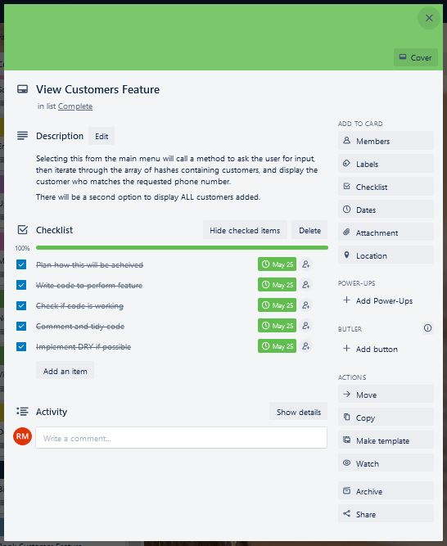

Slide 21
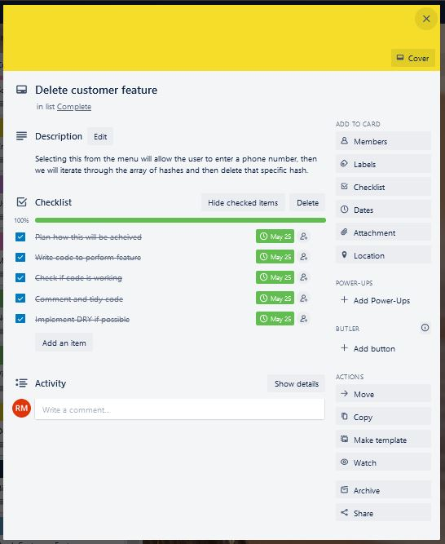

Slide 22
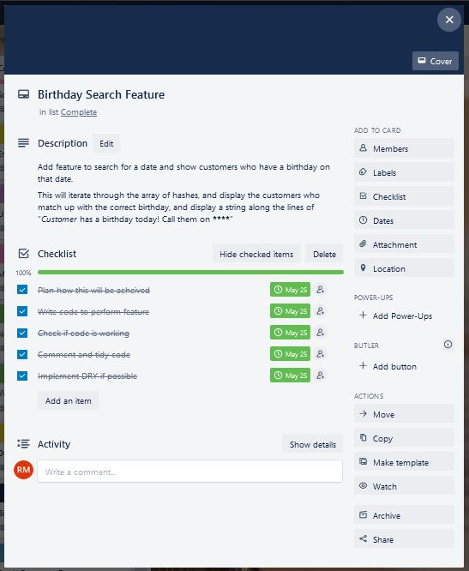

Slide 23
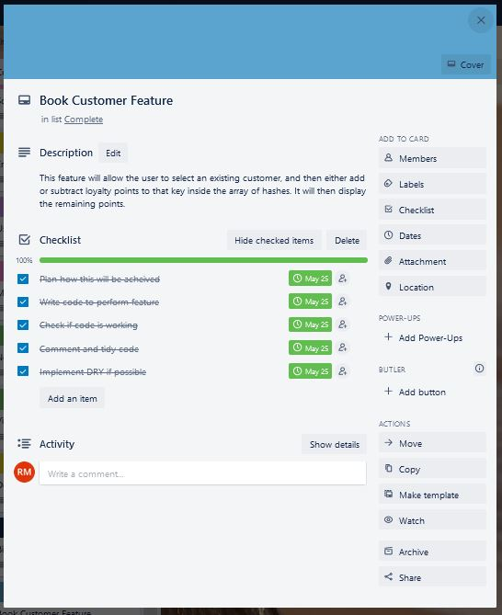

Slide 24
