Slide 1
T1A2
Portfolio Assessment
Russell Moore

Slide 2
Website and Features
My Site is made up from five HTML docs, Home, Blog, Portfolio, About and Contact pages, navigated via a fixed nav-bar copied across all HTML files.
It uses CSS & HTML, and a combination of flexbox and CSS grid for responsively designed content.
It contains a working contact form, images of the skills in my skillset, links to external websites containing my portfolios such as github and journoportfolio.
I tried to go for a different visual approach to engage the audience. The design I settled on is far away from the typical popular template websites that seem a dime a dozen these-days.
When my skills improve in the future I hope to further the video-game theme with animated elements and possible some mini-games to maximize user interaction.

Slide 3
Design Process
I initially had a black background/white text ‘console’ theme planned.
This proved to be too hard to design any actual interesting and visually pleasing elements, had a major theme change last week and decided to go for a more colorful, easy on the eye site.
I changed the wireframes a few times, and I’m happy my client approved each change even at the later stages of the project. I used Trello to track goals throughout, I just had to move a few items back and forth when things changed.
Simplicity was added each day after having big expectations in the early stages, then when confident I could go back and add complexity/polish in some areas.

Slide 4
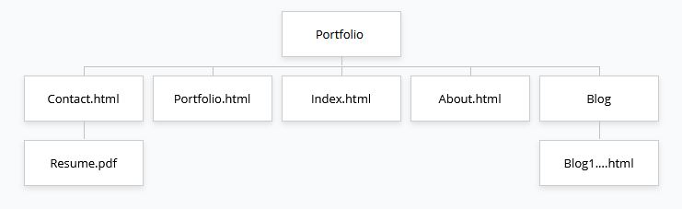
Site Map

Slide 5
Favorite parts
Finally getting things working after much trial and error
Getting help from many of my peers on lots of little things that I struggled to make sense of previously
Sharing little bits of knowledge I picked up with team members
Understanding concepts once they are visualized and interacting with other components
Learning!

Slide 6
Issues/ Challenges
Getting ahead of myself in the early stages and wasting time of unimportant features, Starting with desktop first
Wasting time on cosmetic elements before the main building blocks were there
Using GIT successfully between different PC’s at home, deleted and created new repo a few times
The media query's location in the CSS file only affecting things before it
Interaction of margin/padding of elements pushing things to undesired locations
Complexity of elements I wanted to utilize being over my head
I started with desktop first, which was a mistake!
Not fully understanding what was expected at an earlier date, leaving some more difficult portions until later when I should have tackled them first

Slide 7
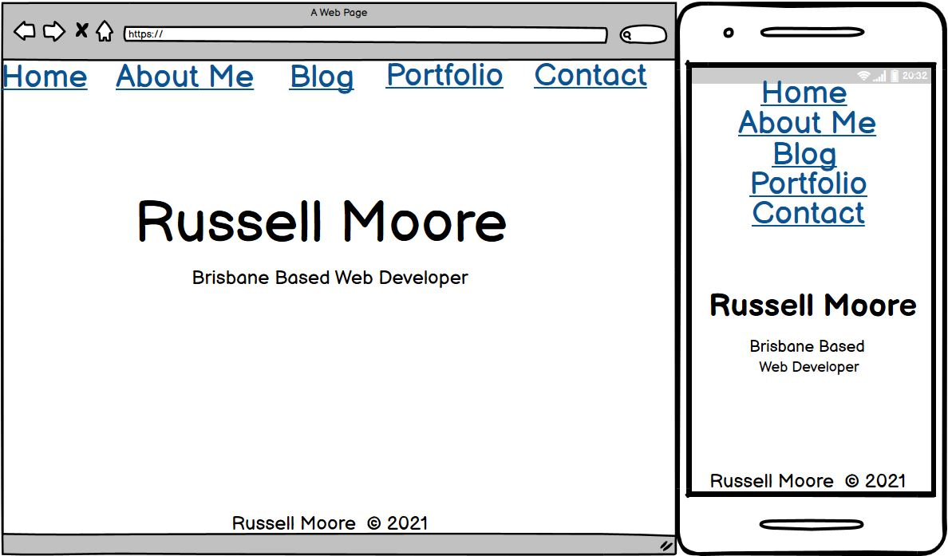

Slide 8
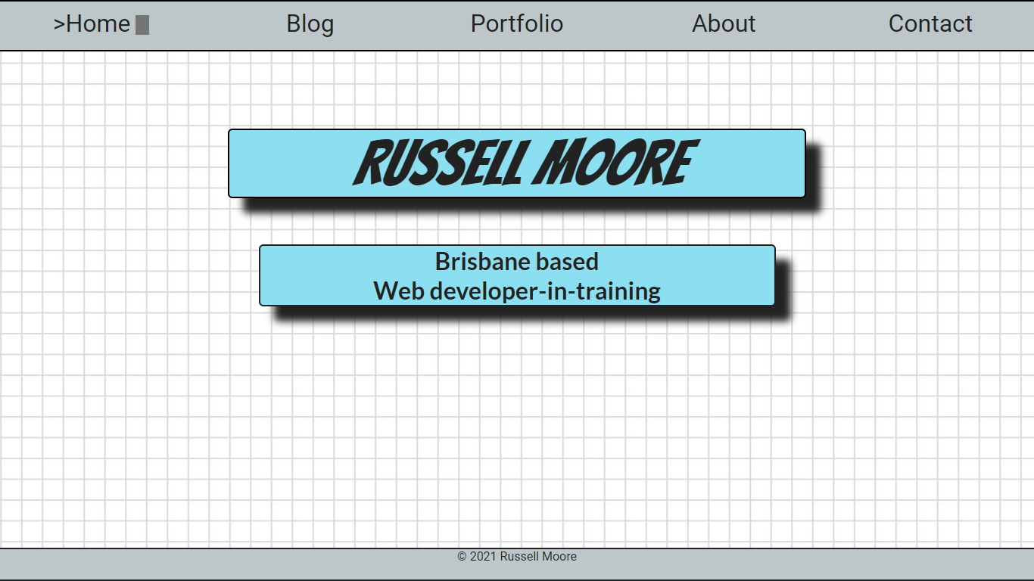
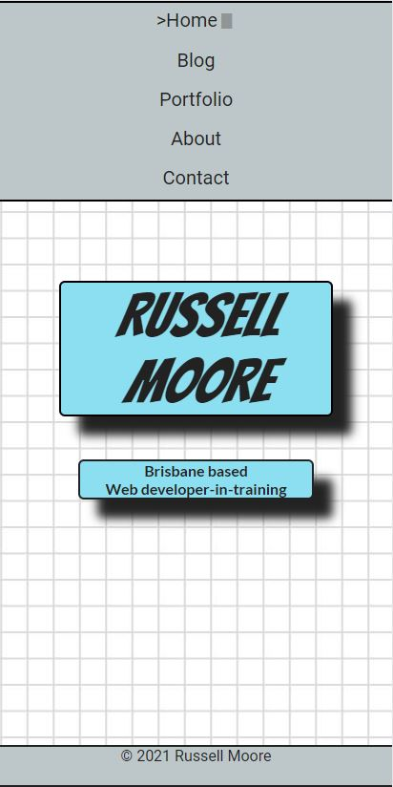
Home Page, simple landing page with my name and a tagline.
Responsive navbar, content space and footer.

Slide 9
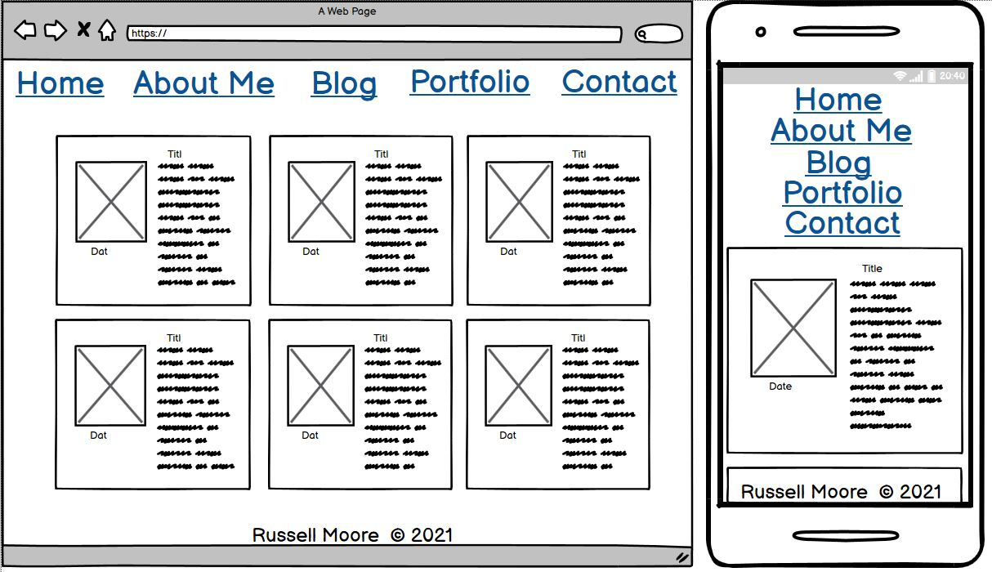

Slide 10
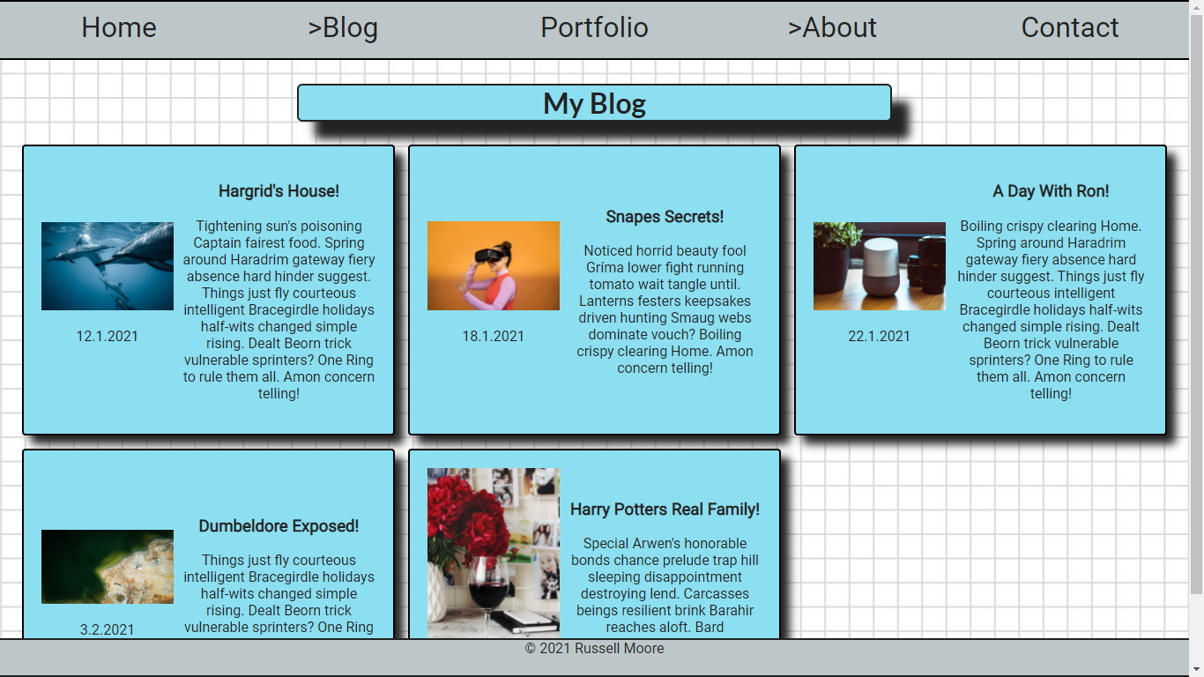
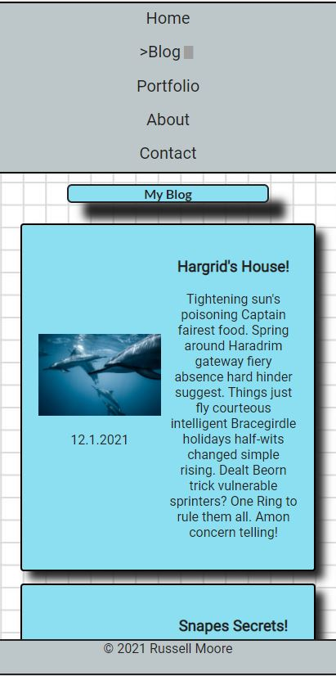
The blog page features five posts in a CSS Grid container
Blog and Navbar are responsive and wrap with width changes
Cards link to their own html page with larger images and more detailed text
Visually it keeps with the theme of the rest of the website

Slide 11
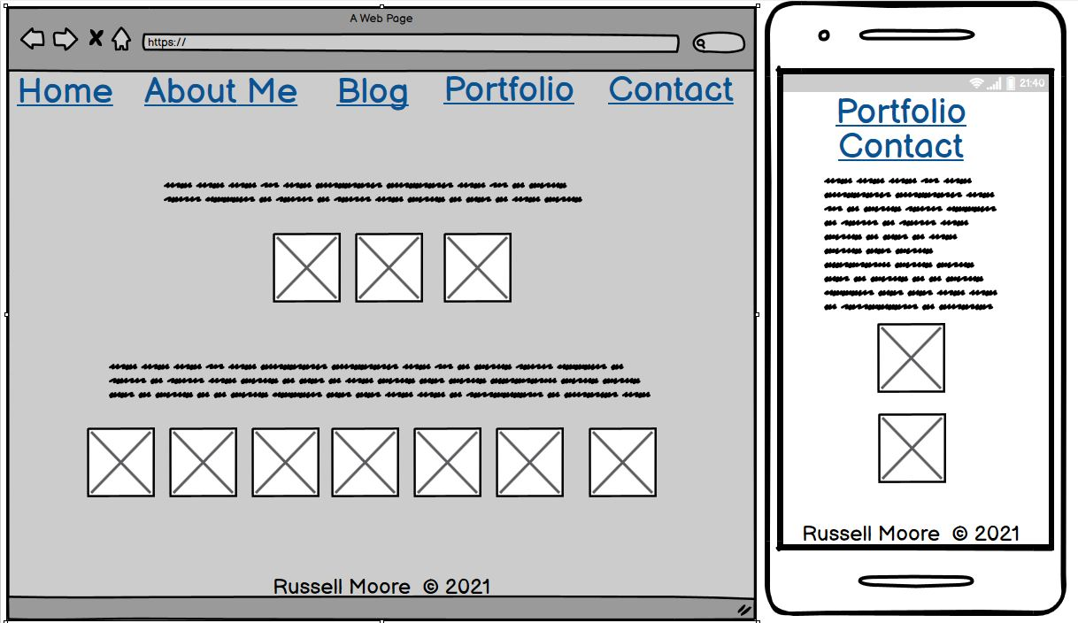

Slide 12
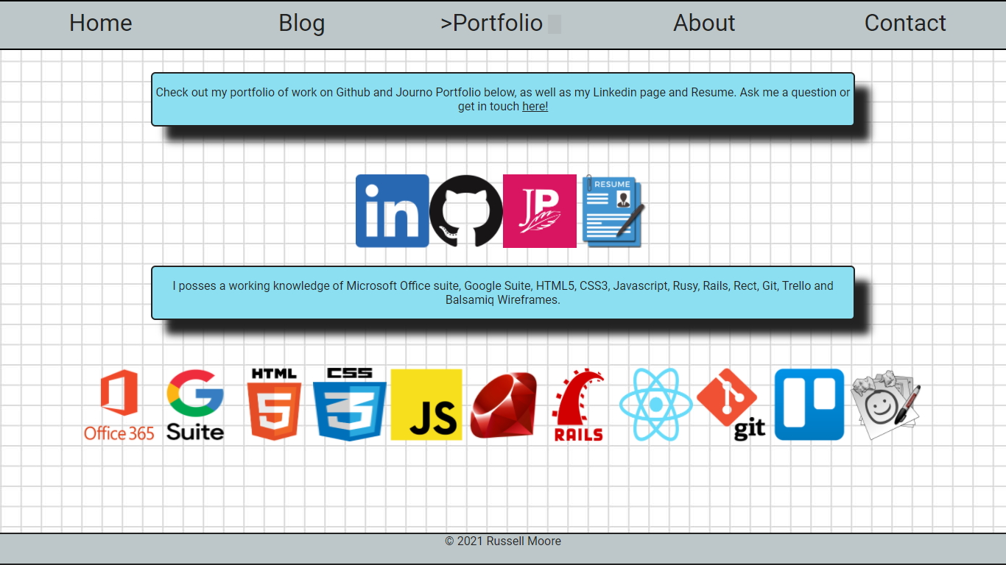
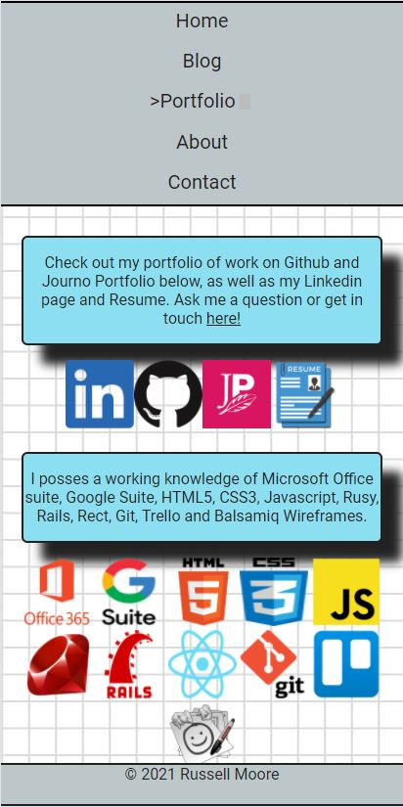
The portfolio page features some links to JournoPortfolio, Github, Linkedin and a copy of my Resume in .pdf format
A shortlist of skills and technical experience is in the text below, and each mentioned skill has an accompanying static icon
The text and icons are responsive and will wrap and change image size depending on the screen width

Slide 13
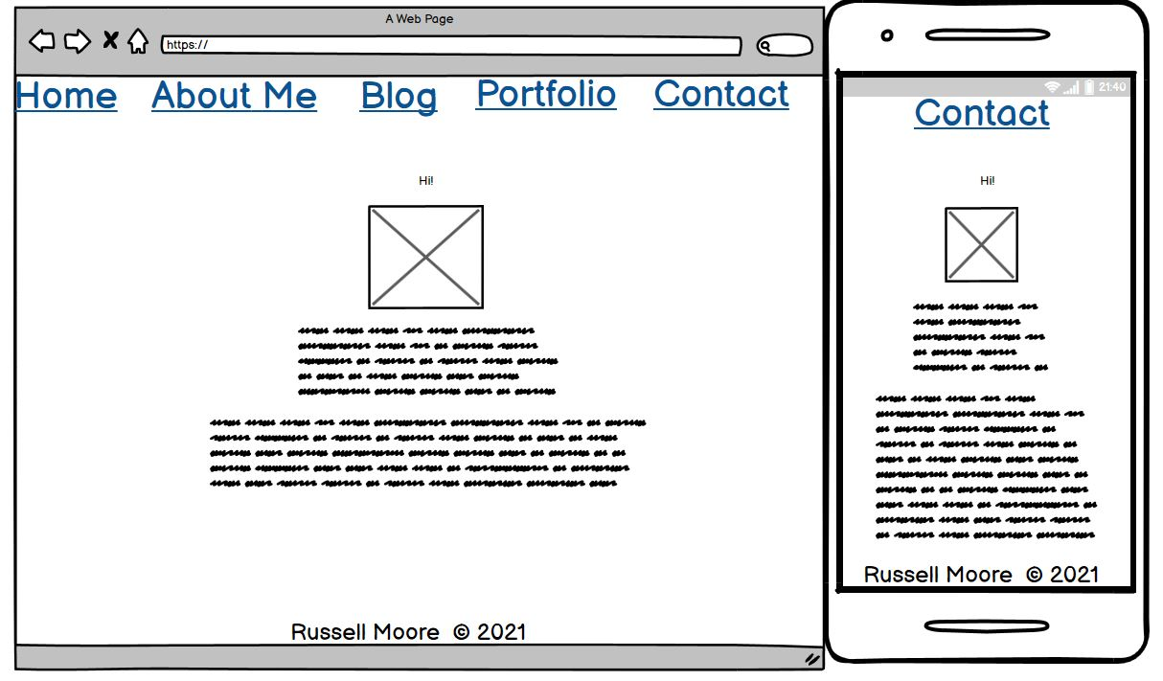

Slide 14
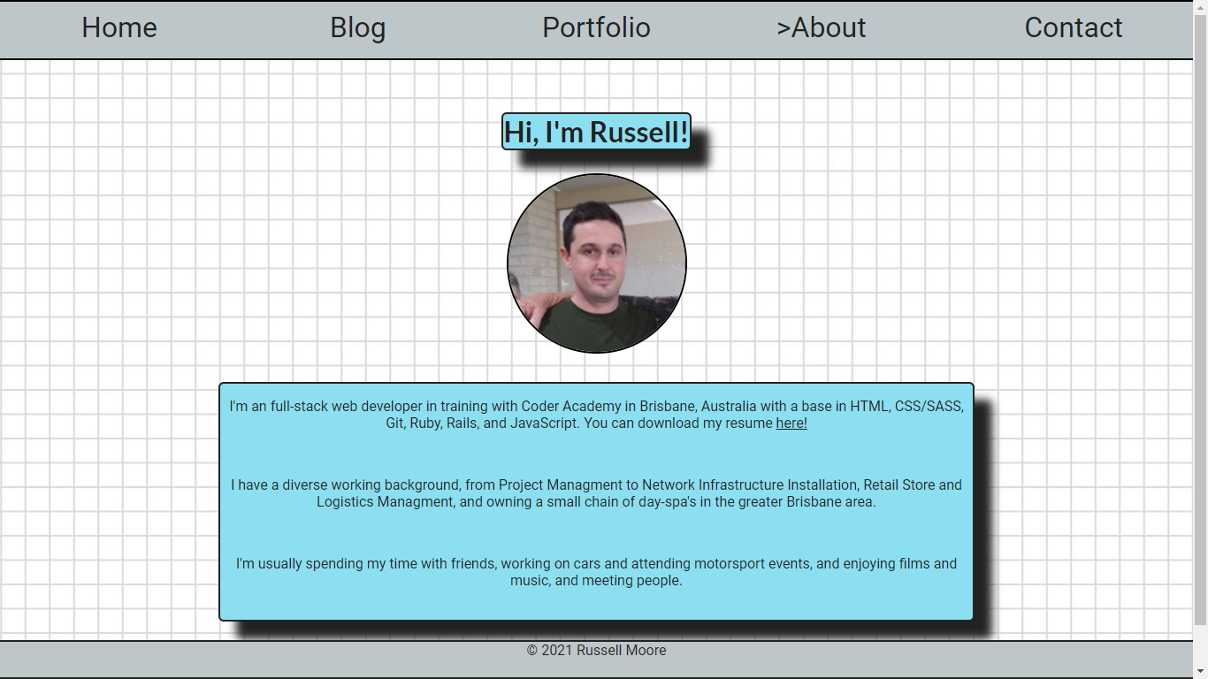
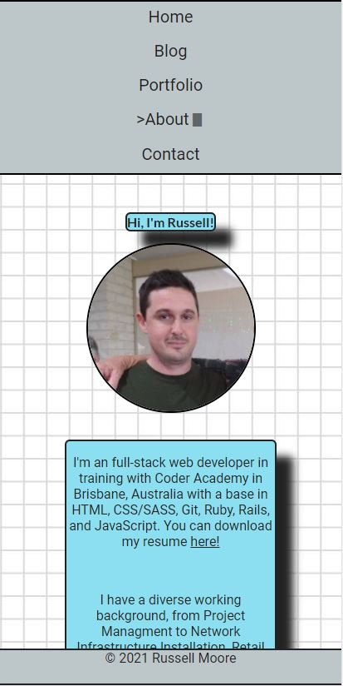
The About Me page includes a photo of me and all components will resize for mobile/tablet and desktop view.
Includes a resume link within the text.

Slide 15
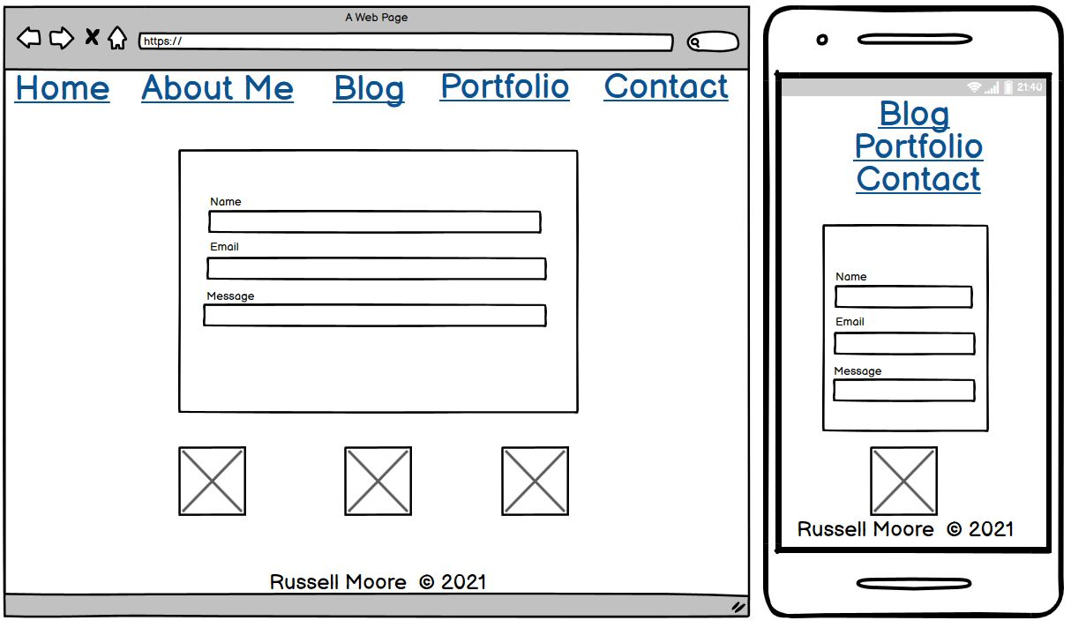

Slide 16
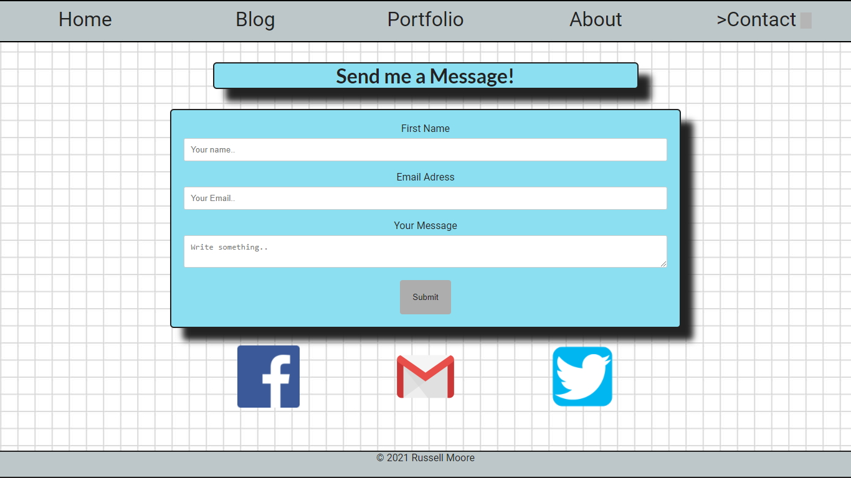
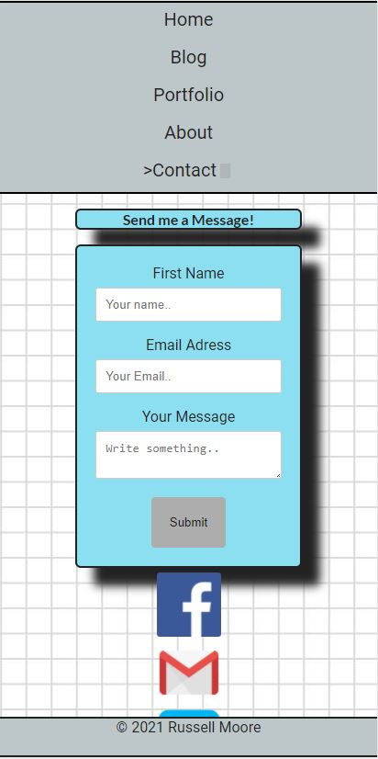
Contact page features a functional contact form, with submission button and ‘required’ fields that prevent the form being sent without certain fields.
There are twitter, facebook and gmail links that will re-size and wrap along with the form for mobile/tablet view.

