Slide 1
Nooks: Safe Device Drivers with Lightweight Kernel Protection Domains
Mike Swift, Steve Martin
Hank Levy, Susan Eggers, Brian Bershad
University of Washington

Slide 2
Device Drivers Limit the Reliability of Operating Systems
Windows 2000: #1 source of reported kernel bugs [Murphy ’00]
Linux: 7x bugs of other kernel code [Chou ’01]
Device drivers are not controlled by OS vendors, yet critically impact the reliability of the system
Windows 2000
Other 3rd Party
Drivers for HCL HW
Kernel code
7%
11%
Drivers for NonHCL
HW
20%
System Config
MSInternalCode
34%
2%
Other IFSDrivers
0%
HW Failure
Anti-Virus
22%
4%
Source: Brendan Murphy, Sample from PSS Incidents
Notes:
Drivers frequently mask hardware bugs, and are not upgrade
My Windows 2000 (with no fancy hardware) has 16 non-microsoft drivers

Slide 3
What Can We Do?
Improve drivers¹
Allow drivers to fail without crashing the kernel²
We want an immediate benefit for the thousands of existing drivers and driver developers
¹ [Chou ’01, Microsoft ’01, Mérillon ’99, Golm ’02]
² [Forin ’91, Hartig ’97, Hunt ’97, Van Maren ’00]
Notes:
Chou – work at stanford, MS = driver verifier, Merillion – Devil
Forin – Mach, Hartig – L4, Van Maren – Fluke, Golm - JX
Improving drivers necessary, before we can debug the thousands of existing drivers or retrain thousands of programmers, we would like to see if we can improve reliability just be changing the OS.
22417 devices in WinXP HCL
We are going to allow drivers to fail

Slide 4
Goals
Improve OS reliability by tolerating device driver faults
Retain compatibility with existing device drivers
Solution: Isolate device drivers within a sandbox, retaining the existing API
Notes:
Sandbox: an area of private memory & resources separate from the rest of the kernel and other drivers
Focus: on hard errors, not on soft errors where system continues to function but inappropriately

Slide 5
Outline
What are the characteristics of the driver environment?
Nooks: Lightweight kernel protection domains
Initial performance evaluation
Conclusion

Slide 6
What makes isolation feasible?
Isolation performance depends on
  Level of isolation required
  Cost of crossing isolation boundary
  Cost of moving data across boundary
  Cost of executing isolated code
We need to understand drivers before we can isolate them.
Notes:
Cost of executing isolated code includes cost of verifying isolation – depends on what we are trying to isolate

Slide 7
How are drivers special?
Drivers are different than previous extensible execution environments
  Drivers already exist
  Drivers move a lot of data
  Drivers have only limited application state
Reliability is fundamentally different than safety / protection
  100% isolation unnecessary
  Drivers are trusted, mostly
Notes:
Older techniques too heavyweight – 100% overhead – need something lighterweight
Need to understand why they fail, what interfaces look like, and what usage patterns look like

Slide 8
Understanding Driver Faults
Most faults are simple [Chou ’01, Linux kernel Bugzilla]
  Illegal memory access
  Invalid use of locks
  Leaving interrupts disabled
Faults can be detected by verifying memory accesses and pre/post conditions on driver execution
Notes:
Illegal memory access – using memory after freed
Not trying to fix logic errors – just crashing faults

Slide 9
Understanding the Driver Environment
Large driver / kernel interface in Linux
  139 interfaces for loadable code, 669 functions
  723 functions in kernel called by drivers
Many optimization opportunities
  Many read-only parameters
  Large data items are handed off
  Majority of functions are for initialization/cleanup
  Many boundary crossings can be avoided
Kernels already support stopping, starting, and binding drivers dynamically
Notes:
Relatively few calls from kernel to drivers
139 interfaces, 669 total functions in modules
723 kernel functions called by modules
Complex parameters tend to be read-mostly and store kernel state for callbacks to kernel
Example: netdevice structure in Linux only support changing three fields: flags, timestamp private data
66 of top 120 functions (by # of callers) don’t modify kernel state
Many functions can be deferred
functions with no return value: netif_rx to receive packets
Many functions can be executed within the sandbox
memory allocation
Data item handoff – means that drivers don’t write to data concurrently with other components – they own the buffer, and then hand it off to someone else

Slide 10
Understanding Driver Execution
Only a few kernel functions are called at performance-critical points
  Majority called during init / cleanup
  Critical functions can be executed locally or deferred
Interrupt handlers take ~20,000 cycles
Notes:
Calls to kernel during initialization / cleanup: not performance critical
Example: 3com 3c905b NIC
45 total calls into kernel
4 kernel calls account for 99% of calls to kernel
cpu_raise_softirq, netif_rx, alloc_skb, eth_type_trans
2 can be handled within sandbox, 2 deferred
Intel E1000:
Interrupt handler takes 22,500 cycles on a p4
Example: Adaptec aic7xxx driver
40 total calls to kernel
1 call to kernel (scsi_old_done) accounts for 99% of calls

Slide 11
Summary
Device drivers are different
  Device drivers are not malicious
  Existing code must be supported
Device drivers are amenable to isolation
  Few kernel functions need to execute quickly
  Many boundary crossings can be optimized away
  Most common faults can be trapped by memory isolation and checks on interfaces
  Kernels support recovery by unloading / reloading drivers

Slide 12
Nooks: Executing Device Drivers Safely
Goals of Nooks:
  Limit scope of corruption caused by drivers
  Recover quickly with no lost application state
  Require only minimal change to the kernel
  Require no source changes for most device drivers
Approach: isolate device drivers with virtual memory, retaining existing API

Slide 13
Lightweight Kernel Protection Domains
A lightweight kernel protection domain is a module that:
  Executes in kernel mode
  Is logically part of the kernel
  Has read access to kernel data
  Has restricted write access to kernel data
Notes:
Commercial OS have been reluctant to use VM for protection
Frequently used for performance (zero-copy networking, COW)
Microkernels suffered performance problems
Drivers get write access only to current data, but read access to entire kernel (but not user space)
Why not:
just SFI: not contiguous memory, so checks are expensive
Segments: not contiguous memory
Safe lang: requires rewriting drivers
New model (UDI): requires rewriting drivers

Slide 14
Implementing LKPD
Memory protection
  Separate page tables / TLB entries
  Same address mapping, different protection
Wrapped kernel/driver entrypoints
  Identify protection domain for code
  Change protection domains / stacks
  Verify / copy / protect parameters
  Track resource usage for cleanup / limits
  Minimize boundary crossings

Slide 15
LKPD benefits
Efficiently supports privileged but unreliable code
  Supports zero-copy parameters
  Allows re-use of existing kernel code
  Supports sparse address space
  Efficiently executes driver code

Slide 16
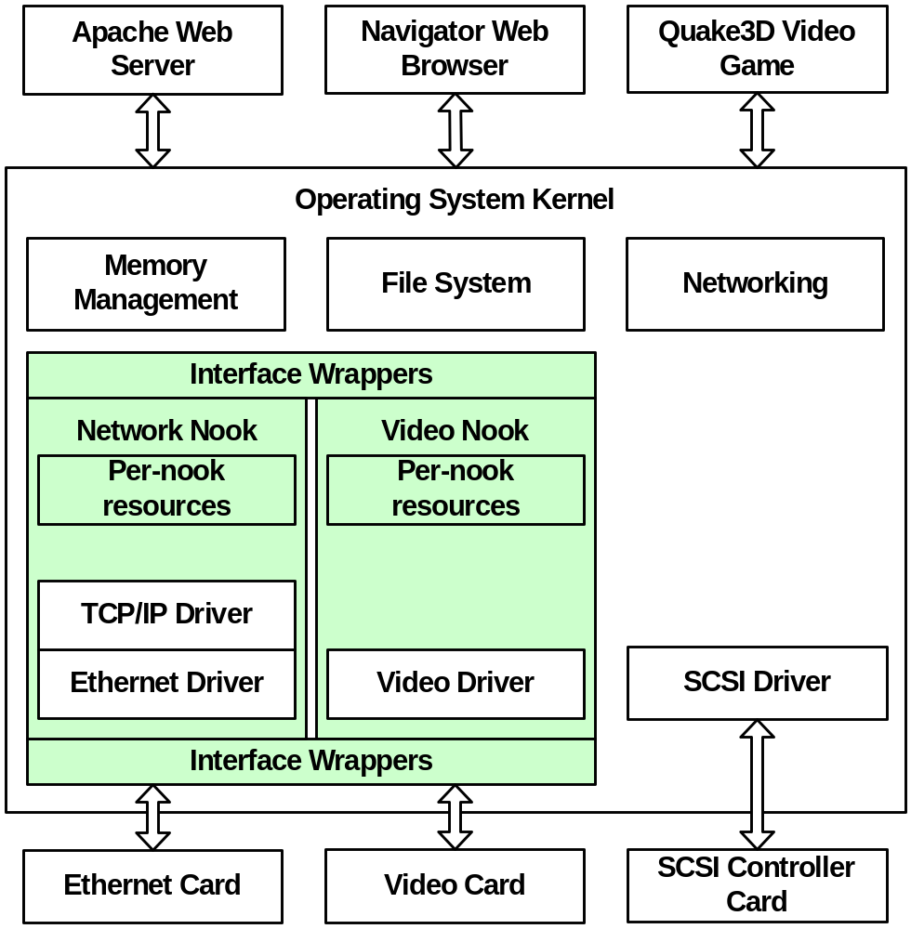
Nooks Architecture
Plugs into existing code with minimal changes
Supports multiple drivers / domain for fate sharing
Not necessary for all drivers

Slide 17
Initial Evaluation
Implementation
  Interface wrappers for resource isolation
  Trap and TLB flush to emulate protection domains
Platform
  Linux 2.4.10 kernel
  1.7 GHz Intel Pentium 4 processor
  Intel E1000 Gigabit Ethernet NIC
Tests
  SPECweb99 with Apache 2.0
  NetPerf
Notes:
10 interfaces, 69 functions
130 kernel functions
4000 lines of code in runtime
66 kernel files changed
no changes to drivers

Slide 18
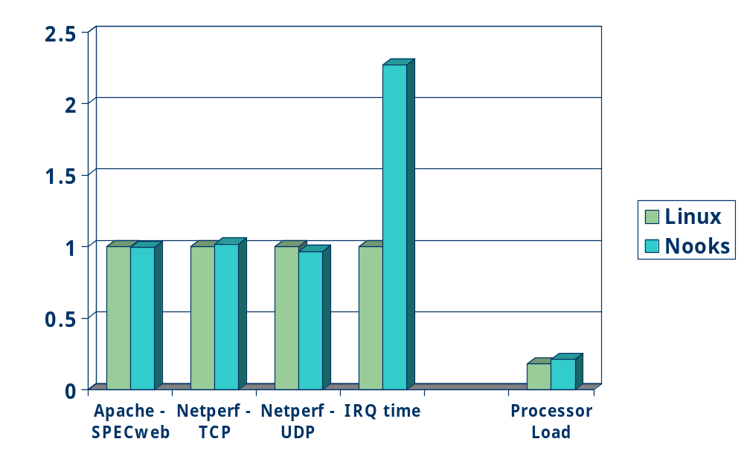
Nooks Performance

Slide 19
Current Status
Implemented separate protection domains
Working on lowering privileges, locking & interrupts, additional devices
Many difficult details:
  x86 architecture: hardware TLB, large kernel pages, global pages
  Linux: inline functions & macros as part of driver API
  Devices: restricting device-hosted DMA

Slide 20
Conclusions
Drivers limit OS reliability
  OS must tolerate buggy device drivers
Lightweight kernel protection domains support reliable driver execution
  Prevents kernel corruption
  Supports existing driver API
  Leverages dynamic driver support for recovery
Nooks implements this in Linux
  Initial performance is promising
We are looking for additional applications of LKPD

