Slide 1
Nooks: an architecture for safe device drivers
Mike Swift, The Wild and Crazy Guy, Hank Levy and Susan Eggers

Slide 2
What are the big problems?
Performance?
  Solved by Intel
Functionality?
  Solved by Microsoft
Scalability?
  Solved by Akamai
Reliability?
  Solved by Boeing, NASA

Slide 3
Reliability is the problem
When do my parents call me?
  When their computer crashes.
Reliability is getting better!
  Computers now execute 100x more cycles between crashes than 10 years ago
    But that was on a 486-33…
    But I now have three computers in my office and two at home…
    But my computers are on 24x7 so I can check the weather faster…

Slide 4
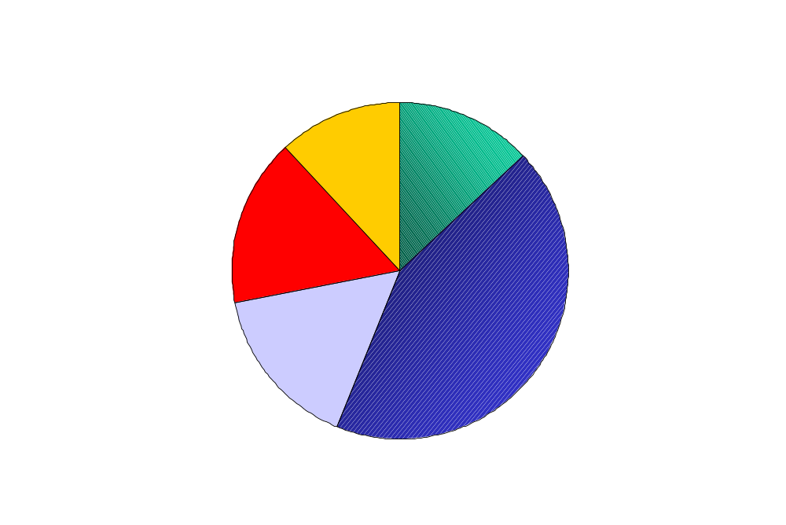
Windows 2000
Failure Analysis.
NT4
Windows 2000
Other 3rd Party
Drivers for HCL HW
Kernel code
7%
Hardware
Failure
13%
11%
Anti-virus
12%
Drivers for NonHCL
HW
20%
Other third-
party drivers
16%
System Config
MSInternalCode
34%
2%
Device
drivers
16%
Core NT
43%
Other IFSDrivers
0%
HW Failure
Anti-Virus
22%
4%
Source: Brendan Murphy, Sample from PSS Incidents:
Notes:
Changes in failure profile discuss.
Note relative size of pie much decreased.
Still need more data on all failures hence development of why boot, discuss the problems.
Note drivers due to unsigned, improvement in this area must be customer driven.
Hardware failures need to start handling.

Slide 5
Drivers are the culprit!
32% of NT 4 faults, 27% of W2k faults
  Microsoft knows how to fix bugs
Drivers are the bulk of the code in the kernel
  Accounts for largest portion of source code
  Accounts for large portion of runtime code
Hardware failures make things worse

Slide 6
Why are drivers hard?
Not written by software companies
Challenging programming environment
Absolute correctness required
Complex asynchronous device protocols

Slide 7
What can we do about it?
There have been past projects on isolating code:
  Multics
  Microkernels – Mach, L4, Fluke
  Extensible kernels – Spin, Exokernel, Vino
  Safe code – SFI, Java
Why not isolate drivers?

Slide 8
Goals
Preserve investment in existing OS
  Don’t require rewrite of large portions of kernel
Preserve investments in existing drivers
  Allow existing drivers to execute safely with just recompilation
Allow different isolation techniques for different drivers, depending on needs
  SFI for low-latency
  VM protection for high-throughput

Slide 9
Why is this feasible?
Drivers:
  Have a limited interface to kernel
  Have limited dependencies from other code
  Are designed to be loaded/unloaded independently
  Make few performance-critical calls-backs into kernel

Slide 10
How hard is this?
What makes it hard?
  Shared state between drivers and kernel
  Weak processors
What makes it easy?
  Read only parameters
  Void functions

Slide 11
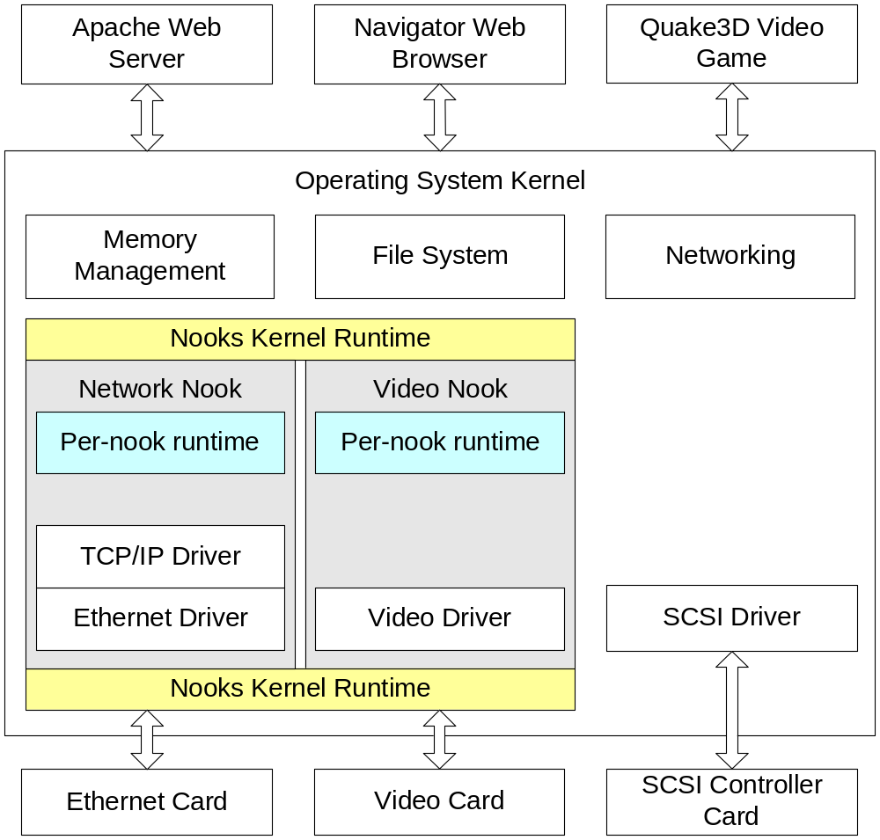
Architecture

Slide 12
Optimizations
Defer as much work as possible
  Timers are only manipulated when already context switching
  Packets are only received when context switching
Provide local resource pools
  Local pool of socket buffers, stacks, local heaps

Slide 13
Implementation
Implemented in Linux 2.4.10
  147 call into kernel
  10 interfaces to drivers
    File operations, VM operations, network device operations, timers, interrupts …
    103 calls into drivers
Duplicated kernel page table grants drivers read-only access to kernel memory
Lowered privileg level prevents drivers from deadlocking

Slide 14
Wrapping and Protection
Protection domain switch when calling into drivers
  Identify all calls to/from kernel
  Implement wrapper functions for all calls
Grant drivers read-only access to kernel memory
Trap privileged instructions when running at with lowered privileges

Slide 15
Hacks for evaluation
Don’t run with separate page table
  Just flush TLB instead
Don’t run with lowered privileges
  Just trap to kernel at appropriate times

Slide 16
Evaluation
Test platform: Blackbox machines
  1.7 GHz P4
  1 GB sdram
  Intel PRO/1000 gigabit Ethernet NIC
    200 microsecond round trip time
Configurations
  Isolate performance impact of wrapping calls, flushing TLB, trapping to kernel

Slide 17
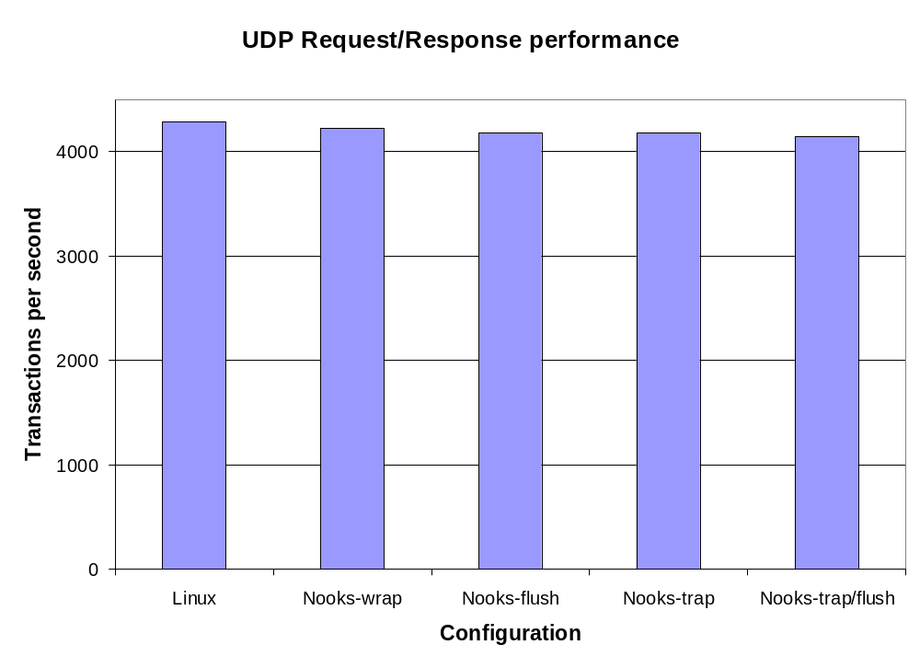

Slide 18
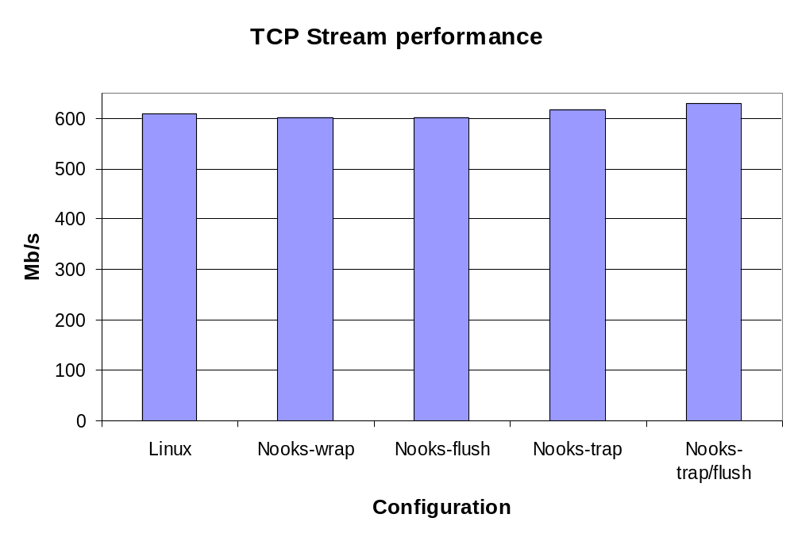

Slide 19
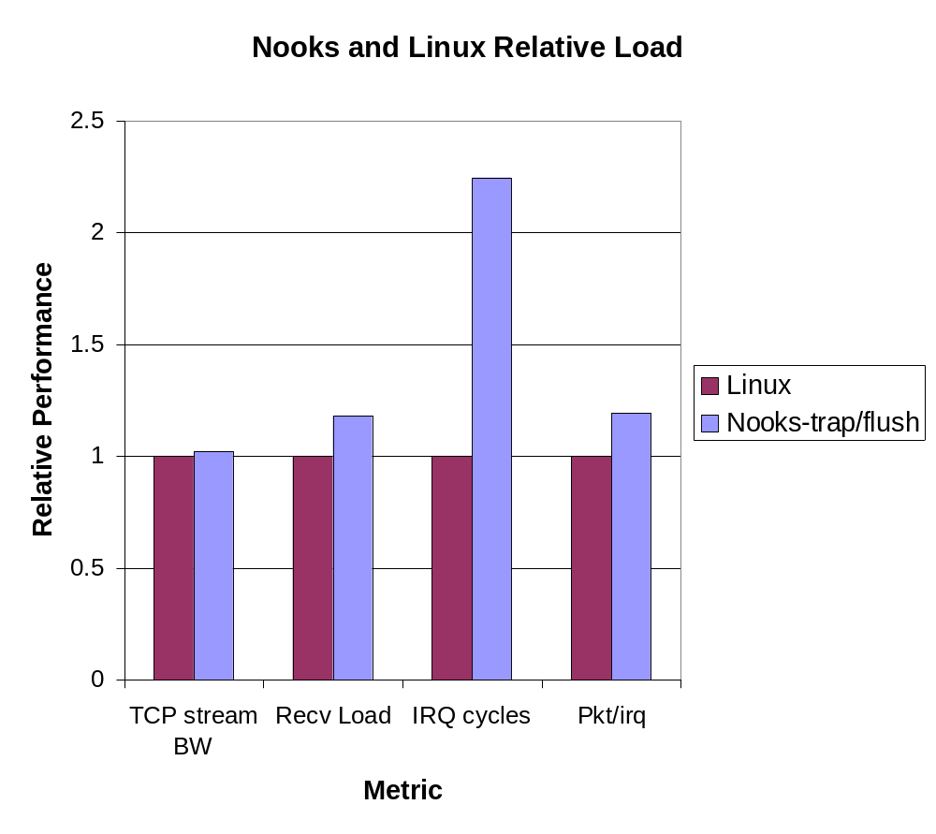

Slide 20
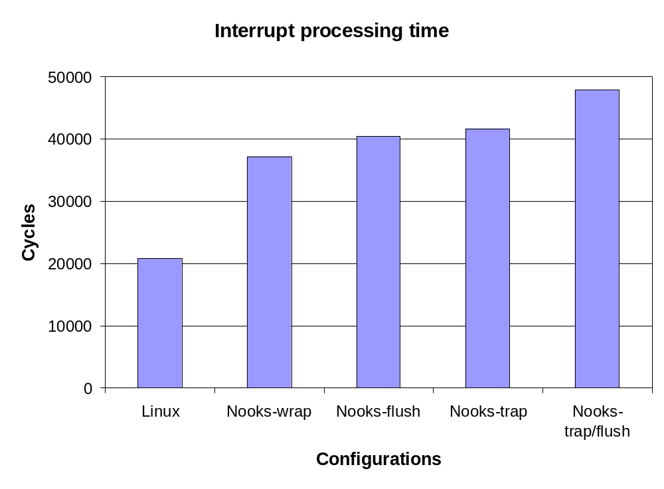

Slide 21
Ongoing / Future work
Create page table structure for safe drivers on IA-32
Allow recovery of drivers without full restart
  Hardware is idempotent…
  Rather than rebooting driver, just retry request

Slide 22
Conclusions
Operating systems should remove their dependence on driver safety
Processors are fast enough spend a little performance on isolation
Existing operating systems can be extended to run existing driver code safely

