Slide 1

Notes:
Topic: the Scientific Revolution as a concept. The usual dates run from Copernicus's De revolutionibus (1543) to Newton's Principia (1687). The phrase itself was introduced by Alexandre Koyré in 1939, and Thomas Kuhn turned 'revolution' into a general model of science in 1962.

Slide 2
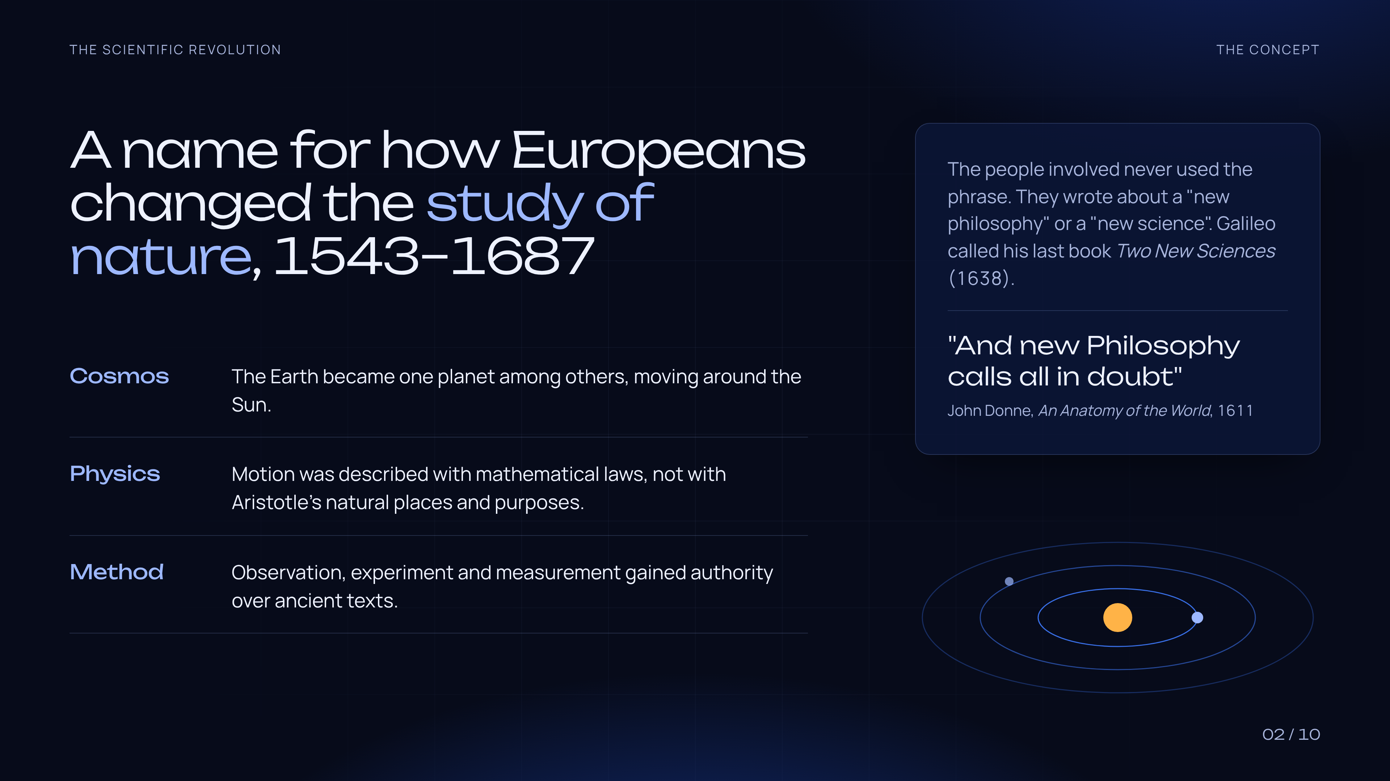
Notes:
The term covers three changes: the Sun-centred cosmos, mathematical laws of motion, and a new respect for observation and experiment. The actors did not call it a revolution. Galileo wrote of 'two new sciences' (1638); John Donne wrote in 1611 that 'new Philosophy calls all in doubt'.

Slide 3
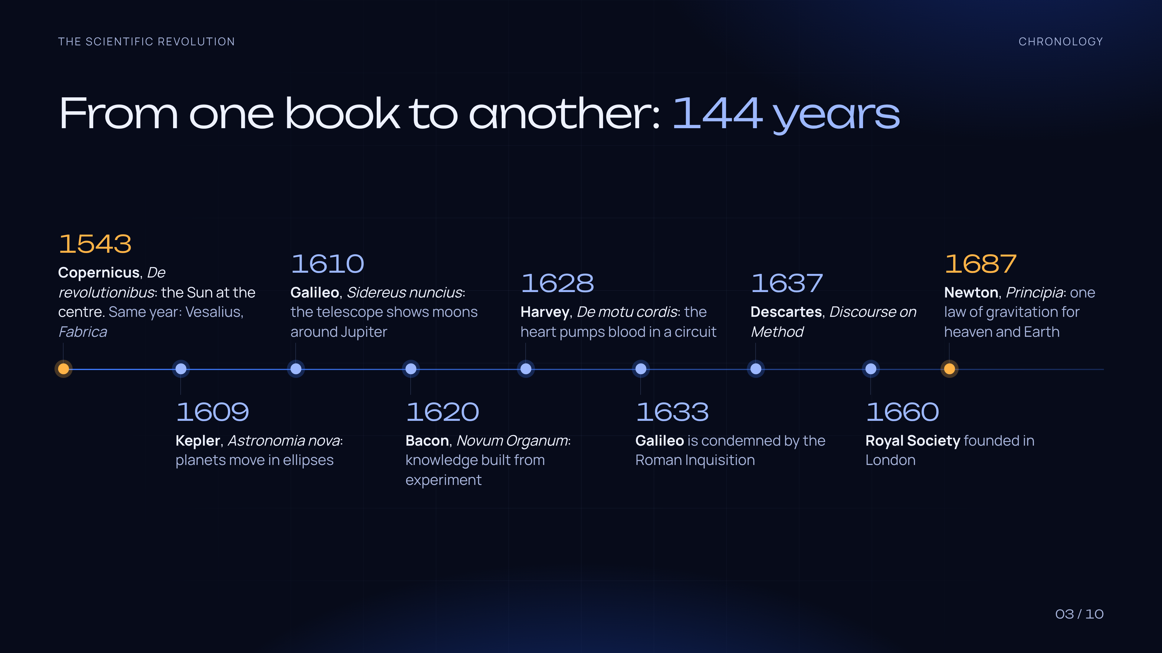
Notes:
Key dates. 1543: Copernicus and Vesalius. 1609: Kepler's Astronomia nova. 1610: Galileo's Sidereus nuncius. 1620: Bacon's Novum Organum. 1628: Harvey on the circulation of the blood. 1633: Galileo condemned. 1637: Descartes's Discourse on Method. 1660: the Royal Society. 1687: Newton's Principia.

Slide 4
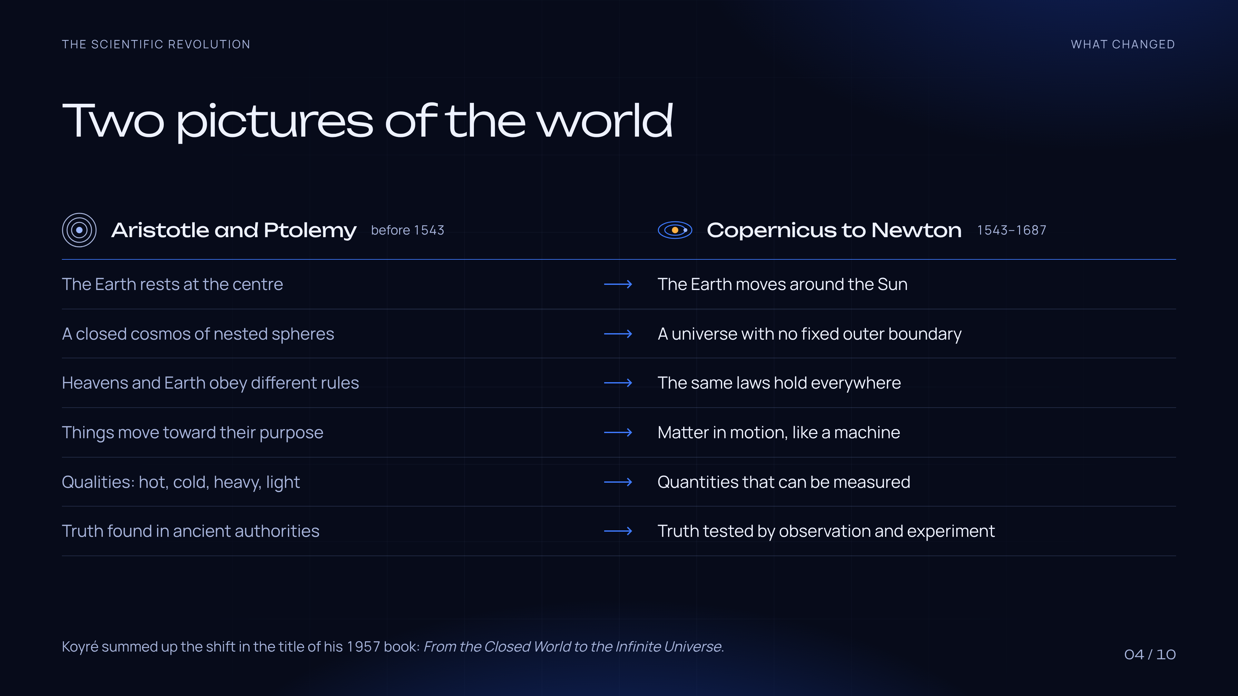
Notes:
Compare the Aristotelian-Ptolemaic world with the world after Newton: the Earth moves, the cosmos has no fixed boundary, the same laws hold on Earth and in the heavens, nature is explained mechanically and measured. Koyré's 1957 title sums it up: From the Closed World to the Infinite Universe.

Slide 5
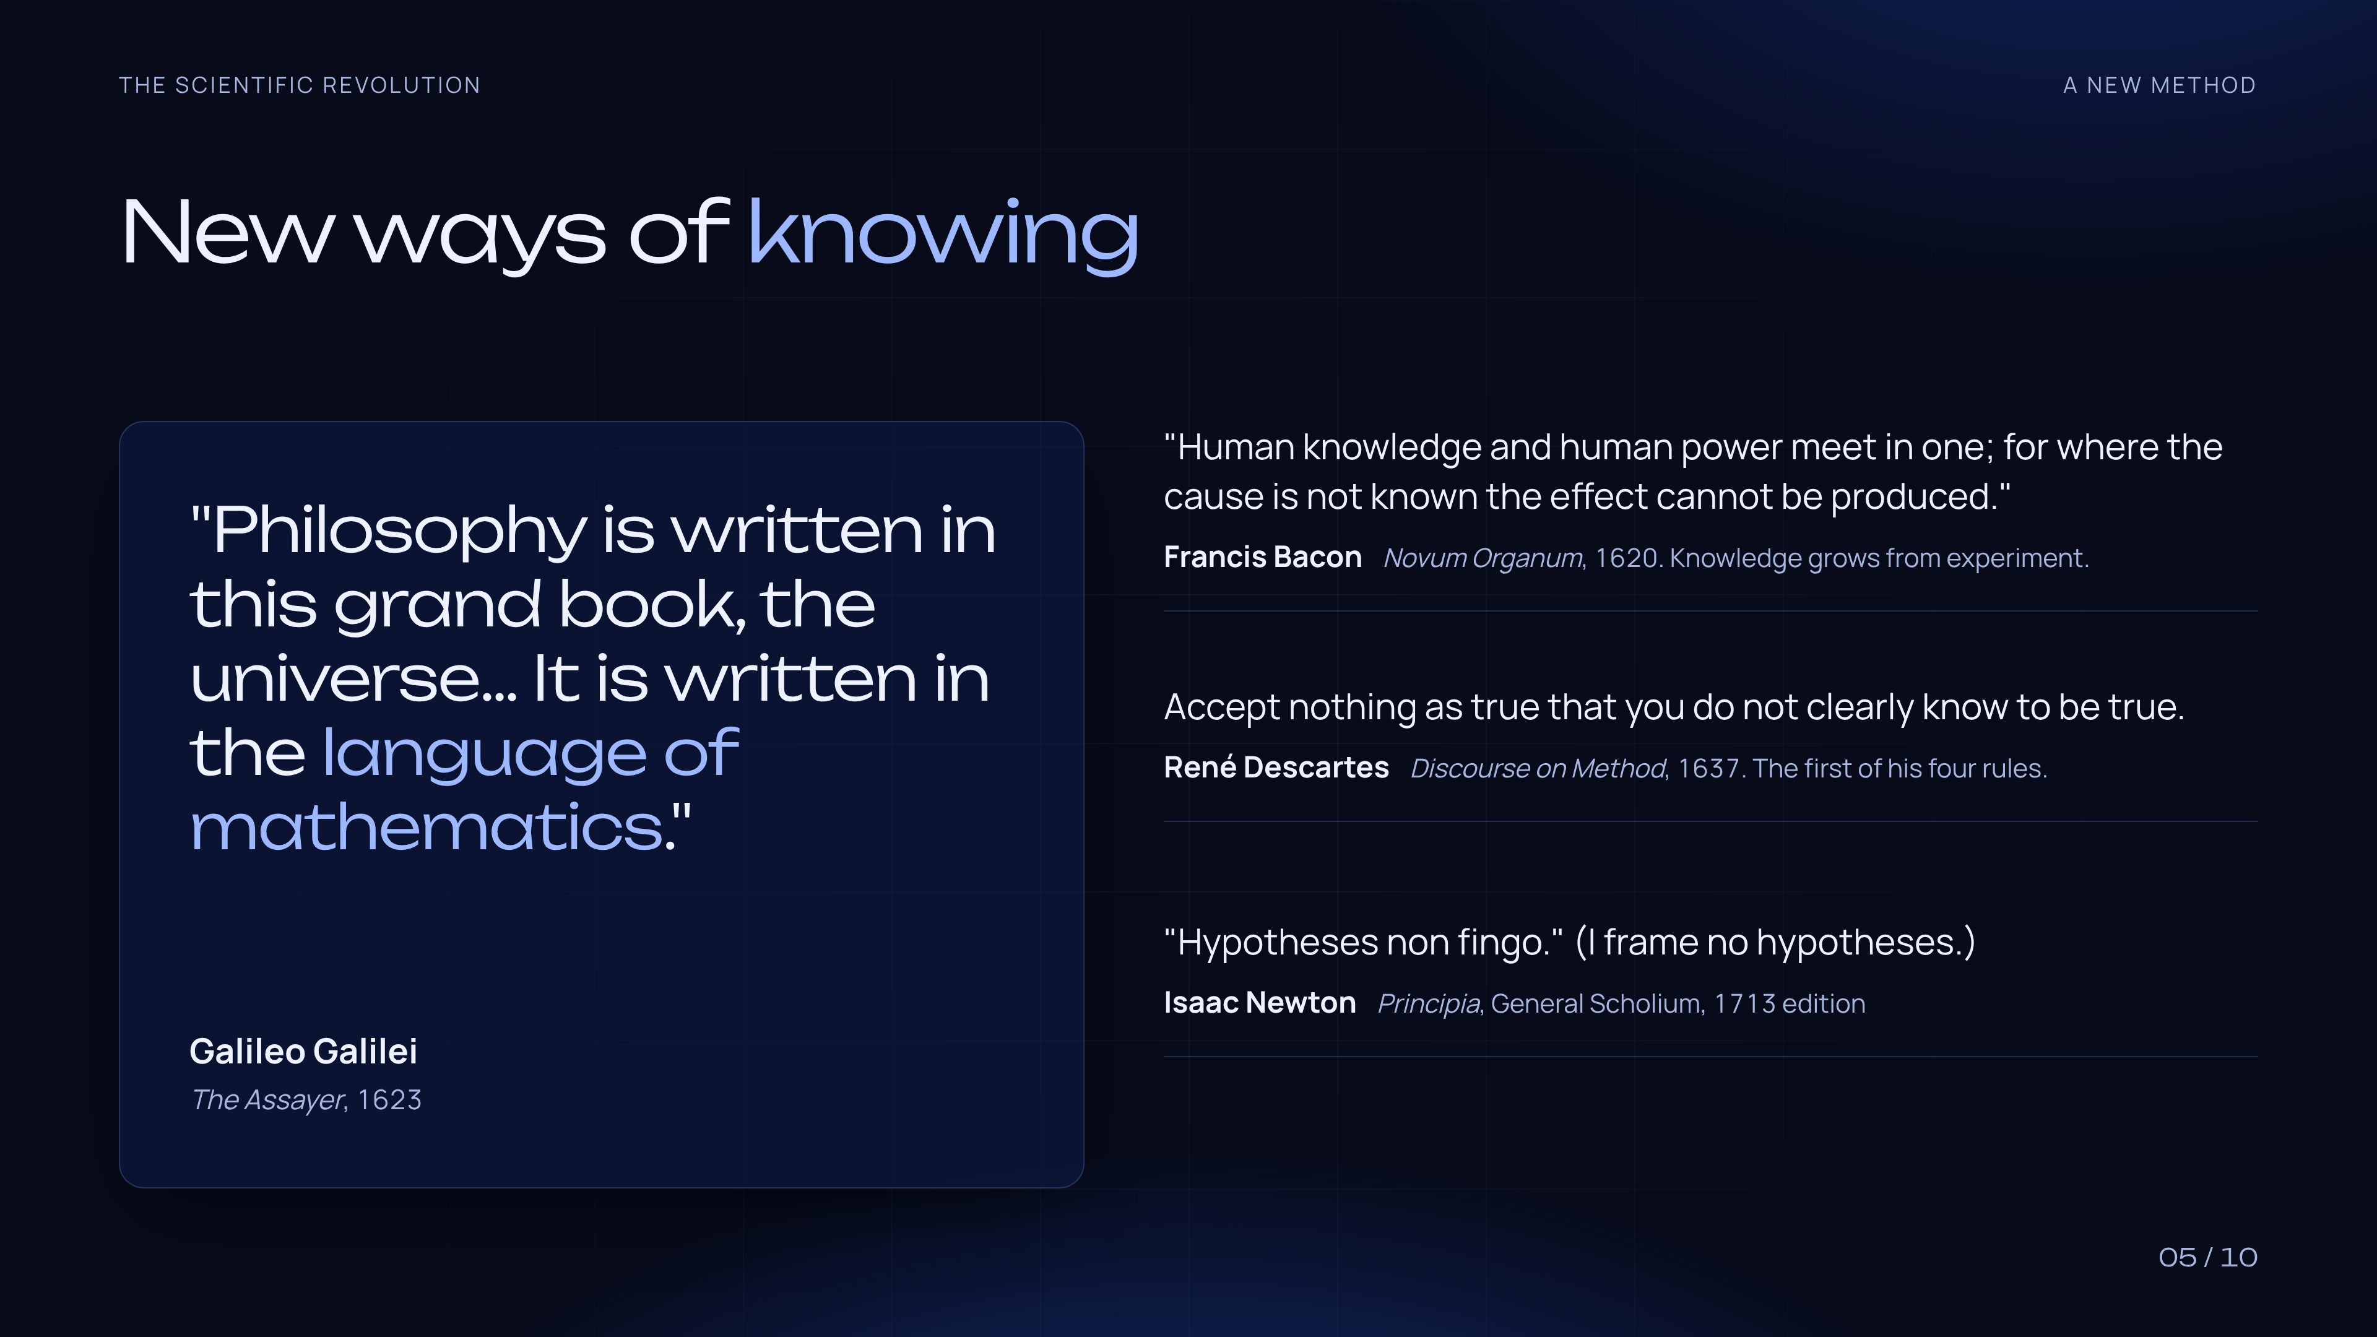
Notes:
Four voices on method. Galileo (The Assayer, 1623): the book of nature is written in mathematics. Bacon (Novum Organum, 1620): knowledge and power meet in one. Descartes (Discourse, 1637): accept nothing you do not clearly know to be true. Newton (General Scholium, 1713): 'Hypotheses non fingo'.

Slide 6
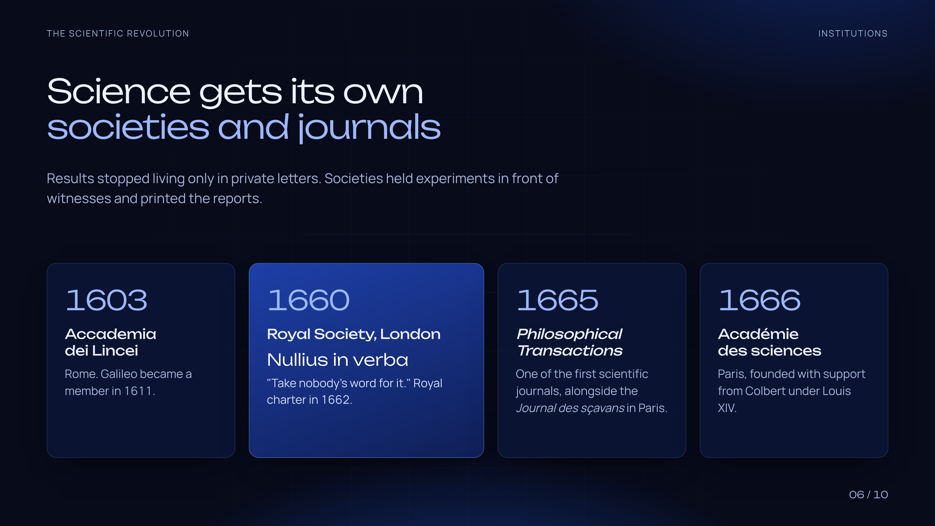
Notes:
New institutions: Accademia dei Lincei (Rome, 1603; Galileo joined in 1611), Royal Society (London, 1660; charter 1662; motto Nullius in verba), Philosophical Transactions and the Journal des sçavans (both 1665), Académie des sciences (Paris, 1666).

Slide 7
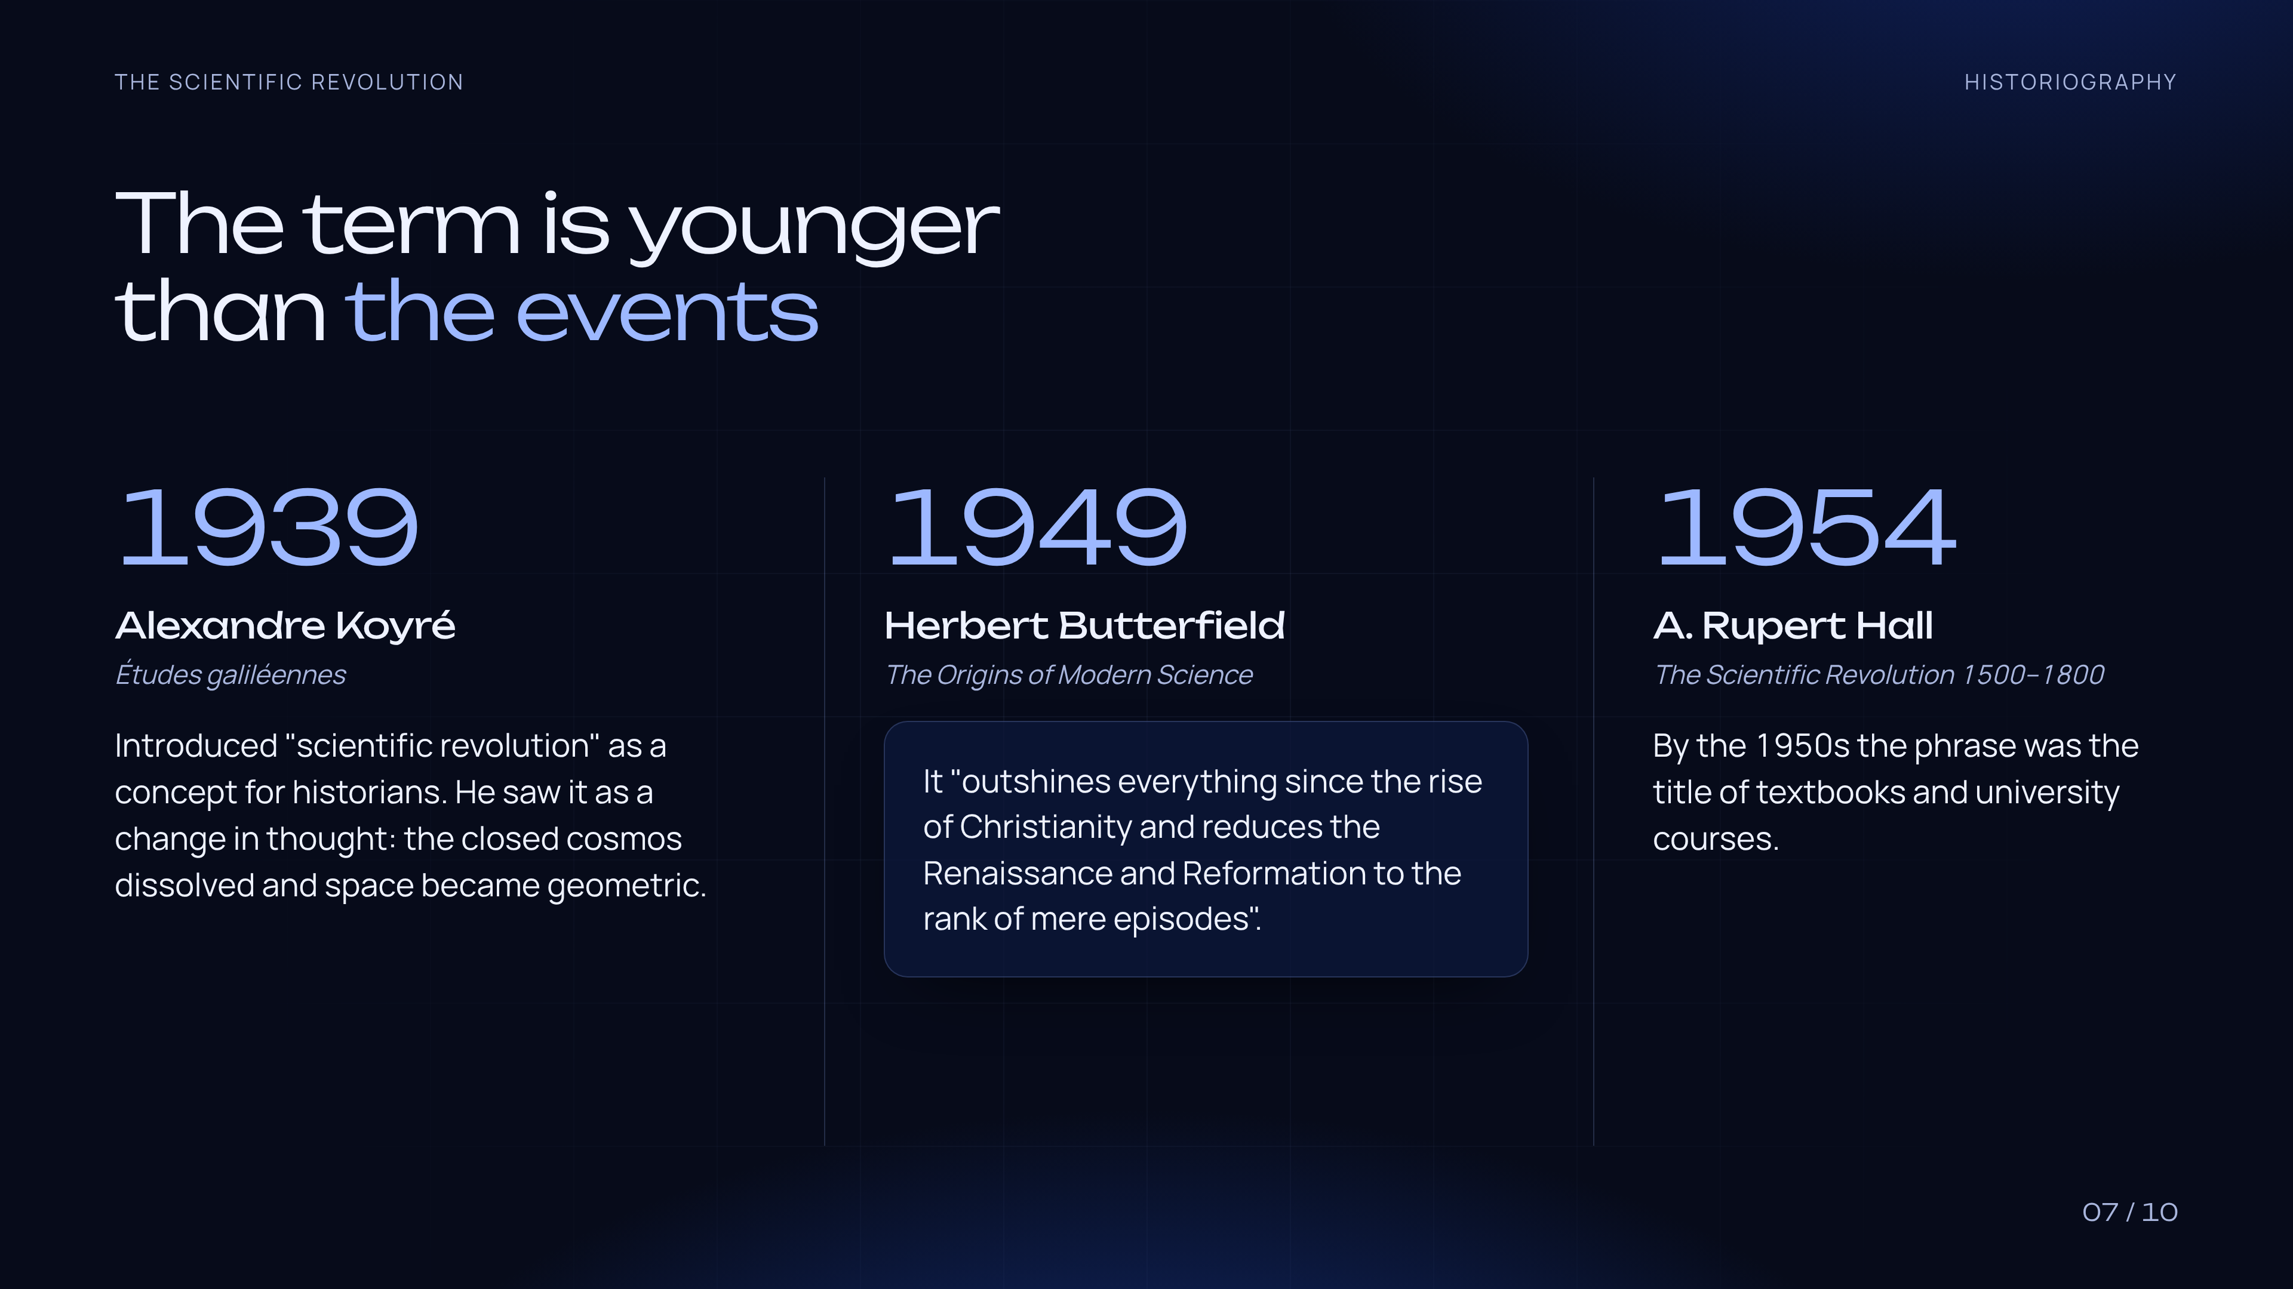
Notes:
The concept is a 20th-century creation. Koyré, Études galiléennes (1939). Butterfield, The Origins of Modern Science (1949), with the famous claim that it outshines everything since the rise of Christianity. A. Rupert Hall, The Scientific Revolution 1500-1800 (1954).

Slide 8
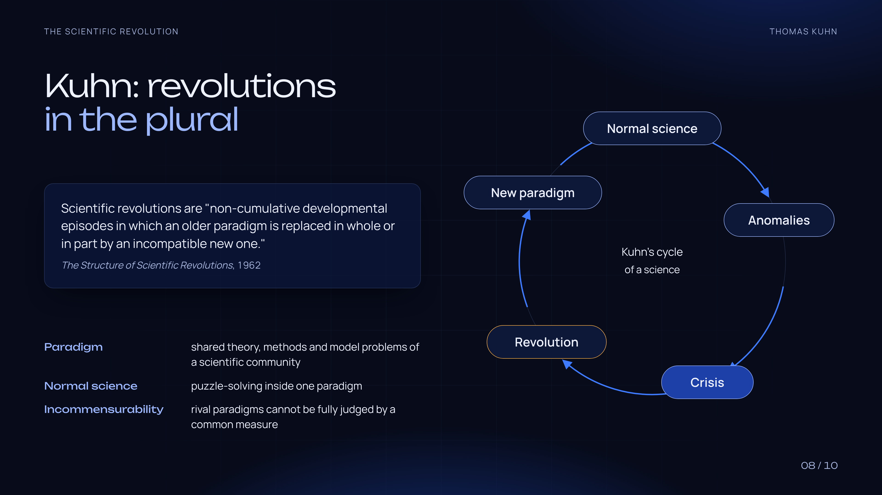
Notes:
Kuhn, The Structure of Scientific Revolutions (1962). Normal science works inside a paradigm; anomalies pile up; a crisis follows; a revolution replaces the paradigm with an incompatible one. Kuhn speaks of revolutions in the plural: the 17th century becomes one case among many. His later essays appeared as The Road Since Structure (2000); Russian edition: 'После «Структуры научных революций»'.

Slide 9
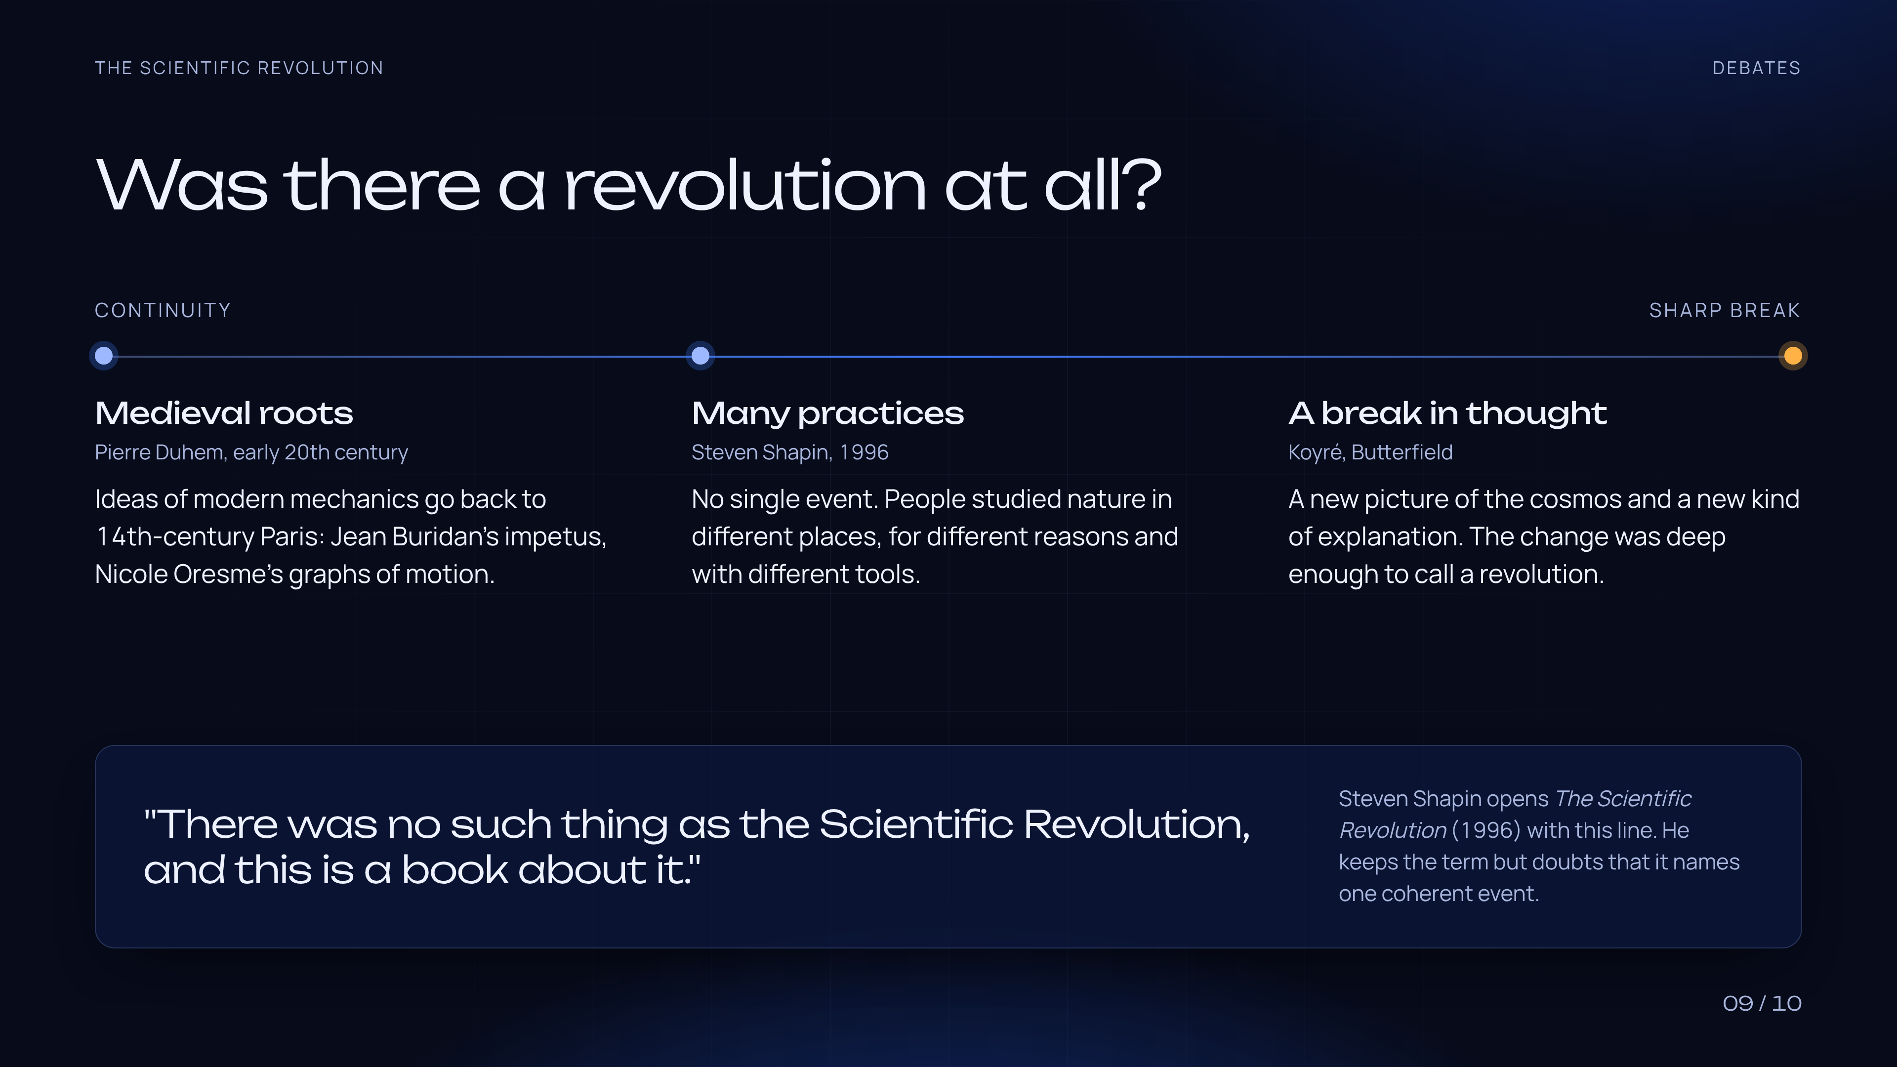
Notes:
Positions in the debate. Continuity: Pierre Duhem traced modern mechanics to 14th-century Paris (Buridan, Oresme). Break: Koyré and Butterfield. Plural practices: Steven Shapin (1996), who opens his book with 'There was no such thing as the Scientific Revolution, and this is a book about it.'

Slide 10

Notes:
Quiz. Answers: 1, B (Alexandre Koyré). 2, B (crisis caused by anomalies). 3, C (De revolutionibus, 1543, and Principia, 1687). The next slide is hidden and shows the answers highlighted.

Slide 11

Notes:
Answers: 1B, 2B, 3C.

