Slide 1
Parking Citations Web Application
CS5001 Senior Design Project

Slide 2
Project Members
Members:
Jason Russell (russej7@mail.uc.edu)
Advisor:
TBD

Slide 3
Project Abstract
My project will be a web-based application that can be used to track parking citations for a small local government. This web-application will be used by the police department to create, track, and print parking citations. This application will also be able to generate reports that city administrators can use to get information on how parking citations impact the city.
I decided on this project because it can provide value to my current job. I am a technical consultant for several local municipalities, and this is something that we have talked to them about creating.

Slide 4
User Stories
Police Officers
As a police officer, I want to be able to create and print a citation to give to a citizen in real time.
As a police officer, I want to be able to search for an edit a citation if necessary.
As a police officer, I want to be able to search for and print a citation for a citizen’s record.
Police Clerk
As a police clerk, I want to be able to search for a citation in case a citizen asks for their citation information.
As a police clerk, I want to be able to edit a citation in case a citation has been paid for or any other information changes.
As a police clerk, I want to be able to add citations, that way if officers bring in paper citations, they can be entered into the application
Administrator
As an administrator, I want to be able to generate monthly or yearly reports so they can be entered into the city record.

Slide 5
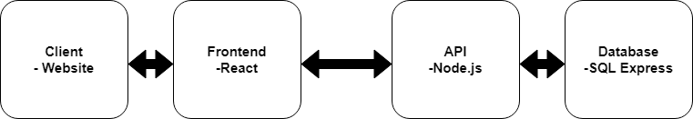
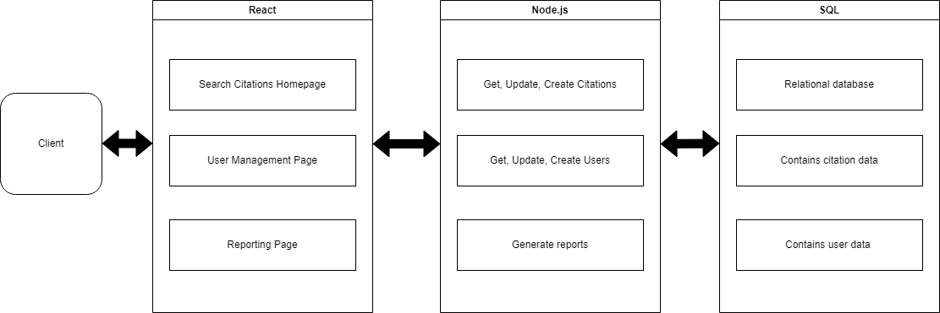
Design Diagrams
Design Diagram D0
Design Diagram D1

Slide 6
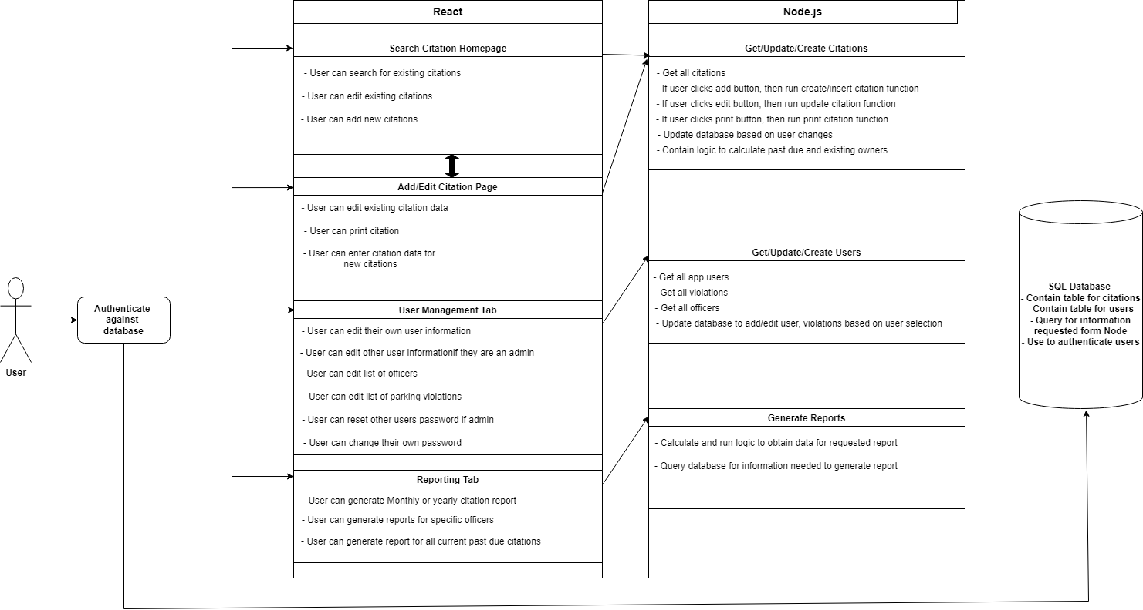
Design Diagrams Cont.
Design Diagram D2

Slide 7
Project Constraints
Professional – I am building this application to be used by clients of my current company, meaning that it has a direct impact on my professional development. This project will also include languages that I am not familiar with, meaning that I will have to do extensive research, and practice.
Security – The application will potentially be used by members of a local government. This means that the project must meet certain security requirements to protect user data.
Social – As mentioned above this application could potentially be used members of a local government. So ideally it will improve their workflow and create revenue if used effectively.

Slide 8
Review of Project Progress
I am currently still in the planning and research phase of the project. The repo has been built, and I am getting familiar with certain languages I would like to use. I am researching what the best languages would be for my application. I am also going over user stories to ensure that my project will meet the needs of the user.

Slide 9
Expected Accomplishments
By the end of the term, I hope to finalize the plan and technology stack. I would also like to begin building the database by the end of the term and some of the back-end. This would give me the entire spring term to work on the front-end and testing.

Slide 10
Division of Work
Since this is a solo project, I will handle all tasks. I have attached the expected hours for each task.
Timeline |  |  | Effort Matrix
Task | Start Date | End Date | Effort Hours
Research React, web app auth methods, REST API, session management | Oct-14-2024 | Nov-14-2024 | 24
Create SQL database for users and citations | Nov-15-2024 | Dec-6-2024 | 12
Create front-end with React | Dec-6-2024 | Jan-3-2025 | 15
Create back-end of application | Jan-3-2025 | Jan-31-2025 | 15
Connect front-end and back-end of the application | Jan-31-2025 | Feb-28-2025 | 12
Create and run unit tests | Feb-28-2025 | Mar-7-2025 | 8
Create host environment for application | Mar-7-2025 | Mar-14-2025 | 4
Deploy application to host enviroment | Mar-14-2025 | Mar-21-2025 | 4

Slide 11
Expect Demo for Expo
For the Expo, I plan to display the full web application, and each feature it has. This includes creating a basic citation, printing a citation, generating reports, and more.

