Slide 1
Parking Citations Web Application
CS5001 Senior Design Project

Slide 2
Project Members
Members:
Jason Russell (russej7@mail.uc.edu)
Advisor:
TBD

Slide 3
Project Abstract
My project will be a web-based application that can be used to track parking citations for a small local government. This web-application will be used by the police department to create, track, and print parking citations. This application will also be able to generate reports that city administrators can use to get information on how parking citations impact the city.
I decided on this project because it can provide value to my current job. I am a technical consultant for several local municipalities, and this is something that we have talked to them about creating.

Slide 4
Goals
My goals for this project are to create a lightweight web application that can be used by several users. I would like to use this project to improve my technical skills and give me a better understanding of different web development frameworks. This project is something that I can include in my portfolio and use for future job opportunities.

Slide 5
Intellectual Merits
I think the most interesting part of this project is the React framework. This is my first time using react and I have come to learn that it is a very useful tool for web development. Compared to other technologies I have learned, the React framework is likely the easiest.
Another interesting part of this project was producing ideas that could be added to this application. Once users begin using the application, I hope that they give me more ideas of what could be added to the application.
The react homepage (https://react.dev/learn) has a lot of documentation that has helped me with this project.

Slide 6
Broader Impacts
Some broader impacts of this application include:
Improve police department workflow
Create revenue for police department/city

Slide 7

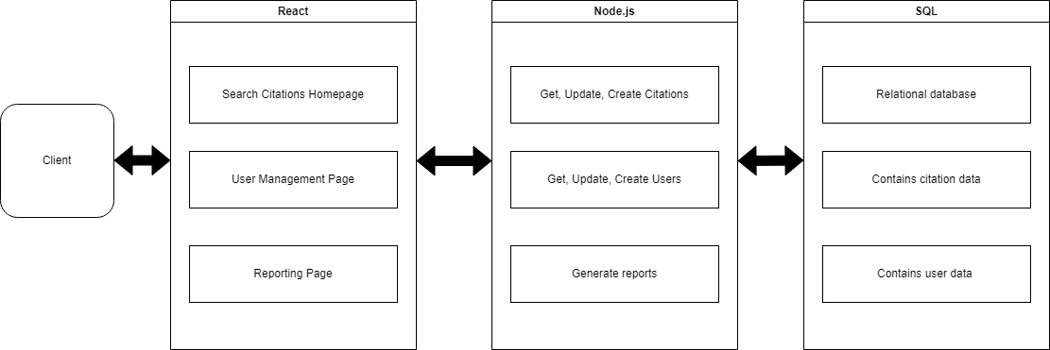
Design Diagrams
Design Diagram D0
Design Diagram D1

Slide 8
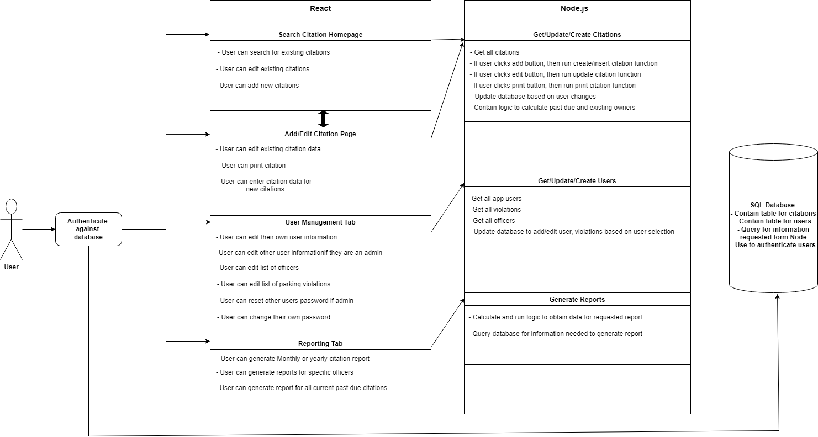
Design Diagrams Cont.
Design Diagram D2

Slide 9




Technologies
Vite:
I used Vite to create the web application because the setup was fast and very simple
React:
I used React for the front-end components like the different pages, navigation bar, etc.
I used React router for navigation between pages (Citations, Users, Login, etc.)
Node:
I used node to handle the server-side logic and database interactions
Each page has its own service which handles the logic, create calls, and update calls.
SQL Express
Created the Citations table and User table in SQL Express

Slide 10
Milestones
1. Identify the use of the application (August 2024)
- Determine exactly what kind of functionality the users will need out of this application.
2. Research technology stack (September 2024 – December 2024)
- Determine which technology stack and libraries will be the best for this application. Get familiar with the technologies chosen.
3. Build out the project (December 2024 – March 2025)
- Build all the components of the web application (Database, front-end, back-end, etc.)
4. Test application (March 2025 – April 2025)
- Create tests, and edit the application based on the test results.
5. Deploy application (May 2025)
- Deploy the application and give access to more users.

Slide 11
Review of Project Progress
I have built out the database tables and the file structure for the project. I am currently building the front end for the each of the pages. Once I finish those, I will start on the backend for each of those pages. The backend for those pages will include the logic for creating citations/users or updating citations/users. For the expo, a test user will be able to login to the application, search for a citation, edit a citation, add a citation, search for a user, edit a user, or add a user.
Finishing tasks:
Write back-end code to communicate with database
Style the front-end pages
Runs tests
Setup demo environment for expo

Slide 12
Challenges
I have run into a few challenges while working on this project. Some of these challenges include:
Learning a new framework
Managing my time
Overcoming these challenges has taken practice and time. Learning a new technology requires patience and a lot of research. Managing my time is an ongoing struggle and it has taken reflection and practice to improve. Being aware of the challenges and what it takes to overcome them has really helped me to maintain progress on this project.

