Slide 1

Introduction to Computational Cognitive Modelling
Russell J. Boag
r.j.boag@uva.nl

Slide 2
This lecture covers…
Introduction to cognitive modelling
What is a model? Why do we model? What makes a good model?
Behavioural performance measures and their limitations
Building a cognitive model from the ground up
Covers the historical progression from early signal detection theory to current evidence accumulation models
Example applications in cognitive neuroscience
Neural evidence for evidence accumulation
Relating model parameters to neuroscientific data
A (very) brief guide to implementing cognitive models
Experimental design, model building, model fitting, model selection

Slide 3
This lecture covers…
Introduction to cognitive modelling
What is a model? Why do we model? What makes a good model?
Behavioural performance measures and their limitations
Building a cognitive model from the ground up
Covers the historical progression from early signal detection theory to current evidence accumulation models
Example applications in cognitive neuroscience
Neural evidence for evidence accumulation
Relating model parameters to neuroscientific data
A (very) brief guide to implementing cognitive models
Experimental design, model building, model fitting, model selection

Slide 4
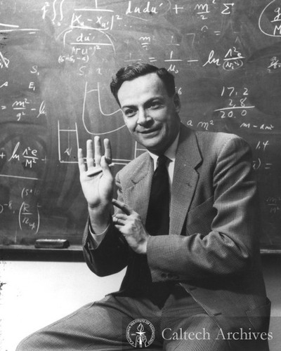
“What I cannot create, I do not understand.”
Richard Feynman (1988)
“To have one’s hunches about how a simple combination of processes will behave repeatedly dashed by one’s own computer program is a humbling experience that no experimental psychologist should miss.”
Douglas Hintzman (1990)
Notes:
“It is only in the context of a particular process model that inferences can be meaningfully drawn from experimental data” – Tulving & Bower (1974)

Slide 5

The ‘black box’ problem of cognitive science
Cognitive scientists seek to understand how the mind produces behaviour
By describing, predicting, and explaining behaviour
What cognitive processes give rise to behaviour
But cognitive processes are latent
Cannot observe or measure cognitive processes directly – the mind is a ‘black box’
We must infer their properties from behavioural data (e.g., RT, accuracy) and controlled experimental manipulations
Understanding data relies on quantitative mathematical models
Data do not ‘speak for themselves’ but require a model to be understood
There are always several alternative models that can explain the data
We would like to select between competing theories and find the best one
?

Slide 6
Observation:
Person A tends to make slower responses than Person B
Competing verbal explanations…
More cautious responding!
Lack of attention!
Cognitive impairment!
Slower arm movements!
Random coincidence!
How can we choose the best explanation?
Build formal models (containing the various mechanisms) that can predict data…
Model 1
Model 2
Model 3
Model 4
Model 5
Test which model and mechanism(s) recreates the data best…
Match between model and data
This raises our confidence in a given explanation beyond what verbal reasoning allows

Slide 7
What is a model?
A formal model is a quantitative mathematical statement which summarizes the computations or processes assumed to underlie some specific behaviour
Models formalize the process(es) that we think generated the observed data
Cognitive models formalize the latent cognitive processes that give rise to behaviour in mathematical expressions
Why do people’s decisions differ in RT and accuracy?
Attention? Cognitive processing? Perception? Slower motor response? More cautious? Experience/learning?
Similar questions arise in may other areas of cognition, including learning, memory, abstract reasoning
Essentially impossible to choose between these options using verbal descriptions alone!
Formal models specify all parts of a theory clearly and unambiguously

Slide 8
Computational models
When formal models are implemented in computer code they are called computational models
Forces us to specify all parts of our theory clearly and unambiguously (otherwise our code will either produce nonsense or not run!)
Allows for explicit, unambiguous theories that can be shared and tested universally
Ultimately, computational models help scientists communicate and reason about theories and develop shared understanding
A piece of code will run the same for everybody
Removes the messy individual differences inherent in scientists’ minds
E.g., differences in knowledge, ability, experience, understanding, cognitive biases, motivated reasoning, political and emotional biases, etc…

Slide 9
Why model?
Most importantly, formalizing our assumptions makes our theories testable
Without formalization, your theory cannot be falsified, rendering it useless
Formal models are the difference between psychology as a science versus psychology as philosophy (i.e., verbal theorizing)
If we make a model predict/generate new data (under the same conditions as the old data that we are interested in) then the new data should look very similar to the old data
This is called model fitting
How well does our model predict our observed data?
Comparing fits of different models is one way we select between competing theories

Slide 10
What makes a good model?
Achieve a basic level of descriptive adequacy
Does the model fit the data well?
Provide insight and understanding
Do the model parameters have psychological meaning?
Facilitate prediction and generalization
What will happen if we change the experiment or situation?
Direct new empirical explorations
Can we develop novel tests of the models predictions?
Foster theoretical progress
Can we further refine our questions?
Shiffrin, Lee, Wagenmakers & Kim (2008)
Notes:
Shiffrin, Lee, Wagenmakers & Kim (2008) propose several criteria that make a good model.
Achieve a basic level of descriptive adequacy. A model should agree with observed data well enough that something sensible can be said about how a cognitive process behaves. For example, a model of memory retention that shows a negatively accelerating decrease in retention over time describes some basic aspects of the data. The model serves to give a formal expression of important empirical regularities.
Provide insight and understanding. A model should help us understand things not directly evident from looking at the data, thereby leading to further studies and tests. It should allow us to deepen, refine, and elaborate our understanding of the cognitive processes at work. For example, a category learning model may account for data only when using a particular value of a selective attention parameter. The value of this parameter has psychological meaning, and provides part of an explanation of how category learning was achieved.
Facilitate prediction and generalization. A good model should help make predictions about what will be observed in the future, or generalizations about what would be observed under altered circumstances.
Direct new empirical explorations. A good model should lead us to develop new empirical studies that have the greatest chance of increasing our understanding and adding to our knowledge.
Foster theoretical progress. There is a sense in which the goal of modelling is not to find answers, but to sharpen questions. Modeling forces theoretical ideas to take precise forms, and to encounter empirical evidence head on. Models help make clear the predictions of theories, and suggest critical tests. To the extent that a model clarifies where theory is working and where it is failing, it makes a valuable contribution.

Slide 11
“All models are wrong, but some are useful.”
Box (1976)
”It is a basic truth that all models (of choice RT and other phenomena) are approximations at some level. All models include simplifications for tractability. These simplifications are included for convenience, and are not intended as statements about the underlying nature of the process at hand. All models of choice RT interpose many layers of approximation between neurophysiological reality and theoretical description: ion flows, membrane potentials, action potentials; all of these are approximated away, and the LBA model adds just one further step. These approximations should not be perceived as inherently harmful to scientific progress. In physics, for example, the ideal gas law and Newtonian motion are both extremely useful models of reality. Their power and utility persist even though both include well-known and demonstrably false simplifications. Indeed, the utility of these laws is increased by these approximations, because the resulting simplicity allows wider application. More modestly, we hope that the simplicity and tractability of the LBA model will allow its application to a wider range of choice RT paradigms than may otherwise have been possible.”
Brown & Heathcote (2008)

Slide 12
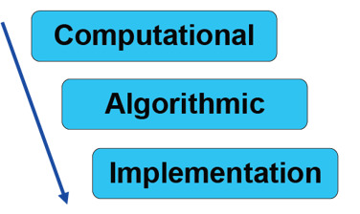
Levels of abstraction/explanation
Marr’s (1982) levels
Goals, outcomes of the behaviour to be explained
Cognitive processes, internal representations
Neurobiology (action potentials, ion flows, neural population dynamics)
Lower? Molecular biology, chemistry, physics
Higher? Metacognition, social/group interactions, game theory, evolutionary fitness
Kriegeskorte & Douglas (2018) Love (2015)

Slide 13
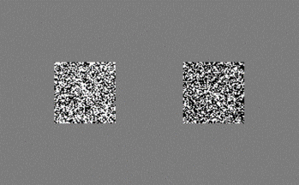
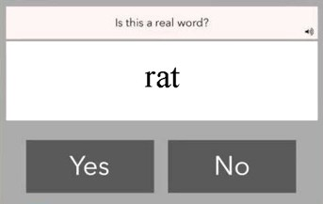
Experimental tasks in cognitive neuroscience
Experimental research in cognitive neuroscience is often based on speeded response time tasks
Participants make a series of 2-choice ‘yes/no’ decisions about stimuli presented on a computer display
Present/absent (signal detection/vigilance)
Light/dark (brightness discrimination)
Left/right (motion discrimination)
Old/new (recognition memory)
Go/no-go (inhibitory control)
Word/non-word (lexical decision)
High/low value (value-based decisions)
Category A/B (categorization)

Slide 14
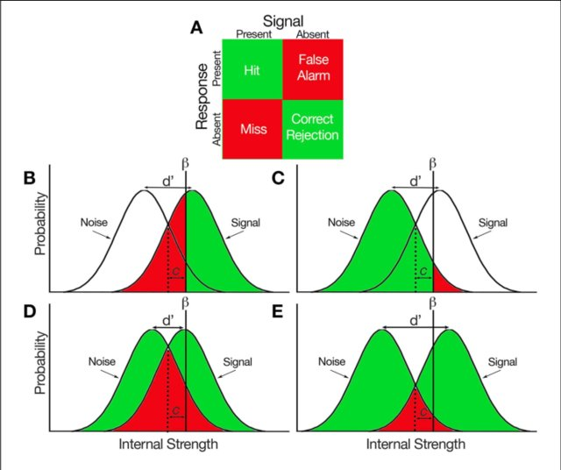
Behavioural performance measures
On each trial we observe a bivariate dependent variable: choice-RT
We are typically interested in comparing performance between conditions, stimuli, or experimental groups
Easy vs. difficult stimuli
Speed vs. accuracy instructions
Patients vs. controls
How can we measure performance?
Accuracy
What proportion of trials do people get correct?
Hit rate
How often do people say Yes when the correct answer was Yes?
False Alarm Rate
How often do people say Yes when the correct answer is No?
Mean RT
On average, how fast are Hits and False Alarms?

Slide 15
Limitations of behavioural measures
Several problems with using mean RT and accuracy as measures of performance
Problem: People can vary their response bias independently of their sensitivity
Accuracy may be poor due to either biased responding or low sensitivity
Hit rate may be high due to biased responding or high sensitivity
HR and FA vary in the same direction when there is a change in bias
HR and FA vary in opposite directions when there is a change in sensitivity

Slide 16
Limitations of behavioural measures
Problem: Participants can trade speed for accuracy and vice-versa
Speed-accuracy trade-off
Reflects decisional style, not performance, and can lead to contradictory inferences depending on which measure is used
E.g., lower accuracy but faster RT
Has performance improved or deteriorated?
Problem: Changes in mean RT and accuracy can have multiple causes
Slower mean RT could reflect stimulus difficulty (e.g., slower processing rate) or response style (e.g., more cautious responding)
Latent effects may be obscured at the level of mean RT/accuracy

Slide 17
Additional drawbacks…
Problem: Ability to summarize performance using either mean RT or accuracy adds researcher degrees of freedom
E.g., report significant effect on mean RT while ignoring nonsignificant effect on accuracy
Problem: Poor use of available information in the data
Available data comprise two RT distributions (one for each response)
Distributions consist of responses from hundreds or thousands of trials per person
Each distribution has a location (mean), shape (variance, skewness), and size (choice proportion) relative to the other
Poorly summarized by one number! (e.g., mean RT, accuracy)
Problem: Not guided by theory
No account of the cognitive processes that are producing behaviour
No account of Marr's (1982) levels
We will now look at potential solutions to each of these issues…

Slide 18
This lecture covers…
Introduction to cognitive modeling
What is a model? Why do we model? What makes a good model?
Behavioural performance measures and their limitations
Building a cognitive model from the ground up
Covers the historical progression from early signal detection theory to current evidence accumulation models
Example applications in cognitive neuroscience
Neural evidence for evidence accumulation
Relating model parameters to neuroscientific data
A (very) brief guide to implementing cognitive models
Experimental design, model building, model fitting, model selection

Slide 19
Building a cognitive model
We will now build a formal model of decision making from the ground up
Signal detection theory (SDT)
Random walk models
Diffusion and racing accumulator models
The overall aim is to show you the logical progression from very early SDT models to current state-of-the-art evidence accumulation models of decision making
We will also touch on some ways these models have been extended and current theorerical developments

Slide 20
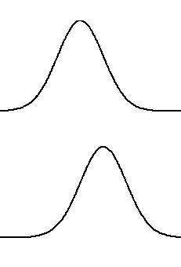
Signal Detection Theory
SDT is a model of detection (e.g., yes/no decisions) that incorporates both sensitivity and response bias
Lets us relate HR and FA to sensitivity and bias
Starting assumptions:
A distribution that generates sensations when there is no signal present (correct response to these sensations is No)
A distribution that generates sensations when there is a signal present (correct response to these sensations is Yes)

Slide 21
Signal Detection Theory
Given a sensation X with some magnitude, there is no way to unambiguously determine which distribution the sensation came from
Respond ‘No’
Respond ‘Yes’
SDT assumes the best an observer can do is set a criterion
X > criterion = Yes
X < criterion = No
Given some parameters which determine the location and shape of the distributions and the position of the criterion, we can generate predictions for the HR and FA
Noise dist.
Signal dist.

Slide 22
Signal Detection Theory
Predictions come from integrating portions of the signal and noise distributions
Miss
Hit
Notes:
Caption:
Hypothetical representations of the signal and noise probabilities distributed within a decision-maker. (A) Response matrix of all signal-response combinations that can be made in a binary decision task. Green indicates correct decision, red indicates incorrect decision. (B) Proportions of hits and misses represented under the signal distribution. β reflects the subject criterion, c reflects bias, and d ′ reflects sensitivity which represents the difference in position between the two distributions. (C) Proportions of false alarms and correct rejections represented under the noise distributions. (D) A condition which hypothetically reflects low subject sensitivity. When the distributions are closer together (i.e., d ′ is smaller), the difference between the proportion of hits and false alarms is lower. (E) A condition which reflects high subject sensitivity. When the distributions are farther apart (i.e., d ′ is larger), the difference between the proportion of hits and false alarms is higher.

Slide 23
Signal Detection Theory
Predictions come from integrating portions of the signal and noise distributions
Correct rejection
False alarm

Slide 24
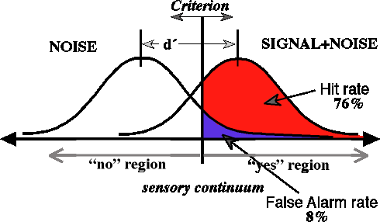
Signal Detection Theory
Parameters:
Mean & SD of noise distribution
Mean & SD of signal distribution
Criterion
Given some parameter values we can generate predictions
We can thus estimate the model’s parameters from observed data
Note: All that matters is the distance between the distributions (not the actual means)
So we reparametrize in terms of this distance (i.e., sensitivity/d-prime)
Computed as: 𝑑′ = 𝑍(𝐻𝑅) − 𝑍(𝐹𝐴)
Z(P) is the inverse cumulative distribution function of a normal distribution
This is only true if we assume that the variance of the signal and the noise distribution both equal 1
If we assume different variance, then we need to alter the computation to account for that assumption

Slide 25
Limitations of SDT
SDT explains HR/FA in terms of cognitive parameters
However, SDT does not explain RT
Behaviour takes time
Model mimicry - many different models can accurately predict HR and FA
Trade-offs between bias and sensitivity affect response time (i.e., speed-accuracy trade-off)
So we need a model that allows independent variation of sensitivity and bias but also predicts RT
Mean RT is not enough (predicting similar mean RTs is relatively easy)
However, RT distributions provide a lot more information than mean RTs (e.g., the position of the leading edge, the mean/median, the amount of skew)
All of these factors can be used to differentiate different models
We want to make use of as much information in the data as possible

Slide 26
What we still need to explain…
Speed-accuracy trade-off
People can choose to respond faster (but with lower accuracy)
People can choose to respond more accurately (but with slower speed)
One property of RTs that has proven to be very difficult to explain is the very large difference in RT between the speed-emphasis and accuracy-emphasis conditions
Mean RT more than doubles when people are instructed to be more accurate rather than instructed to be faster
Accuracy only changes by < 10%

Slide 27
What we still need to explain…
Crossover pattern of correct and error RTs
Under accuracy instructions (or when decisions are hard to make) errors are slower than correct responses
Under speeded instructions (or when decisions are easy) errors are faster than correct responses
This crossover pattern has also been observed by others and has proven difficult to model
See Luce (1986) for a summary
In summary, a model of choice-RT must be able to predict:
Choices and response times
Skewed shape of RT distributions
Speed-accuracy trade-off
Cross-over pattern of correct/error RTs

Slide 28
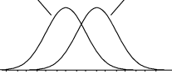
Extending SDT to the time domain
In traditional SDT we sample just once and whichever side of the response criterion our sample falls on, we emit the associated response
When samples fall above the criterion, the observer responds ‘signal’ (or whatever response is associated with that distribution)
When samples fall below the criterion, the observer responds 'noise'
Notes:
Note that we don’t really have access to any of the information about the signal and noise distributions - all we have is our sample and our criterion.

Slide 29
Extending SDT to the time domain
If we assume that we sample multiple times rather than responding after a single sample, each sample provides some evidence that the stimulus is drawn from the signal distribution and some evidence that the stimulus is drawn from the noise distribution
This is known as sequential sampling and forms the basis for a very successful class of models
When samples fall above the criterion, we step towards (i.e., gather evidence for) a ‘signal’ response
When samples fall below the criterion, we step towards a ‘noise’ response
Assuming that each sample takes time, how many samples do we need before we make a decision?
Notes:
Note that we don’t really have access to any of the information about the signal and noise distributions - all we have is our sample and our criterion.

Slide 30
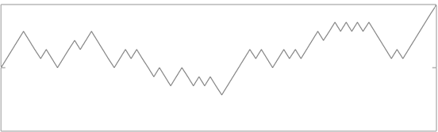
The Random Walk Model
Assume we have a counter between two response boundaries (representing ‘signal’ and ‘noise’ responses)
Boundaries represent the evidence (number of samples) required to trigger the corresponding response
We then accumulate a sample (gather evidence) at each time step and update our counter accordingly
If the sample falls in the signal portion of the distribution, we take a step toward the signal boundary
Otherwise, we take a step toward the noise boundary
Respond ‘signal’
+1
-1
-1
+1
+1
+1
+1
-1
-1
+1
+1
+1
Time
Respond ‘noise’

Slide 31
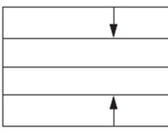
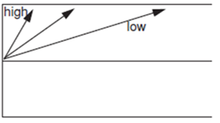
The Random Walk Model
Samples (i.e., evidence) continue to accumulate until we hit one of the two boundaries
When that occurs, we stop sampling and make the response associated with that boundary
How does this help us model reaction time?
Boundary Separation
We can independently vary how much evidence is necessary before we make a decision
Quality of Evidence
The overall quality of evidence affects the drift rate (i.e., the probability of taking a step up / sampling from the signal distribution)
Notes:
Can also vary starting-point bias.

Slide 32
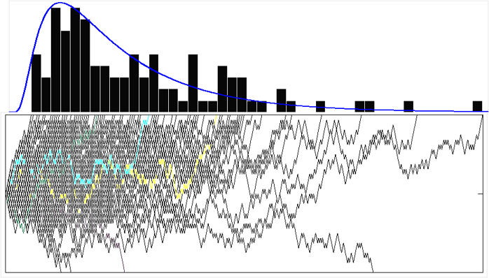
The Random Walk Model
We can then repeat this process over many trials to generate a predicted RT distribution
The frequency of stopping at each time point gives us the probability of stopping at that point
We can then compare this predicted RT distribution with our actual observed data
We do this by adjusting the parameters representing the probability of sampling from the signal distribution and the stopping threshold until we obtain a distribution that fits our data well

Slide 33
The Drift Diffusion Model
Evidence accumulation in the basic random walk model proceeds in discrete time steps of a particular size/duration
In the limit, as the step size approaches zero, the discrete-time random walk becomes a continuous-time Weiner diffusion process
In psychology and cognitive science this model was popularised by Ratcliff (1978) and is known as the drift diffusion model (DDM) or Ratcliff diffusion model
We will now look at how adjusting diffusion model parameters affects the shape and position of RT distributions

Slide 34
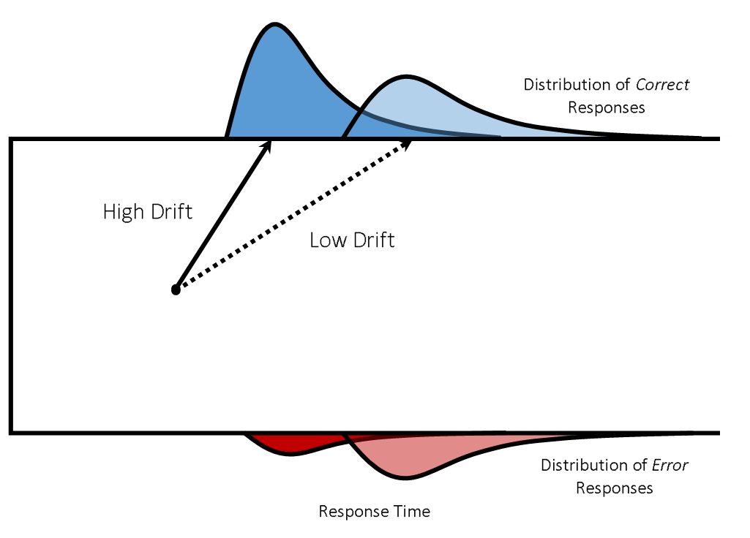
Effect of drift rate on choice-RT
High drift rates make responses fast and accurate
Less skewed RT distributions
Low drift rates make responses slower and less accurate
More skewed RT distributions

Slide 35
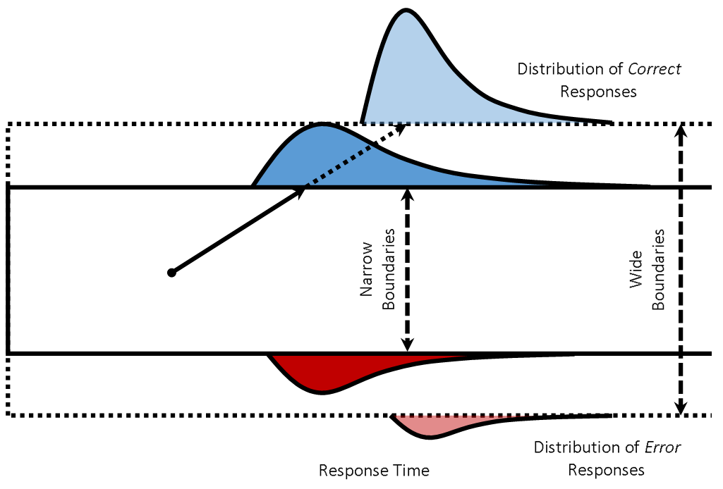
Effect of thresholds on choice-RT
Low thresholds (narrow boundaries) make responses faster but less accurate
Diffusion paths more susceptible to random fluctuations
High thresholds (wide boundaries) make responses slower and more accurate
Diffusion paths less susceptible to random fluctuations

Slide 36
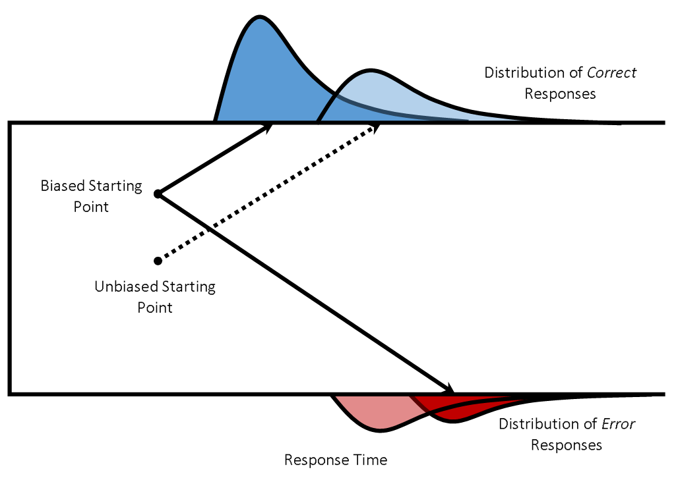
Effect of starting point on choice-RT
Starting closer to the correct response boundary makes errors slower and less frequent (due to the longer distance to the error boundary)
Conversely, starting closer to the error boundary makes errors faster and more frequent

Slide 37
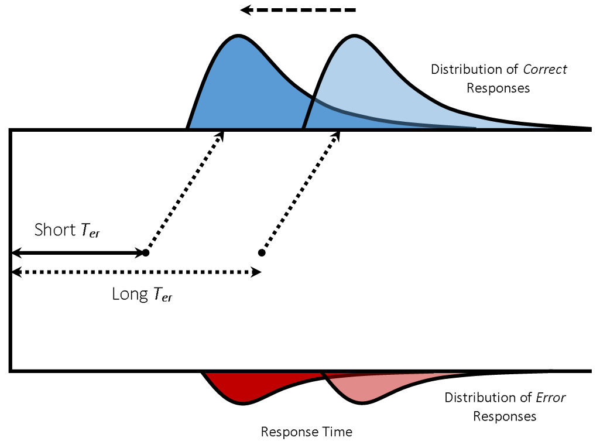
Effect of nondecision time on choice-RT
Nondecision time shifts the RT distribution along the horizontal (time) axis
Cannot affect accuracy
Full DDM also includes parameters to capture between- and within-trial variance in key parameters
These too are sometimes interpreted cognitively
For a review of the evolution of and extensions to the DDM:
Ratcliff et al. (2016) Trends Cog Sci

Slide 38
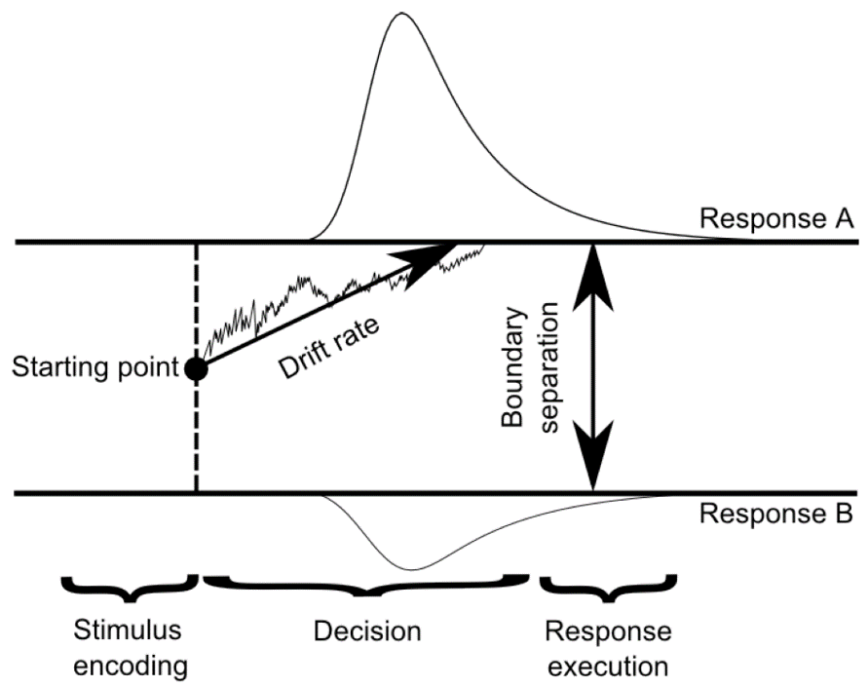
The Diffusion Model
Diffusion (and random walk) models allow independent variation of sensitivity (drift rate), response threshold (boundary separation), nondecision time
Can predict a wide variety of RT distribution shapes (inc. SAT and crossover effects) by varying its parameters
Allows the model to predict all benchmark data
Skew, speed-accuracy trade-off, crossover of correct/error RTs
Disentangles the action of different latent processes

Slide 39
The Diffusion Model
Model parameters map onto psychologically meaningful processes
Drift rate measures processing speed/stimulus discriminability
Boundary separation (distance between thresholds) measures response caution (i.e., amount of evidence needed)
Starting point measures a priori response/base-rate biases
Nondecision time measures time for perceptual encoding and motor response execution
Establishes links between Marr’s (1982) levels
Mainly at computational and algorithmic levels
Explains latent cognitive processes that give rise to behaviour
But also makes connections to neural/implementation level
Model-based cognitive neuroscience
We will see more on this shortly…

Slide 40
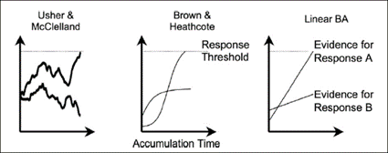
Accounting for multiple choices: Race architectures
DDM limited to tasks involving two choices
Race architectures
Have several ‘accumulators’ each gather evidence in a race against each other
A step toward one options does not necessarily mean a step away from another option
Can model any number of choice options (i.e., using one accumulator per response)
The leaky competing accumulator adds nonlinear processes
Passive decay of accumulated evidence
Response competition (inhibition), i.e., evidence for one response decreases the evidence for the other
The ballistic accumulator then omitted the within-trial noise from the evidence accumulation process
The linear ballistic accumulator (LBA) further omits the nonlinearities from the ballistic accumulator
Evidence accumulates linearly for both responses, without moment-to-moment variability (i.e., within-trial noise), continuing until the response threshold is reached for one response.
Evidence for each response is independent of evidence for other responses
Brown & Heathcote (2008)

Slide 41
Recent extensions to accumulation models
The aforementioned architectures provide a basic framework for the majority of evidence accumulation modelling in cognitive neuroscience
However, the basic models have been (and continue to be) extended in many interesting ways
Collapsing bounds, drift rate gain, urgency (Hawkins et al., 2015)
Attentional capacity, gain and focus (Boag et al., 2019a,b)
Reinforcement learning for adaptive evolution of decision-making over time (Miletic, Boag, & Forstmann, 2020)
Many other modelling frameworks – not only decision-making models!
However, evidence accumulation models are one of the most successful classes of model in cognitive (neuro)science

Slide 42
This lecture covers…
Introduction to cognitive modeling
What is a model? Why do we model? What makes a good model?
Behavioural performance measures and their limitations
Building a cognitive model from the ground up
Covers the historical progression from early signal detection theory to current evidence accumulation models
Example applications in cognitive neuroscience
Neural evidence for evidence accumulation
Relating model parameters to neuroscientific data
A (very) brief guide to implementing cognitive models
Experimental design, model building, model fitting, model selection

Slide 43
Example applications
Evidence accumulation models widely applied in many domains
Cognitive psychology
Cognitive processes underlying decision making (VSTM, lexical decision, prospective memory, identification)
Applied psychology/human factors
Air-traffic control, maritime surveillance/UAVs, submarine navigation, automation
Clinical psychology/psychiatry
Locus of cognitive deficits in clinical populations (depression, anxiety, schizophrenia, aging)
Model-based cognitive neuroscience
Explores the neural basis of cognitive processes
Associate brain measurements with latent cognitive processes rather than statistical summaries of behavioural data
Individual differences analyses

Slide 44
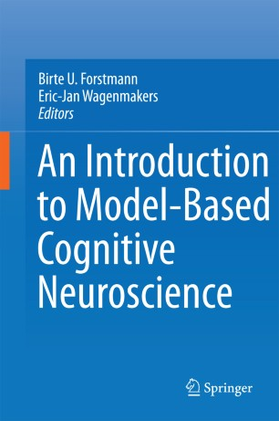
Model-based cognitive neuroscience
Highly interdisciplinary field...
Cognitive science: learning, memory, decision making, attention, perception
Mathematics: statistics & probability theory, linear algebra, calculus, DEs
Data analysis: general linear model, machine learning, Bayesian modelling, hierarchical modelling
Physics: understanding models at a mechanical level, understanding methods, e.g., MR physics (fMRI), signal processing (EEG)
Neuroscience: biology, anatomy, chemistry, physiology
Computer science: programming, algorithms, parallel computing, reproducible research
Communication: scientific writing, data visualization, teaching, presenting
Forstmann & Wagenmakers (2015)

Slide 45
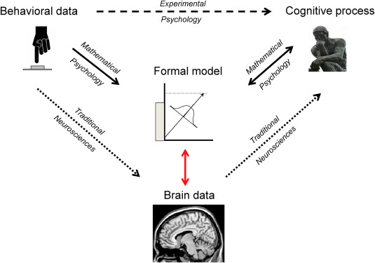
Model-based cognitive neuroscience
Models can be extended to account for neurophysiological data (EEG, MEG, fMRI, DWI)
Idea is to connect neuroscientific measurements to latent processes (described by model parameters) that give rise to observed behavior rather than relatively coarse summary statistics (e.g., mean RT, accuracy)
Models as a bridge between brain and behavior
Love (2015)
”Model-in-the-middle” approach
Corrado & Doya (2007), Forstmann & Wagenmakers (2015), Forstmann et al. (2016)
Further discussion of methods for relating brain and behavior
Turner et al. (2017)
Best to look at some examples…

Slide 46
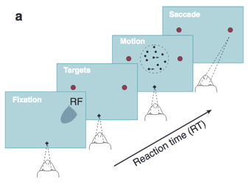
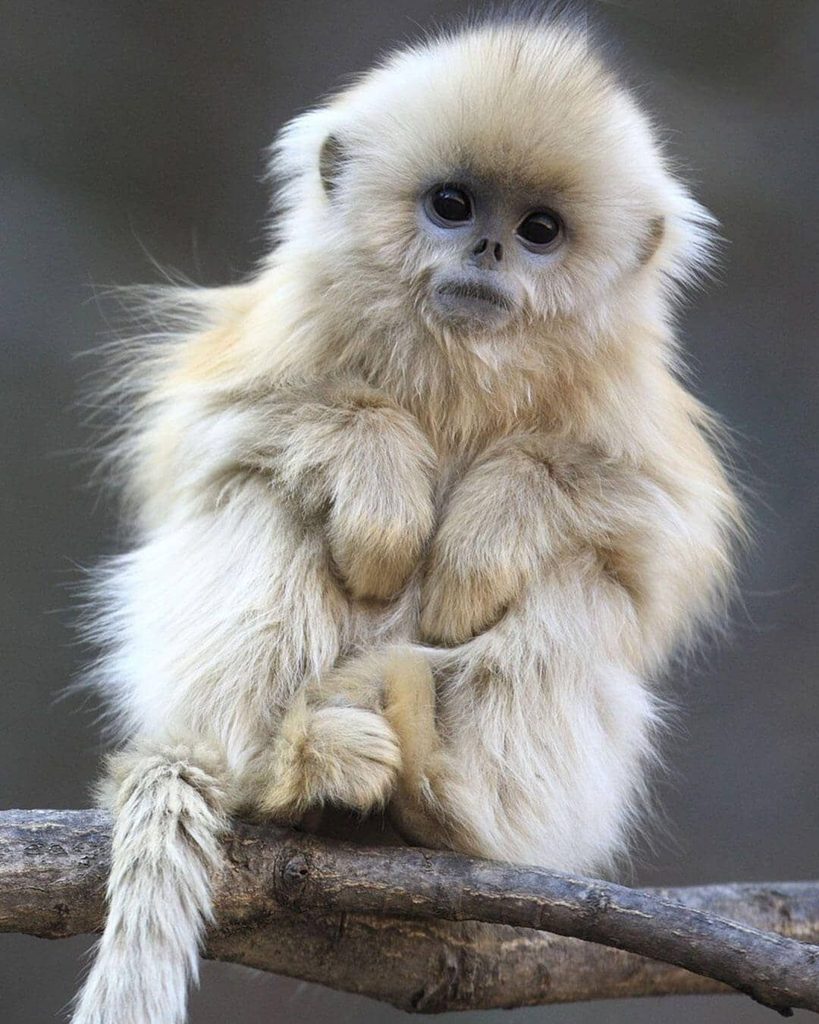
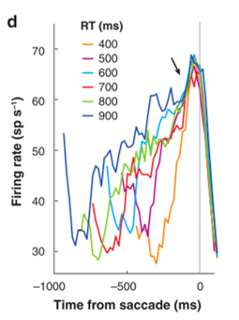
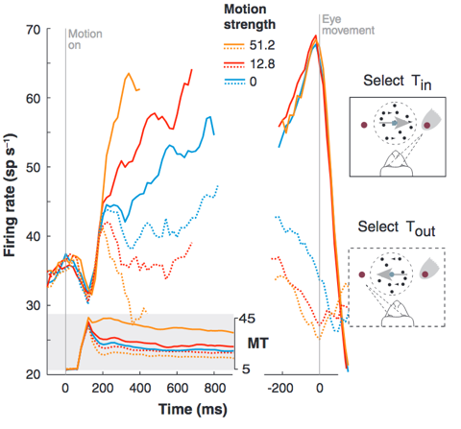
Early neural evidence for evidence accumulation
Jeff Schall (90s-00s)
Gold & Shadlen (2001, 2007)
Firing rates in monkey LIP (and FEF) appear to mimic DDM predictions
Speed of increase dependent on difficulty
Reach threshold before movement
Non-decision time component in range of fitted model parameters
See Latimer et al. (2015) for further discussion

Slide 47
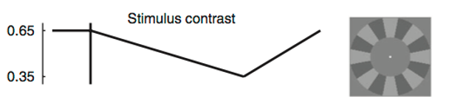
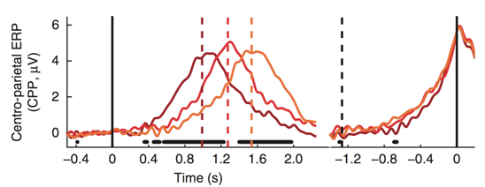
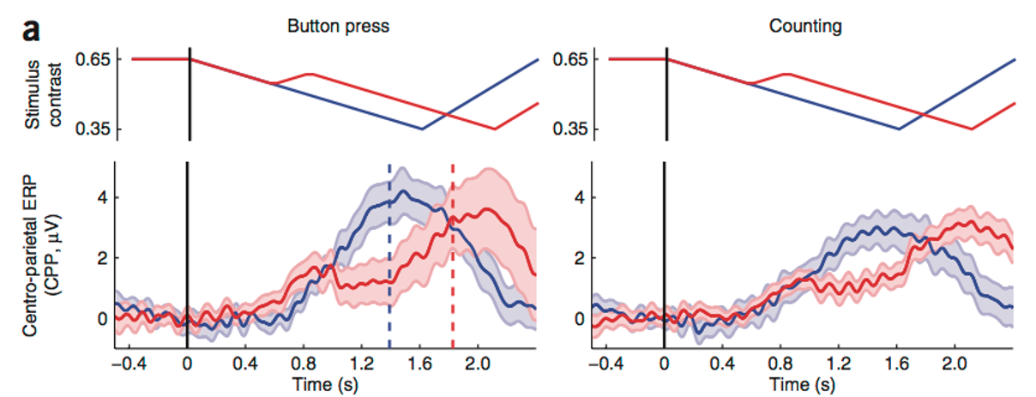
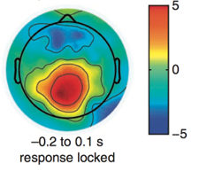
Early neural evidence for evidence accumulation
Analogous findings in humans with EEG
O’Connell et al (2012) Nat Neuro
Recent review paper
Schall (2019) Trends Neurosci

Slide 48
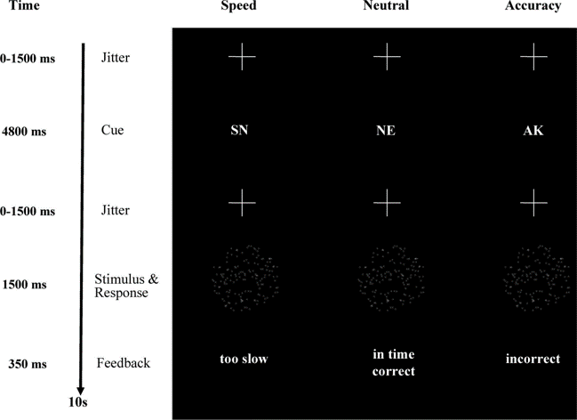
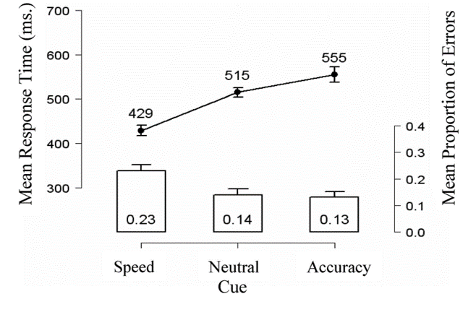
Forstmann et al. (2008)
Investigated the neural correlates of the speed-accuracy trade-off
Participants performed a cued dot-motion discrimination task (i.e., classify left- vs. right-moving dots)
Trials were cued with either speed, accuracy, or neutral instructions
Behavioural results
Responses faster and less accurate under speed instructions (suggesting a threshold effect)

Slide 49
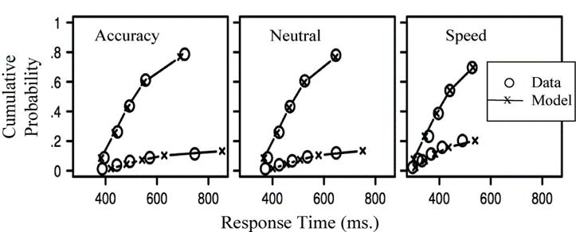
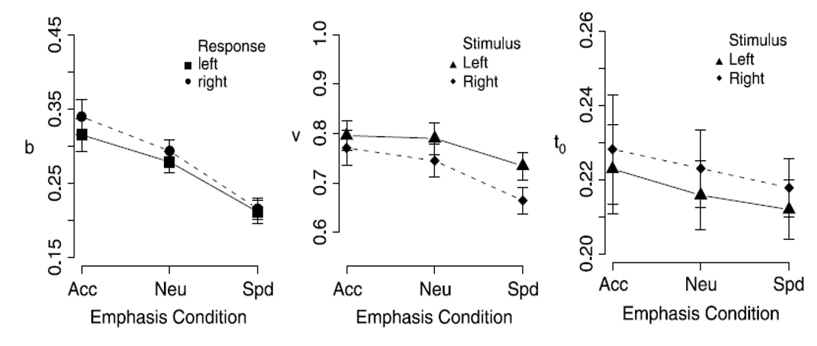
Forstmann et al. (2008)
Cognitive modelling
Fit LBA models with different parameters allowed to vary by speed/accuracy cue
Model selection favoured model with only thresholds free to vary by cue
Model captures empirical RT quantiles for both correct and error responses
Accounts for changes in location and shape of entire RT distributions by cue
Evidence for lower thresholds under speed instruction
Drift rate and nondecision time trends but greater within-subjects variability

Slide 50
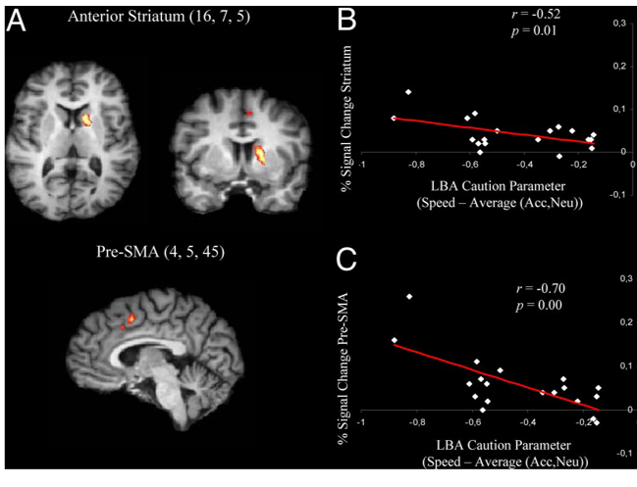
Forstmann et al. (2008)
Neuroimaging
Performed individual difference analyses
Correlated model parameters (size of threshold shift) with BOLD activity from fMRI data
Larger threshold shifts under speed stress associated with increased BOLD % signal change in striatum and pre-SMA
Facilitates fast but potentially premature responses
Consistent with role of BG in regulating decision-making
Established links between neural (implementation) level and cognitive (algorithmic) level processes that give rise to behaviour
Also related to pre-SMA-BG connection strength in structural MRI
Forstmann et al. (2010)

Slide 51
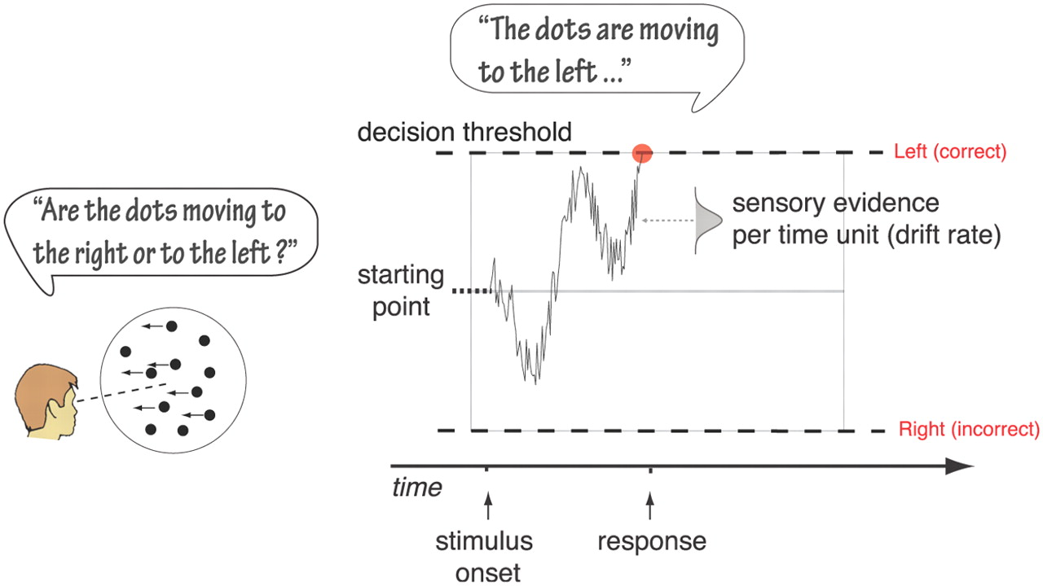
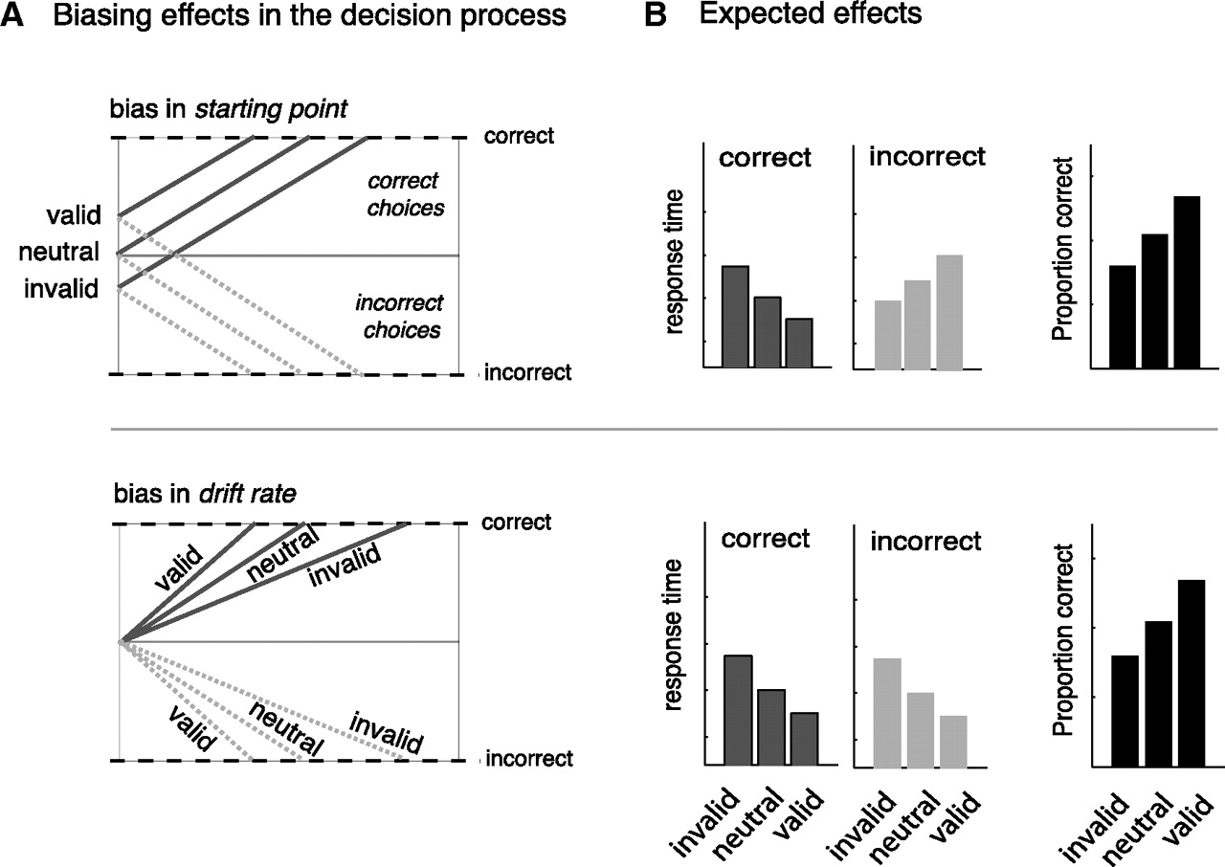
Mulder et al. (2012)
Similar random dot motion task
Investigated effect of biases on cognitive processes and brain activity
Prior probability
Payoff structure
Tested two competing explanations of bias in diffusion model
Starting point vs. drift rate

Slide 52
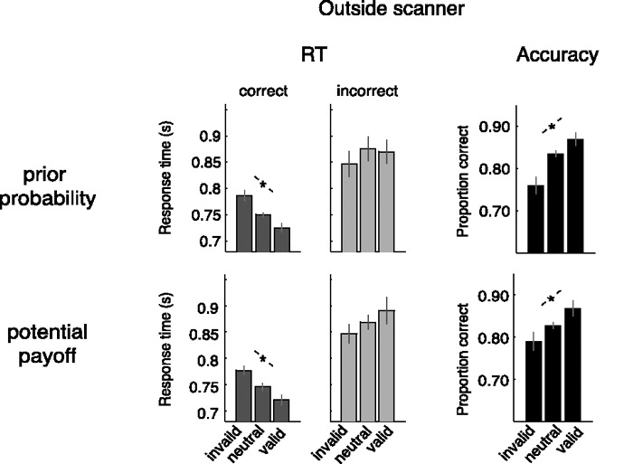
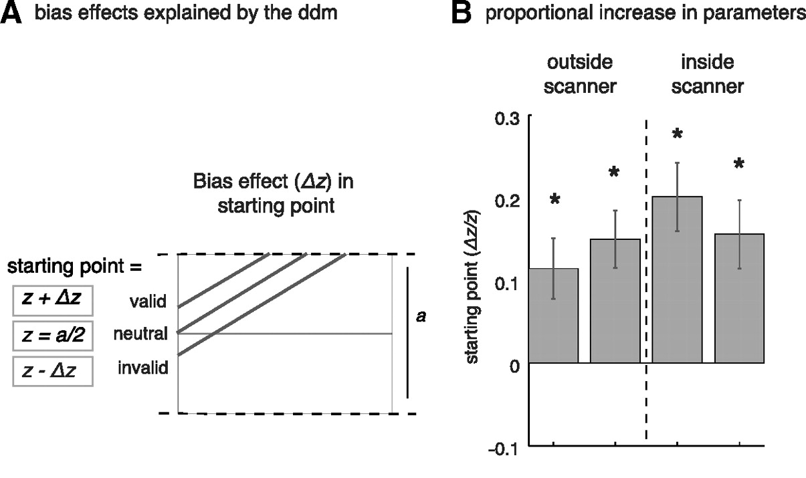
Mulder et al. (2012)
Behavioural results
Pattern of correct and error RT and accuracy match predictions of starting point bias model
For both manipulation types
Cognitive modelling
Prior probability and payoff reflected in starting point bias
Little evidence for drift rate effect

Slide 53
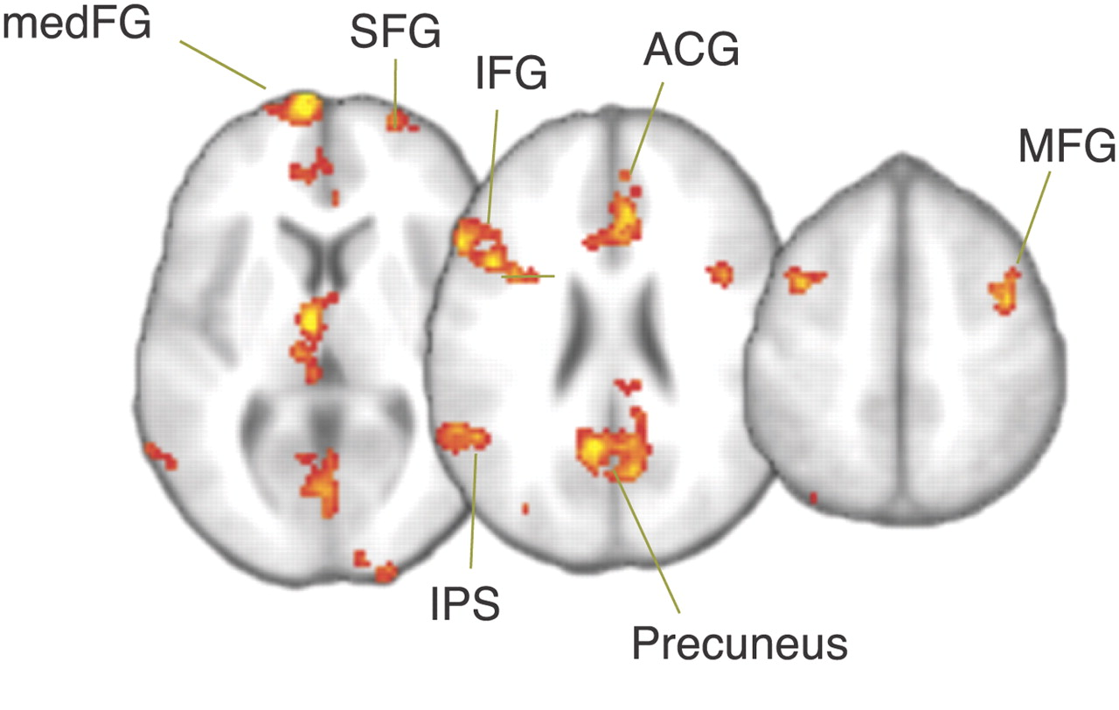
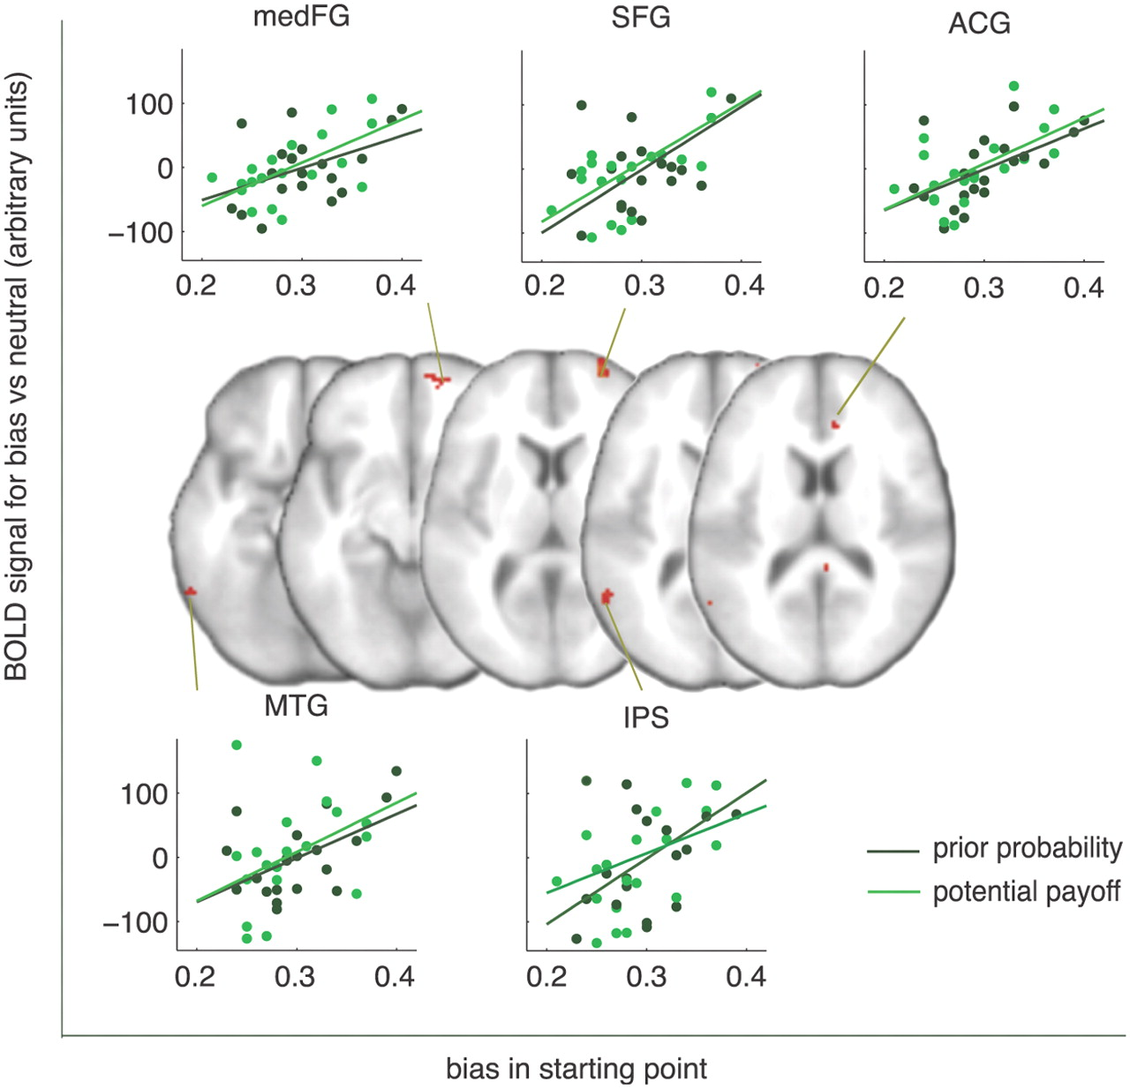
Mulder et al. (2012)
Neuroimaging
Changes in fMRI BOLD response related to bias manipulations
Frontal-temporal regions previously implicated in decision making
Individual differences
Size of BOLD changes related to size of changes in diffusion model parameters
Further evidence for neural basis of cognitive processes that control decision-making behaviour
Conclusions only possible with a cognitive model “in the middle”

Slide 54
Take-home messages
Numerous limitations to using summary behavioural measures such as mean RT and accuracy
Cognitive models address these issues and provide additional benefits
Use all information in data
Psychologically meaningful parameters
Model parameters can be linked to neural data
Aids interpretation of neural data
Spurs further development of cognitive models
Ultimately the goal is to facilitate shared understanding of our scientific theories, data, and the brain
Chandraskharan (2009)

Slide 55
This lecture covers…
Introduction to cognitive modeling
What is a model? Why do we model? What makes a good model?
Behavioural performance measures and their limitations
Building a cognitive model from the ground up
Covers the historical progression from early signal detection theory to current evidence accumulation models
Example applications in cognitive neuroscience
Neural evidence for evidence accumulation
Relating model parameters to neuroscientific data
A (very) brief guide to implementing cognitive models
Experimental design, model building, model fitting, model selection

Slide 56
A (very) brief guide to implementing cognitive models
An overview of a typical modelling workflow
(see Farrell & Lewandowsky’s book for more info)

Slide 57
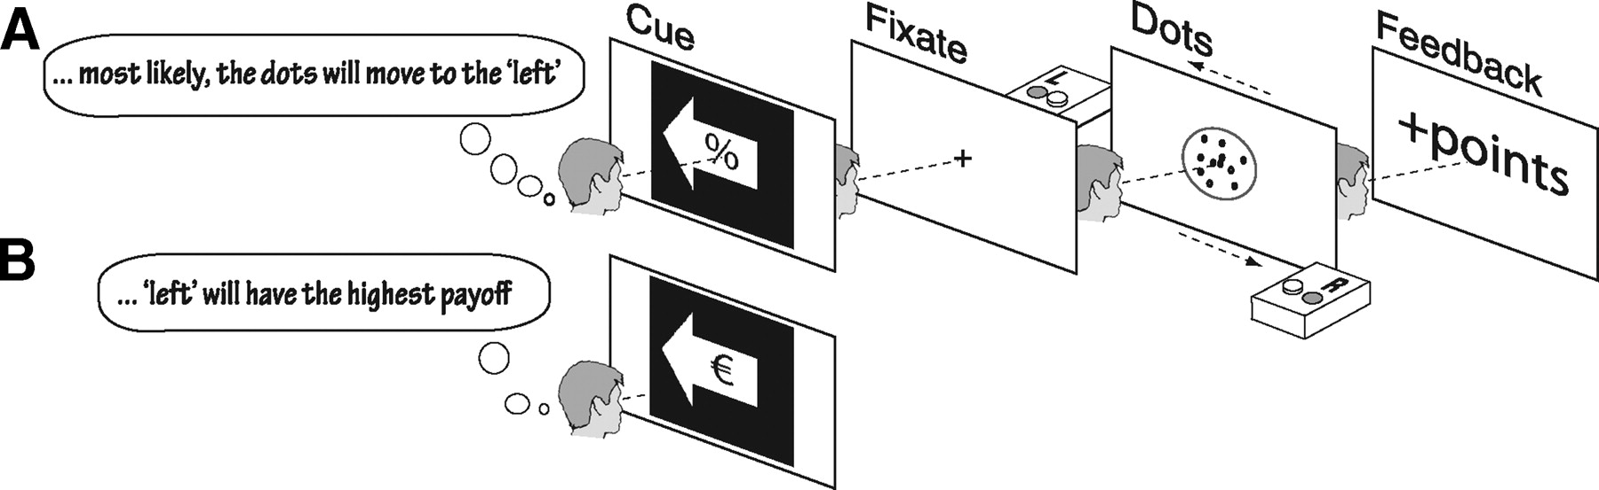
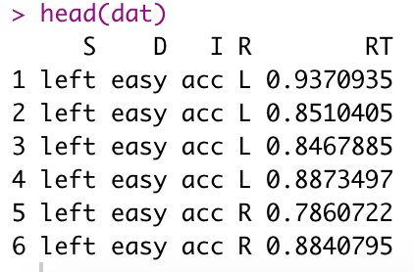
Experimental design and data preparation
Select an appropriate task and experimental design to answer your research question
What manipulations will be informative?
E.g., speed-accuracy instructions, payoff structure, stimulus discriminability, etc.
What are the expected effects? On behaviour? On model parameters?
Collect data and ensure it is in an appropriate format for modelling
Usually ‘long format’ (each row = 1 trial)
Pre-process data
Remove outliers
Excessively fast or slow responses assumed to stem from nuisance processes
E.g., pre-emptive responses, attentional lapses
Remove nonresponses (if not modelling them… Matzke et al., 2017)
Common practice recommendations can be found in model tutorial papers and methods sections

Slide 58
Model building
Build a pool of candidate models and fit to data
Let different parameters vary by stimulus, condition, or experimental group
E.g., Does drift rate explain the effect? Or thresholds? Nondecision time?
Should be guided by theory
Important to test many alternative models/mechanisms
We will get some experience doing this in the tutorial
Reading lots of modelling papers will help with your model-building intuition

Slide 59
Model fitting
Evaluate model fit
Also known as model fitting/parameter estimation/optimization
Compare model predictions to observed data (via a discrepancy function such as RMSE)
Iteratively adjust model parameters until the best fitting parameter values are found
Sampling algorithms: SIMPLEX, differential evolution-MCMC, particle swarm
Aim is to find the best and simplest model that adequately captures major trends in the data
Make plots
Empirical data vs. model predictions
CDFs
We will also do this in the tutorial

Slide 60
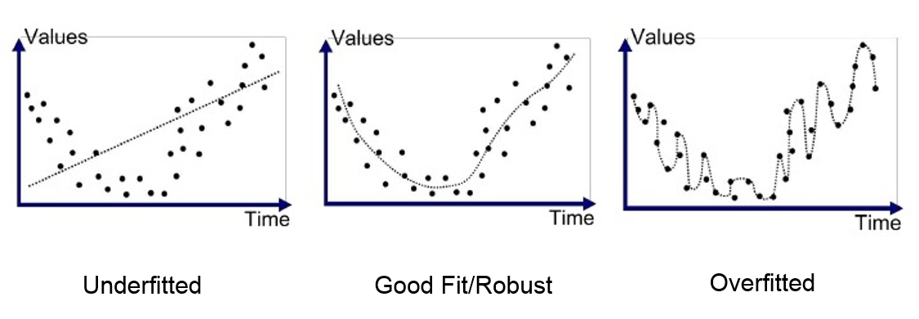
Model selection
Select between competing models
Simplicity vs. complexity
Bias-variance trade-off
Data = generating process + noise
Modelers aim to capture the generating process but exclude the noise
Model selection indices
Goodness of fit penalized by model complexity (number of parameters)
Many different measures
AIC, BIC, DIC, WAIC
Each have strengths and weaknesses in different applications
Overly simple models generalize to new data well but may lack detail and fail to capture certain trends in data
Overly complex models capture all data but risk overfitting, i.e., fitting noise and spurious effects which do not replicate (i.e., the model fails to generalize to new data

Slide 61
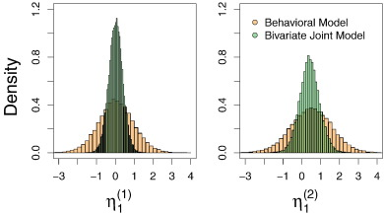
Inference
Interpret parameters and connect to neural data
Enter parameters as dependent variables in inferential statistical tests (e.g., ANOVA, regression)
Regress parameters on other measures of interest (e.g., neural spike rates, BOLD signal, EEG amplitude)
Joint modelling of behavioural and neural data
Turner et al. (2017)

Slide 62
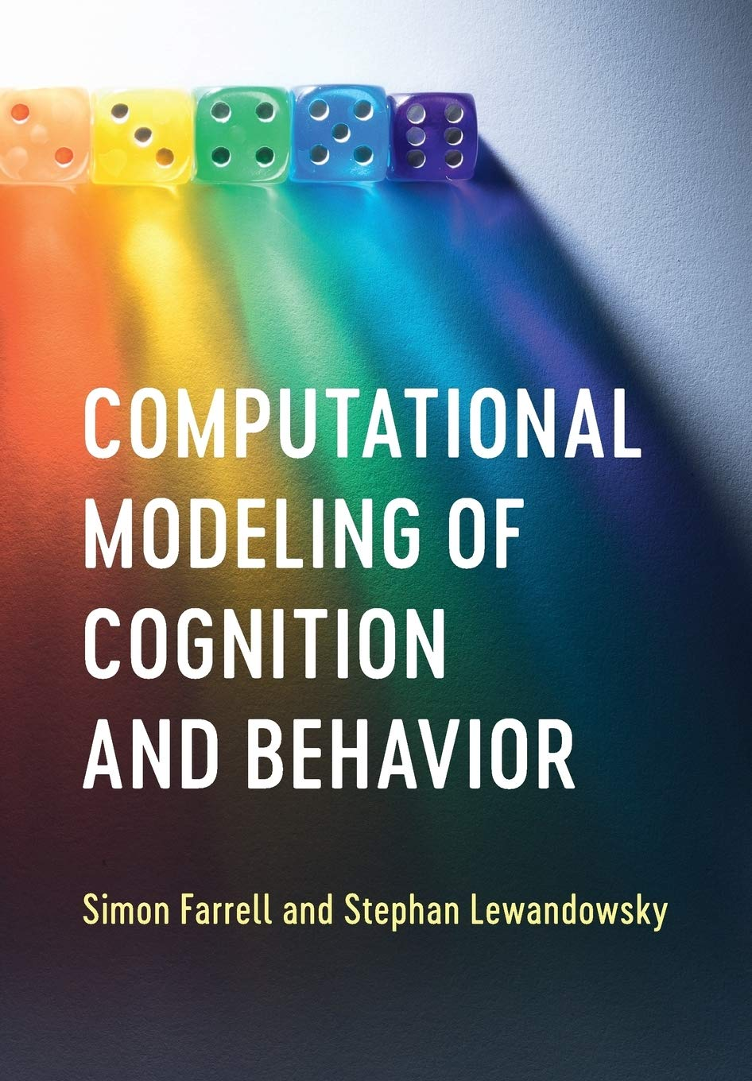
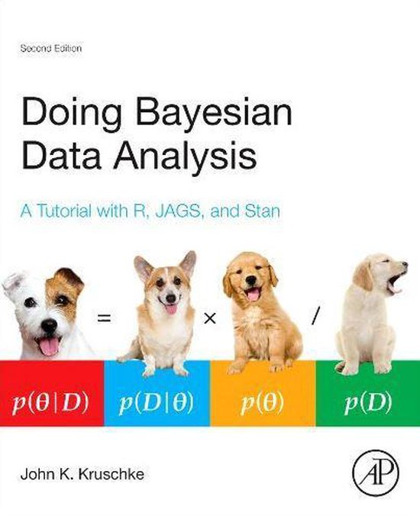

Broader issues…
Identifiability – the extent to which a unique set of parameter values can be determined from data
Testability/falsifiability – there should exist a conceivable experimental outcome/pattern of data with which the model is not consistent
Fitting to individual vs group-average data
Usually have a group of participants
Typically prefer to fit to each subject's data individually to obtain individual parameter estimates - individual differences / classical statistics on parameters, SEM
Fitting individuals avoids artefacts due to averaging group data (e.g., Simpson's paradox; Heathcote (2000) exponential vs power law of practice)
Hierarchical model – individual fits informed by group-level information by specifying 'parent distributions' from which individual parameters are drawn
Hierarchical models tend to be less biased / give more robust predictions
See Farrell and Lewandowsky (2018), Gelman et al. (2013), and Kruschke (2010) for more discussion of these issues

Slide 63
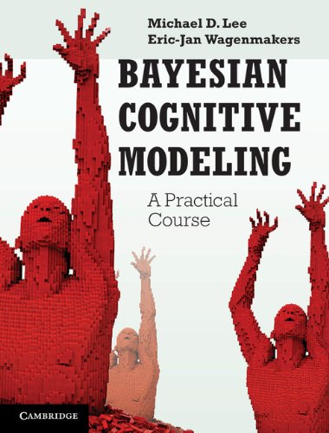
Want to know more?
Model-based cognitive neuroscience summer school
Usually held during early-mid August at UvA
www.modelbasedneurosci.com
Good resources for further self-study
Farrell and Lewandowsky (2018)
Lee and Wagenmakers (2014)
Forstmann and Wagenmakers (new edition coming soon)

Slide 64
Up next…
Tutorial
Evidence accumulation modelling with Dynamic Models of Choice (DMC) software
Heathcote et al. (2018)
Using the R programming language
Preparation:
Download and install R and R-Studio
Download tutorial material from Canvas
Assignments
Individual assignment: submit answers to tutorial question sheet
Group assignment: design a cognitive model

