Slide 1
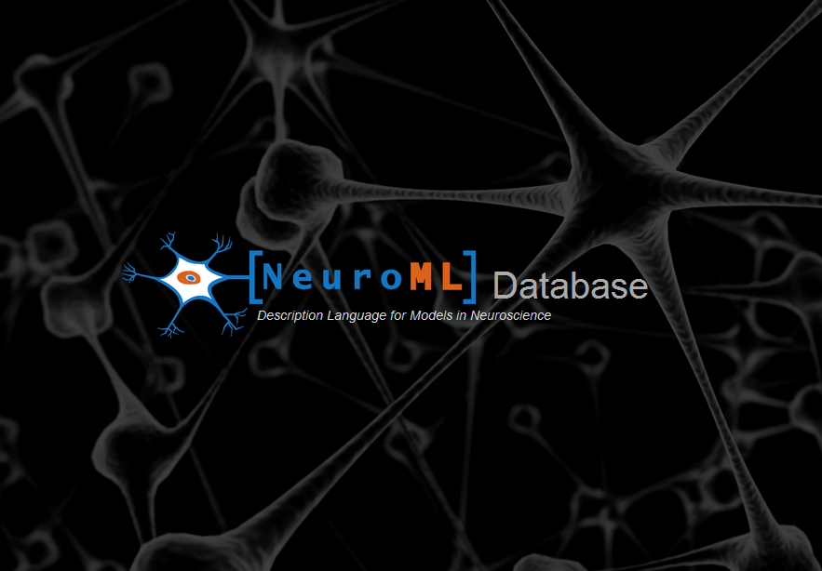
NeuroML-DB.org

Slide 2
Simple Search

Slide 3
Advanced Search
Search by:
1) Brain Region
2) Neurotransmitter or
3) Both

Slide 4
NeuroML-DB.org

