Slide 1
SQL Introduction
Jan 2018

Slide 2
What is it?
SQL = Structured Query Language, talk to DB
T-SQL = Microsoft SQL Server.
PL/SQL = Oracle sql
SQL-lite
ACID (Atomicity, Consistency, Isolation, Durability)
Above are extensions of ANSI SQL (ISO Standard)
RDBMS = Relational Database Management System
ORMS – ActiveRecord, Link
Notes:
ACID (Atomicity, Consistency, Isolation, Durability) is a set of properties that guarantee that database transactions are processed reliably. They are defined as follows: Atomicity. Atomicity requires that each transaction be “all or nothing”: if one part of the transaction fails, the entire transaction fails, and the database state is left unchanged. An atomic system must guarantee atomicity in each and every situation, including power failures, errors, and crashes.
Consistency. The consistency property ensures that any transaction will bring the database from one valid state to another. Any data written to the database must be valid according to all defined rules, including constraints, cascades, triggers, and any combination thereof.
Isolation. The isolation property ensures that the concurrent execution of transactions results in a system state that would be obtained if transactions were executed serially, i.e., one after the other. Providing isolation is the main goal of concurrency control. Depending on concurrency control method (i.e. if it uses strict - as opposed to relaxed - serializability), the effects of an incomplete transaction might not even be visible to another transaction.
Durability. Durability means that once a transaction has been committed, it will remain so, even in the event of power loss, crashes, or errors. In a relational database, for instance, once a group of SQL statements execute, the results need to be stored permanently (even if the database crashes immediately thereafter). To defend against power loss, transactions (or their effects) must be recorded in a non-volatile memory.
RDBMS system that manages many databases, user, security etc.
ORMS – Software layer between DB and application, has pros (easy to use, in code) and cons (can be inefficient, state management)

Slide 3
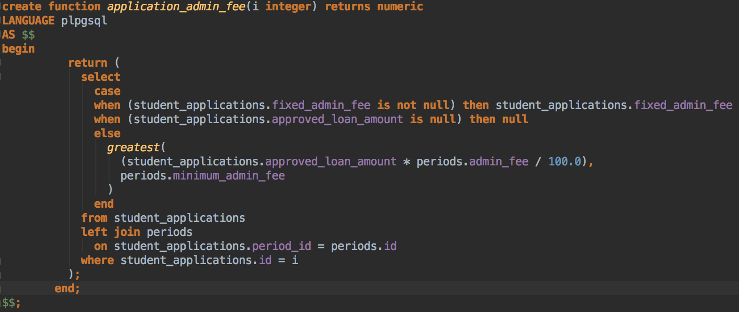
SQL Language
Is Turing complete?
Fields
Tables
Records
Keys
Functions
Stored Procedures
Views
Mat views
Notes:
ANSI is not Turing complete, but many of the derivatives are (TSQL, PSQL) – sim Turing machine to perform set of actions.
Fields = integer, decimal, mumeric, date, datetime, text, varchar, char, array, json, bool, binary, null...etc
Tables = Collections of data rows, query-able with SQL, supports CRUD operations.
Records – data row in a table. N > 1 columns of data (in relational database)
Keys = Primary Key - unique identifier, F Key – allows one to match a record in one table to a record in another. Composite key – unique identifier across multiple fields
(Ref integrity)
Functions: User defined, common functions that can be called as required ie. Function to calc the diff in days between to date objects.
Views: A cached SQL statement, can be used as a virtual table.
Stored Procs: Stored parameterized SQL statements that can be called as needed, persisted in RDBMS. similar to a function
Views: Virtual table, cached SQL statement. Can be joined on.
Mat views: similar to view but the result of the SQL statement is cached in the DBMS, needs to be refreshed to update contents.
Today will focus on the basics. Tables, fields, joins.

Slide 4
Concepts: Fields & tables
Create table: CREATE TABLE user(name VARCHAR(255), login_date DATE);
Select from table: SELECT name, login_date FROM user ORDER BY name; - can use * for all cols.
Insert into table: INSERT INTO user(name, login_date) VALUES('Dave Chaplin', NOW());
Alter col in the table: ALTER TABLE user RENAME COLUMN login_date TO cur_date; ALTER TABLE user ALTER COLUMN cur_date TYPE VARCHAR;
Delete: DELETE FROM user WHERE name = 'Sim' or name like '%dav%’
Remove the table: DROP russ_user

Slide 5
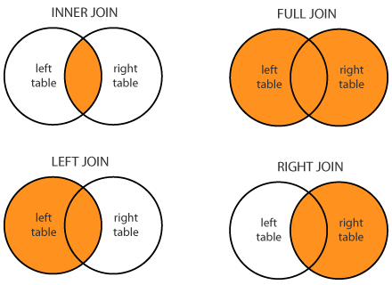
Concept: SQL Joins
Relation part of the RDBMS
JOINS related to set theory
INNER JOINS
LEFT JOINS (LEFT OUTER JOIN)
RIGHT JOINS (RIGHT OUTER JOIN)
FULL JOIN (LEFT + RIGHT)
CROSS JOIN
UNION (UNION ALL)
Notes:
INNER JOIN (a.k.a. “simple join”): Returns all rows for which there is at least one match in BOTH tables. This is the default type of join if no specific JOIN type is specified.
LEFT JOIN (or LEFT OUTER JOIN): Returns all rows from the left table, and the matched rows from the right table; i.e., the results will contain all records from the left table, even if the JOIN condition doesn’t find any matching records in the right table. This means that if the ON clause doesn’t match any records in the right table, the JOIN will still return a row in the result for that record in the left table, but with NULL in each column from the right table.
RIGHT JOIN (or RIGHT OUTER JOIN): Returns all rows from the right table, and the matched rows from the left table. This is the exact opposite of a LEFT JOIN; i.e., the results will contain all records from the right table, even if the JOIN condition doesn’t find any matching records in the left table. This means that if the ON clause doesn’t match any records in the left table, the JOIN will still return a row in the result for that record in the right table, but with NULL in each column from the left table.
FULL JOIN (or FULL OUTER JOIN): Returns all rows for which there is a match in EITHER of the tables. Conceptually, a FULL JOIN combines the effect of applying both a LEFT JOIN and a RIGHT JOIN; i.e., its result set is equivalent to performing a UNION of the results of left and right outer queries.
CROSS JOIN: Returns all records where each row from the first table is combined with each row from the second table (i.e., returns the Cartesian product of the sets of rows from the joined tables). Note that a CROSS JOIN can either be specified using the CROSS JOIN syntax (“explicit join notation”) or (b) listing the tables in the FROM clause separated by commas without using a WHERE clause to supply join criteria (“implicit join notation”).
UNION merges the contents of two structurally-compatible tables into a single combined table. The difference between UNION and UNION ALL is that UNION will omit duplicate records whereas UNION ALL will include duplicate records. Performance: UNION ALL will typically be better than UNION, since UNION requires the server to do the additional work of removing any duplicates. So, in cases where is is certain that there will not be any duplicates, or where having duplicates is not a problem, use of UNION ALL would be recommended for performance reasons.

Slide 6
SQL Joins 2
INNER JOIN:
SELECT * FROM users u INNER JOIN countries c ON u.country_of_nationality = c.code;
LEFT OUTER:
SELECT * FROM users u LEfT OUTER JOIN countries c ON u.country_of_nationality = c.code;
Notes:
Discuss code in relation to picture.

Slide 7
SQL Joins 3
JOINING on a SUBQUERY with GROUP BY and HAVING clause
SELECT name, sa.max_loan FROM users u INNER JOIN (SELECT student_id AS id, MAX(approved_loan_amount) AS max_loan FROM student_applications GROUP BY student_id HAVING MAX(approved_loan_amount) IS NOT NULL) sa ON u.id = sa.id WHERE type = 'Student' AND u.created_at > '2017-01-01'
Notes:
Discuss, sub query, GROUP BY, MAX function, HAVING, WHERE.

Slide 8
Concepts: Indexing and constraints
Indexing
Constraints:
NOT NULL. CHECK. DEFAULT. UNIQUE. PRIMARY KEY. FOREIGN KEY.
Notes:
Like index in a book
Pros: faster lookups Cons: slower reads, needs to read order index when new data is inserted into the table
Unique, clustered, non clustered.
Constraint can be used to specify the limit on the data type of table. Constraint can be specified while creating or altering the table statement. Sample of constraint are.

Slide 9
SQL Extras
DB connection config .yaml file.
Ruby mine has good DB connection console.
In rails will use active record DB migrations to handle DB level operations.
Postgres vs MySQL
SQL vs NoSQL
https://prodigyfinance.atlassian.net/wiki/spaces/WIKAP/pages/20119590/SQL
http://www.postgresqltutorial.com/
https://pgexercises.com/
Notes:
Redis, Mongo

