Slide 1
Kinase mutations
Gurdeep
AG-Russell

Slide 2

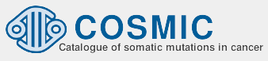

Kinase mutations?
Activating mutations: That constitutively activate the kinase
Deactivating mutations: That constitutively deactivate the kinase
Resistance mutations: That result in drug resistance
Activating
Deactivating
Resistance
Pkinase
(PF00069)
144 mutations
73 kinases
276 mutations
148 kinases
55 mutations
16 kinases
hmmalign

Slide 3
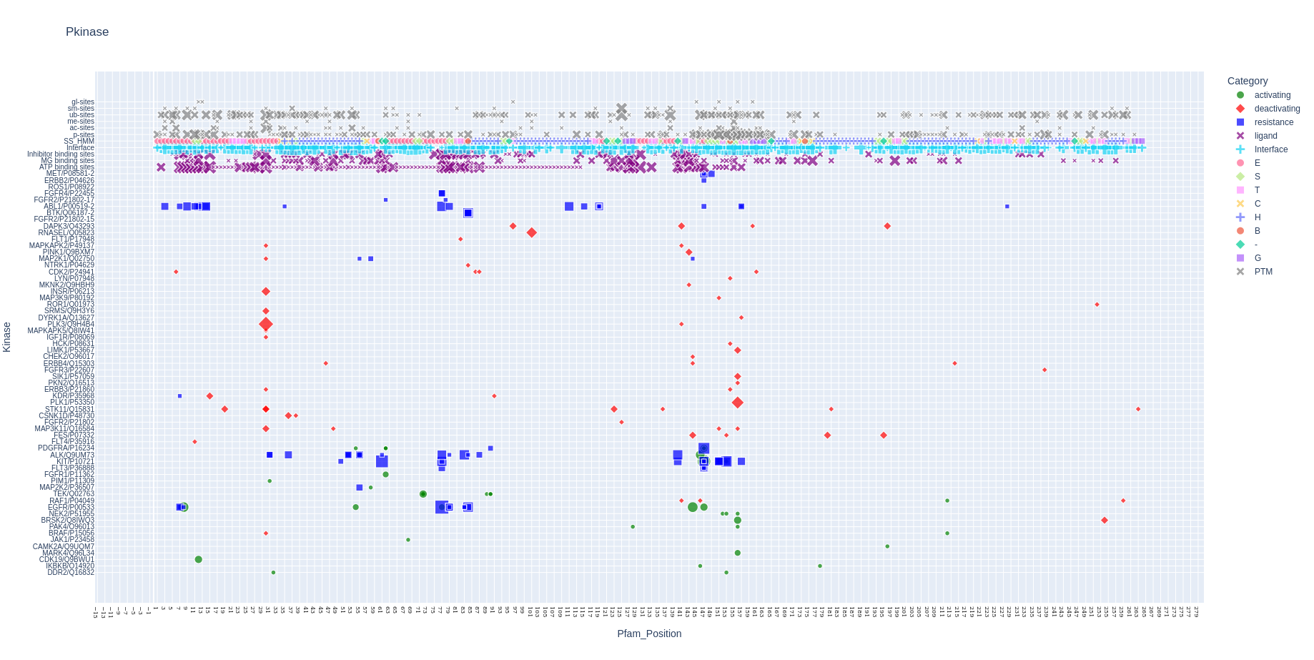
Features
Active site (K30)
Activation loop
Kinases
Pkinase domain

Slide 4
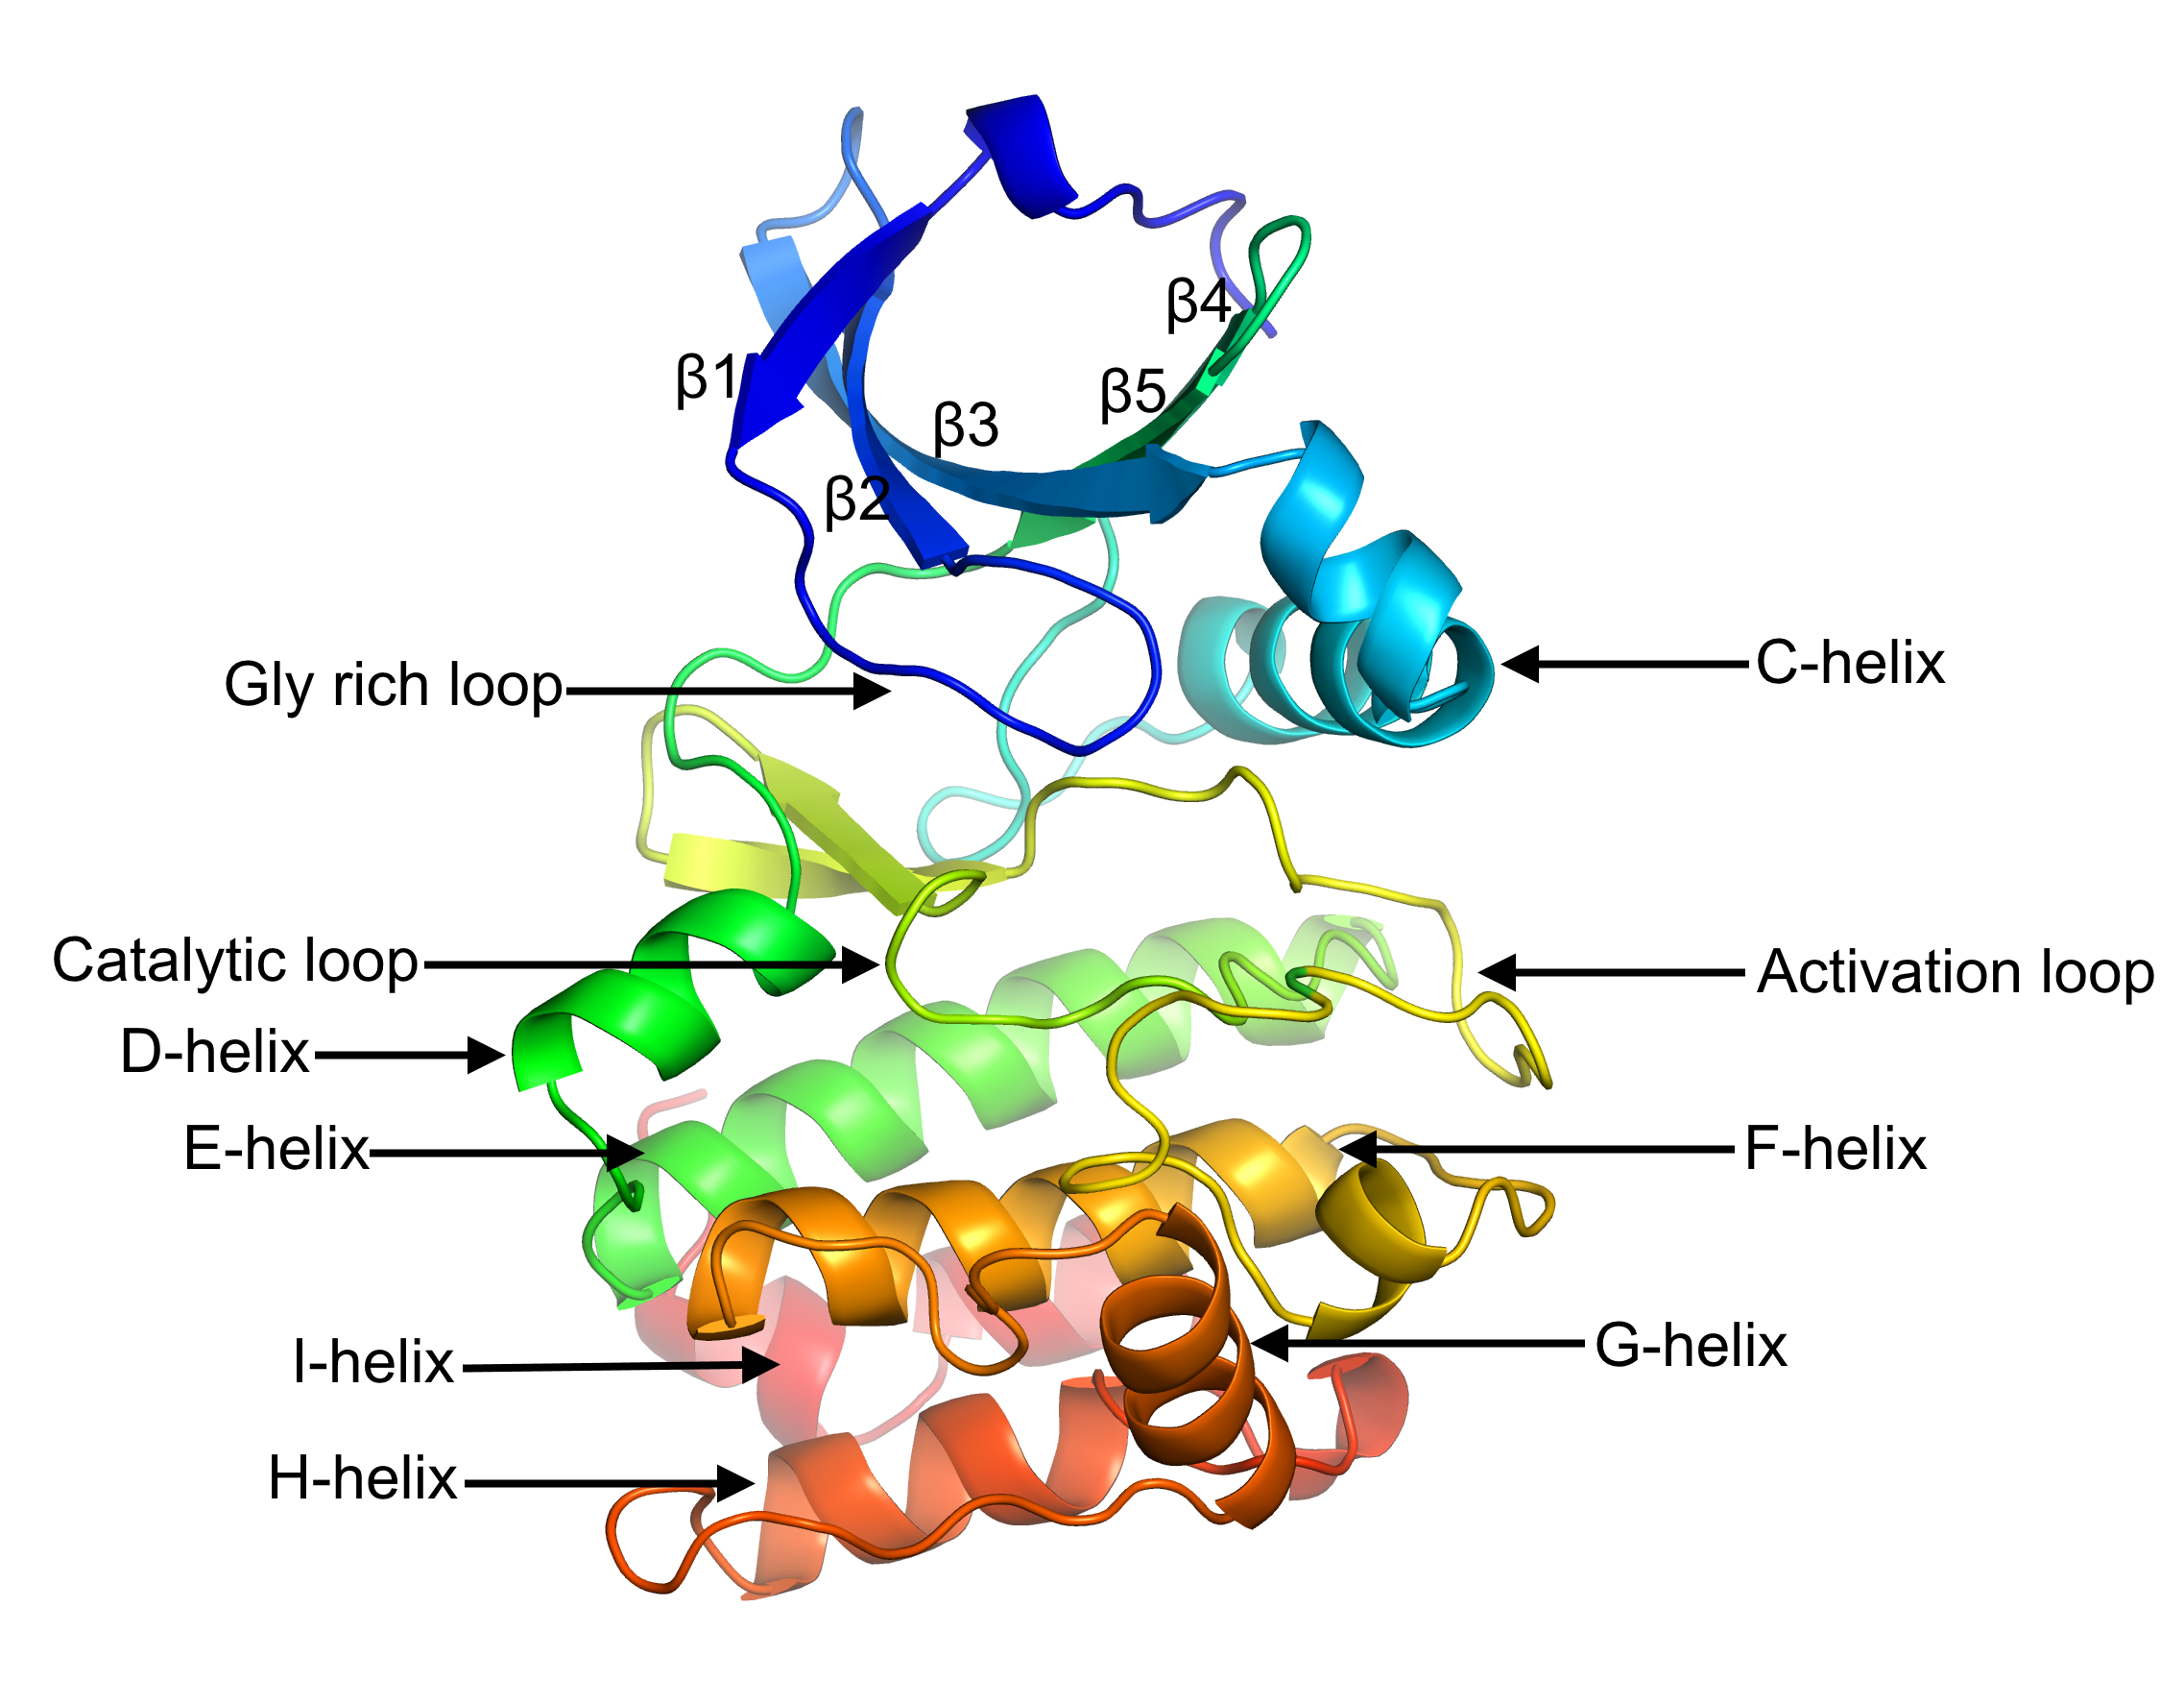
Do we see patterns?
HIGHLY conserved sites
PTM sites (known or inferred)
Activation loop
Elsewhere (~10-15% cases)
Very likely to be a deactivating mutation (eg: K30)
Can be activating/deactivating/resistance mutation
Substitution determines the exact outcome (S->D, T->E or K->Q)
Can be activating/deactivating/resistance mutation
activating/resistance mutations may occur AT or ADJACENT to a p-site
Substitution determines the exact outcome
Is it at an interface of its activator? Eg: CDK2
Is it a Methionine? Is it a MG+2 binding site?
Follow Rob’s Bioinformatics 101 lectures (for example L->P in an alpha helix)
Protein kinase domain. (2022, August 9). In Wikipedia. https://en.wikipedia.org/wiki/Protein_kinase_domain

Slide 5
Data
Activating
Deactivating
Resistance
Pkinase
(PF00069)
144 mutations
73 kinases
276 mutations
148 kinases
55 mutations
16 kinases
hmmalign

Slide 6
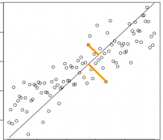
Feature vector
mutations
.
.
bitscore
HMM
PTM?
(ws=3)
wt AA
(one hot encoding)
Homo/ortho/para-logs
(log-odd scores)
A/D/R
LRRK2 / K1906A
1
Is phosphomimic?
mut AA
(one hot encoding)
Any other known A/D/R?
(ws=3)
.
.
mutations
PCA

Slide 7
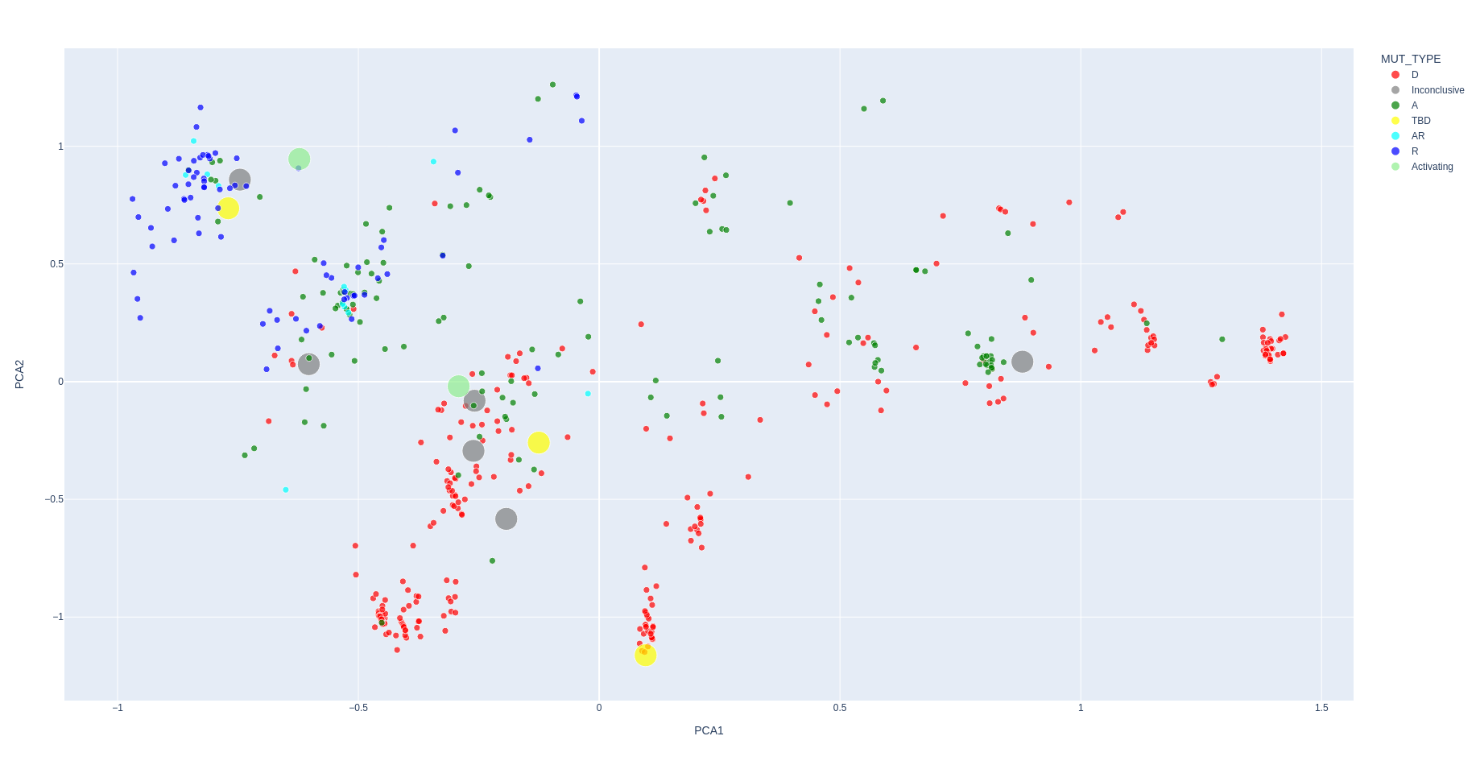
PCA
PC2
UniProt/COSMIC
Validation results (Torsten & Nina)
PC1

Slide 8
PCA
PC2
PC1

Slide 9
PCA
PC2
Highly conserved residues
eg:
K30 (active site)
D141 (DFG motif)
E167 (APE motif)
PC1

Slide 10
PCA
PC2
Phosphosites
eg:
S/T/Y -> D/E
Or
S/T/Y -> ! D/E
PC1

Slide 11
PCA
Resistant
Or
Both activating & resistant
mutations
PC2
PC1

Slide 12
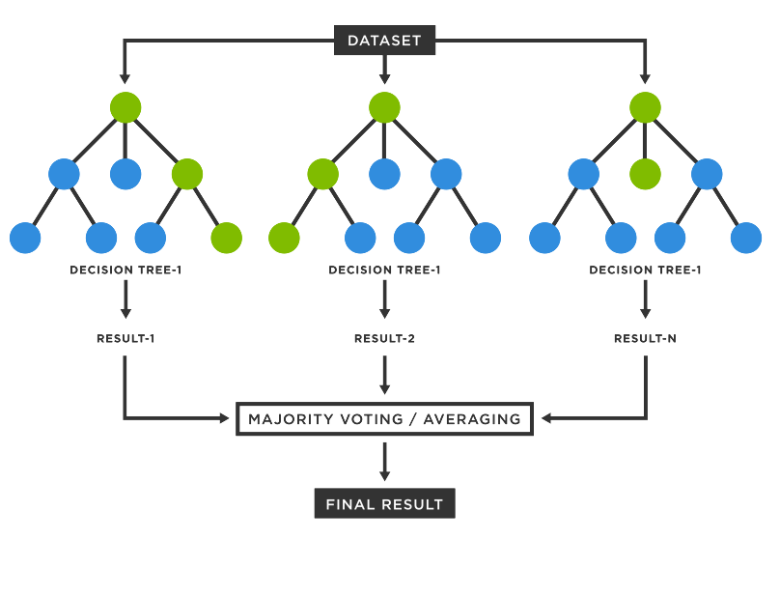
Random Forest
RF uses an ensemble of decision trees to improve the accuracy and stability of predictions.
Each tree in the forest is trained on a different subset of the training data and uses a random subset of features for each split (this helps to reduce overfitting).
https://www.tibco.com/de/reference-center/what-is-a-random-forest

Slide 13
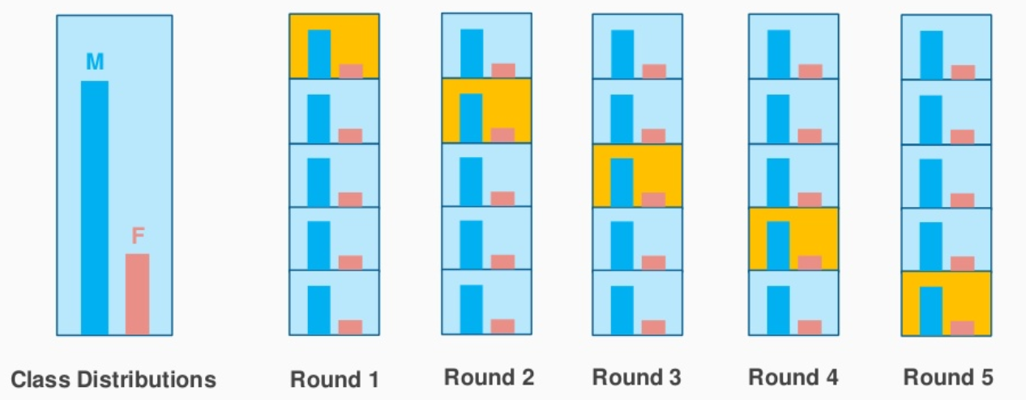
Protocol
To predict if a given mutation is Activating or Deactivating
Train set = mutations that are only activating (131) or only deactivating (276)
Test sets
  Test set 1 = mutations that are both activating and resistant (12)
  Test set 2 = resistant mutations (73)
  Test set 3 = lab validations (from Torsten & Nina)
RF using Stratified cross-validation

Slide 14
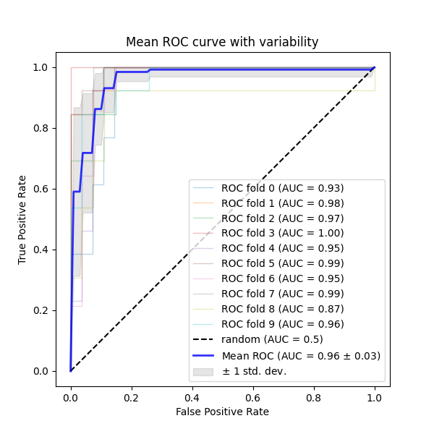
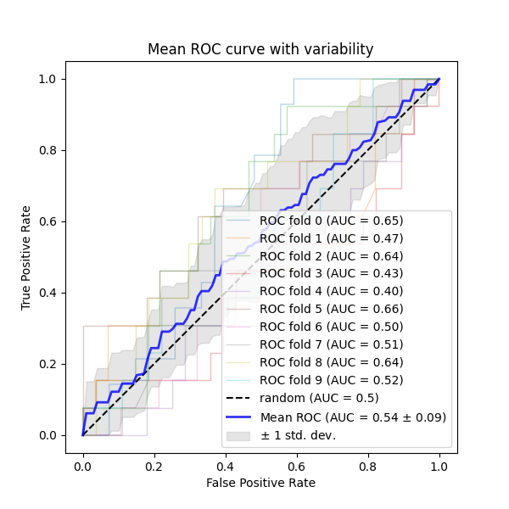
Cross-validation results
Original train set
Train set with randomly shuffled labels

Slide 15
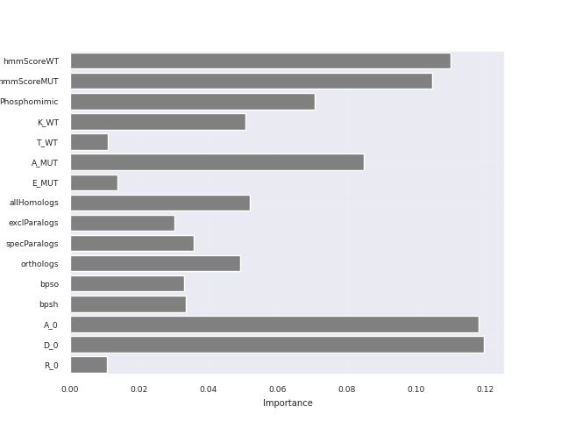
Feature Importance & Testing
Test set 1 & 2
Test set Test set | Test set | N | Recall
1 | Activating & resistant mutations | 12 | 0.95
2 | Only resistant mutations | 73 | 0.84
Test set 3 (lab validations)
Gene | Acc | Mut | Prob | Pred | Lab
MAP2K3 | P46734 | A84T | 0.42 | D | A
PIM1 | P11309 | S97N | 0.56 | A | A
CDK5 | Q00535 | F82I | 0.82 | A | TO DO
MAP2K1 | Q02750 | K97A | 0.05 | D | TO DO
MAP2K1 | Q02750 | V211D | 0.5 | A | TO DO
CHEK2 | O9601 | K373E | 0.65 | A | -
MAP2K3 | P46734 | R94L | 0.64 | A | -
MAP2K3 | P46734 | R96W | 0.573 | A | -
MAP2K3 | P46734 | L215W | 0.24 | D | -
MAP2K3 | P46734 | T222M | 0.38 | D | -
PIM1 | P11309 | Q127E | 0.9 | A | -

Slide 16

Thanks!

Slide 17
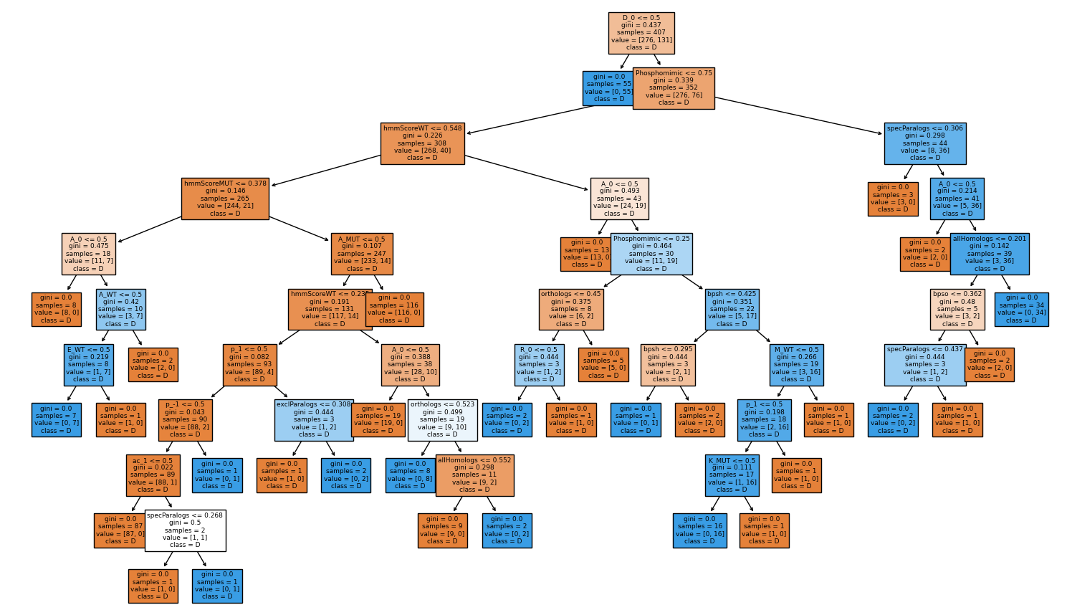
Best Tree in the forest

