Slide 1
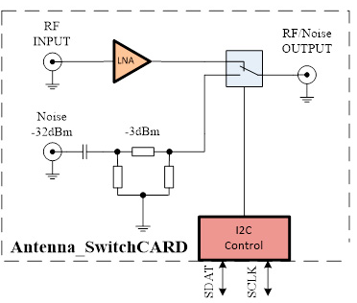
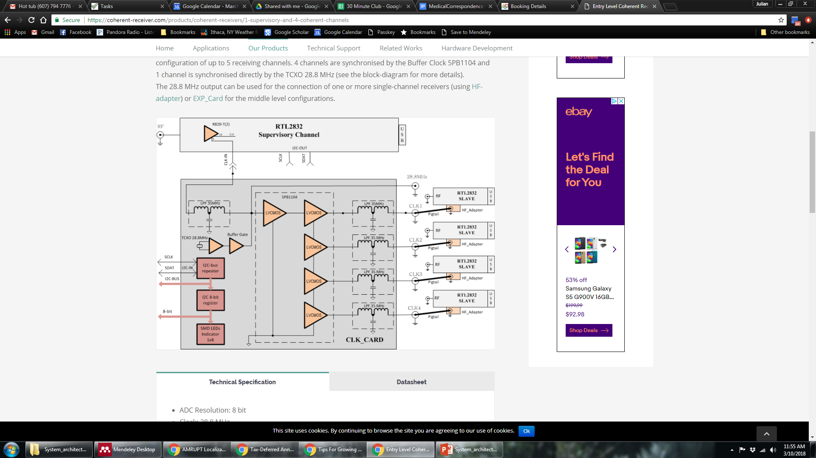
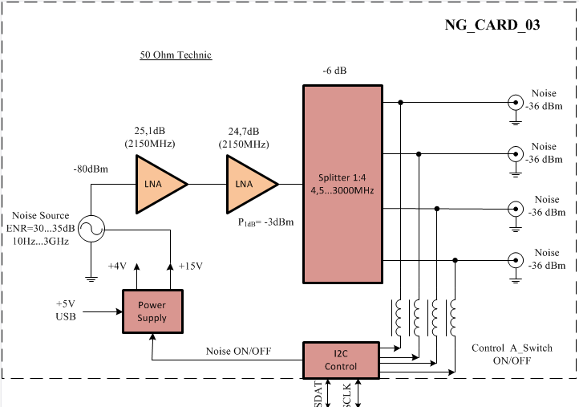
Antenna 1
Antenna 2
Antenna 3
DF Algorithm running on RaspberryPi
Antenna 4

Slide 2
ABANDONED 3/10/2018
signal
RF in
CC1310
ID out
control
Trigger
LNA
Local Oscillator
ADC
DF Algorithm running on RaspberryPi
Antenna 1
1
2
Watson-Watt pair 1
3
LNA
4
Antenna 2
I
I/Q
Antenna 3
LNA
Q
1
Watson-Watt pair 2
2
LNA
Demodulator
&
IF Mixer
3
Antenna 4
4
Notes:
TDOA

Slide 3
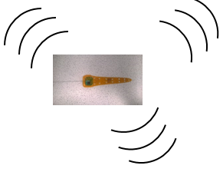

TRX 1
Automated phase-based telemetry receiver system
TRX 2
Local
Oscillator
Local
Oscillator
Antenna 1
Low Noise
Amplifier
CC1310 1
Antenna 1
Low Noise
Amplifier
CC1310 1
Antenna 2
Low Noise
Amplifier
CC1310 2
DF Algorithm running on RaspberryPi
Antenna 2
Low Noise
Amplifier
CC1310 2
DF Algorithm running on RaspberryPi
Antenna 3
Low Noise
Amplifier
CC1310 3
Antenna 3
Low Noise
Amplifier
CC1310 3
Antenna 4
Low Noise
Amplifier
CC1310 4
Antenna 4
Low Noise
Amplifier
CC1310 4
GPS
RxTx communication protocol
Compass
Energy harvesting
Time-keeping,
coordination w/txrs
coordination w/ rxrs
localization of receivers
Orienting antenna elements
Node-to-node VHF uplink
TRX3
Trilateration algorithm
Uses RSSI?
Machine learning w/ calibration beacons?
TRX4
Local
Oscillator
Bluetooth / VHF uplink to central hub
Local
Oscillator
Antenna 1
Low Noise
Amplifier
CC1310 1
Antenna 1
Low Noise
Amplifier
CC1310 1
Antenna 2
Low Noise
Amplifier
CC1310 2
DF Algorithm running on RaspberryPi
Antenna 2
Low Noise
Amplifier
CC1310 2
DF Algorithm running on RaspberryPi
Antenna 3
Low Noise
Amplifier
CC1310 3
Antenna 3
Low Noise
Amplifier
CC1310 3
Antenna 4
Low Noise
Amplifier
CC1310 4
Antenna 4
Low Noise
Amplifier
CC1310 4

Slide 4
ABANDONED 11/10/2017
Local
Oscillator
Antenna 1
Low Noise
Amplifier
CC1310 1
i1,q1,rssi1,ID
Watson-Watt pair 1
Antenna 2
Low Noise
Amplifier
CC1310 2
i2,q2,rssi2
DF Algorithm running on RaspberryPi
Antenna 3
Low Noise
Amplifier
CC1310 3
i3,q3,rssi3
Watson-Watt pair 2
Antenna 4
Low Noise
Amplifier
CC1310 4
i4,q4,rssi4
Notes:
TDOA

