Slide 1
GFP Calibration

Slide 2
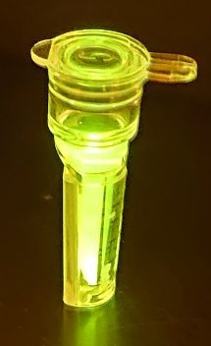
Calibration
Purified from BL21 and produced a sample of 1.1 mg/mL or g/L
Measured with Bradford assay
Fit is linear up to 8.2 uM

Slide 3
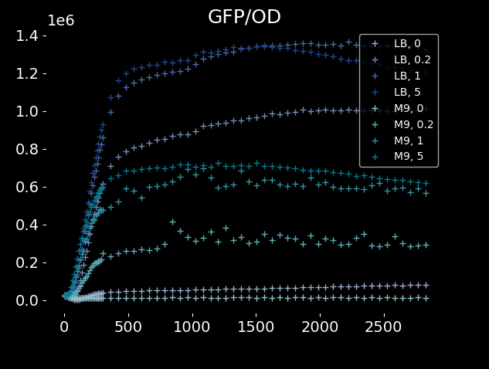
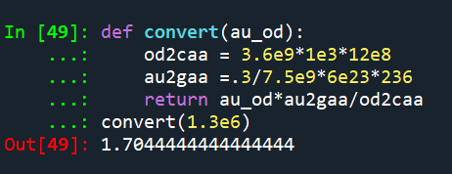
Review
OD2CellAA
3.6e12 fl of cell volume per mL per OD
12e8 aa per fl
AU2GFPAA
0.3 mL
7.5e9 AU mL per M
6e23 prot per mol
236 aa per prot
Result not acceptable

Slide 4
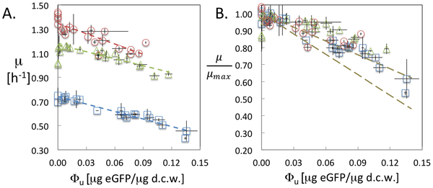
Review
OD2CellAA
3.6e12 fl of cell volume per mL per OD
12e8 aa per fl
AU2GFPAA
0.3 mL
7.5e10 AU mL per M
6e23 prot per mol
236 aa per prot
Result
170% of cell aa is in GFP
Much higher than expected given that growth rate was practically unaffected
Does NOT agree with literature

Slide 5
Repeated
OD2CellAA
3.6e12 fl of cell volume per mL per OD
12e8 aa per fl
AU2GFPAA
7.5e10 AU mL per M
6e23 prot per mol
236 aa per prot
Result
170% of cell aa is in GFP
Much higher than expected given that growth rate was practically unaffected
Does NOT agree with literature

Slide 6
Literature

Slide 7
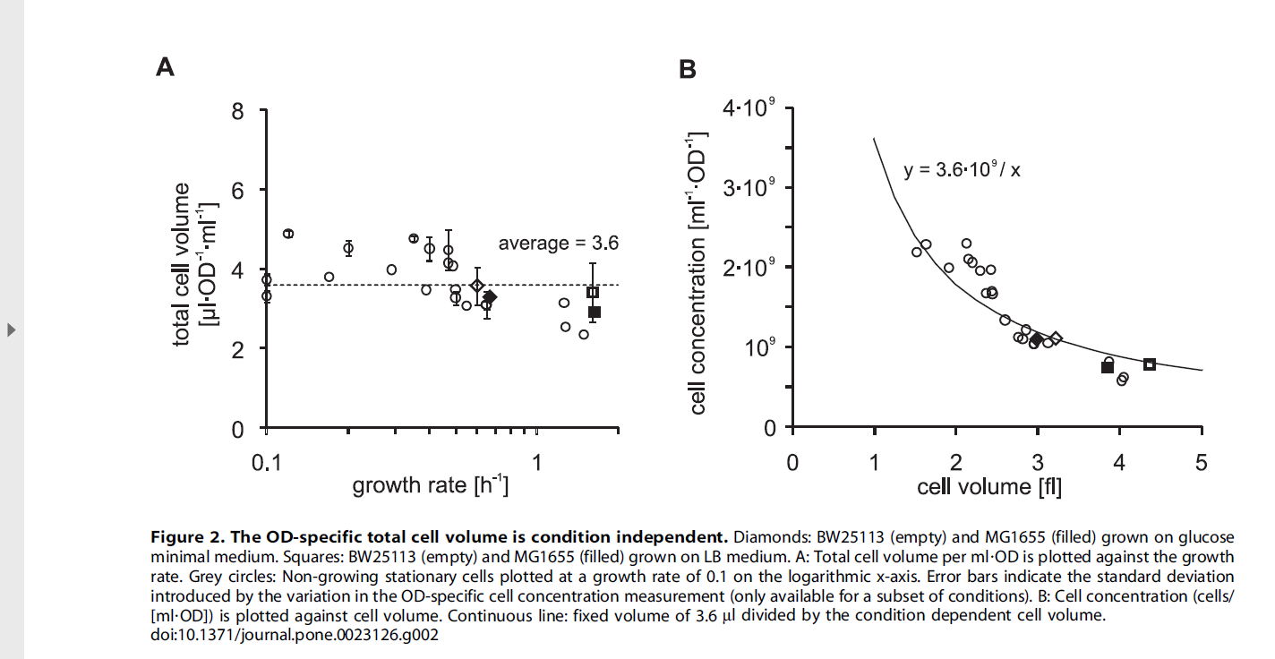

Slide 8
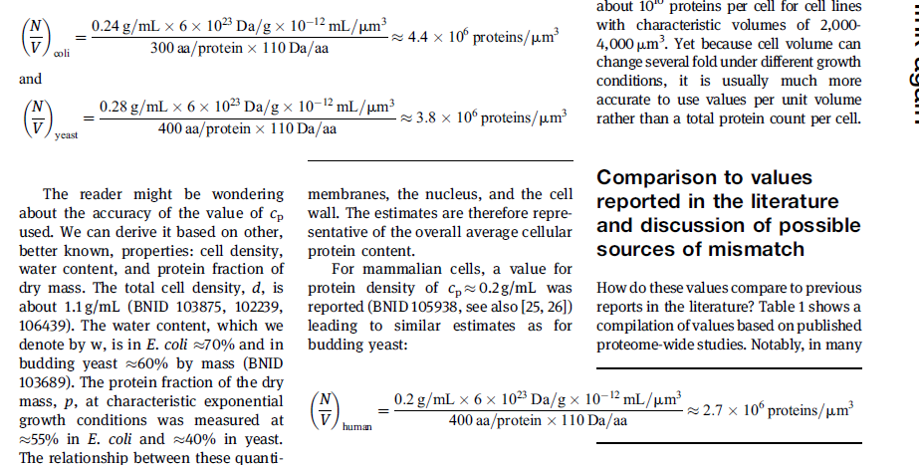

Slide 9
A. Growth rate plotted as a function of eGFP mass fraction of dry cell weight (d.c.w.) for promoter variants grown in M9 (blue open squares), M9-CA (green open triangles), and LB (red open circles). Dashed lines are best linear fits of each dataset. B. Relative growth rate plotted as a function of eGFP mass fraction of d.c.w. for promoter variants. The growth rate is normalized to the maximum growth rate in the absence of gene expression. The dashed olive lines represent the range of values from theoretical predictions. Error bars represent one standard deviation of at least two independent measurements.

