Slide 1
Dunlin

Slide 2
Background
Text File
Reduces written code and improves productivity in ODE-based modeling.
Models are specified using .ini-based format OR SBML.
SBML for inter-operability
.ini for convenience
The file is read and config data/a dict is produced.
The config data is converted into model_data which can be used with the user’s own code.
The results can be used to update the config.
Read
Write
Config Data
Parse
Update
User Code
Model Data
Analyze
Script
Results

Slide 3
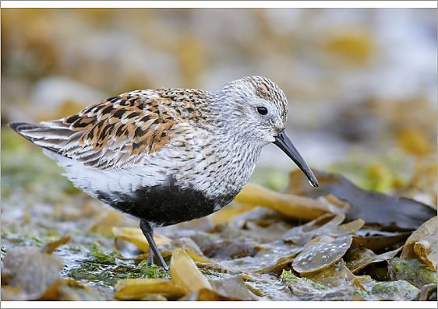
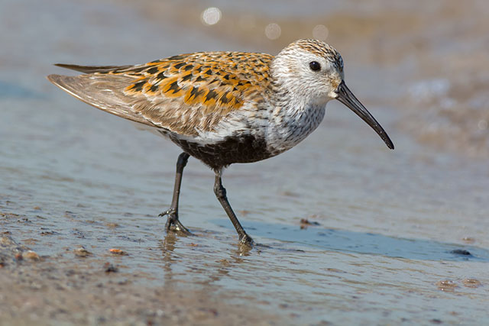

Slide 5
Light blue 212 223 #D4DFF1
Gray 116, 106, 109 #746A6D
Dark brown 46 38 31 #2E261F
Orange 220, 171, 82 #DCAB52

Slide 6
Light blue 212 223 #D4DFF1
Gray 116, 106, 109 #746A6D
Dark brown 46 38 31 #2E261F
Orange 220, 171, 82 #DCAB52
An important piece of information
Step 1
Step 2

Slide 7
定 风 波
莫听穿林打叶声
何妨吟啸且徐行
竹杖芒鞋轻胜马
谁怕
一蓑烟雨任平生
料峭春风吹酒醒
微冷
山头斜照却相迎
回首向来萧瑟处
归去
也无风雨也无晴

Slide 8
Light blue 212 223 #D4DFF1
Dark brown 46 38 31 #2E261F
Orange 220, 171, 82 #DCAB52

Slide 9
section
model | config
subsection
ungrouped | grouped

Slide 10
Compatibility with SBML
Model
Function definitions
Unit definitions
Compartments
Species
Parameters
Initial assignments
Assignment rules
Constraints
Reactions
Events
SBML hierarchical (current work)
SBML multi, spatial and FBC (future work)
Notes
Units are not currently required by Dunlin for
The following SBML elements are not covered as they can be described using other means that are
Non constant stoichiometries
Use a separate reaction
Algebraic rules
Reformulate as assignment rules
Should Dunlin encounter such element the appropriate response should be to
Raise a NotImplementedError
Reformulate the model via intermediate steps

Slide 11
.dun Structure
A whitespace-preserving lightweight markup language
Strings: The fundamental datum to be parsed.
Dun strings: Serialized data
Py elements: Python code
Elements: Corresponds to
A dun element produces multiple strings if shorthands are used and a single string otherwise.
A py element collapses multiple lines of code into a smaller number of lines if shorthands are used
Subsections: Groups elements by the type of information they represent.
Sections: Groups subsections for a single model.
A .dun file contains
Import statements
Comments delimited with a “;” at the start of the line
Sections, subsections and elements (which are then parsed into strings)

Slide 12
.dun Rules
Allowed
References to other models in the same file or group of files.
Not allowed:
Double underscores in any part of the code: Avoid unsafe code.
Repeated definitions of sections/subsections/elements with same name.

Slide 13
Subsection Type
Related to |  | Corresponding SBML | Element type
Model definition | States | Species with/without InitialAssignments, Param (not const) with RateRule | Dun
 | Params | Param (const) | Dun
 | Reactions | Reaction, kineticLaw, LocalParameter | Dun
 | Variables | Param (not const) with AssignmentRule | Dun
 | Functions | Function | Dun
 | Compartments | Compartment | Dun
 | Spatial (Not implemented yet) | Spatial: Geometry | Dun
 | GeneProduct | FBC: GeneProduct | Dun
Analysis settings | Optimize | FBC: FluxObjective | Dun
 | Exv | NA | Py
 | Cf_iterations | NA | Dun
 | Priors | NA | Dun
 | Param_bounds | Constraints(TBC) | Dun
 | Solver_args | NA | Dun

Slide 14
Dun Elements
Motivation
Hold numerical/string values or nested numerical/string values
Detect numbers and convert them into float
A single key-value pair where the value can be
A single value
A list
A dictionary of key-value pairs
Nesting is possible but the parser for each subsection type can set a minimum/maximum level of nesting
Not whitespace sensitive

Slide 15
Py Elements
Motivation
Holds Python code that can be inserted into templated functions.
Is whitespace sensitive. This avoids the problem of having to infer indentation or limit functionality.
Note:
Definition of the element should start on the line after its declaration. If it does not, dunlin will try to infer the correct level of indentation for the first line of code (which may not always work)

Slide 16
Overview of Algorithm for Reading .dun

Slide 17
dun_string_reader
Parses strings and converts them into data
Downstream operations
dun_element_reader
Contains parsers for each type of subsection Parses shorthands and converts elements to strings
dun_file_reader
Reads full file and returns dun_data (structure TBC) Augment to accept SBML in the future.
base_error
Contains the template for raising dunlin-based exceptions

Slide 18
Future Work
Reading and writing SBML
Map information according to the table shown earlier
Roundtripping not guaranteed
SBML spatial and multi
Generate multiple lines with shorthands
SBML FBC
Similar to parameter estimation
Optimize a function other than the posterior/SSE

Slide 19
Overview

Slide 20
dn_reader
Purpose: Read .dun files
base_error
Purpose: Provide the class for Dunlin-related errors
funcs
Purpose: Store dynamically generated functions

Slide 21
Event handling
Map to scipy.integrate.solve_ivp event argument
https://docs.scipy.org/doc/scipy/reference/generated/scipy.integrate.solve_ivp.html
Create a function with the “terminal” attribute set to True

Slide 22
Initial Assignments

Slide 23
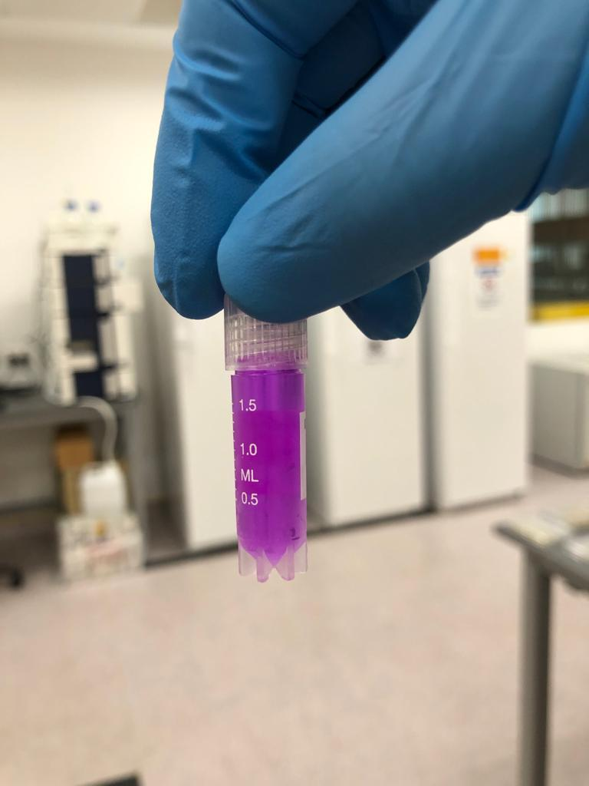
Conc: 2.25~2.50 mg/L

