Slide 1
Dunlin

Slide 2
Background
.ini
Reduces written code and improves productivity in ODE-based modeling.
Models are specified using .ini-based format.
The file is read and a config/dict is produced.
The config data is converted into model_data which can be used with the user’s own code.
The results can be used to update the config.
Read
Write
config
Parse
Update
User code
model_data
Analyze
Script
results

Slide 3
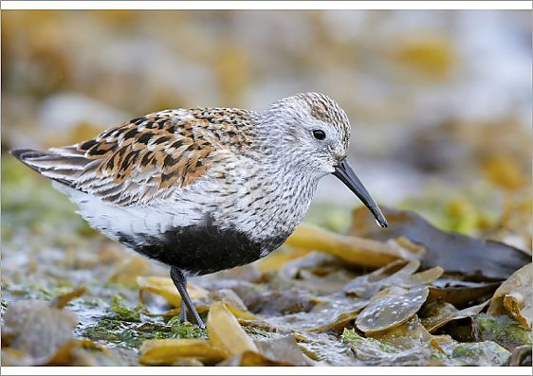
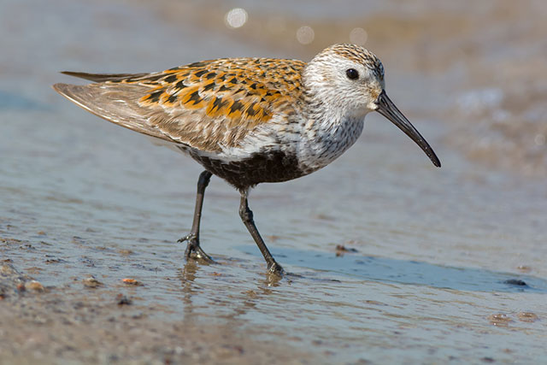

Slide 4
Light blue 212 223 #D4DFF1
Gray 116, 106, 109 #746A6D
Dark brown 46 38 31 #2E261F
Orange 220, 171, 82 #DCAB52

Slide 5
Light blue 212 223 #D4DFF1
Gray 116, 106, 109 #746A6D
Dark brown 46 38 31 #2E261F
Orange 220, 171, 82 #DCAB52
An important piece of information
Step 1
Step 2

Slide 6
定 风 波
莫听穿林打叶声
何妨吟啸且徐行
竹杖芒鞋轻胜马
谁怕
一蓑烟雨任平生
料峭春风吹酒醒
微冷
山头斜照却相迎
回首向来萧瑟处
归去
也无风雨也无晴

Slide 7
Light blue 212 223 #D4DFF1
Dark brown 46 38 31 #2E261F
Orange 220, 171, 82 #DCAB52

