Slide 2
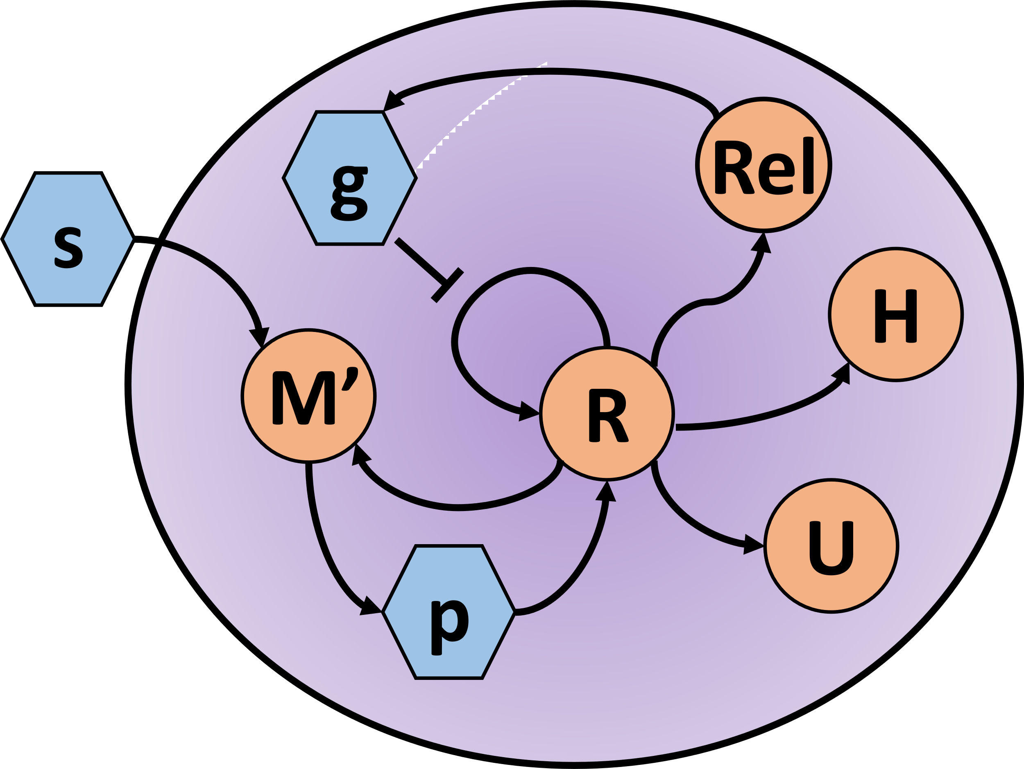
Negative feedback
State Variables | State Variables
R | Ribosomal proteins.
M’ | Proteins involved in metabolizing the internal substrate.
Rel | RelA
U | Proteins not directly affecting growth.
H | Heterologous proteins.
s | External substrate.
p | Translational precursors such as amino acids.
g | (p)ppGpp
uptake
metabolism

Slide 3
