Slide 1
Dunlin

Slide 2
Package Design Goals

Slide 3
What is Dunlin
The dunlin package
Analysis of models
SBML compatible as much as possible
Will also look into other standards
The dunlin language
High level declaration of models
Gets rid of boilerplate code

Slide 4
Compatibility with SBML
Model
Function definitions
Unit definitions
Compartments
Species
Parameters
Initial assignments
Assignment rules
Constraints
Reactions
Events
Notes
Units are not currently required by Dunlin
The following SBML elements are not covered as they can be described using other means that are
Non constant stoichiometries
Use a separate reaction
Algebraic rules
Reformulate as assignment rules
Should Dunlin encounter such element the appropriate response should be to
Raise a NotImplementedError
Reformulate the model via intermediate steps

Slide 5
SBML Extension Packages | Design Considerations
Arrays | Design in tandem with spatial modelling. Dunlin’s shorthands already allow array-like coding and it likely already covered. The likely scope of work is then to ensure Dunlin can recognize and interpret arrays.
Hierarchical Model Compositions | Dunlin allows hierarchical models but will not follow this package. It tries to cover too many scenarios when simpler workarounds exist. Antimony has also avoided using this package directly. In addition, the examples are hard to parse. Dunlin will make hierarchical modelling compatible with the core.
Distributions | To work on. A new model class will probably have to be created.
Dynamic Structures | Not a priority. It is likely that simpler workarounds exist.
Flux Balance Constraints | To work on. A new model class will probably have to be created.
Groups | Annotates related components but does not enforce any behaviour/interpretation. Can easily be included and treated as metadata.
Layout | To work on. To be done in tandem with spatial processes.
Extended MathML | Could not find documentation but unlikely to be a major concern.
Multistate, Multicomponent and Multicompartment Models | To work on. A new model class will probably have to be created.
Rendering | Not a priority.
Spatial Processes | To work on. A new model class will probably have to be created.

Slide 6
Information | Dunlin | SBML
Model definition | States | Species with/without InitialAssignments, Param (not const) with RateRule
 | Params | Param (const)
 | Reactions | Reaction, kineticLaw, LocalParameter
 | Variables | Param (not const) with AssignmentRule
 | Functions | Function
 | Compartments | Compartment
 | Spatial (Not implemented) | SBML Spatial Geometry
 | GeneProduct (Not implemented) | SBML FBC GeneProduct
Analysis settings | Integration | NA
 | Extra | NA
 | Simulation | NA
 | Optimization | NA

Slide 7
External Packages
Numpy
Scipy
Pandas
Seaborn
Pyyaml
Potential to be used
pyrfc3339
xarray
arviz
salib
escher
cobrapy
scikit
bokeh

Slide 8
Motivation for New Markup Language

Slide 9
User Requirements
Code must be easy to read and write
Users may have to write large amounts of code
Whitespaces, brackets and delimiters become difficult to keep track off once the amount of code grows large
Should support string interpolation and high level declarations as models are expected to contain significant repetitive code
Code must be flexible and general purpose
The code represents information that depends on external standards like SBML which might be subject to change
The code must be represent information for analysis settings and possibly scripting which will grow as new functionalities are added to the package

Slide 10
Existing Options
Antimony
Highly dependent on Tellurium and thus difficult to extend functionality
New work combines SED-ML commands which results in two different syntaxes being used in Tellurium notebooks
Model definition gets messy when dealing with complex models
Not easily extensible to model analysis outside of SED-ML
String interpolation not supported
Ini
Nesting not allowed. Very bad.
Toml
String interpolation not supported
YAML
To verbose for large models
Whitespace sensitivity is annoying when user has to write large amounts of code manually
String interpolation not supported
JSON
Not meant for manual creation

Slide 11
Dunlin Language
A general purpose language supporting dictionary-style data
No need to change the language when the requirements of the analyses change
Simple syntax
Can be understood in a few minutes
Nesting support
Can easily create deeply nested structures
String interpolation
Change code in one place to effect changes throughout the file
Shorthands
Chunks of similar code can be collapsed into a single coding element

Slide 12
Parsing
Reading
Config files are parsed into dicts which are then read by Dunlin functions
Writing
Is more complicated as there are multiple ways to organize code in Dunlin
However, dicts are still the default input

Slide 13
Dunlin syntax

Slide 14
Data Types
Primitives
Numbers
Integers
Floats
Math Expressions
Strings
Certain characters not allowed e.g. double underscores
Boolean
Not case-sensitive
Datetime objects
Specified according to RFC3339 format
Containers
Dicts
Key-value pairs. Keys must be primitives.
Lists
Tuples
Can only contain primitives
The top level of a file contains a dict.

Slide 15
Organization of Data
Strings: Key-value pairs where the value can be any data type allowed in dunlin.
If a string is list-like, it is to be enumerated into a dict
Elements: A chunk of code that represents a single string if it contains no shorthands and multiple strings if it does. An element contains:
Template: The framework for the string
Horizontal shorthands: Extend the template by filling in repetitive values
Useful when the template is long but made of repetitive/formulaic chunks
e.g. x0 + x1 + x2 + x3 … -> use a horizontal shorthand to shorten the template
Vertical shorthands: Generates multiple strings from the template
Useful when multiple strings have similar code e.g.
dx0 = p0*x0
dx1 = p1*x1
…
These strings can be collapsed into a single element
Interpolators: Chunks of code that are substituted into an element before parsing the shorthands
Useful when multiple elements share common chunks of code
Unlike shorthands, interpolators are defined OUTSIDE the elements containing them
Interpolators: Details above. Defined at the top level like a global variable.
Directory: Reduces the number of brackets and delimiters required to specify highly nested information
A directory specifies a dict analogous to setting the “current directory” in a command line.
All elements must be contained in a directory.

Slide 16
File Structure
A file contains:
Comments
Directory
Elements
Interpolators

Slide 17
Module Structure

Slide 18
comp
Flattens hierarchical models
comp
Converts flattened dict into standardized structures for downstream operations Follows SBML where possible and sensible Allows backward conversion into flattened dict and dunl code.
Standardfile
Handles conversion between Python and dun/SBML
utils
A place to dump commonly used functions
ode
Contains classes for deterministic ODE kinetic models
simulate
Handles simulation
optimize
Contains classes for optimization
Spatial (In progress)
Contains classes for spatial modelling
fbc (Future work)
Contains classes for flux balance constraints
stochastic (Future work)
Contains classes for stochastic modelling (Not done)

Slide 19
Config File
Other Files
Config
Standardfile
Python
Raw Data
Comp
Data
… other submodules…
Flattened Data
TimeResponse
Data
Datastructures
ODEModelData
Odemodel
ODEModel

Slide 20
Hierarchical Models

Slide 21
Resolving Hierarchical Models
Dunlin distinguishes between
Main models which must be “complete” i.e. its rhs must return the derivative of every state
Submodels which do not need to be complete
A parent model can use multiple instances of a submodel
Items in a submodel are referred to using dot notation when parsing the parent model
E.g. M1.x0 is the item x0 inside the submodel M1
M1.M2.x0 is the item x0 inside submodel M2 which is a submodel of M1

Slide 22
Modifying submodels
Using a submodel is not simply adding its contents to the parent model
Some contents in the parent model may be a duplicate of that in the submodel but under a different name or defined in a different way
SBML has two ways of handling this
Replacement
Allows parent-to-child and child-to-parent mappings
Only the former is allowed in dunlin for simplicity
Used to merge items e.g. the parent model contains a species that also appears in the submodel
Used to override item e.g. the parent model contains a new definition of a rate law that should be used instead of the one in the submodel
This means that SBML replacement actually performs two functions
In Dunlin, these are called renaming and
Deletion
Removes an item in the submodel
Used to get rid of unnecessary items or replace items in the submodel with new ones.
In Dunlin this is called deletion

Slide 23
Parent-Child Operations in Dunlin
Deletion
Removes an item from the child
Overwrite
Replaces the value in the child
Rename
Replaces the namespace and value in the child
Ignored for rates because rates do not have user-defined namespaces

Slide 25
Rough Work

Slide 26
dun_string_reader
Parses strings and converts them into data
Downstream operations
dun_element_reader
Contains parsers for each type of subsection Parses shorthands and converts elements to strings
dun_file_reader
Reads full file and returns dun_data (structure TBC) Augment to accept SBML in the future.
base_error
Contains the template for raising dunlin-based exceptions

Slide 27
Event handling
Map to scipy.integrate.solve_ivp event argument
https://docs.scipy.org/doc/scipy/reference/generated/scipy.integrate.solve_ivp.html

Slide 28
Initial Assignments

Slide 29
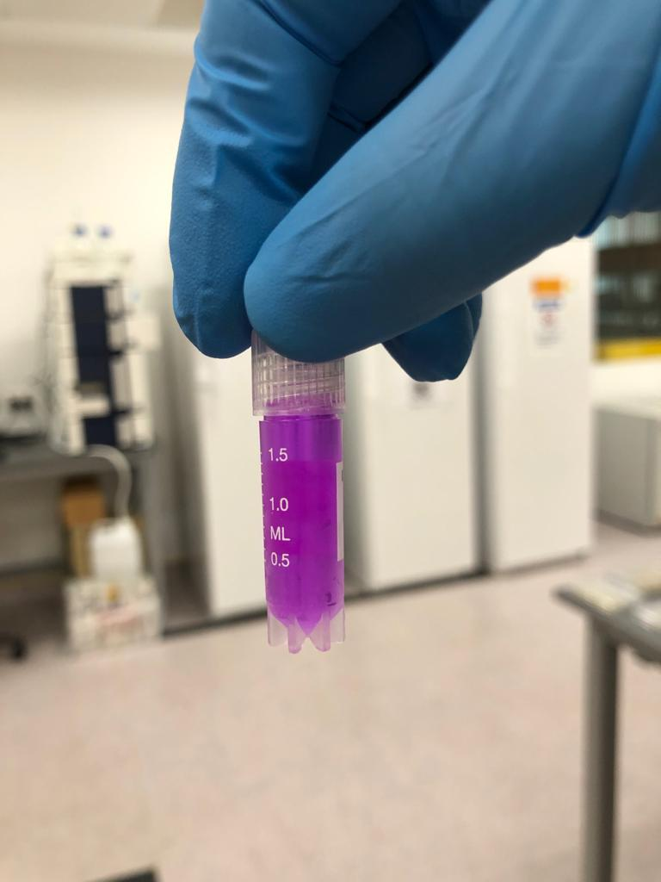
Conc: 2.25~2.50 mg/L

Slide 30
定 风 波
莫听穿林打叶声
何妨吟啸且徐行
竹杖芒鞋轻胜马
谁怕
一蓑烟雨任平生
料峭春风吹酒醒
微冷
山头斜照却相迎
回首向来萧瑟处
归去
也无风雨也无晴

Slide 31
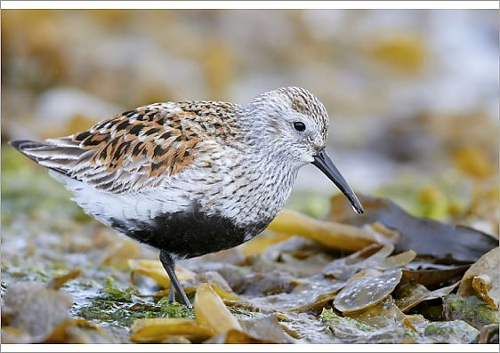
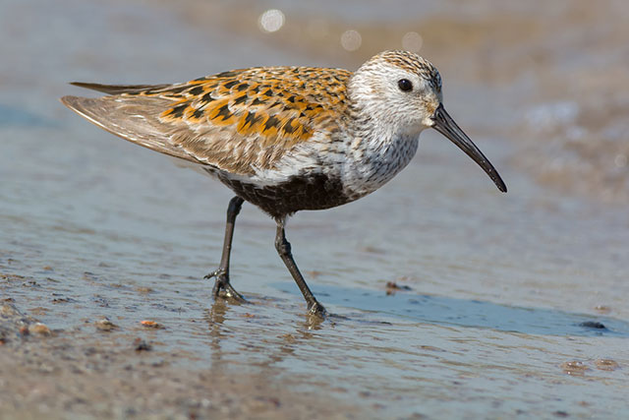

Slide 33
Light blue 212 223 #D4DFF1
Gray 116, 106, 109 #746A6D
Dark brown 46 38 31 #2E261F
Orange 220, 171, 82 #DCAB52

Slide 34
Light blue 212 223 #D4DFF1
Gray 116, 106, 109 #746A6D
Dark brown 46 38 31 #2E261F
Orange 220, 171, 82 #DCAB52
An important piece of information
Step 1
Step 2

Slide 35
Light blue 212 223 #D4DFF1
Dark brown 46 38 31 #2E261F
Orange 220, 171, 82 #DCAB52

Slide 36
section
model | config
subsection
ungrouped | grouped

