Slide 1
Docker + Vagrant

Slide 2
The Problem
Inconsistent developer environment
Dependency versioning
Underlying OS inconsistencies (Windows vs. Mac)
Time to ramp-up

Slide 3
OpenGive
12 developers with varied backgrounds
Windows and Mac dev environments
Limited amount of dev time so needed to maximize productive work

Slide 4
Vagrant + Virtualbox
Created a consistent environment across all devs
No need to mess with ruby or rails version mismatch
Running code matched environment that production would eventually deploy to
Vagrant maps filesystem so code can be edited with preferred tool
At OpenGive, a git checkout and vagrant up was all that was needed for 90% of the users. The other 10% were missing Virtualbox…easily remedied

Slide 5
Great, what about a more complicated setup
Multiple services, DB, messaging system, LB, etc.
We COULD use vagrant here too
Now we have 5 VMs running locally
Individual control is nice, but YUGE resource drain
Networking can be a pain, managing name resolution esp.

Slide 6
Docker solves this!
Docker containers are not full VMs
Lightweight allowing multiple containers to share OS resources
Docker containers don't work natively on Windows or Macs
boot2docker
Doesn't match production
Back to inconsistent dev setups

Slide 7
A Solution: Vagrant AND Docker
Docker host can match prod (Ubuntu e.g.)
Vagrant manages networking
Vagrant provisioning scripts can match what is done for prod (always testing deployment)

Slide 8
Demo
We have a client called Pizza NOW!
They have asked us to build out a new system for order and delivery
We are only response for the backend. Front-end work could definitely fit in this workflow, I’m just lazy.

Slide 9
Design
Front End Client
Proxy/Load Balancer
Listening on:80
Order
Kitchen
Delivery
Micro services listening on :8080
Messaging service

Slide 10
Goals
From dev machine, call APIs of all micro-services via port 80
Edit code with MY editor of choice
Build and relaunch specific containers after code change without rebuilding whole environment in single command
Access logs of container commands for troubleshooting
Virtualbox Instance on Dev Machine
Docker Host VM Running Ubuntu
Five containers:
Apache for proxy
3 Spring Boot services
RabbitMQ

Slide 11
Vagrant file definition for Proxy/Load Balancer machine
Vagrant.require_version ">= 1.6.0”
VAGRANTFILE_API_VERSION = "2”
# Create and configure the Docker container(s)
Vagrant.configure(VAGRANTFILE_API_VERSION) do |config|
config.vm.define "lb" do |lb|
# Configure the Docker provider for Vagrant
lb.vm.provider "docker" do |docker|
# Define the location of the Vagrantfile for the host VM
# Comment out this line to use default host VM that is
# based on boot2docker
docker.vagrant_vagrantfile = "host/Vagrantfile”
docker.vagrant_machine = 'docker-host’
docker.remains_running = true
# Maps host share to container path
docker.volumes = ["/var/log/apache2:/var/log/apache2"]
# Specify the Docker image to use
docker.build_dir = "lb/”
# Specify port mappings
# If omitted, no ports are mapped!
docker.ports = ['80:80', '443:443']
# Specify a friendly name for the Docker container
docker.name = 'lb’
end
end
end
Without this, Vagrant would use boot2docker but we want Ubuntu so we have to define a separate Vagrantfile for building the docker host.
The expectation is that our containers run indefinitely. This configuration tells Vagrant that if if the container does not stay running, to throw an error.
Location of Dockerfile relative to current Vagrantfile.
Define the ports that Docker should expose to the docker host

Slide 12
Vagrant file definition for Docker host machine
Vagrant.require_version ">= 1.6.0”
VAGRANTFILE_API_VERSION = "2”
# Create and configure the VM(s)
Vagrant.configure(VAGRANTFILE_API_VERSION) do |config|
config.vm.provider "virtualbox" do |vb|
vb.memory = 2048
end
config.vm.synced_folder "../logs", "/var/log”
# Assign a friendly name to this host VM
config.vm.hostname = "docker-host”
config.vm.define "docker-host”
# Spin up a "host box" for use with the Docker provider
# and then provision it with Docker
config.vm.box = "ubuntu/trusty64”
config.vm.provision "docker”
config.vm.network :private_network, ip: "10.10.10.29”
end
The default memory allocated by Vagrant is not enough to support our 5 containers. This is still WAY less than we would need for 5 separate machines.

Slide 13
Dockerfile for Proxy/Load Balancer container
FROM ubuntu
ENV DEBIAN_FRONTEND noninteractive
RUN apt-get update && apt-get install -y --no-install-recommends apache2
RUN a2enmod proxy proxy_http proxy_ajp rewrite deflate headers proxy_balancer proxy_connect proxy_html
COPY conf/sites-available/000-default.conf /etc/apache2/sites-available
VOLUME ["/var/log/apache2"]
EXPOSE 80 443
ENTRYPOINT ["apache2ctl", "-D", "FOREGROUND"]
After getting apache installed, copying over our config file for the proxy.
000-default.conf
<VirtualHost *:80>
ServerAdmin webmaster@localhost
DocumentRoot /var/www/html
ErrorLog ${APACHE_LOG_DIR}/error.log
CustomLog ${APACHE_LOG_DIR}/access.log combined
ProxyPassMatch /([^/]*)/(.*) http://$1:8080/$1/$2
</VirtualHost>

Slide 14
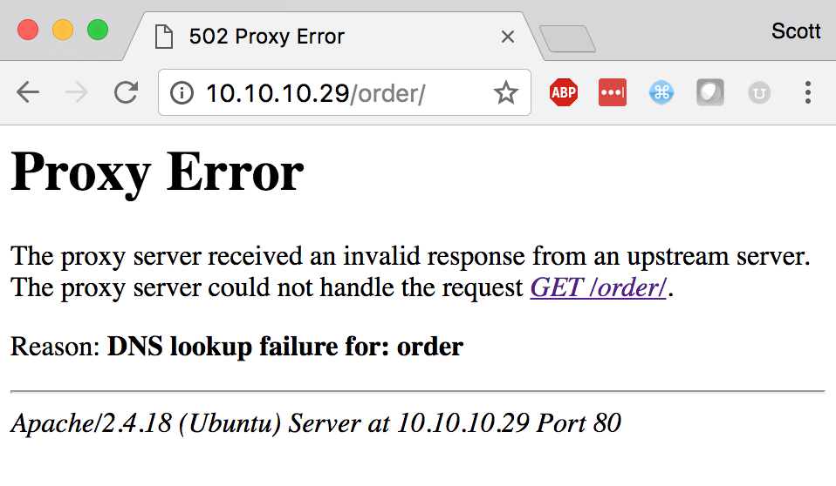
Vagrant up and test
~/work/docker-productivity$ vagrant up
This error is expected. We haven’t spun up the order micro service. But our proxy server appears to be working so win #1!

Slide 15
Vagrant file definittion for Order micro service machine
Vagrant.require_version ">= 1.6.0”
VAGRANTFILE_API_VERSION = "2”
# Create and configure the Docker container(s)
Vagrant.configure(VAGRANTFILE_API_VERSION) do |config|
config.vm.define "lb" do |lb|
<deleted for brevity>
end
config.vm.define "order" do |order|
# Configure the Docker provider for Vagrant
order.vm.provider "docker" do |docker|
# Define the location of the Vagrantfile for the host VM
# Comment out this line to use default host VM that is
# based on boot2docker
docker.vagrant_vagrantfile = "host/Vagrantfile”
docker.vagrant_machine = 'docker-host’
docker.remains_running = true
# Maps host share to container path
docker.volumes = ["/var/log/order:/var/log/order"]
# Specify the Docker image to use
docker.build_dir = "services/order/”
# Specify a friendly name for the Docker container
docker.name = 'order’
end
end
end
Notice this is the same setup as the LB machine we did before.
Mapping container volume to the docker host path. The docker host is mapped to the dev machine so we have access to the log files from our machine

Slide 16
Vagrant up and test…again
~/work/docker-productivity$ vagrant up order
This error is UN-expected. But that’s OK because a demo where everything works on the first try is boring.

Slide 17
Troubleshooting name resolution issue
First of all, is the order container running? Using Vagrant’s docker-logs command we can get the output from our container’s startup up CMD. In this case, it should be output from our java –jar instruction.
~/work/docker-productivity$ vagrant docker-logs order
…
==> order: 2017-04-24 19:40:07.096 INFO 6 --- [ main] com.pizzanow.OrderApplication : Started OrderApplication in 10.234 seconds (JVM running for 11.262)
==> order: 2017-04-24 19:40:38.164 INFO 6 --- [nio-8080-exec-1] o.a.c.c.C.[Tomcat].[localhost].[/] : Initializing Spring FrameworkServlet 'dispatcherServlet’
==> order: 2017-04-24 19:40:38.169 INFO 6 --- [nio-8080-exec-1] o.s.web.servlet.DispatcherServlet : FrameworkServlet 'dispatcherServlet': initialization started
==> order: 2017-04-24 19:40:38.205 INFO 6 --- [nio-8080-exec-1] o.s.web.servlet.DispatcherServlet : FrameworkServlet 'dispatcherServlet': initialization completed in 35 ms
==> order: 2017-04-24 19:40:38.355 INFO 6 --- [nio-8080-exec-1] o.h.h.i.QueryTranslatorFactoryInitiator : HHH000397: Using ASTQueryTranslatorFactory
That looks good so the issue must be in name resolution. Docker by default has put both of these containers on the same network named default. The Docker documentation says that automatic name resolution is not configured for the default network. We need a custom network in our Docker host.

Slide 18
Troubleshooting name resolution issue
Back to our docker-host configuration where we add the instruction for a custom network
Vagrant.require_version ">= 1.6.0”
VAGRANTFILE_API_VERSION = "2”
# Create and configure the VM(s)
Vagrant.configure(VAGRANTFILE_API_VERSION) do |config|
config.vm.provider "virtualbox" do |vb|
vb.memory = 2048
end
config.vm.synced_folder "../logs", "/var/log”
# Assign a friendly name to this host VM
config.vm.hostname = "docker-host”
config.vm.define "docker-host”
# Spin up a "host box" for use with the Docker provider
# and then provision it with Docker
config.vm.box = "ubuntu/trusty64”
config.vm.provision "docker”
config.vm.provision "shell", inline:
"docker network create --driver bridge pizza"
config.vm.network :private_network, ip: "10.10.10.29”
end
Runs a docker command in the VM that creates a new network named “pizza”
And in BOTH of our machine configs, we need to add this instruction which will get used when Vagrant calls the docker run command.
docker.create_args = ['--network=pizza']

Slide 19
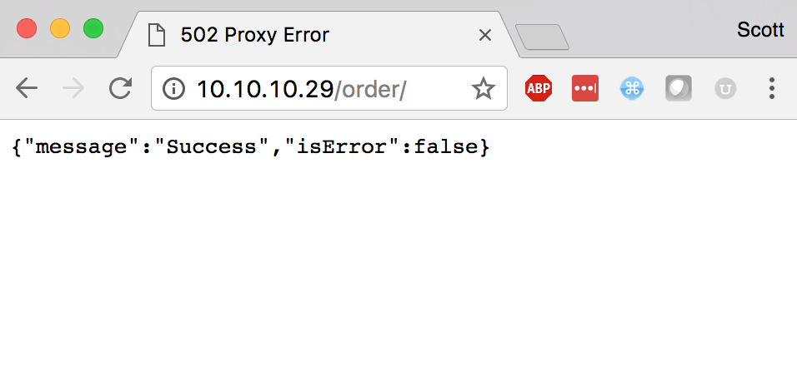
Vagrant up and test …again …again
~/work/docker-productivity$ vagrant up
Success!

Slide 20
Full Disclosure
In the previous slide I skipped over the part where I deleted the docker-host VM first in order for the new network provision to get run. Here is what that entailed:
~/work/docker-productivity$ vagrant global-status
id name provider state directory
-----------------------------------------------------------------------------------------
a9d7655 docker-host virtualbox running /Users/sstevenson/work/docker-productivity/host
…
In order to use the typical Vagrant commands on the docker-host VM, we have to identify its Vagrant ID
~/work/docker-productivity$ vagrant destroy a9d7655
docker-host: Are you sure you want to destroy the 'docker-host' VM? [y/N]
…
Now we can call the Vagrant destroy command to remove our incorrectly configured docker-host VM.
You can also use the ID to SSH into the docker-host VM for when you need more control of the docker environment. For example, you can run docker ps to get the running containers.

Slide 21
Vagrant file definition for Messages machine
Vagrant.require_version ">= 1.6.0”
VAGRANTFILE_API_VERSION = "2”
# Create and configure the Docker container(s)
Vagrant.configure(VAGRANTFILE_API_VERSION) do |config|
config.vm.define "lb" do |lb|
<deleted for brevity>
end
config.vm.define ”order" do |order|
<deleted for brevity>
end
config.vm.define ”kitchen" do |kitchen|
<deleted for brevity>
end
config.vm.define ”delivery" do |delivery|
<deleted for brevity>
end
config.vm.define ”messages" do |messages|
# Configure the Docker provider for Vagrant
order.vm.provider "docker" do |docker|
docker.vagrant_vagrantfile = "host/Vagrantfile”
docker.vagrant_machine = 'docker-host’
docker.remains_running = true
# Specify the Docker image to use
docker.build_dir = ”rabbitmq”
docker.ports = ['5672:5672', '15672:15672']
# Specify a friendly name for the Docker container
docker.name = ’messages’
end
end
end
Machine configs for our other two micro services will follow the same pattern as Order
Up to this point, we have used a Dockerfile to configure our containers. Vagrant can also deploy a docker image which will pull from Docker Hub by default, but could also be a private registry.

Slide 22
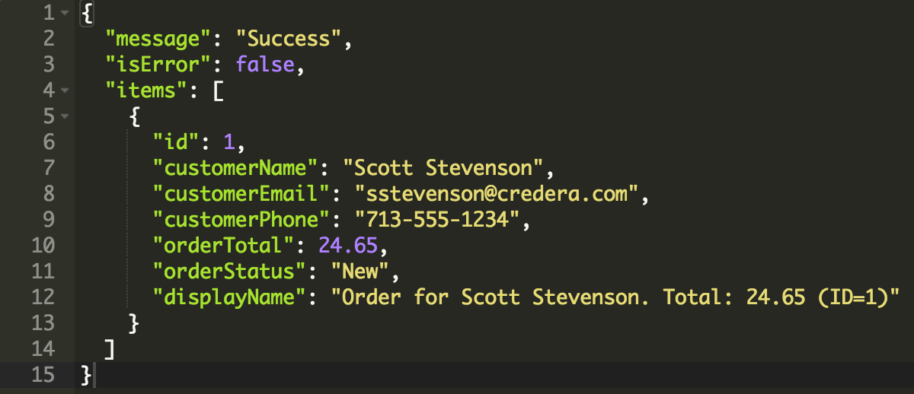
Development Example
Let’s make a code change on one service and re-deploy just that service. Currently the Order API returns this result which doesn’t indicate the type of the items collection.

Slide 23
Development Example
Using my IDE locally, I can make the relevant change needed.
@JsonGetter("itemType")
public String itemType() {
if (item != null) {
return item.getClass().getSimpleName();
} else if (!CollectionUtils.isEmpty(items)) {
return items.get(0).getClass().getSimpleName();
}
return null;
}
And then re-launch the order service
~/work/docker-productivity$ vagrant reload order
Oh, wait! I didn’t re-build my jar! This breaks my goal of deploying in one step. Vagrant has a trigger plugin that can be configured to run a pre- or post- deploy step.
[:up, :reload].each do |cmd|
config.trigger.before cmd, :vm => ["order", "kitchen", "delivery"] do
run "gradle build -p services/#{@machine.name}”
end
end
config.vm.define "lb" do |lb|
<deleted for brevity>
end
…

Slide 24
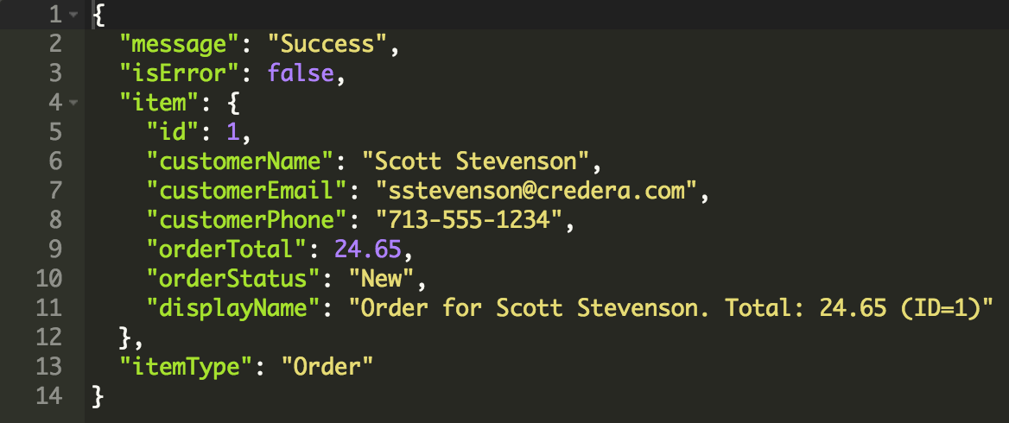
Development Example
Now we can re-launch the order service
~/work/docker-productivity$ vagrant reload order

Slide 25
Thank you for listening
Github:

