Slide 1
CS230 Mobile App Programming
Instructor: Russell Butler
Fall 2019

Slide 2
Lecture outline
Mobile landscape
My apps
First project: Gaitergram

Slide 3
Mobile landscape (2019)
Macro trends
Gaming
Retail
Restaurant and food delivery
Banking and finance
Video streaming
Social networking and messaging
travel

Slide 4
Summary
194 billion downloads worldwide (2018)
$101 billion worldwide app store consumer spend (2018)
3 hours per day spent in mobile by average user (2018)
360% higher average IPO for companies with mobile focus
Snapchat, line, candy crush, tinder, uber, etc..
30% higher engagement in non-gaming apps for gen Z vs older demographics

Slide 5
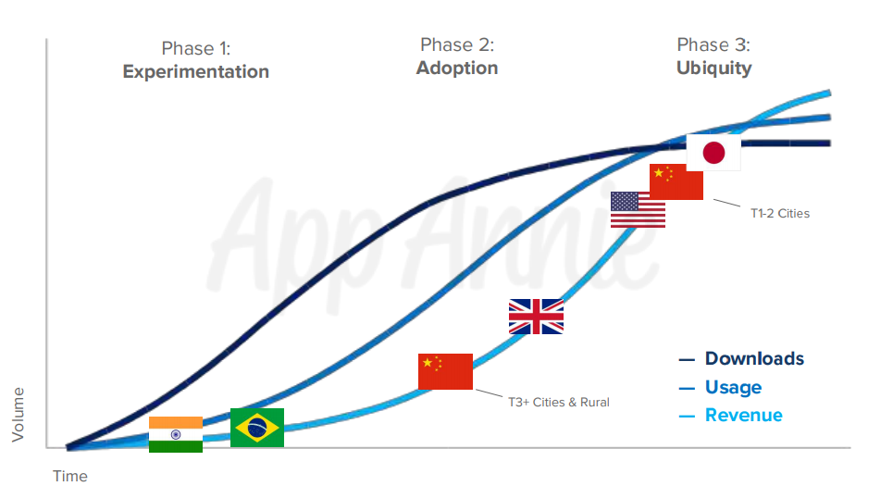
Macro trends
Experimentation: strong download numbers driven by new mobile device owners discovering and experimenting with new apps
Adoption: engagement climbs as mobile habits begin to form and users settle in to their go-to apps
Ubiquity: increased engagement and consumer spend as mobile takes over consumer mindshare

Slide 6
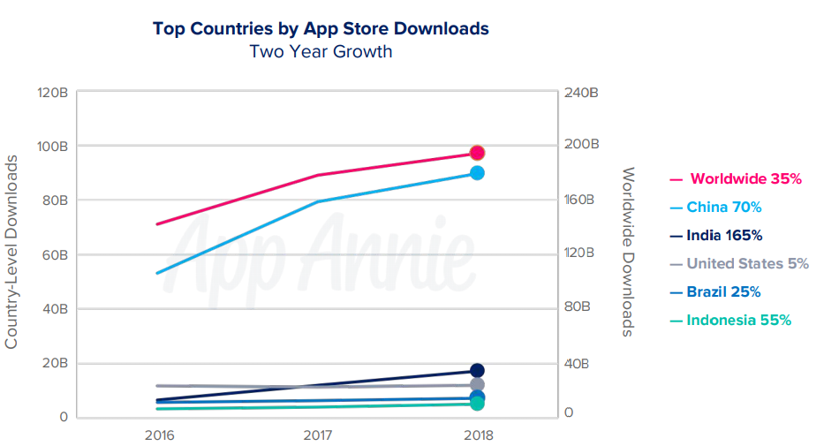
Download trends
Downloads up 35% from 2016 to 2018 (exceeded 194,000,000,000 in 2018)
China accounted for nearly 50% of downloads across iOS and Android
Emerging markets continue to fuel download growth
Mature markets (US) continue to see strong download numbers but growth has slowed
Mature markets growing strongly in other metrics (engagement and spend)
Games account for 35% of all downloads

Slide 7
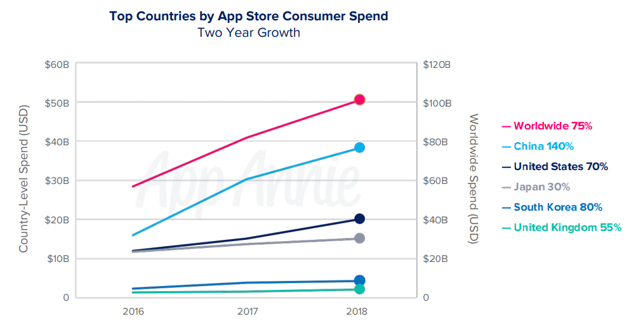
Spending trends
Consumer spend up 75% from 2016, to 101,000,000,000
Paid downloads, in-app purchases, in-app subscriptions
Does NOT include payments outside app store (Uber, Amazon, etc) or revenue from in-app advertising
China accounted for 40% of consumer spend in 2018
Games accounted for 74% of consumer spend in 2018
Non-gaming apps accounted for 26% of consumer spend in 2018, up from 18% in 2016 due to growth in in-app subscriptions

Slide 8
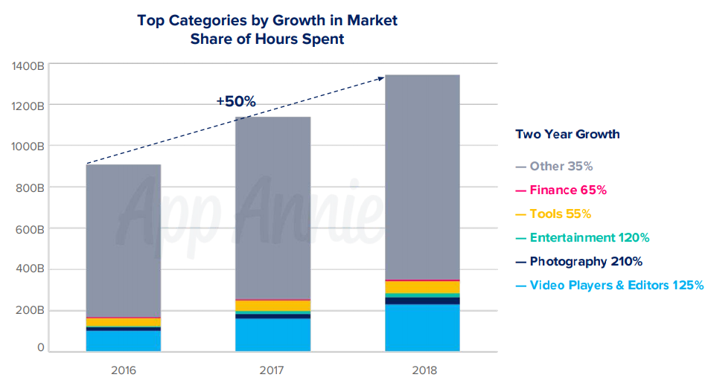
Engagement trends
Time spent in apps grew 50% from 2016 to 2018
Led by: (110% growth)
Video players/editors
Entertainment
Photography
Tools and finance
50% of time spent on mobile devices is in social and communications apps
15% in video players/editors, 10% in games

Slide 9
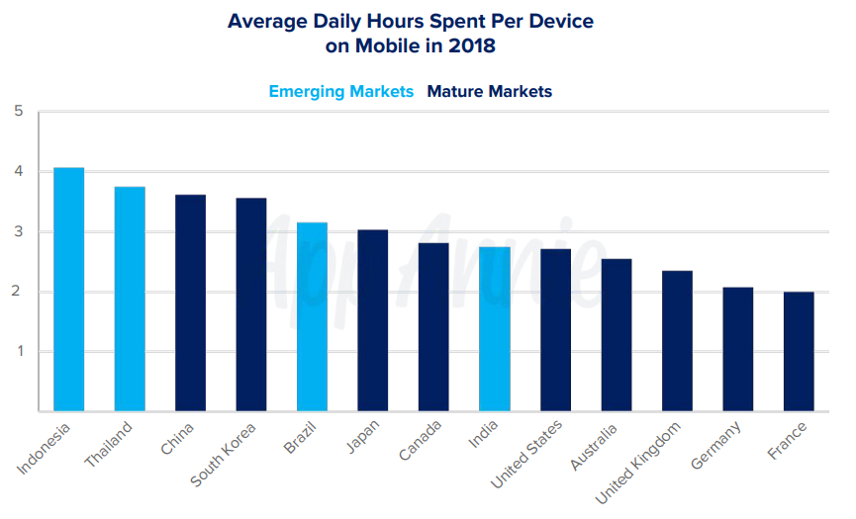
Daily use trends
Mobile users spent over 4 hours a day on their devices in Indonesia
3 hours per day in mature markets (US/Canada)
Time spent mostly performing micro-movements (checking email/bank, browsing news, etc) as well as gaming, social media, and streaming

Slide 10
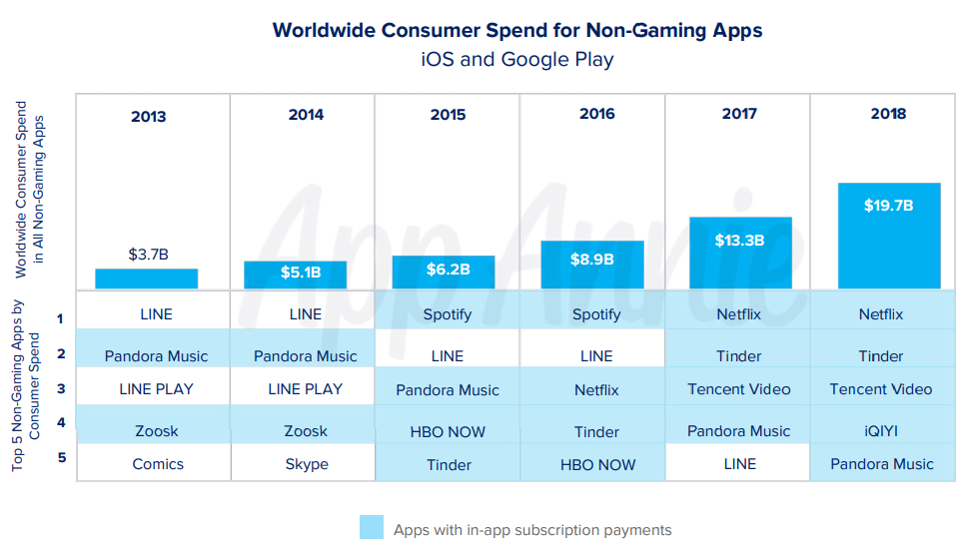
Subscription boom
Global consumer spend in non-gaming apps grew 120% from 2016
Top 5 most lucrative non-gaming apps of 2018 were all subscription based
Forecasted to increase to 75 billion by 2022
Netflix has stopped offering subscriptions through app store

Slide 11
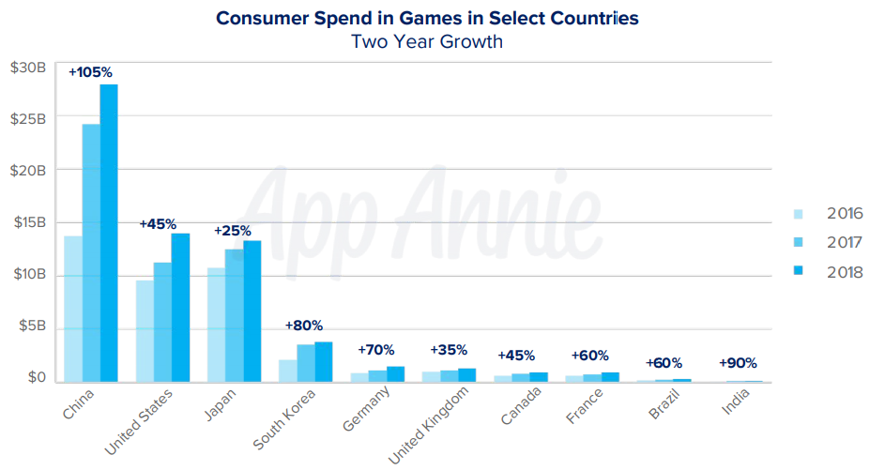
Gaming trends
Games accounted for 74% of consumer spend in 2018
Mobile gaming is fastest growing sector of gaming market, beating consoles, PC, and handhelds
Mobile gaming will reach 60% of gaming market share by 2019, up 35% from 2013
China, US, Japan account for 75% of gaming spend

Slide 12
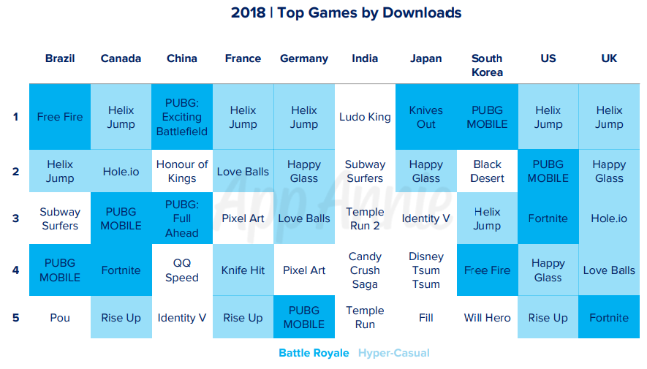
Gaming trends
Battle royale and hyper-casual games dominated 2018
PUBG Mobile, fortnite, rules of survival, free fire
Mobile devices are powerful!
Competitive online gaming culture
Hyper-casual games (simple gameplay mechanics)
Voodoo, Helix Jump, Hole.io
Candy crush, pokemon go, still popular

Slide 13
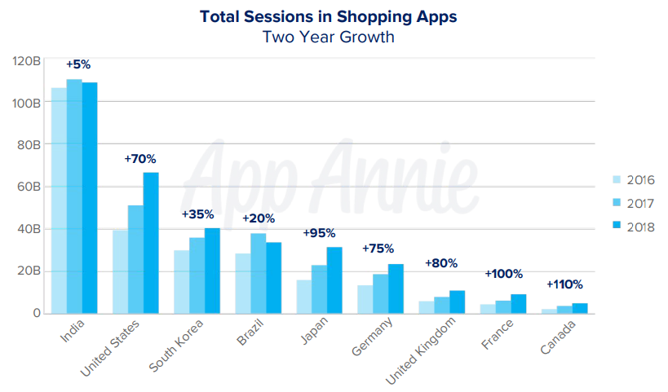
Retail trends
Time spent in shopping apps up 45% from 2016-2018
70% growth in US, 475% growth in Thailand
Time spend in shopping apps correlates with e-commerce sales
Mobile projected to comprise 75% of e-commerce sales by 2021

Slide 14
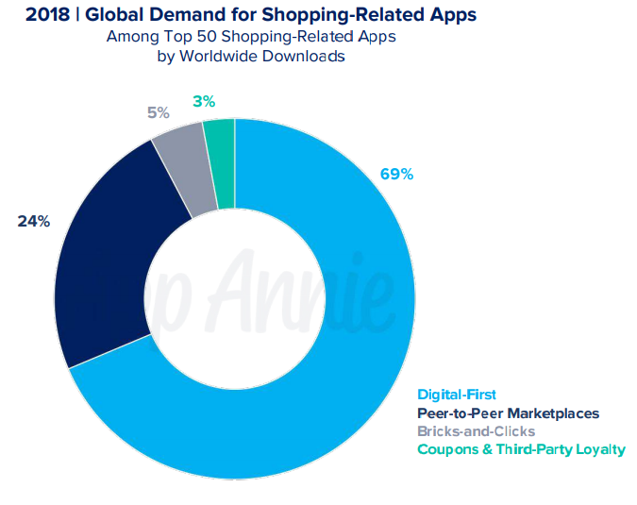
Peer to peer marketplaces
p2p markets were the 2nd most popular way to shop mobile in 2018
Shopee, ebay, Mercadolibre, letgo, OLX the top 5 p2p marketplace apps by download in 2018

Slide 15
Restaurant and food delivery
Globally, mobile purchases of food and drink up 130% from 2016 to 2018
325% growth in France, 230% growth in South Korea
Growth in fast food apps (quick service restaurants QSRs) and delivery services
Traditional brick and mortar food/drink industry with strong presence in mobile space
Top 5 food delivery app downloads up 115% from 2016 to 2018
Particularly in established markets (Canada, US, UK)
Starbucks and UberEats partnering in China and now US to streamline delivery and morning routine, transforming our daily rituals
QSRs such as Mcdonalds/Burger King leveraging loyalty programs through their apps (flash deals through push notifications)
Burger King leveraging location based offers (1 cent whopper) to hit #1 daily downloads on iphone in December 2018

Slide 16
Banking and finance
3.4 billion downloads of finance apps in 2018, up 75% from 2016
Brazil, India, Indonesia saw strongest growth
Banking and Fintech
Democratization of fintech services
Investing (Acorns, robinhood, wealthsimple)
Money transfer (Revolut)
Consumer loans (kredivo)
Microloans (afterpay) (Credit card alternatives)
Average user checks bank account 1x per day (up 35% from 2016)
Retail banking apps topped average monthly active users (MAU) chart
Revolut secured European banking license in 2018
Plans to open chequing/saving accounts and retail/business lending options
Paying by phone QR code becoming common, (PayPay in japan) (convenient and frictionless)

Slide 17
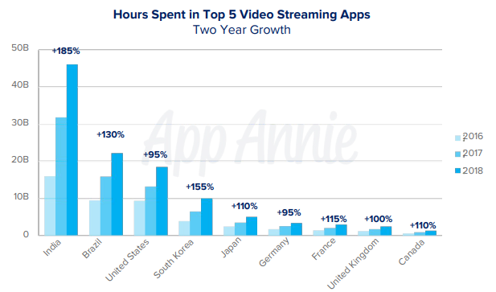
Video streaming
>100% growth in 8 major countries for time spent in top 5 video streaming apps
Consumption switching from desktop/tv to mobile
Youtube dominates video streaming apps (9 of every 10 minutes streamed was from youtube)
Youtube kids, Twitch
Youtube comes pre-installed
Consumer spend in video streaming apps exploded (285% worldwide increase 2018 vs 2016)
Youtube’s premium features
Disney+ launch in 2019
2.2 billion spent on top 5 streaming services in 2018 (Netflix #1 worldwide)
Live streaming apps (BIGO LIVE, Nonolive)
Sport streaming

Slide 18
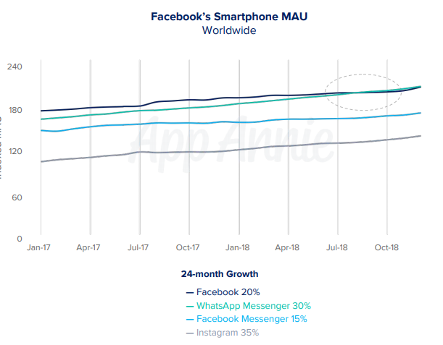
Social networking and messaging
685 billion hours spent globally in social/messaging apps in 2018, up 35% from 2016
Half of time spent on mobile globally is in social/messaging
Video is an expected feature for many social/messaging apps
Live streaming, video calling, viewing short-form video clips
Instagram, snapchat, tik tok foster deep engagement for generation z
Whatsapp was top social/messaging app for user engagement
demand for free calls and messages
Simple UI, ease of use for adding contacts
Encrypted messaging
higher MAU than Facebook
Snapchat 2nd place for user engagement
Photos/videos important for modern communication
Instagram users up 35% from 2017 to 2018
Users don’t seem to care about privacy (facebook scandals)

Slide 19
Travel
Number of sessions in travel/navigation apps up 50% 2016 to 2018
Google Maps, Uber, Airbnb
Car sharing apps up 25% year over year in 2018
Bike and scooter sharing apps breakout (up 530%) in 2018 vs 2017
Still in early phases (Bird and Lime)
Top 5 airline apps grew 55% from 2016 to 2018
Apps allow airlines to establish direct relationship with customers, this connection has been undermined by travel aggregators in recent years

Slide 20
Other industries
Dating apps – $400million to $1.4 billion or 190% increase in consumer spend (Subscriptions) from 2016 to 2018, led by Tinder
Unique dating apps (Bumble, women initiate first message)
Global spend in health/fitness apps up 300% from 2016 to 2018
Myfitnesspal
Meditation apps, culture shift towards wellness
Video calling doctors

Slide 21
2019 predictions
App store consumer spend will surpass $120 billion in 2019
double the global box office market
growing 5x rate of global economy
Gaming: mobile will grow to 60% of global gaming market share
Fortnite/PUBG combined with powerful devices
Hypercasual games with simple gameplay
Pokemon Go (first game past $1 billion, at ~$3 billion today)
10 minutes of every hour spent consuming media in 2019 will be streaming video on mobile
60% more apps will monetize through in-app ads
Mobile dominates digital advertising market (155 billion, or 62% of 250 billion)

Slide 22
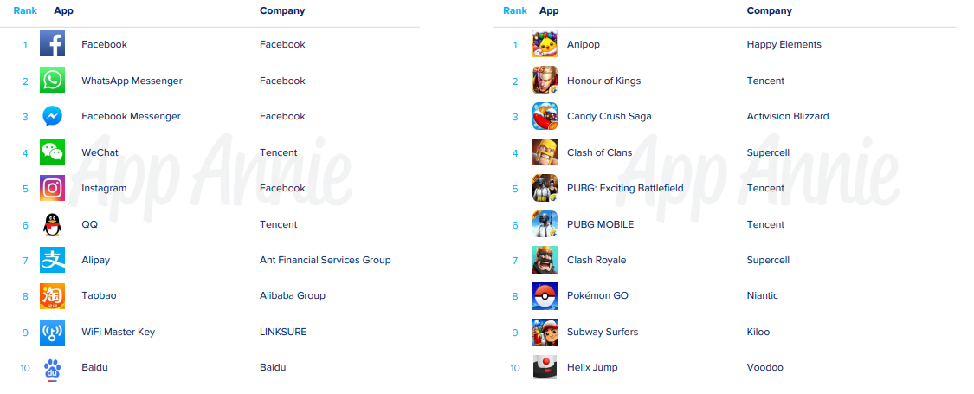
Top 10 apps by monthly active users worldwide

Slide 23
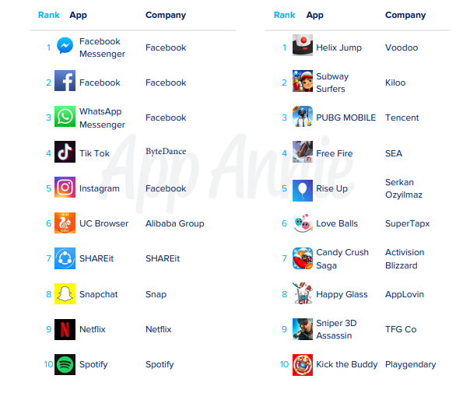
Top 10 apps by download worldwide

Slide 24
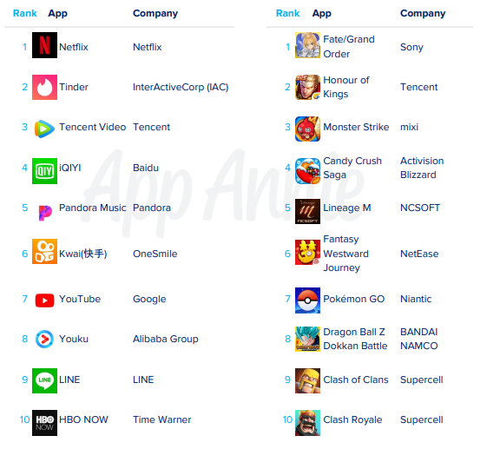
Top 10 apps by consumer spend worldwide

Slide 25
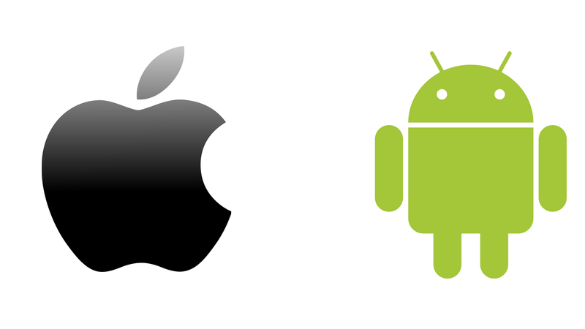
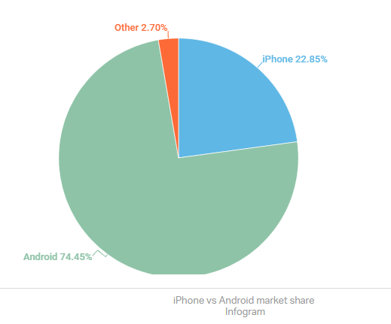
Android vs ios
Iphone 22.8%
Android 74.4%
Android sells more phones because of China and India
Android sells wider range of devices (and price)

Slide 26
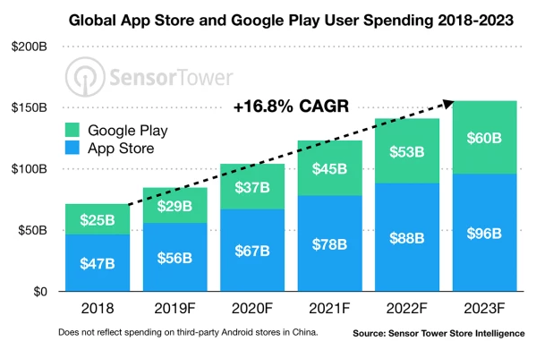
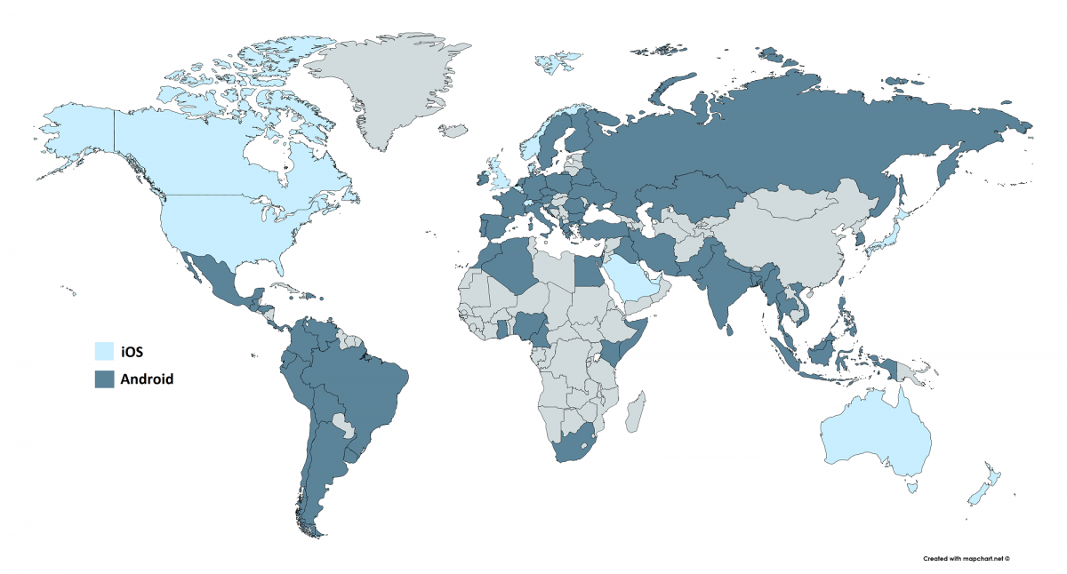
Google play and Apple App Store
Google Play has 2x the number of users as Apple App store
Apple app store generates 2x the revenue of Google Play

Slide 27
Resources:
Android developer conference (this October)
https://developer.android.com/dev-summit
Android developer guide:
https://developer.android.com/guide
Android developer documentation
https://developer.android.com/docs

Slide 28
Prerequisites and goals
Familiarity with at least one object-oriented programming language (preferably java or C++)
Should recognize the following terms: class, constructor, interface, getter, setter, generic types

Slide 29
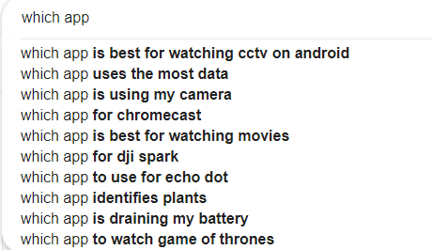
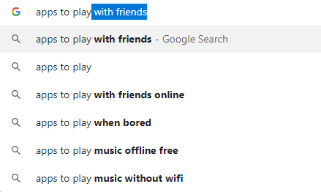
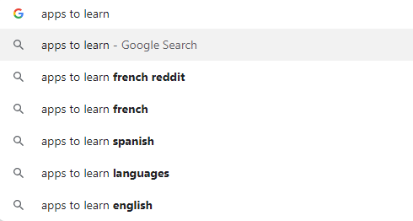
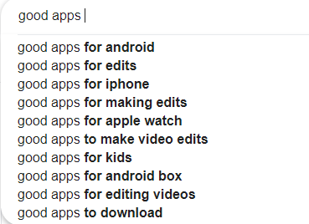
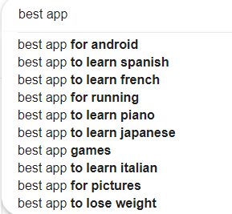
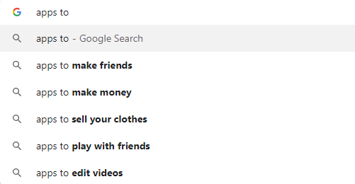
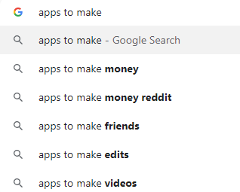
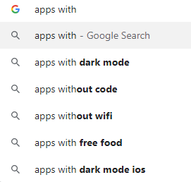
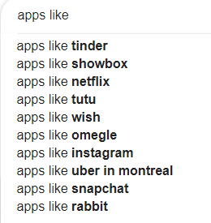
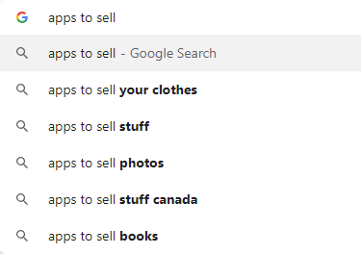
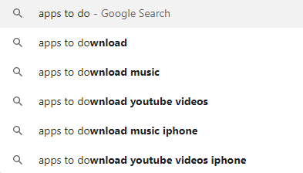
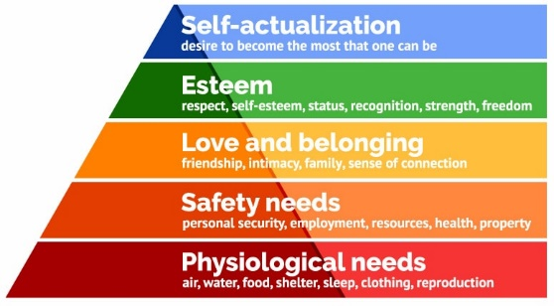
Mobile apps

Slide 30
Learning app through examples:
The location tracker app
The system scanning app
The multimedia streaming app
The messenger/communication app
The game app
Unity, graphics2D, openGL
The social media/sharing app
The selfie editing app
What do all these apps have in common? UI,

Slide 31
Reverse engineer popular apps
Reverse engineer popular apps, and replicate their basic functionality

Slide 32
An imaginary real estate agent / realtor app. Give them a test web service with a few endpoints:
List of properties
Property details
Maybe tokenized user login (bonus points)
Maybe add favourites (bonus points)
Making this work would cover a good amount of basic Android development: fragments, layouts, lists, async image loading, infinite scroll, adapters, web service interaction, navigation, Google Maps display etc.

Slide 33
The majority of android development is making an api call and displaying a list of data from that. You'll probably want to cover that. And something to include custom views/viewgroups and what role those play

Slide 34
A note taking app. This is what I build for new frameworks that I wanna learn. It covers a lot thing like:
Persistent data storage
Making adapters and using them in recycler view
Dealing with observables and updating when their value chnages
Android Navigation
There are many features that you can add to it to make it more complex like remote syncing, password protection, labels for notes, etc. From my experience, it is a great place to start

