Slide 1

Hello World and Tic Tac Toe
An introduction to Android

Slide 2
Android Studio

Slide 3
Create project
Choose activity type (Basic, maps, full screen, etc.)
Name
Package name
Save location
Language
Minimum API level
Support instant apps
Use androidx.* artifacts

Slide 4
MainActivity.java (hello world)
1) import base class for activities that use the support library action bar features
2) import a mapping from String keys to various Parcelable values
3) default Activity to run app in (more on activities later)
4) base class for activities that use the support library action bar features
5) called when activity is first created
6) contains data saved earlier if activity is being re-initialized
7) assign Context to Activity, avoid SuperNotCalledException
8) assign visual design of activity through xml layout file
import androidx.appcompat.app.AppCompatActivity; import android.os.Bundle; public class MainActivity extends AppCompatActivity { @Override protected void onCreate(Bundle savedInstanceState) { super.onCreate(savedInstanceState); setContentView(R.layout.activity_main); } }
R - resources
.layout – folder in resources
.activity_main – xml file in layout folder
What is the support library? What is the action bar?

Slide 5
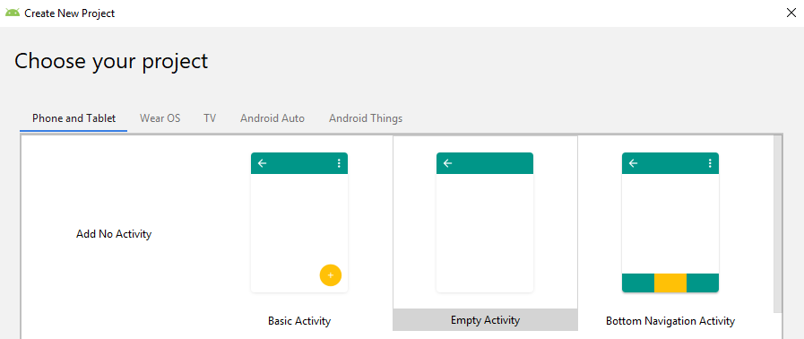
Support library action bar
Action bars
Action bar is a primary toolbar within the activity that may display activity title, navigation, and other interactive items
Android support library is a set of code libraries that provide backward-compatible versions of Android framework APIs as well as features that are only available through the library APIs

Slide 6
activity_main.xml (hello world)
encoding
character encoding for xml document
Constraintlayout
constraintLayout is a ViewGroup which allows you to flexibly position and size widgets
xmlns:android
xmlns:android –defines android:xxx elements
xmlns:app
defines app:xxx attributes
xmlns:tools
defines additional namespace to help design UI, discarded at build time.
android:layout_width
tools:context
TextView
<?xml version="1.0" encoding="utf-8"?> <androidx.constraintlayout.widget.ConstraintLayout
xmlns:android="http://schemas.android.com/apk/res/android" xmlns:app="http://schemas.android.com/apk/res-auto" xmlns:tools="http://schemas.android.com/tools" android:layout_width="match_parent" android:layout_height="match_parent" tools:context=".MainActivity"> <TextView android:layout_width="wrap_content" android:layout_height="wrap_content" android:text="Hello World!" app:layout_constraintBottom_toBottomOf="parent" app:layout_constraintLeft_toLeftOf="parent" app:layout_constraintRight_toRightOf="parent" app:layout_constraintTop_toTopOf="parent" /> </androidx.constraintlayout.widget.ConstraintLayout>
Why does http:.//schemas.* not exist? “URIs as schema identifiers are not required to point to documents that exist. There is no schema for the android xml files since the elements or attributes are completely dependent on what classes and attributes your application defines.” -joe

Slide 7
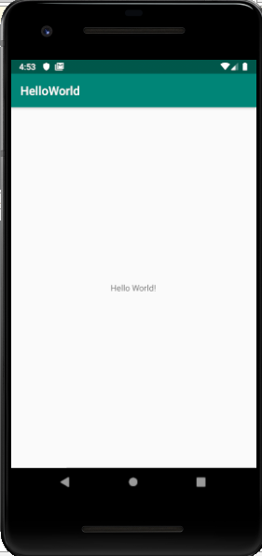
Hello world
protected void onCreate(Bundle savedInstanceState)
App lifecycle
Android system calls
What actually happens when we press the app icon?
setContentView(R.layout.activity_main);

Slide 8
Tic tac toe
Need an Activity and a Layout
Need an interactive 3x3 grid
Interactive = can press on grid and leave an ‘X’ or an ‘O’
Need a reset button
Need to know whose turn it is

