Slide 1
CS230 Developing Mobile Apps
Lecture 2

Slide 2
Outline for today
Admin:
First assignment will be released next week, will involve UI
Devices (smartwatch, oculus, phones, etc.)
Today:
Java refresher
First project - Hello World
Android Studio
Second project – Tic Tac Toe

Slide 3

Java refresher (can also use Kotlin)
Java is a general purpose programming language that is class based and object-oriented
Intended to let application developer write once, run anywhere
Compiled java code runs on all platforms that support java
Similar syntax to C, C++, but fewer low-level facilities
Automatic garbage collection
9 million developers using java as of 2019

Slide 4
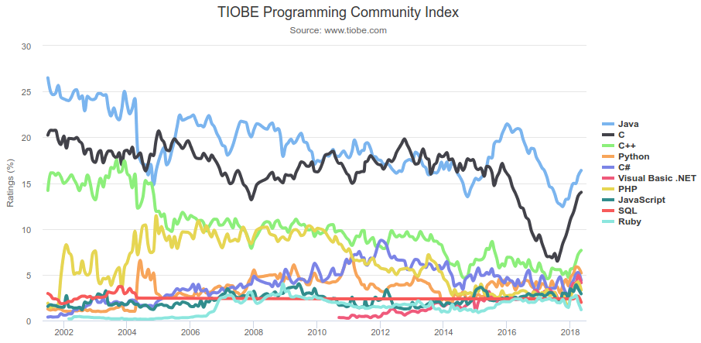
Java popularity
TIOBE programming language popularity index
Based on number of search engine results for queries containing name of language
Important for Android because 95% of the problems you run into will have solutions posted on Stack Overflow

Slide 5
Things to know for this course:
Classes
Interfaces
Generics

Slide 6
Classes
Java is an object-oriented programming language
Everything in Java is associated with classes and objects, along with its attributes (fields) and methods
An object is created from a class
Can create multiple objects from one class
Can extend classes through inheritance
Can have static methods/fields

Slide 7
Class example
You want to create a class to hold information about CS230 (no pun intended!)
public, private, static, final, get, set
public class CS230{ private String[] studentNames; public static final int MAX_STUDENTS = 30; public String[] getStudentNames(){ //getter return studentNames; } public void setStudentNames(String[] studentNames){ //setter this.studentNames = studentNames; } }

Slide 8
Interfaces in Java (you will be using them often!)
An interface in the Java programming language is an abstract type used to specify the behavior that the class must implement
Declared using the interface keyword
Cannot be instantiated, but rather are implemented by a class
Benefits:
Simulate multiple inheritance
Unaffected by changes to class that implements them
Allow standard set of methods to be used across the class hierarchy

Slide 9
Interface example: Clickable
You are creating a GUI, and you want to store all the different objects the user can interact with in the same array
Problem: you have many different types of objects (buttons, text viewers, sliders, etc.)
Solution: use an interface to define common methods across all the objects
Step1: define the interface:
public interface Clickable { void click(); void doubleClick(); }
Step2: implement the interface (and others):
class ExampleClass implements Scrollable, Clickable {}
Step3: create your array to hold the interface type:
Clickable[] guiObjects;

Slide 10
Generics
public class GenericMethodTest { // generic method printArray public static < E > void printArray( E[] inputArray ) { // Display array elements for(E element : inputArray) { System.out.printf("%s ", element); } System.out.println(); } public static void main(String args[]) { // Create arrays of Integer, Double and Character Integer[] intArray = { 1, 2, 3, 4, 5 }; Double[] doubleArray = { 1.1, 2.2, 3.3, 4.4 }; Character[] charArray = { 'H', 'E', 'L', 'L', 'O' }; System.out.println("Array integerArray contains:"); printArray(intArray); // pass an Integer array System.out.println("\nArray doubleArray contains:"); printArray(doubleArray); // pass a Double array System.out.println("\nArray characterArray contains:"); printArray(charArray); // pass a Character array } }
Generics allow you to write a single generic method (or class) declaration that can be called (or initialized) with arguments of different types
Enables you to specify, with a single method declaration, a set of related methods

Slide 11
Generic classes
public class Box<T> { private T t; public void add(T t) { this.t = t; } public T get() { return t; } public static void main(String[] args) { Box<Integer> integerBox = new Box<Integer>(); Box<String> stringBox = new Box<String>(); integerBox.add(new Integer(10)); stringBox.add(new String("Hello World")); System.out.printf("Integer Value :%d\n\n", integerBox.get()); System.out.printf("String Value :%s\n", stringBox.get()); } }
A generic class declaration looks like a non-generic class declaration, except that the class name is followed by a type parameter section
As with generic methods, type parameter section of generic class can have one or more type parameters separated by commas

Slide 12
Android Studio
Android Studio is the official integrated development environment (IDE) for Google’s Android operating system, built on JetBrains’ IntelliJ IDEA software and designed specifically for Android development
IntelliJ IDEA is a Java IDE developed by JetBrains
Code completion by analyzing context
Code navigation (jump directly to class or declaration)
Code refactoring (improve readability, reduce complexity)
Linting (check adherence to coding standards, pinpoint possible logic errors)
Helpful suggestions

Slide 13
Create project
Choose activity type (Basic, maps, full screen, etc.)
Name
Package name
Save location
Language
Minimum API level
Support instant apps
Use androidx.* artifacts

Slide 14
Hello world
4 main files
MainActivity.java
activity_main.xml
AndroidManifest.xml
build.gradle

Slide 15
MainActivity.java
import androidx.appcomp…
import base class for activities that use the support library action bar features
import android.os…
import a mapping from String keys to various Parcelable values
public class MainActivity
default Activity to run app in (more on activities later)
extends AppCompatActivity
base class for activities that use the support library action bar features
onCreate()
called when activity is first created
Bundle savedInstanceState
contains data saved earlier if activity is being re-initialized
super.onCreate();
assign Context to Activity, avoid SuperNotCalledException
setContentView();
assign visual design of activity through xml layout file
R.layout.activity_main
MainActivity.java is the application file which ultimately gets converted into an executable and runs your code
import androidx.appcompat.app.AppCompatActivity; import android.os.Bundle; public class MainActivity extends AppCompatActivity { @Override protected void onCreate(Bundle savedInstanceState) { super.onCreate(savedInstanceState); setContentView(R.layout.activity_main); } }
What is the support library? What is the action bar?

Slide 16
activity_main.xml
encoding
character encoding for xml document
Constraintlayout
constraintLayout is a ViewGroup which allows you to flexibly position and size widgets
xmlns:android
defines android:xxx elements
xmlns:app
defines app:xxx attributes
xmlns:tools
defines additional namespace to help design UI, discarded at build time.
android:layout_width
Set to wrap_content or match_parent or a number in dpi
tools:context
Tells which activity the layout is associated, helps guess a default layout theme at design time (since themes are defined in manifest, and associated to activities not layouts)
TextView
A user interface element that displays text to the user
A typical android app is comprised of one or more screens. You define what each screen looks like using an XML layout.
<?xml version="1.0" encoding="utf-8"?> <androidx.constraintlayout.widget.ConstraintLayout
xmlns:android="http://schemas.android.com/apk/res/android" xmlns:app="http://schemas.android.com/apk/res-auto" xmlns:tools="http://schemas.android.com/tools" android:layout_width="match_parent" android:layout_height="match_parent" tools:context=".MainActivity"> <TextView android:layout_width="wrap_content" android:layout_height="wrap_content" android:text="Hello World!" app:layout_constraintBottom_toBottomOf="parent" app:layout_constraintLeft_toLeftOf="parent" app:layout_constraintRight_toRightOf="parent" app:layout_constraintTop_toTopOf="parent" /> </androidx.constraintlayout.widget.ConstraintLayout>
Why does http:.//schemas.* not exist? “URIs as schema identifiers are not required to point to documents that exist. There is no schema for the android xml files since the elements or attributes are completely dependent on what classes and attributes your application defines.” -joe

Slide 17
AndroidManifest.xml
package
App’s package name, used by build tools to determine location of code entities when building project
application
Declaration of the app. This element contains sub-elements that declare each of the application’s components and has attributes that affect all components
android:allowBackup=
Allow application data to be backed up during adb backup
icon, label, roundIcon
Specify icon, label, and round icon
android:supportsRtl
Suports right to left layouts (Arabic, Urdu, Hebrew, etc.)
android:theme
A theme is a type of style that’s applied to an entire app, not just an individual view
activity android:name
Activity component, every app component you create must be declared in manifest
intent-filter
Intent filter declaration, when an app issues an intent to the system, the system locates the appropriate app based on the intent filter
The manifest file describes the fundamental characteristics of the app and defines each of its components
<?xml version="1.0" encoding="utf-8"?> <manifest xmlns:android="http://schemas.android.com/apk/res/android" package="com.russ.helloworld"> <application android:allowBackup="true" android:icon="@mipmap/ic_launcher" android:label="@string/app_name" android:roundIcon="@mipmap/ic_launcher_round" android:supportsRtl="true" android:theme="@style/AppTheme"> <activity android:name=".MainActivity"> <intent-filter> <action android:name="android.intent.action.MAIN" /> <category android:name="android.intent.category.LAUNCHER" /> </intent-filter> </activity> </application> </manifest>
https://developer.android.com/guide/topics/manifest/manifest-intro

Slide 18
build.gradle
apply plugin: 'com.android.application'
Indicate that you are building an application, not a library
compileSdkVersion 29
Version of the API the app is compiled against
buildToolsVersion "29.0.1"
Version of compiler to use
defaultConfig {}
Block to define manifest properties
applicationId "com.russ.helloworld"
Every android app has a unique application ID that looks like a java package name
minSdkVersion 15
Determine which of a user’s devices app can be installed on
targetSdkVersion 29
Indicate to Android OS your app is tested up to this version
versionCode 1
Positive integer used as internal version number, higher=more recent
versionName "1.0"
User-friendly version name
testInstrumentationRunner
Instrumentation runner, entry point into running your test suite.
minifyEnabled
Detect and remove unused classes, fields, methods, and attributes from packaged app
proguardFiles
Java class file shrinker, optimizer, obfuscator, and preverifier. Optimizes bytecode and removes unused instructions.
dependencies {}
Modern software projects rarely build code in isolation. Projects reference modules for the purpose of reusing existing, proven functionality.
apply plugin: 'com.android.application' android { compileSdkVersion 29 buildToolsVersion "29.0.1" defaultConfig { applicationId "com.russ.helloworld" minSdkVersion 15 targetSdkVersion 29 versionCode 1 versionName "1.0" testInstrumentationRunner "androidx.test.runner.AndroidJUnitRunner" } buildTypes { release { minifyEnabled false proguardFiles getDefaultProguardFile('proguard-android-optimize.txt'), 'proguard-rules.pro' } } } dependencies { implementation fileTree(dir: 'libs', include: ['*.jar']) implementation 'androidx.appcompat:appcompat:1.0.2' implementation 'androidx.constraintlayout:constraintlayout:1.1.3' testImplementation 'junit:junit:4.12' androidTestImplementation 'androidx.test:runner:1.2.0' androidTestImplementation 'androidx.test.espresso:espresso-core:3.2.0' }
Gradle is a build system used to automate building, testing, deployment, etc. build.gradle is a script where you can automate these tasks

Slide 19
Running Hello World
Android emulator simulates Android devices on your computer
Test your app on variety of devices/API levels without a physical device
Provides almost all capabilities of a real Android device
Simulate incoming calls/txt messages
Specify location of device
Simulate different network speeds
Simulate rotation and other sensors
Access Google Play Store, and much more
Lacks capabilities for: Bluetooth, NFC, SD card insert/eject, headphones
More info here: https://developer.android.com/studio/run/emulator

Slide 20
Add a toast
A toast provides simple feedback about an operation in a small popup
Fills only the amount of space required for the message
Current activity remains visible and interactive
Automatically disappears after a timeout
Requires context, text, and duration

Slide 21
Tic Tac Toe
Get experience working with layout xml
Get experience handling views in source code
Some simple game logic
Next course: adding an options menu to Tic Tac Toe

