Slide 1
CS230 Developing Mobile Apps
Lecture 7

Slide 2
Lab 4
Create new project, name it AsyncBitmap
Extend AsyncTask in a private class within MainActivity
Get bird.png, chrome.png, penguin.png from moodle, place in res/drawable
Add a button, progress bar, and imageview to activity_main.xml
Write the appropriate code in onCreate() and AsyncTask’s methods:
onPreExecute()
doInBackground()
onProgressUpdate()
onPostExecute()
Such that, when the button is pressed the app asynchronously loads and displays the 3 images one by one in the imageview, updating the progress bar accordingly
Demo (hint add Thread.sleep() call in doInBackground() to slow down the loading a bit)

Slide 3
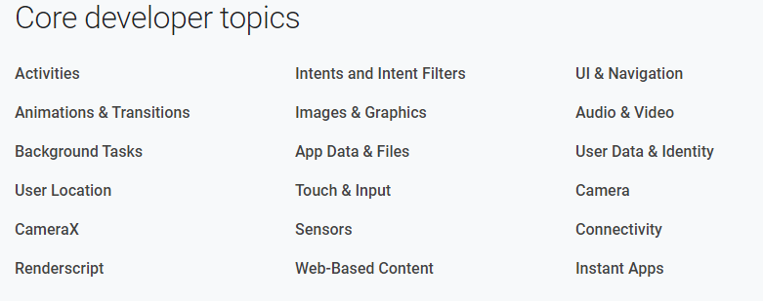
https://developer.android.com/docs

Slide 4
Permissions overview
The purpose of a permission is to protect the privacy of an Android user
Android apps must request permission to access sensitive user data (contacts, SMS, location) as well as certain system features (camera, internet)
Depending on the feature, permission might be granted automatically, or user might be prompted to approve the request
Principle of least privilege: by default, no app has permission to perform any operations adversely affecting other apps, the user, or the OS
Reading/writing the user’s private data
Reading/writing another app’s files
Performing network accesses
Keeping the device awake
Etc.
We will look at: how permissions work, how permissions are presented to the user, install time vs run time permissions, enforcing permissions, and types of permissions
https://developer.android.com/guide/topics/permissions/overview

Slide 5
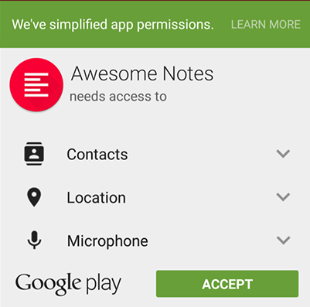
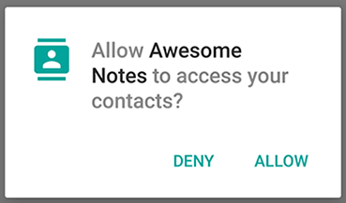
Permission approval
Publicize required permissions through <uses-permission> tag in manifest
Normal (non-risky) permissions listed in manifest are automatically granted
Dangerous (risky) permissions must be explicitly granted by the user
On Android 6.0 and later, app must ask user to grant permissions at runtime
Users can also remove a permission later through settings, so check for and if necessary re-request permission at runtime to guard against SecurityExceptions
On versions <5.1, system asks for permission at install time, if the user clicks accept, all permissions are granted, if they deny, the installation of the app is cancelled
<uses-permission android:name="android.permission.SEND_SMS"/>
https://developer.android.com/guide/topics/permissions/overview

Slide 6
Permissions for optional hardware features
Access to some hardware features (Bluetooth, camera) requires permission
However not all devices possess these features, so if your app requests a camera, make sure you also include the <uses-feature> tag in the manifest
android:required="false tells Google Play your app can be installed on devices without the camera
However, if you don’t provide the <uses-feature> tag, when Google Play sees that your app requires camera permission, it will assume your app requires a camera and devices without a camera will not be able to search/install your app
<uses-feature android:name="android.hardware.camera" android:required="false" />
https://developer.android.com/guide/topics/permissions/overview

Slide 7
Permission enforcement (Activities, Services, Broadcast Receivers)
Permissions are not only for requesting system functionality. Other apps can enforce custom permissions to restrict who can use them
Activity permission enforcement: you can add android:permission attribute to an <activity> tag in the manifest, restricting who can start the activity.
If another app tries to call Context.startActivity() without the required permission, a SecurityException is thrown
Service permission enforcement: add the android:permission attribute to the <service> tag, in the manifest, to restrict who can access the associated Service.
Context.startService(), Context.stopService(), context.BindService()
Broadcast permission enforcement: add the android:permission attribute to the <receiver> tag in the manifest to restrict who can send broadcasts to the associated BroadcastReceiver.
The sender of the broadcast can also supply a permission, to restrict who is able to respond to the broadcast.
https://developer.android.com/guide/topics/permissions/overview

Slide 8
Permission enforcement (Content Provider)
Add the android:permission attribute under your <provider> tag in the manifest to restrict who can access data in a ContentProvider
android:writePermission restricts who can write to the provider
android:readPermission restricts who can read from the provider (just because you can write to the provider doesn’t mean you can also read)
If you try to retrieve a provider without the appropriate permission, SecurityException is thrown
URI permissions: the standard system above is not sufficient, a provider may want to protect itself with read/write permissions, but its direct clients may want to hand specific URIs from the content provider to other apps
Example: email attachments, access to email should be protected by permissions, however, if a URI from an email attachment is given to an image viewer, the viewer cannot open the attachment because it doesn’t hold email permission
The solution is per-URI permissions: when starting an activity or returning a result from an activity, set Intent.FLAG_GRANT_READ_URI_PERMISSION (or _WRITE_), this allows the other activity to access the specific URI.
Called fine-grained permissions, declared in manifest through <grant-uri-permissions>
https://developer.android.com/guide/topics/permissions/overview

Slide 9
Protection levels
Permissions divided into several protection levels (normal, signature, dangerous)
Whether or not runtime requests are required depends on protection level
Normal permissions: automatically granted at install time, normal permissions cover areas where your app needs to access data/resources outside its sandbox (virtual machine) but doesn’t risk privacy or operation of other apps
Example: permission to set time zone is a normal permission
Signature permissions: granted by system at install time, but only when the app using the permission is signed by same certificate as app defining the permission
Dangerous permissions: areas where the app wants data/resources involving users private information, or potentially affecting stored data or the operation of other apps. Example: reading the user’s contacts.
To use dangerous permissions, user must grant permission at runtime.
https://developer.android.com/guide/topics/permissions/overview

Slide 10
Special permissions
SYSTEM_ALERT_WINDOW and WRITE_SETTINGS are particularly sensitive, most apps should not use these permissions.
SYSTEM_ALERT_WINDOW – allows your app to open a window on top of other apps from the background (facebook messenger’s chat heads)
WRITE_SETTINGS – allows the app to read/write device settings
To use these permissions, must declare in manifest AND send an intent requesting user’s manual authorization
Can check all permissions below (normal, signature, dangerous, special)
https://developer.android.com/reference/android/Manifest.permission.html
https://developer.android.com/guide/topics/permissions/overview

Slide 11
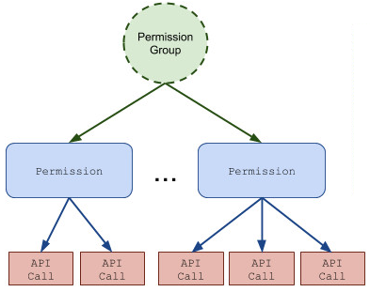
Permission groups
Permissions are organized into groups related to a device’s capabilities/features
Under this system, permission requests are handled at the group level, and a single permission group corresponds to several permission declarations in the manifest
Example: SMS group includes both READ_SMS and RECEIVE_SMS
Grouping permissions this way enables the user to make meaningful, informed choices without being overwhelmed by complexity
All dangerous Android permissions belong to permission groups
The user grants permission at the group level, so if the user grants ‘contacts’ permission for a READ_CONTACTS request, a later request to WRITE_CONTACTS by the same app will be granted automatically without user interaction
https://developer.android.com/guide/topics/permissions/overview

Slide 12
Request app permissions
First, place the <uses-permission> element in your app’s manifest
For dangerous permissions, you must check whether you have the permission every time it is used at runtime (because users can revoke permissions later)
If the app has permission, method returns PERMISSION_GRANTED and the operation can proceed, if not, app has to explicitly request permission from user
if (ContextCompat.checkSelfPermission(thisActivity, Manifest.permission.WRITE_CALENDAR) != PackageManager.PERMISSION_GRANTED) { // Permission is not granted }
https://developer.android.com/training/permissions/requesting

Slide 13
Requesting permissions
Explain why the app needs permission: help the user understand why app needs the permission.
Typically, only explain why permission needed if user has previously denied the permission. Use shouldShowRequestPermissionRationale(), a method that returns true if the user has previously denied the permission
Request to become default handler if necessary: if you want to request permissions specific to call logs and SMS messages, you must prompt the user to set your app as default handler for these functions before requesting at runtime
https://developer.android.com/training/permissions/requesting

Slide 14
Example
// Here, thisActivity is the current activity if (ContextCompat.checkSelfPermission(thisActivity, Manifest.permission.READ_CONTACTS) != PackageManager.PERMISSION_GRANTED) { // Permission is not granted // Should we show an explanation? if (ActivityCompat.shouldShowRequestPermissionRationale(thisActivity, Manifest.permission.READ_CONTACTS)) { // Show an explanation to the user *asynchronously* -- don't block // this thread waiting for the user's response! After the user // sees the explanation, try again to request the permission. } else { // No explanation needed; request the permission ActivityCompat.requestPermissions(thisActivity, new String[]{Manifest.permission.READ_CONTACTS}, MY_PERMISSIONS_REQUEST_READ_CONTACTS); // MY_PERMISSIONS_REQUEST_READ_CONTACTS is an // app-defined int constant. The callback method gets the // result of the request. } } else { // Permission has already been granted }
https://developer.android.com/training/permissions/requesting

Slide 15
Handling permission request response
After the user responds to the app’s permission request, system invokes onRequestPermissionsResult(), passing it the user’s response
Take the appropriate action in this method:
@Override public void onRequestPermissionsResult(int requestCode, String[] permissions, int[] grantResults) { switch (requestCode) { case MY_PERMISSIONS_REQUEST_READ_CONTACTS: { // If request is cancelled, the result arrays are empty. if (grantResults.length > 0 && grantResults[0] == PackageManager.PERMISSION_GRANTED) { // permission was granted, yay! Do the // contacts-related task you need to do. } else { // permission denied, boo! Disable the // functionality that depends on this permission. } return; } // other 'case' lines to check for other // permissions this app might request. } }
https://developer.android.com/training/permissions/requesting

Slide 16
App permissions best practices
Adhere to the following tenets:
#1: Only request permissions necessary for your app to work – try to find a way to accomplish the task without relying on access to sensitive information
#2: Pay attention to permissions required by libraries – including a library in your app inherits its permission requirements, be aware of what you’re including.
#3: Be transparent – be clear to the user what you are accessing and why, make this information explicit through dialogues.
#4: Make system accesses explicit: provide continuous indications to the user when accessing sensitive capabilities (camera, microphone), avoid the perception that you are collecting data sneakily.
https://developer.android.com/training/permissions/usage-notes

Slide 17
Permissions in Android 6.0+
Android 6.0 introduced new model: apps can request permissions at runtime
This allows the app to request the permission only when the service/data is actually required, rather than all at once at install time
This create a few changes relevant to the way sensitive user data is handled:
1) Increased situational context – users prompted at runtime, making them more sensitive to context in which permission is required. Therefore, the functionality of the app should match permission request, when it is requested.
2) greater flexibility in granting permissions – this can result in broken functionality that will surprise the user. Make sure your app handles exceptions raised if user suddenly decides to deny a permission.
3) Increased transactional burden – users will be asked to grant permissions for different groups. This makes it extremely important to minimize the number of permissions you request, to decrease the probability the user uninstalls/denies.
https://developer.android.com/training/permissions/usage-notes

Slide 18
Avoid requesting unnecessary permissions
Every permission request forces the user to make a decision. The user may uninstall your app in favor of a similar app that requests fewer permissions.
Use an intent instead – example, suppose your app needs to take picture with the device camera. You could request CAMERA permission, allowing direct access
Instead, use intent action type MediaStore.ACTION_IMAGE_CAPTURE, which allows you to capture images without requiring camera permission.
Don’t overwhelm the user – ask only for permissions as you need them. Example: you have a photo app that shares photos with contacts, only ask for contact permissions when the user tries to share a photo for the first time.
Pause media after losing focus – if your media app is interrupted by a phone call, a common solution is to listen for changes in phone state using PhoneStateListener to know when to resume. This requires READ_PHONE_STATE permission. Instead, use onAudioFocusChange() event handler, which will trigger automatically when OS shifts audio focus to/from the call.
https://developer.android.com/training/permissions/usage-notes

Slide 19
Permissions summary
Since Android 6.0 (October 2015) all dangerous permissions must be explicitly granted by user at runtime
Whenever possible, find a way to avoid requesting dangerous permissions
Be clear to the user why the permission is necessary, and make sure the permission matches the functionality of the app

