Slide 1
CS 230
Professor: Russell Butler
Fall 2019

Slide 2
Notes
Github for android studio – do tutorial

Slide 3
Java
Memory managed (more productive, less errors)
C# inspired by java, xcode has automatic reference counting
Documentation
Java development kit (JDK)

Slide 4
Platforms that support android OS:
Smartphones, game consoles, tv, watch, glasses, tablet

Slide 5
Emulator (AVD)
Simulation vs emulation: iOS using simulation, does not run targeted OS, AVD launches a sandboxed version of the linux kernel and android stack in order to emulate the environment on the physical android device.
Emulator has improved, physical device still preferable

Slide 6
Android studio
Android projects typically composed of many packages, directories, and files, and hundreds of assets.
Primary purpose of any IDE is to edit files (central panel, editor), all other windows are called tool windows and cluster around editor.
Gutter conveys information about your code, set break points, facilitate code folding, and display scope indicators
The Marker Bar indicates location of important lines in your code (warnings, compile-time errors)
Default Layout is a specific set of tool windows clustered around the editor
The Main Menu Bar is the uppermost bar and cannot be hidden
The Toolbar contains actions for cut, copy, paste, build, etc
The Navigation Bar presents a horizontal panel of boxes showing the path to the currently opened file in the Editor
The Status Bar presents context sensitive information (running processes, git status, etc)
Undo (Ctrl-Z) and Redo (Ctrl-Shift-Z)
Extended paste (Ctrl-Shift-V)

Slide 7
Android studio 2
Last edit location (Ctrl-Shift-Backspace)
Select in (Alt-F1)
Select Class (Ctrl-N)
Related File (Ctrl-Alt-Home)
Type Hierarchy (Ctrl-H when java file selected in Editor)
Find declaration (Ctrl while moving cursor over method)
Find (Ctrl-F) and Find in Path (Ctrl-Shift-F)
Replace and Replace in Path – better to use Refactor -> Rename
Surround block of code with try/catch or other block (Ctrl-Alt-T)
SmartType code completion (after ‘new’) (Ctrl-shift-space)

Slide 8
Programming in Android Studio
Code Folding – conserve screen real estate, hide blocks of code.

Slide 9
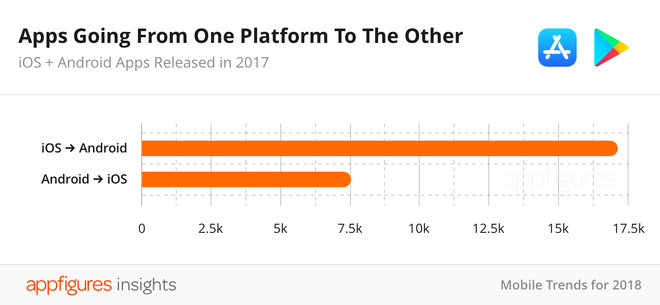
Mobile trends

Slide 10
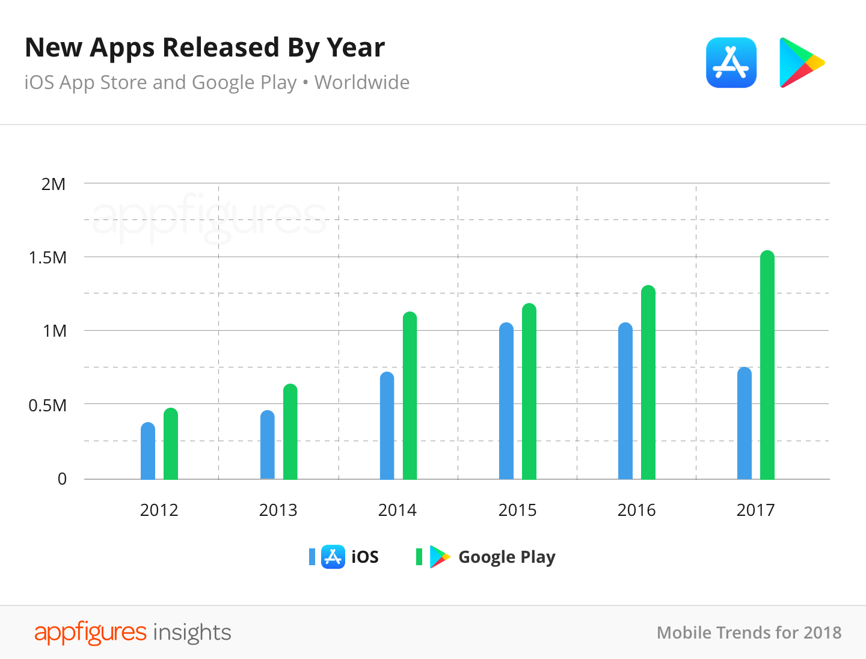

Slide 11
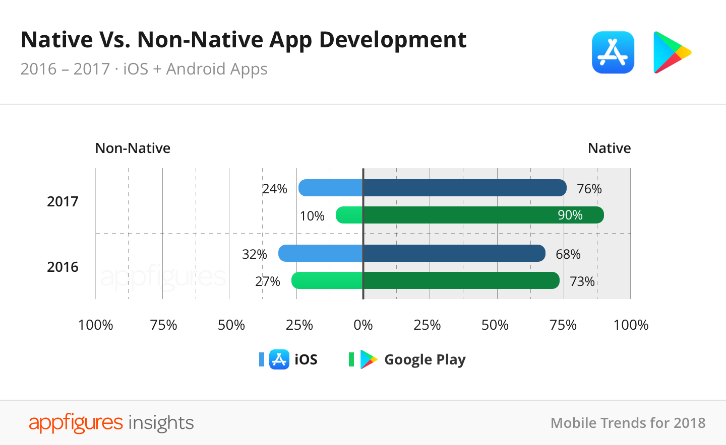

Slide 12
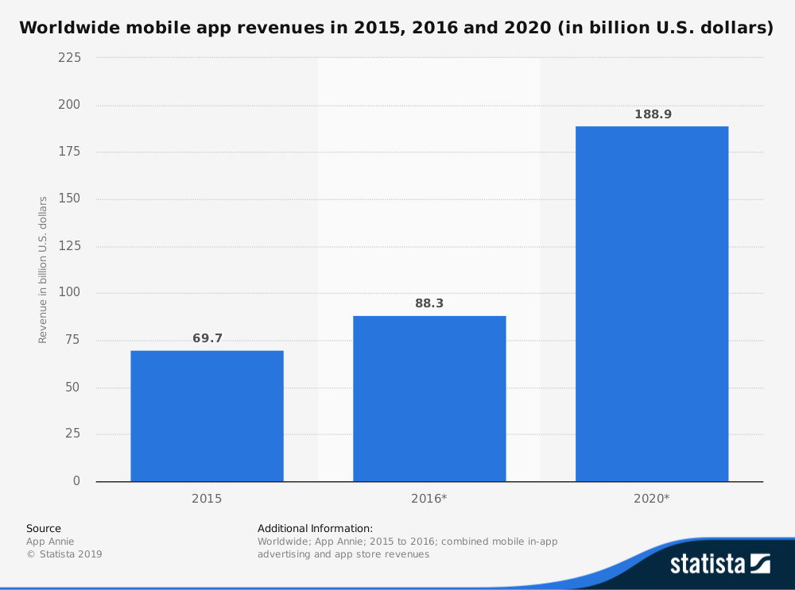

Slide 13
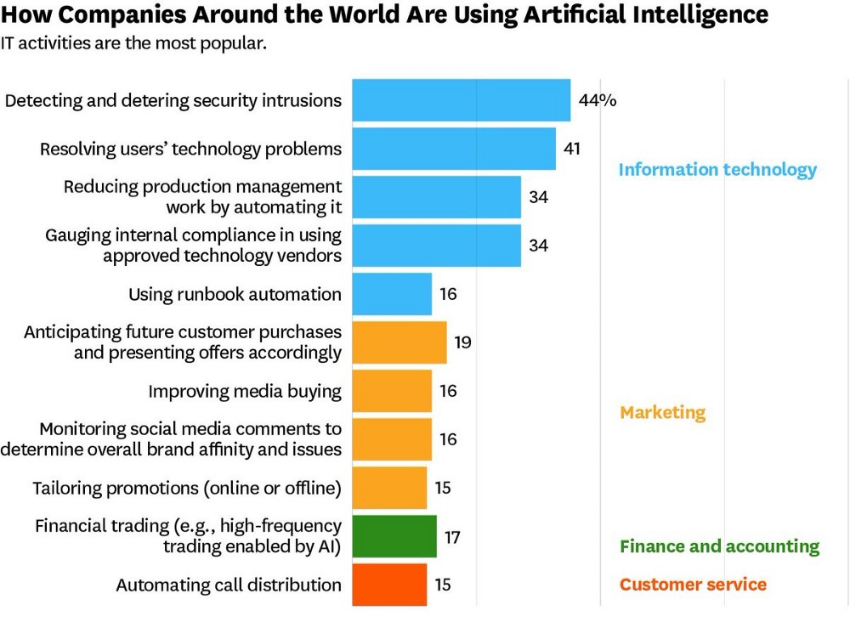
It is expected that the AI industry will rise up to $40 billion by 2020.
ML industry is growing at a rate of 42% and will reach up to $9 billion by 2022.
Though AI technology has become a hit launch, you still need to know about its features properly through many of its components. For instance, chatbots will play a more integral role in the deployment of AI technology.
For mobile app developers, it’s now easy to integrate chatbots on their website and apps. In coming years, you’ll see chatbots more like the virtual assistants that will feel like you’re talking to a real person.

Slide 14
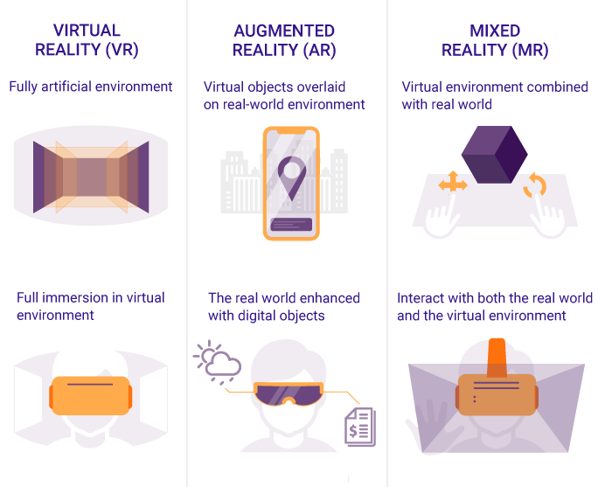
More mobile apps will adapt to augmented reality and virtual reality in 2019. These apps incorporate the real world experience in your mobile application. The best example of an augmented reality mobile application is Pokemon Go. Here’s the detail of the features of games-
All elements like grass, trees, sky, people in the game exist in the reality that you can see through your camera.
But in reality, all the elements that you see through your device aren’t actually there.
Important Stats
According to reports, Pokemon Go has generated a revenue of $1.2 billion and was downloaded approx. 752 million times.
Around 5 million active users playing Pokemon Go across the globe.
It’s better to say that this was really a huge success for this gaming brand. And, that’s why more companies are going to try and use augmented reality and virtual reality apps to drive their mobile application downloads and revenue for their business.

Slide 15
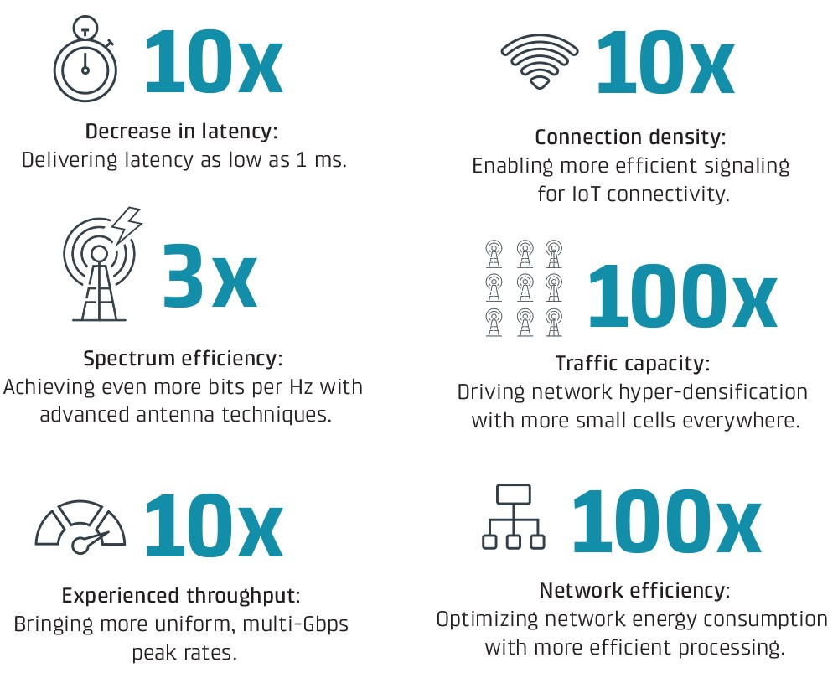
5G technology is going to be the most popular app development trend for the year 2019. For mobile app developers, technology is about to transform mobility forever. Thousands of app developers are taking 5G mobile technology into consideration to enhance the functionality of their apps in relation to data security, speed, 3D gaming, augmented reality and adding new features to their mobile application.
Development related to these areas will be greatly influenced by 5G. With that said, developers should expect to see more users on their mobile app, as you will provide them with better and faster top-end speeds than ever before.
The features such as custom made network slices and ultra-low network latency can help improve your mobile application responsiveness and speed that is something beyond just a slower internet connection.

Slide 16
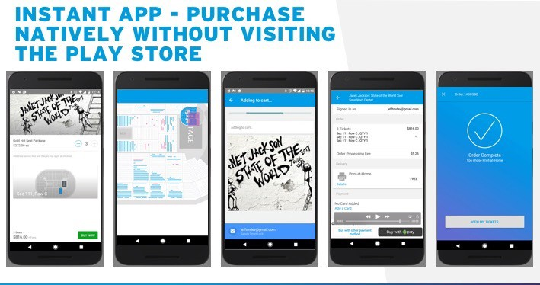
The concept of instant mobile apps is getting more popular day by day. The best part is, instant apps are not only popular among individuals, but mobile app development firms also finding them useful because it helps iOS andAndroid app developers achieve a better conversion rate in comparison to a regular mobile app.
For example, apps like Hollar and NYTimes have increased their conversion rate by 20% and 27% respectively by using the instant mobile application.

Slide 17
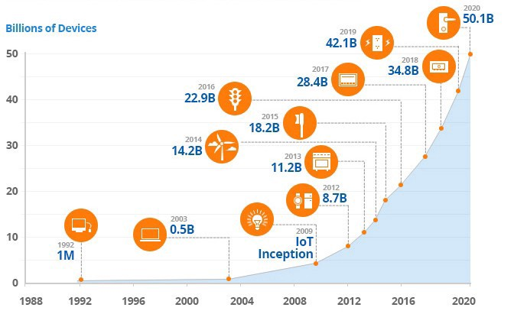
The Internet of Things for mobile app development has become a big industry that is evolving with time. Using this technology, mobile application developers can create intuitive platforms to control different non-IT equipment via apps.
Almost all tech giants have started developing IoT friendly apps. It is expected that the IoT investment will reach $120 billion by 2020.

Slide 18
