Slide 2
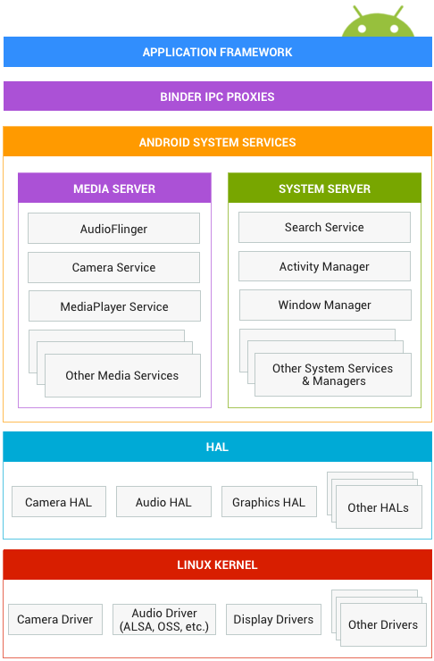
androidOS
Released by google shortly after the iphone appeared
Based on the open source linux operating system
5 layers in the android operating system
1) application framework
2) binder IPC proxies
3) Android system services
4) HAL (hardware abstraction layer
5) linux kernel
https://www.educba.com/structure-of-an-android-operating-system/

Slide 3
Android application framework
Used by the android app developers, furthest from hardware
Developed using Java
Works on the principle of least privilege: whenever

Slide 4
androidx vs android

Slide 5
main() vs MainActivity
Android apps have multiple entry points (instead of just one like a conventional program)

Slide 6
Fragmentactivity
onRequestPermissionsResult
Pendingintent stops on force close
https://stackoverflow.com/questions/54821741/what-happens-to-a-pendingintent-if-the-target-app-was-force-closed
BroadcastReceiver, onReceive: https://developer.android.com/reference/android/content/BroadcastReceiver

Slide 7
AsyncTask
https://stackoverflow.com/questions/9671546/asynctask-android-example
Can cause memory leak for long-running async tasks when defined as an inner class https://stackoverflow.com/questions/2531336/asynctask-wont-stop-even-when-the-activity-has-destroyed/13147992
Do not use async task for long running operations (> a few seconds),

Slide 8
SharedPreferences
Interface for accessing and modifying preference data returned by Context#getSharedPreferences
https://developer.android.com/reference/android/content/SharedPreferences.html

Slide 9
Data and file storage
Android provides several options for you to save your app data. The solution you choose depends on your needs, such as how much space your app requires, what kind of data you need to store, and whether the data should be private to the app or accessible to other apps/users.
https://developer.android.com/guide/topics/data/data-storage

Slide 10
Doze and standby
https://developer.android.com/training/monitoring-device-state/doze-standby

Slide 11
Broadcast receiver vs service
https://stackoverflow.com/questions/14548927/android-broadcast-receiver-vs-service
<service>: https://developer.android.com/guide/topics/manifest/service-element
https://developer.android.com/guide/components/services

Slide 12
Create long running service
Use PARTIAL_WAKELOCK to getupdates or do the same action at the same rate when the device is screen off and standby.
Best service for this case is Foreground Service. It won't be killed by the system, it is the highest priority server. But you must show the notification widget.
Implement a GPS singleton or similar logic with service or application context. Don't rely on any Activity or Fragment to avoid components life cycle.

