Slide 1
Guide to App Architecture

Slide 2
Guide to app architecture
Best practices for and recommended architecture for building robust, production-quality apps
Assumes a basic familiarity with Android Framework
https://developer.android.com/jetpack/docs/guide

Slide 3
Mobile app user experiences
Unlike desktop apps, mobile apps have a more complex structure, a single android app contains multiple components including activities, fragments, services, content providers, and broadcast receivers
Most of these components are declared inside the manifest, which allows the Android OS to decide how to integrate your app into the device’s overall user experience
Consider the simple task of taking/sharing a photo through facebook:
1) app triggers a camera intent. Android launches the camera app to handle the request. The user has now exited facebook.
2) the camera app might launch other intents, such as a file chooser.
3) eventually, the user returns to facebook and the photo is shared
At any point from 1-3, the user could be interrupted by a phone call/message, and expects to seamlessly return from this interruption to the photo sharing procedure. Your app must be able to handle this flow correctly.
Given the general conditions of this dynamic and unpredictable environment, your app components can be launched individually, out of order, and can be destroyed at any time by the OS. Therefore, you shouldn’t store any data or state in your app components, and your app components should be independent of one another.
https://developer.android.com/jetpack/docs/guide

Slide 4
Common architectural principles
If you shouldn’t use components to store app data and state, how should you design the app?
Separation of concerns – UI based classes such as Activity and Fragment should only contain logic handling UI and OS interactions, keep these classes as lean as possible to avoid lifecycle-related problems
Minimize dependency on Activity/Fragment classes
Drive UI from a persistent model: models are components that are responsible for handling the data for an app. They are independent from View objects and app components, so are unaffected by the app’s lifecycle and associated concerns
Persistent models are ideal because: 1) users don’t lose data if the system destroys your app to free up memory, and 2) the app continues to work when a network connection is flaky/unavailable
https://developer.android.com/jetpack/docs/guide

Slide 5
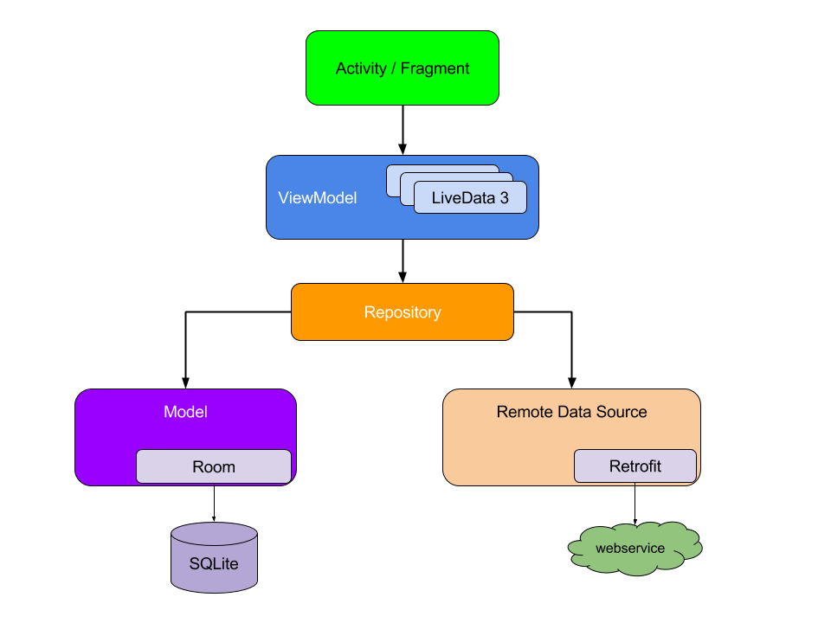
Recommended app architecture
Imagine we are building an app that shows a user profile, using a private backend and a REST API to fetch data for a given profile
The diagram shows how all the components should interact with each other after designing the app
Notice that each component depends only on a single component one level below (except the repository)
This design creates a consistent, pleasant user experience. Regardless whether the user returns to the app several minutes or days after closing, they instantly see locally persisted user data (maintained through the model) which is updated
https://developer.android.com/jetpack/docs/guide

Slide 6
Building a user interface
UI consists of a fragment (UserProfileFragment) and corresponding layout file (user_profile_layout.xml)
To drive the UI, data model needs to hold following data elements:
1) User ID – identifier for user, pass using fragment arguments so information is preserved if OS destroys the fragment’s process
2) User object – data class containing info about the user
We define a UserProfileViewModel based on the ViewModel architecture component to store this info
https://developer.android.com/jetpack/docs/guide

Slide 7
ViewModel
A ViewModel object provides the data for a specific UI component, such as a fragment or activity, and contains data-handling logic to communicate with the model
ViewModels can call other components to load/save data, and forward user requests to modify data.
ViewModel is unaware of UI state, and unaffected by configuration changes (device rotation)
https://developer.android.com/jetpack/docs/guide

