Slide 1
Kotlin Lecture

Slide 2
Why Kotlin?
Only JVM language other than java which offers integration with android studio
Concise: java is verbose, eliminates boilerplate getters and setters.
No more NullPointerException: null safety.
Java interoperability: can use libraries written in java, and can call kotlin code in java. Important because android APIs are written in java.
Designed by jetbrains professionals based on analysis of dev experiences, best usage guidelines (clean code) and data about java’s usage.

Slide 3
Advantages of Kotlin over Java
Java is an old language, many design issues that can’t be resolved due to back-compatibility constraints
Kotlin brings many proven programming concepts to the android development scene
More expressive – you can write more with less code
Safer – Kotlin is null safe, meaning you can deal with null exceptions at compile time rather than runtime. You can explicitly state that an object is null, and check nullity before using the object.
Functional – Kotlin is an object oriented language, not a pure functional language, but it uses many concepts from functional programming (such as lambda expressions) to solve problems and deal with collections more elegantly.
Makes use of extension functions – can extend any class even if we don’t have access to the source code.
Highly interoperable – you can continue using libraries and code written in java, and its even possible to create mixed projects with java and kotlin classes.
Java was never meant to be mobile
https://adtmag.com/articles/2017/10/11/kotlin-edges-java.aspx

Slide 4
About Kotlin:
A new language that targets the Java platform, its programs run on the JVM
2017 Google announced first-class support for Kotlin on the android platform (shipping out of the box with Android Studio 3.0)
Like java, kotlin is object-oriented. Classes, interfaces, and generics look and behave much like in java, allowing java developers to build on their strengths.
Statically (types known at runtime) and strongly typed like java, but unlike java uses type inference (var).
However, kotlin is still relatively new (created in 2011, officially adopted by google in 2017), so it may yet disappear
Open source – can check out the project, and be actively involved in any aspect of Kotlin such as plugins, compilers, documentation, or the language itself.
Very similar to Swift (iOS programming language), and there are plans to port kotlin to iOS.

Slide 5


Kotlin examples:
Notice that kotlin does not require semicolons
Don’t need to specify a variable type (inferred from context)
Assigning an int to a var with inferred type string will result in a compile time error

Slide 6

Kotlin examples: string templates
No need to join strings using the + character (as with java)
Can easily incorporate single variable or even whole expressions into string literals

Slide 7

Kotlin examples: null safety
In java, any variable can store null values.
In kotlin, strict null safety forces us to explicitly mark each variable that can store null values.
Adding the question mark to the data type tells the compiler that the variable is nullable
The safe call operator allows us to call potentially null variables, the method will be invoked only ‘savedInstanceState’ is not null, otherwise, it will be ignored (Avoids null pointer exceptions)

Slide 8





Kotlin examples: new data types
The Range datatype allows us to define end-inclusive ranges
The Pair datatype, combined with infix notation, allows to store a common pair of values
Pairs can be deconstructed into separate variables using destructive declarations
Can even iterate through a list of pairs
Or use the foreach function

Slide 9

Kotlin examples: mutable and immutable collections
Kotlin distinguishes between mutable and immutable collections by a providing a set of interfaces and helper methods
Mutable means state can change after initialization, immutable means state cannot change after initialization

Slide 10
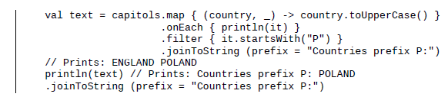
Kotlin examples: operations on collections
The kotlin standard library contains many functions that allow us to perform operations on collections in a simple and concise way
Example: stream processing on lists

Slide 11
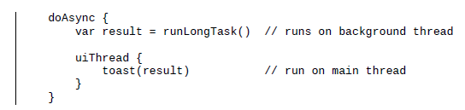
Kotlin examples: asynchronous requests
Can make asynchronous requests easily and display results on the main thread using the doAsync function

Slide 12
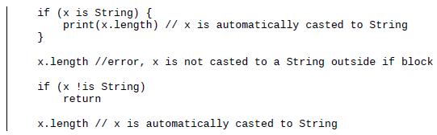
Kotlin examples: smart casting
Kotlin compiler knows x is a string after performing the check, allowing it to automatically cast to string type and use all properties/methods of string type

Slide 13

Kotlin examples: functions as expressions
If your function contains only a single expression, you can shorten the syntax by declaring it with an expression body

Slide 14
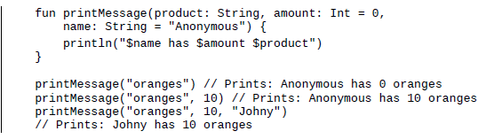
Kotlin examples: default argument syntax
Using default argument syntax, can define the default value for each function argument and call it in various ways
Need to supply all arguments without default values
Can also use named argument syntax to specify function arguments

Slide 15

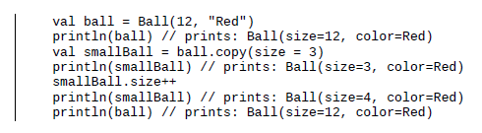
Kotlin examples: data classes
Kotlin data classes provide an easy way to define and operate on classes from the data model. Use data modifier before class name to define a data class.
Provides human readable string representation of class instance, do not need new keyword to instantiate class.
Can also easily create a custom copy of the class
Makes working with immutable objects very easy and convenient

Slide 16
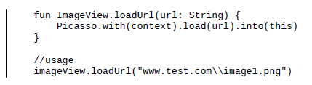
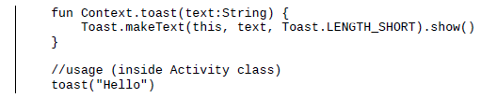
Kotlin examples: extentions
One of the best features in kotlin, allows to add new behavior (method or property) to existing class without changing its implementation.
Reduces code verbosity and removes need to use utility functions known from java (example, StringUtils class).
Can define extensions for custom classes, third party libraries, or even Android framework classes.
Example: imageview cannot load images from network, so we create the loadUrl extension function
Example 2: add a simple method displaying toasts to the Activity class

Slide 17
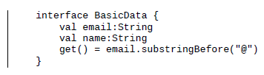
Kotlin examples: interfaces
Interfaces in kotlin can have default implementations as long as they don’t hold any state

Slide 18
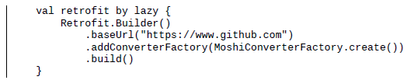
Kotlin examples: Delegates
In android there are many applications where we want to delay object initialization until it is needed/used. We use delegates to solve this problem.
This results in faster startup time as object loading/creation is deferred until it needs to be accessed.

Slide 19
The Kotlin standard library (stdlib)
Provides essential elements needed for every day work with kotlin, including:
Data types (Arrays, collections, lists, ranges, etc)
Extensions
Higher order functions
Various utilities for working with strings and other char sequences
Extensions for JDK classes, making it convenient to work with files, IO, and threading

Slide 20
Kotlin foundations:
Fundamental building blocks that are the core elements of the Kotlin programming language
To discuss: kotlin type system that introduces strict null safety and type casts, new operators, and new ways to handle application flows and deal with equality in a unified way.
Will cover the following topics:
Variables, values and constants
Type inference
Strict null safety
Smart casts
Kotlin data types
Control structures
Exception handling

Slide 21



Variables
In kotlin there are two types of variables: var and val. Var is a mutable reference that can be updated after initialization, var keyword is used to define a variable in kotlin.
The second type of variable is a read-only reference ‘val’. Vals cannot be reassigned after initialization. Equivalent to ‘final’ keyword in java.
However, variables defined using ‘val’ can still be modified, so the ‘val’ keyword does not guarantee that the object is immutable.

Slide 22
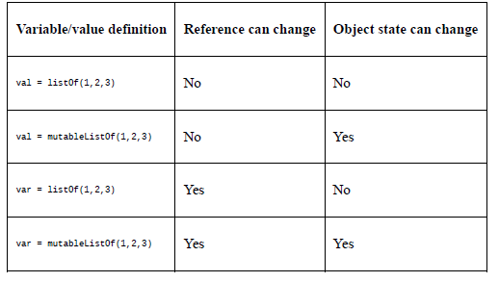
Immutable vals:
To make sure the object will not be modified, need to use both an immutable reference and an immutable object.
Fortunately, Kotlin’s standard library contains an immutable equivalent of any collection interface

Slide 23

Type inference:
Unlike java, the Kotlin type is declared after the variable name. This may seem strange, but is actually a building block of an important feature in kotlin, type inference, which allows the compiler to infer type from the context or value of expression assigned to the variable
When declaration and initialization are performed together, we can omit type declaration.
Keep in mind the type is still implicitly set to string, because Kotlin is a strongly typed language.

Slide 24

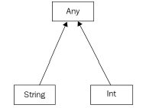
The ‘Any’ type
If we want to later assign our string to be an integer, we have to specify its type as one that is common to both string and integer, the closest such type in the Kotlin type hierarchy is ‘Any’, which is the Kotlin equivalent of java’s ‘Object’
‘Any’ defines three methods: equals, toString, and hashCode

Slide 25



More type inference:
Type inference can also be performed when the variable is assigned the output of a function
Type inferences also works on generic types. Assuming we pass only instances of the Person class, the inferred type will be List<Person>
However, if the variable is not initialized at declaration, the type cannot be inferred and an error will occur.

Slide 26

Strict null safety
The biggest source of error in java is the nullPointerException, and has been called the ‘billion dollar mistake’ by Tony Hoare, who invented the null reference (has led to innumerable errors, vulnerabilities, and system crashes).
To avoid nullPointerExceptions, we need to write defensive code that checks if an object is null before using it (ie, convert a runtime error into a compile time error).
One simple feature of Kotlin allows us to do this: the Kotlin type system distinguishes between references that can hold null (nullable references) and those that cannot (non-nullable references).
By default, regular types cannot be null (Cannot store null references) unless they are explicitly allowed (variable marked as such).
This is done by adding the question mark suffix to the variable type declaration

Slide 27

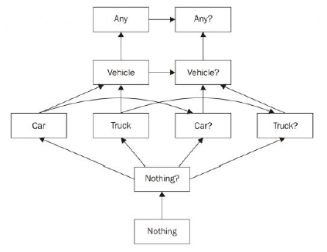
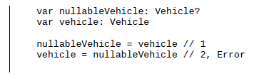
Strict null safety 2
Cannot call a method on a potentially nullable object unless a nullity check is performed prior to the call
Every non-generic class can be used to define two kinds of type, nullable and non-nullable.
Nullable types are a superclass of non-nullable types
This hierarchy is why we can assign a non-nullable type (Vehicle) to a variable typed as Nullable (Vehicle?) but not the other way around

Slide 28

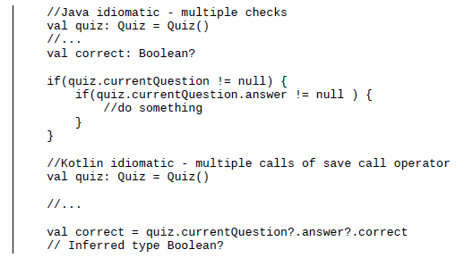
Safe Call Operator
Question mark followed by a dot
If the left hand side of the expression is null, it will return null, else it will return the result of the right hand expression
Question mark operator can be chained together on a single line to avoid nested null checks

Slide 29


Elvis operator
Question mark followed by colon
If first operand is not null, it will be returned, else, second operand will be returned
Example: will return the result of savedInstanceState.getBoolean if savedInstanceState is not null, otherwise, will return false
Basically, elvis operator allows us to define a default value when calling a nullable variable

Slide 30


Not null assertion operator
Double exclamation mark
Casts nullable values to non-nullable values
When restoring an activity instance, savedInstanceState is passed to the onCreate method, so the code will work without exceptions. However, when creating an activity instance, savedInstanceState will be null (no previous instance to restore), so NullPointerException is thrown at runtime.
Basically, the not null assertion operator allows us to force a method call/variable access on a potentially nullable variable. Think about it as a potential danger or warning sign!

Slide 31
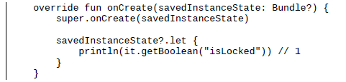
Let function
Function defined in Kotlin standard library
savedInstanceState inside the let function can be accessed using the it variable
Code defined in the block after let will be executed if savedInstanceState is not null

Slide 32

Nullability and Java
Java is much more lenient about nullability than java, and basically the entire Android SDK and libraries are written in java.
Whenever possible, the Kotlin compiler will determine type nullability from code and represent types as nullable or non-nullable using nullability annotations
There are many situations where it is not possible to determine variable nullability. All variables coming from java can be null, and it is impractical to check them all.
Kotlin introduces the concept of platform types, which are types that come from java types with relaxed null checks, meaning that each platform type may be null or not.

Slide 33
Platform types
Platform type syntax is a single exclamation mark suffix in a variable type declaration.
Will the textview be nullable or not? As developers, we must make the decision based on our code and knowledge of the layouts (do all layouts contain the textView, or is it only present for certain device orientations, etc?

Slide 34


Casts
Convert an object of one particular type into another type
In java, need to cast an object explicitly before accessing its members, or cast it and store it in a variable of the casted type.
Kotlin simplifies the concept of casting by introducing smart casts
Typical casting operations:
Upcasting – cast to supertype
Downcasting – cast to subtype
Interface – cast to interface type
The ‘as’ operator can result in ClassCastException, which is why the as operator is called an unsafe cast operator
To fix this we can use the safe cast operator, as?
Also called a nullable cast operator, it tries to cast the to the specified type, and returns nullif the value cannot be case

Slide 35
Smart casts
Converts a variable of one type to another type, but as opposed to safe casting, is done implicitly (don’t need the ‘as’ keyword)
Works only when the kotlin compiler is absolutely sure the variable will not be changed after checking, making them safe for multithreaded applications.
Two types of smart cast:
Type smart casts cast an object of one type to another type
Nullity smart casts cast nullable references to non-nullable

Slide 36
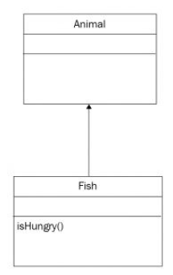
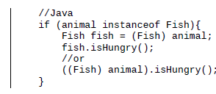

Type smart casts
Lets assume we want to call the isHungry() method and we want to check if the animal is an instance of fish
In java, we first have to check if the animal is a fish, and then explicitly cast it to fish after the check.
The Kotlin compiler handles this redundancy using the smart cast mechanism, casting the animal to fish inside the if block.

Slide 37
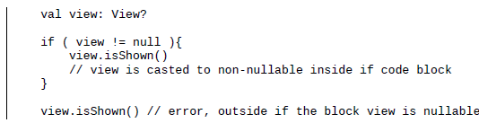
Non-nullable smart casts
Smart casts can also handle nullity checks.
We could use the safe call operator to access view methods and properties, but in some cases we want to perform more operations later, in these cases smart casting may be the better solution
Allows us to decrease the number of nullity checks

Slide 38
Primitive data types
Everything is an object in kotlin, there are no primitive data types
Primitives are not composed of other data types, and are passed by value, where as objects are composed of other types and passed by reference
For optimization purposes, simple types such as Int, Long, Short, etc are stored as primitive types, but we can still call methods on them as with any other object
When a nullable number references is needed (Int?) or generics are involved, java uses Boxed representation. Boxing means wrapping a primitive type into a corresponding boxed primitive type, meaning that the instance behaves as an object (int vs Integer, long vs Long).
Whenever kotlin creates a number (Long, Int, Double, etc), it is stored as a primitive type, unless it is declared as nullable, in which case, stored as a boxed representation.
Generic types cannot be parameterized using primitive types, so boxing is performed.
Kotlin does not implicitly convert shorter numerical values to longer ones (ie, Int to Long), they must be explicitly cast instead.

Slide 39


Arrays
In kotlin, arrays are represented by the Array class
Kotlin also has specialized numerical array classes to reduce boxing and improve performance
We can pre-allocate with an array of nulls
Can also fill a predefined size array using a factory function taking the size as first parameter and a lambda that can return the initial value of each array element given its index as the second parameter

Slide 40





Strings
Similar to java, but with a few improvements
Can access string elements like an array
Some extension methods:
Java uses long concatenation expressions to combine strings
Instead of concatenation, Kotlin uses string templates, which allows us to simply place a variable inside a string using the dollar character as placeholder
Can also insert entire expressions into the placeholder

Slide 41

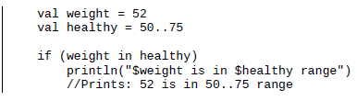
Ranges
Ranges are a simple way to define a sequence of values, denoted by the first and last values in the sequence
Useful in for loops:
Can be used to check if a value is with a certain range
Ranges in kotlin are closed (end inclusive)
Numerical ranges are incremental by default (goes in steps of 1), ie 1, 2, 3, etc
but can change step size using step
Can go in reverse order using ‘downTo’

Slide 42
Collections

Slide 43
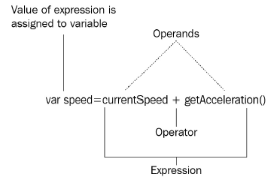
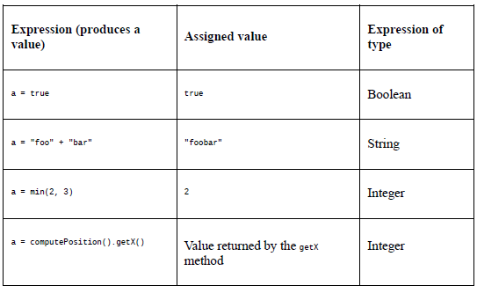
Statements vs expressions
A program is basically a sequence of statements and expressions. what is the difference between a statement and an expression?
An expression produces a value, which can be used as part of another expression, variable assignment, or function parameter
An expression is a sequence of one or more operands (Data that is manipulated) and zero or more operators (token representing a specific operation) that can be evaluated to a single value
Statements perform an action and cannot be assigned to a variable, because they simply don’t have a value. They can contain language keywords used to define classes (class), interfaces, variables (var, val), functions (fun), loop logic (for, break), etc.
Kotlin is an expression oriented language, meaning many constructs that are statements in java are expressions in kotlin. In kotlin, with the exception of loops, all control structures are treated as expressions instead of statements, like in java.

Slide 44
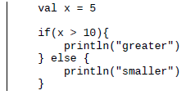
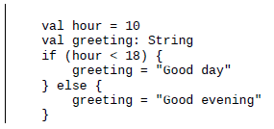

Control flow in kotlin: if
The if statement: same syntax as java, however, kotlin treats if statements as expressions (with output) so the result of an if statement in kotlin can be passed directly as a function argument
Another example:
*note when using if as an expression, there must be an else branch as well.
Can also use if expressions inside a string template

Slide 45

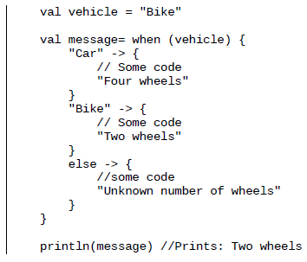
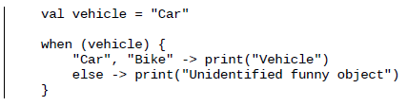
Control flow in kotlin: when
Multi-way branch statement, designed as a more powerful replacement for ‘switch…case’ statements in java
No need for redundant break statement, matches until the condition is satisfied
As with the if in kotlin, when can be used as both a statement and an expression
Last line of the curly braces in each block is the return value
Can also use many matching arguments in a single branch using commas to separate them

Slide 46
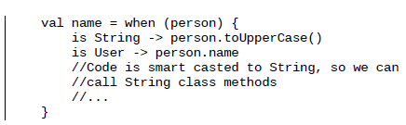
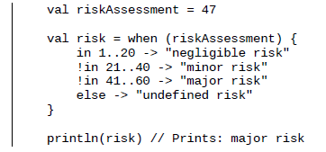
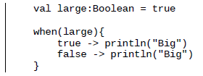
Checking variable types with when
Can use when to check variable type, validating that a value is or !is of a particular type
Smart casts come into play here, allowing us to access methods and properties of a matching type without further checks
Can also check if range or collection contains a certain value in the when block
Can omit the final else only if the compiler is able to verify all cases have been covered (one of the blocks will execute)

Slide 47



Loops
In kotlin, loops can iterate through anything that has an iterator
An iterator is an interface with two methods: hasNext, and next, and can iterate over any entity that is represented as a sequence of elements
As with other languages, kotlin has the for, while, and do...while loops
Can also iterate using indices, if necessary
Difference between while and do…while is that do…while evaluates the conditional after loop is completed, so the body will always execute at least once

Slide 48

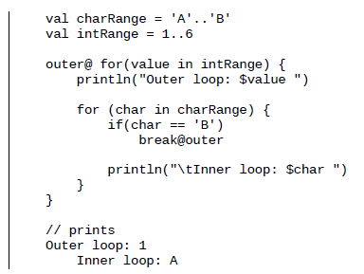
Breaking from inner loops
Break and continue function as in other languages
However, what if we want to break out of an outer loop, when an inner loop condition is fulfilled?
Kotlin introduces two forms of break – the labeled and unlabeled forms. We can then select which loop to break by referring to the label name from within the loop

Slide 49
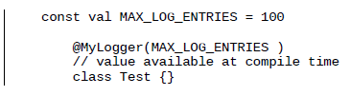
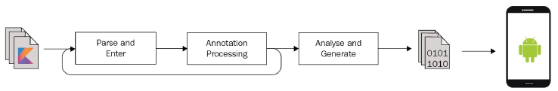
Compile-time constants
Vals are read only, and can be treated as constants in most cases, which means initialization can be delayed and there are scenarios where val may not be initialized at compile time, for example when assigning the result of a method call to a value
However, there are situations when we need this value at compile time, for example when we want to pass parameters to annotations.
Annotations are aform of syntactice metadata that can be added to source code.
We use the const modifier to make sure the value is known at compile time, and can be processed by the annotation processor

Slide 50
Summary
Discussed the differences between variables, values, and consts
Discussed basic kotlin data types including ranges
Looked into kotlin type system that enforces strict null safety, and ways to deal with nullable variables using various operators and smart casts
We can now write more concise code using type inference and advanced control structures that are treated as expressions in kotlin

Slide 51
Playing with functions
In java, the class is the building block of the code. Kotlin however supports functional programming, so it is possible to create whole programs or libraries without any classes.
The function is the most basic building block in kotlin
We will cover the following:
Basic function use in kotlin
The unit return type
The vararg parameter
Single expression functions
Tail-recursive functions
Default argument values
Named argument syntax
Top-level functions
Local functions
The nothing return type

Slide 52

Basic function declaration and usage
Hello world in kotlin: (not android)
Defines a single parameter type args
Uses the println function from the kotlin stdlib, equivalent to system.out.println in java
Shows we can define functions without any enclosing class. Starts with fun keyword, followed by name of function, parameters in enclosing brackets, and function body
*difference between method and function? A function is a piece of code called by name, a method is a function associated to an instance of a class (object), sometimes called a member function. Some people argue that the methods of static classes are, in fact, functions.

Slide 53

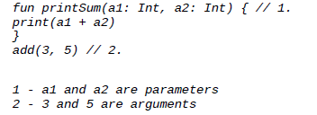

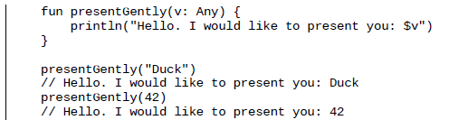
Function parameters
Parameter types must be explicitly specified
All parameters are defined as read-only variables
Parameters are not mutable, as this is error-prone. If necessary, can just declare a local variable to shadow parameters
Arguments and parameters are not the same. Arguments are the actual value passed to the function, parameter refers to the variables defined inside the function declaration
Functions in kotlin can contain multiple parameters
Functions can accept any sub-types of the parameters, so if we use Any, the function can accept all arguments (with one exception!)

Slide 54




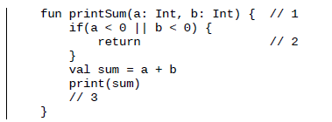
Returning functions
So far most functions have been defined as procedures (don’t return any value). However, in kotlin all functions return some value, and when it is not specified the default return value is Unit. Unit is the kotlin equivalent of java’s void, but we can treat it as any other object
Notice that we define the return type after the function name, not before as in java
Omit the return type when the function returns unit, to make the code more concise
*Unit is a singleton, which means there is only one instance of it
We can return from a function with unit return type with a simple return command

Slide 55
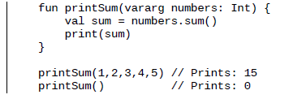
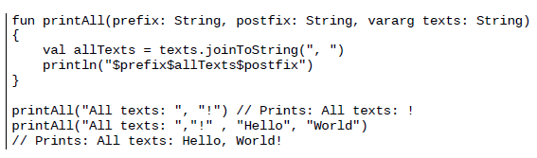
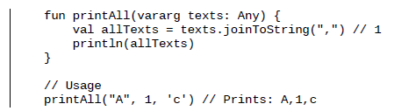
Vararg parameter
We can define functions where the number of arguments is not known in advance. Example: multiple integers
Arguments specified using vararg will be accessible as an array within the function body
We are still able to specify more parameters before/after the vararg parameter, as long as it is clear which argument is directed to which parameter
Arguments provided to vararg can be subtypes of the specified type

Slide 56

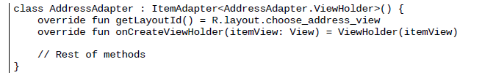
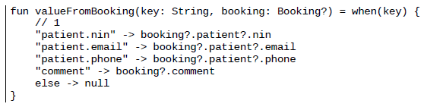
Single expression functions
It is common for functions to contain only one expression
In kotlin, these types of functions can be converted to one-liners by omitting the body
There are many instances in android where we can use single expression functions, for example the RecyclerView adapter that provides the layout ID and creates ViewHolder
Single expression functions also go well with the when construct, an example used to get specific data from an object according to a key
1) don’t need type because it is inferred from the when expression

Slide 57
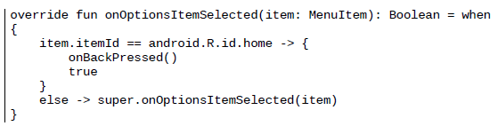
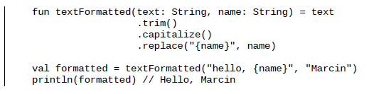
More android examples of single use function and when
Combine when with the Activity method onOptionsSelected which handles top bar menu clicks
Chain multiple operations on a single object
Single expression functions make the code more readable and concise, and are commonly used in android projects

Slide 58


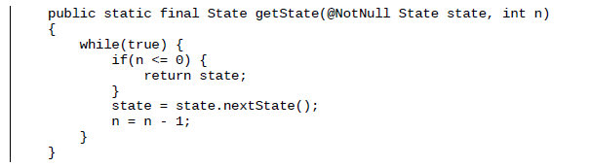
Tail-recursive functions
Recursive functions are functions that call themselves, and are important in functional programming
The problem is that each recursive function call needs to keep track of return address of previous function call, which can lead to a StackOverflowException, a serious limitation for recurrence usage
One solution is use of a tail-recursive function, supported by modern languages such as kotlin
A tail-recursive function is a special type of recursive function where the function calls itself as the last operation it performs, which allows the compiler to optimize recursive calls and perform recursive operations in a more efficient way. Decompiling the kotlin code to java shows that the implementation is based on iteration, preventing the occurrence of a stack overflow
Use the tailrec modifier

Slide 59

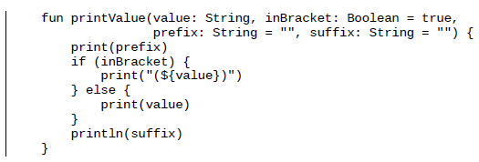
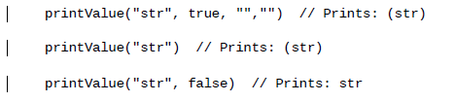

Different ways of calling a function
Sometimes, we want to call a function and provide only certain arguments, java solves this by overloading the function (providing multiple definitions) but this has limitations (difficult to maintain, each overload must be unique to compiler). This results in function calls with multiple null arguments in java, decreasing readability
This problem does not exist in kotlin because kotlin has default arguments and named argument syntax
A default argument provides a value for a parameter in case it is not provided in the function call
Named argument syntax allows us to pass specific arguments using the argument name, so if we want to only provide the last argument, we can do that, as long as all arguments without default values are provided as well.
*this introduces a pitfall however because if we change the parameter name in the function definition, it will cause errors in function calls with named arguments elsewhere in the code.

Slide 60
Top-level functions
Top level functions are functions defined outside of a class
We can use them from anywhere, assuming they are public (default visibility modifier in kotlin)
Typical top-level functions:
Factorial
maxOf, minOf
listOf
Println
Kotlin is compiled to java bytecode that runs on dalvik virtual machine (pre 5.0) or android runtime (post 5.0), these VMs can only run code defined inside a class. Kotlin compiler will hence generate classes for top level functions during compilation

Slide 61
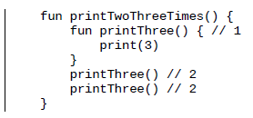
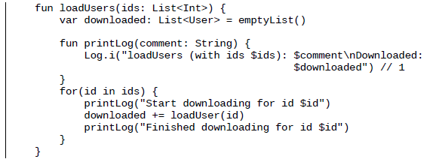
Local functions
We can define functions at many levels in kotlin – top level functions, member functions, and inside other functions (local functions)
Local functions are not accessible outside the scope they were declared within
Useful for accessing local variables
Local functions should be used only when we are extracting functionality to be used only by a simple function, and that functionality is using the variables, values, and parameters of this function

Slide 62
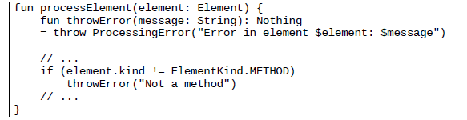
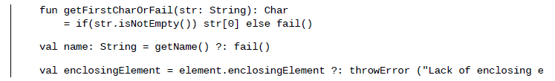
Nothing return type
Sometimes, we need to define functions that constantly throw exceptions (never terminate normally), two cases being
1) functions that simplify error throwing, especially useful in libraries where the error system is important and there is a need to provide more data about error occurrences
2) functions used for throwing errors in unit tests, useful when we need to test error handling in our code
For these situations, there is a special class called Nothing, which is an uninhabited type meaning it has no instances. A function that has nothing return type won’t return anything or ever reach the return statement, it can only throw an exception.
We can construct complex error messages using elements available in the context where it is defined
This type of function can be used, just like a throw statement, as an alternative that does not influence the function return type. This is a special trait of the nothing class, which acts as a subtype of all possible types, which is why it is referred to as an empty type

Slide 63
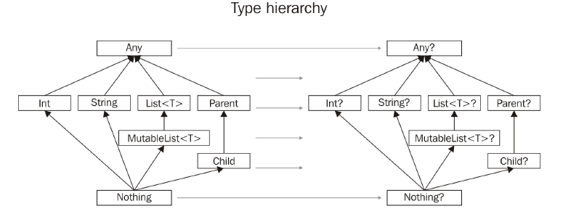
The uninhabited (Nothing) type
The concept of the uninhabited type is new in the world of java, but the idea is simple.
The Nothing instance never exists, while there is only an error that might be returned from functions that specify it as a return type. And there is no need for Nothing to be added to something to influence its type.

Slide 64
Functions summary:
We’ve seen how to define and use functions
Functions can be defined top level, inside a class, or used inside other functions
Discussed the different features related to functions: vararg parameters, default names, and named argument syntax
Saw special return types: Unit (equivalent to void in java), and Nothing, a type that cannot be defined and means nothing can be returned (only exceptions)

Slide 65
Classes and objects
Kotlin fully supports object-oriented programming (OOP), simplifying and improving the implementation of many concepts from java
Classes are the fundamental building blocks of object oriented programming

Slide 66


Class declaration
Defined using the class keyword
The definition of person does not contain any body but can still be instantiated with a default constructor
Unlike java, class instantiation in kotlin does not require the new keyword, even for classes defined in java. However, instantiating a kotlin-defined class in java still requires new

Slide 67
Properties
A property is a combination of a backing field and its accessors (getters/setters).
It is generally advised to define properties as private fields and access them through getters/setters (instead of accessing the field directly)
Getter: parameterless method with name corresponding to property name prefixed by get
Setter: single argument method with names starting with set
The kotlin language design maintains this principle, because it provides encapsulation benefits:
The ability to change an internal implementation without changing an external API
Enforces invariants (calls methods that validate an object’s state)
The ability to perform additional operations when accessing a member, for example a log operation.

Slide 68
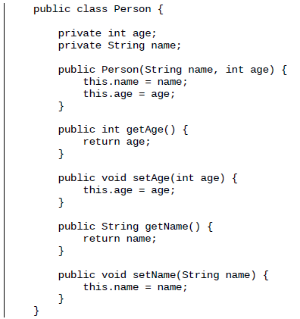

Class Person example
Verbosity of java makes the code difficult to read, and professional developers actually spend most of their time reading, not writing code
The kotlin code is the exact equivalent of the java code.
In kotlin, getters and setters are generated by the kotlin compiler
It is still possible to define custom getters and setters in kotlin

Slide 69



Further boilerplate reduction
Kotlin provides an alternative concise syntax for defining constructors, by using the class header to define the constructor. This is called a primary constructor (as opposed to a secondary constructor using the constructor keyword)
The primary constructor cannot contain code, so initialization is performed in the init block, which executes during class creation
The code can be further simplified by accessing constructor parameters directly in property initializers
The code still contains a lot of boilerplate (type declaration and property names are duplicated). When properties do not have custom getters and setters, we can define them directly inside the primary constructor by adding the val or var modifier
If the primary constructor does not have any annotations (@Inject) or visibility modifiers (public, private), we can omit the constructor keyword
It is also good practice to define each parameter in a new line to improve code readability and decrease the chance of potential merge conflicts (when merging branches from a source code repository)

Slide 70
Final comparison java vs kotlin
The two class definitions are equivalent – the kotlin compiler does all the work, generating the appropriate fields and accessors
This makes the class very easy to read, understand, and maintain

Slide 71

Read-write vs read-only
To define read-only parameters in a class, use the val keyword, so only a getter will be generated

Slide 72



Property access syntax between kotlin and java
Java accesses a property using the corresponding method (getSpeed/setSpeed)
Kotlin promotes property access syntax, a more expressive way of accessing properties, because there is no need to write get and set or use parentheses
This also permits the direct use of the increment and decrement operators (++, --) together with property access
In pre-increment, speed is retrieved, incremented, and passed to a function.
In post-increment, speed is retrieved, passed to a function, and then incremented
We can use this same pre/post increment syntax on classes defined in java

Slide 73

Some android property access examples:
Property access syntax results in more concise and easier to read code

Slide 74





Custom getters/setters
Sometimes we want more control over the use of properties, performing other operations when using the property, example:
Verify a value before its assigned to a field
Log the entire operation
Invalidate an instance state
We can do this by defining custom getters/setters, to do this we need to move the property definition from the class header into the class body
We can provide the default value instead of filling a property with the constructor argument
We can also compute default values based on some other properties using when
Type declaration can be omitted due to type inference when defining property inside class body

Slide 75


Custom getters and setters
Lets define a custom getter and setter with the default behavior that will be the equivalent of the preceding property
Inside the get and set block, we have access to a special variable called field, which refers to the corresponding backing field of the property
To compute a value each time a property is retrieved, we need to explicitly define a getter

Slide 76


The getter vs property default value
By omitting the getter, we can create a default value for the property. This value will be computed only once during class creation and will never change (changing weight value will have no effect on isHeavy value)
This type of property does have a backing field, because its value is always computed during object creation.
We can also create read-write properties without a backing field.
This type of property does not have a backing field, because its value is always computed using another property

Slide 77


Late-initialized properties
Sometimes, we know a value won’t be null, but it also won’t be initialized with its value at declaration time
Example: button can’t be initialized at declaration time because the layout is not yet initialized. We can retrieve the button reference in onCreate(), but to do this we need to declare button as nullable
This is impractical button is available at all time after onCreate is called, but the client still needs to use safe call or other nullity checks to access it
To avoid nullity checks when accessing a property, we inform the kotlin compiler that the variable will be filled before it is used, but initialization will be delayed. We do this using lateninit modifier, which tells the compiler that the property is non-nullable but its initialization is delayed

Slide 78
Annotating properties
Kotlin generates multiple JVM bytecode elements from a single property (private field, getter, and setter)
Sometimes, the framework annotation processor or the reflection based library requires a particular element to be defined as a public field, an example of this behavior is the Junit test framework, which requires rules to be provided through a test class field or a getter method.
We may encounter this problem when defining activityTestRule or Mockito’s Rule annotation

Slide 79

Inline properties
Can optimize property calls using the inline modifier. During compilation, each property call will be optimized, instead of really calling a property, the call will be replaced with the property body
This improves performance because there is no need to create additional objects. No getter will be invoked because the body replaces the property usage.
Inlining can only be applied to properties that do not have a backing field

Slide 80




Constructors
Kotlin allows us to define classes without any constructors, or a primary constructor and multiple secondary constructors
Declaring properties is not allowed for secondary constructors. If we need a property initialized by secondary constructors, we must declare it in the class body, and then initialize it in the secondary constructor body.
When a primary constructor is defined, every secondary constructor must call the primary constructor implicitly (directly) or explicitly (through another secondary constructor).
To call another constructor we use the this keyword
If the class has not primary constructor and the superclass has a non-empty constructor, each secondary constructor has to initialize the base class using the super keyword or call another constructor that does that

Slide 81

Properties vs constructor parameters
If we remove the var/val keyword from the constructor property declaration, we’ll end up with a constructor parameter declaration, meaning that the property will be changed to a constructor parameter, so no accessors will be generated and we won’t be able to access the property on the class instance

Slide 82



Constructors with default arguments
Since the early days of java, there has been a serious flaw with object creation: it is difficult to create an object instance when an object requires multiple parameters and some of those parameters are optional. Patterns solve the issue of object creation
Telescoping constructor pattern: a class with a list of constructors where every constructor adds a new parameter, used in the android.view.View class (nowadays, considered an anti-pattern or bad solution)
Javabeans pattern: a parameterless constructor plus one or more setter methods to configure objects. The main problem is we can’t know if all the required methods have been called on an object so it may be only partially constructed.
Builder pattern: uses another object (builder) that receives initialization arguments step by step and returns the resulting constructed object at once when the build method is called
Builder was considered best for a long time, but now, a combination of default arguments and named argument syntax is an even more concise option
By defining default parameter values, we can create objects in multiple ways without needing to pass all arguments, giving us much more flexibility in object creation

Slide 83



Inheritance
The supertype of all types in Kotlin is Any, the equivalent of the java type Object. We can explicitly or implicitly extend Any
Like java, Kotlin promotes single inheritance, so a class can extend only one other class, but can implement multiple interfaces
Every class and method in kotlin is final by default, to prevent unexpected behavior from a subclass changing. Modification of a base class can cause incorrect behavior in subclasses, because changed code of base class no longer matches assumptions of subclass (final means class/method cannot be extended/overridden)
Must use the open keyword in class declaration to allow for extension
Defining a class as abstract will make the class/methods open by default, no need to use open keyword

Slide 84



JvmOvleroads annotation
When subclassing android.view.View, safer to override all 3 constructors, so the class will work correctly in all 3 scenarios
We can use the @JvmOverload annotation to reduce boilerplate. In this case, all the required constructors will be generated

Slide 85



Interfaces
Kotlin interfaces similar to java 8 interfaces, but different from older versions of java
Use the interface keyword to define, and the colon character to implement
Place the superclass directly after the colon, and the interfaces after the superclass, when defining a class that both inherits another class and implements an interface
Can declare properties in the interface
All methods and properties have to be overridden in a class implementing the interface
Properties defined in a primary constructor can be used to override parameters from the interface

Slide 86


Interfaces 2
Major improvement of Kotlin/Java 8 over previous java interfaces: interfaces can not only define behavior, but also implement it, meaning the default method of property implementation can be provided by the interface
Limitation: interfaces cannot reference any backing fields or store a state
Interfaces are stateless, while abstract classes can have state

Slide 87

Data classes
Many classes have only one purpose: to store data (retrieved from a server or local database).
In java, to create data classes we need to generate a lot of redundant getters and setters, making the code hard to maintain. In kotlin, we can generate data classes by adding the data keyword before the class definition
The data class adds additional capabilities to a class in the form of methods generated by the kotlin compiler:
Equals
hashCode
toString
Copy
Multiple componentN methods

Slide 88

Equals and hashCode methods
When working with data classes there is often a need to compare two data class instances for structural equality (contain same data, but are different instances)
A common method is to use the equals method that uses hashCode method internally
hashCode is often compared before equals because it is much cheaper to simply compare hashcodes than every field in the object. If two objects are equal, they must return the same hashCode, however, just because two objects return the same hashCode does not mean they are equal
hashCode is typically implemented by converting the internal address of the object into an integer
In kotlin, the equals and hashCode methods are automatically generated by the compiler (less boilerplate)
By default, hashCode and equals are generated based on every property in the primary constructor

Slide 89




toString and copy method
The twoString generated method prints the names and values of all properties declared in the primary constructor
The copy constructor takes a single argument whose type is the class containing the constructor, returning newInstance of this class
The copy factory is a static factory that takes a single argument whose type is the class containing the factory, and returns a new instance of the class
We can create a modified instance copy of a data class using the copy method combined with default argument syntax
We can also create immutable data classes using vals, to reduce potential errors in data synchronization across multithreaded applications

Slide 90


Destructuring declarations
Sometimes it makes sense to restructure objects into multiple variables, this syntax is called a destructing declaration, and allows us to create multiple objects at once
For every property declared in the primary constructor of the data class, the kotlin compiler generates a single componentN method, the N corresponds to the order of properties declared in the primary constructor,
We can omit properties using the underscore when destructuring
We can destructure simple types such as strings

Slide 91


Operator overloading
Can provide custom implementations for each operator by using them in operator method corresponding with an operator token
The compiler generates method calls under the hood based on the operators used
We can also define multiple operators with the same name but different parameter types

Slide 92


Object declaration
Declaring singletons in java: the most common way to define a class that has a private constructor and receives instances via a static factor method
This solution is verbose, in kotlin there is a special language construct for creating singletons called object declaration, achieving the same result in a much simpler way
The object keyword rather than class is used to define the singleton in kotlin
Can add methods and properties to an object declaration just as with a class
Object declarations are initialized lazily, so they can be nested inside other object declarations or non-inner classes, and assigned to an object

Slide 93



Object expression
Equivalent to java’s anonymous class, used to instantiate objects that might inherit from another class or implement an interface, classically used when we instantiate objects that implement an interface
Kotlin uses object expressions to create an instance of an anonymous class that implements ServiceConnection interface
An object extension can also extend a class

Slide 94



Object expressions and the Adapter pattern
The adapter design pattern allows otherwise incompatible classes to work together by converting the interface of one class into an interface expected by the clients
Example: we have a player interface and a function that requires player as a parameter. There is a public library with VideoPlayer class, with play method defined, but not implementing Player
While the videoplayer class meets the method requirements of playWith, it does not technically implement Player, so it cannot be passed to playWith
To solve this problem we make an Adapter, implementing VideoPlayer as an object of anonymous type that implements the Player interface

Slide 95


Companion objects
Kotlin lacks the ability to define static members (unlike java), instead, we define objects that are associated with a class. These companion objects share their state across all instances of a particular class.
When a singleton object is associated with a class of the same name, it is called the companion object of the class, and the class is called the companion class of the object.
Three instances of the car class sharing a single instance of an object.
The main purpose of a companion object is to have code related to the class, but not necessary to any particular instance of the class.
The simplest way to define a companion object is to define a single block of code (within the class definition)

Slide 96



Companion object instantiation
A companion object is a singleton created by a companion class and kept in its static property.
Companion object instantiation is lazy (only when needed)
To mark when car class instance and its corresponding companion object are created, we add two initializer blocks – one for car class, and one for the companion object
The initializer block inside the companion object works the same as for an ordinary class, being invoked when the companion object is created.
By accessing the count property defined in the companion object, we trigger its creation, even though the instance of car has not yet been created
If we instantiate car before accessing the companion object, the companion object is created along with the first instantiation of car
Companion objects can also contain functions, implement interfaces, and extend classes

Slide 97



Enum classes
An enumerated type (enum) is a data type consisting of a set of named values, we define enum types by adding the enum keyword to the class declaration header
Use the valueOf method like in java to parse a string into an enum
To list all values in an enum class, use the values function (like in java)
Enum types can also have a constructor, and we can associate custom data with each enum constant
We can add an rgb method to access r,g,b variable data for a particular enum and calculate the value for each enum element separately

Slide 98



Infix calls for named methods
Infix calls are features of kotlin that allow us to create more fluid and readable code
In essence, infix notation gives us the ability to call a method without using the dot or call operator
Point class example – explicitly mark the method as infix
We can use infix methods with enums to achieve very fluid syntax

Slide 99



Combining infix with enums for fluid syntax
We want to define the syntax that will allow us to define a card from its suit and rank it this way
We first create two enums to represent all ranks and suits
We then need a class that will represent a card composed of a particular rank and suite
We can simplify the syntax by introducing a new infix method into the Rank enum
This allows us to use infix notation, which when combined with static imports achieves our final result
The code is also type safe, due to the use of predefined enums rank and suit

Slide 100

Visibility modifiers (top level)
Kotlin supports 4 types of visibility modifiers – private, protected, public, and internal, and the default visibility modifier in kotlin is public
Public: element is visible everywhere
Private: element is visible inside the file containing the declaration
Protected: not available at top level
Internal: element is visible everywhere in the same module, it is public for elements in the same module. A module is just a set of kotlin files compiled together, for example IntelliJ IDEA module and Gradle project
1) version property is public (visible from all files)
2) UnitConverter is accessible in the branch.kt file while it is in the same module, but not in main.kt vecause it is located in another module
3) printSomething function is only accessible in the file where it is defined

Slide 101


Visibility modifiers (members)
Members are elements declared inside a top-level element (methods, properties, constructors, nested classes/interfaces, etc)
Public (default): clients who see the declaring class see its public elements
Private: element is only visible from within the class or interface
Protected: visible inside the class and its subclasses
Internal: any client within the module who sees the class, can also see the internal members

Slide 102


The internal modifier and java bytecode
Public, private, and protected modifiers are compiled to bytecode in the same way as for java, but what about internal (which has no direct analog in java)?
This is solved by compiling internal to the public modifier, and then mashing the name so that it is not usable. This is controversial because it can be bypassed using a java adapter, but there is no other way to implement it

Slide 103



Overriding visibility modifiers
Visibility modifiers can be overridden when overriding a member function
Defining class and constructor visibility: primary constructor definition is in the class header, so two visibility modifiers are required in a single line
Assuming the preceding class is defined at the top level, it will be visible inside the module, but it can only be instantiated from within the file containing the class declaration

Slide 104



Sealed class
A sealed class is a class with a limited number of subclasses (Sealed subtyping hierarchy), and the subtypes have to be declared within the same file.
To mark a class as sealed, simply add the sealed modifier to the class declaration header
The subclasses of a sealed class can be extended (provided they are not also sealed)
Sealed classes work well with a when expression, eliminating the need for an else clause because the kotlin compiler can verify that each subclass of a sealed class has a corresponding clause inside the when block. The application will not compile if we later add another subclass to vehicle
Sealed classes are abstract by default, and can never be open or final
Sealed classes are useful for example when we want to protect an inheritance hierarchy when building a module by prohibiting clients from extending our class, but keeping the ability for ourselves

Slide 105


Nested classes
A nested class is a class defined within another class
Nesting small classes within top level classes places the code closer to where it is used, and allows a better way of grouping classes
We can define a class as a member inside another class, allowing us to create instances of the nested class without having to create instances of the outer class, in this case the nested class cannot refer directly to the members of the outer class
Instead, to enable this behavior we use the inner keyword, inner classes can only be instantiated from the outer class, and can access all the methods and properties defined in the outer class and share its state
The usage of class/inner class depends on your goals, if you only need a single instance to access from within the outer class, use inner, however if the inner class may be useful in a context outside serving the outer class, just declare it as you would a top level class

Slide 106


Import aliases
An alias is a way to introduce new names for types, for example, if the type name is already used in the file, or if it is too long, or inappropriate, we can introduce a new name and use it instead
The compiler replaces a class alias with an actual class, so the alias does not exist at runtime
Example: the InterstitialAd type is defined in both facebook and google’s advertising libraries
Lets say we want to use them both in a single file (to compare profits between them), this would force us to fully qualify the class name (writing both namespace and class name)
In this situation (Both classes located in an external library) the solution is to use the import alias
We can then use the aliases around these types like actual types, improving readability

Slide 107
Summary
We discussed constructors, the building blocks of OOP, learned how to define interfaces and various classes, and the differences between inner, sealed, enum, and data classes
All elements public by default
All classes/interfaces are final by default (must use open)
We can define proper data models using concise data classes combined with powerful properties, and properly operate on data using various methods generated by the compiler and how to overload operators
Create singletons using object declarations
Define anonymous objects that can extend/implement using object expressions
Lateinit modifier allows defining non-nullable types with delayed initialization

Slide 108

Kotlin basics – variables and constants
Basic types - In Kotlin, there is no concept of primitive types, instead, all types are objects with member functions and properties.
Variables and constants – declare a variable using the var keyword, and constants using the val keyword. When declaring, the type does not have to be explicitly defined, but will be inferred from the context. A val can only be declared once. A variable or constant can only be assigned a null value if its explicitly declared as a nullable type. You declare a nullable type by appending a ‘?’ to the end of the type.
In the code, a and b will both be treated as String. When trying to reassign a variable with an inferred type with a different type, a compile-time error will occur.

Slide 109

Kotlin basics - properties
In kotlin, properties are accessed by simply referring to them by name.
Getters and setters are not a requirement, but you are not prohibited from creating them. A property’s getter/setter can be created as part of its declaration. A setter is not allowed if the property is a val. A property needs to be initialized when created.

Slide 110
Kotlin basics: classes and objects
Like in java, kotlin classes are declared using the ‘class’ keyword.
Basic structure of a class consists of: the class keyword, name of the class, header, and body of class enclosed in curly braces.
Header can consist of a primary constructor, parent class if applicable, and interface to implement, if applicable.
Secondary constructors have to call the primary constructor.

Slide 111

Kotlin basics: data classes
When building apps, most of the time we require classes whose only function is to store data.
In java, data classes are called POJOs (plain old java objects) and used to store data.
In kotlin, a special class exists, called the data class, which has built in methods:
Equals()/hashCode(), toString(), copy()
The copy() method is useful when you want to create a copy of an object but with part of its data altered, for example:
Declare data class Student which takes 3 parameters in its primary constructor
Anna variable is an instance of student
Joseph variable is created from copying anna and changing two of the properties

Slide 112


Data class example: java vs kotlin
1 line of kotlin code does the same thing as 26 lines of java code, because getters and setters are not needed, and the primary constructor is defined in the class header.

Slide 113
Kotlin basics: Objects
Object Expressions

Slide 114
Kotlin basics: type checks and null safety
What makes kotlin a null safe language, and how can we take advantage of this?
One of the most common pain points developers have in general is the NullPointerException, which occurs at runtime when trying to access variables or methods of a null reference
There are only 4 times when you would run into a NullPointerException in kotlin
1) when calling external java code
2) with an explicit call to NullPointerException
3) usage of the !! Operator (more on this later)
4) data inconsistency regarding initialization
How does kotlin ensure this?

Slide 115


Kotlin basics: Nullable and non-nullable types
Nullable type: a reference that can hold a null value
Non-nullable type: a reference that cannot hold a null value
Accessing a member method/property of a nullable type is not done in the same way as for a nullable type.
There are a number of ways to access a method or property of a nullable type
1) checking for null using an if statement
2) using a safe call operator ?.
3) using the Elvis operator ?:
4) using the !! Operator
5) performing a smart cast

Slide 116




Kotlin basics: accessing nullable types
Safe call operator: In this code, if the value of gender is not null, len will be set to the value, otherwise, len will be set to null.
Elvis operator: similar to the ternary if operator in java, a way of simplifying if-else statements. In this code, the value of len will be set to 0 if gender?.length evaluates to null
The !! operator: if we don’t care about running into a null pointer exception, this code will result in a nullPointerException if gender is null
Smart cast: compiler keeps track of the results of the type check, and automatically casts gender to string, thereby allowing the call to gender.length, this is called a smart cast

Slide 117

Kotlin basics: functions and lambdas
In kotlin, functions are declared in the following format:
Return type and parameters are optional, functions with no return type return Unit (equivalent to void in java)

Slide 118


Functions
Functions with a single expression as its body can eliminate the curly braces as well:
The return type can be left out if the type can be inferred by the compiler:

Slide 119

Parameters
In kotlin, function parameter types defined using the pascal notation (parameter_name:Type), each parameter’s type is explicitly declared, parameters can be assigned a default value in function declaration:
Can leave out parameters which have default values when calling a function, but in this case the parameters you pass have to be preceded by their names

Slide 120

Higher order functions and lambdas
Higher order function is a function that takes another function as a parameter, or returns a function.
Here, the function logStudent takes 3 parameters (name, age, and createStudent)
createStudent is a function that takes a string and int as input and returns a student as output
The createStudent function is not declared but is passed as an expression to the logStudent function, this is called a lambda expression

Slide 121
Lambda expressions
A lambda expression is an anonymous function that is not declared but passed immediately as an expression

Slide 122
Gradle
Gradle is a build automation system that is easy to use and can automate the life cycle of your project, from building and testing to publishing. It takes your source code and configured android build tools and generates an android package kit (apk) file.
Android studio generates the basic gradle configurations needed to build your apk.
build.gradle: the android section specifies all android specific configurations, such as
compileSdkVersion (specifies android API level app should be compiled with),
buildToolsVersion (specifies build tools version your app should be built with),
applicationId (used to uniquely identify the app when publishing to play store),
minSdkVersion (minimum API level required to run the app),
targetSdkVersion (API level used to test your app),
versionCode (specifies version number of your app, changed for every new version before publishing),
versionName (user friendly version name).
The dependencies section specifies the dependencies needed to build your app.

Slide 123
Parts of an android project
Manifests/AndroidManifest.xml: specifies important details about your app required by android system to run the app (package name, app components (activities, services, etc), and permissions required by your app.
Res directory: contains application resources (images, xml layouts, colors, dimensions, and string resources)
Res/layout directory: contains xml layouts that defines the app’s User Interface (UI).
Res/menu directory: contains layouts that define the contents of the app’s menus.
Res/values directory: contains resources such as colors and strings.

Slide 124
Configuring project for Kotlin
Tools-> Kotlin-> Configure Kotlin in Project
Select android with gradle option in Choose configurator popup
Select version of Kotlin to use and click ok
This will cause a number of changes in build.gradle:
The version of kotlin used is declared in project’s build.gradle
The kotlin gradle plugin is declared as part of the project’s classpath dependencies
And, in app module’s build.gradle file: kotlin-android plugin is applied to the module, and Kotlin Standard library is declared as a compile time dependency for the app module.
Kotlin to java – open MainActivity, got to Code | Convert java file to Kotlin file

Slide 125
Build.gradle
(Project: MyApplication) file is in the root folder of the project and its configuration settings apply to every module in the project. A module is an isolated piece of the bigger project. In a multi-module project, these modules have their own jobs but work together to form the whole project. Most Android projects only have one module, the app module.
(Module: app) file here is in the app folder. Its build settings apply only to the app module. If there were another module, then that module would have its own build.gradle file, too. As an example I made a library project with three modules: a library module, a demo app module, and another app module that I plan to use for testing. Each of them have their own build.gradle files that I can tweak.

Slide 126
The user interface
Code for the app UI is written in XML and stored in layout files
Res/layout/activity_main.xml (select ‘Text’ at bottom of screen)
1) parent element: Coordinator layout, introduced in android 5.0, provides better control over touch events between its child views (for example the way snackbar appears under floatingActionBar instead of covering it.
2) Toolbar acts as top navigation for your app, displays title of app, app logo, action menu, and navigation button.
3) the ‘include’ tag is used to embed a layout into another layout, in this case res/layout/content_main.xml which contains a TextView that we see when we run the app. Most of the layout changes will happen in res/layout/content_main.xml
4) FloatingActionBar is an actionable ImageView that floats on the screen.

Slide 127
More xml:
Res/values – reduce the amount of duplicate xml code
Styles.xml:
Dimens.xml – declare dimensions used in your layout
Strings.xml – declare string resources used within your app
You can do some simple inheritance in xml using the Parent.child format, for instance Cell.left, Cell.right, and Cell.middle will all inherit the attributes of the Cell style

